Slide 1
Explainable & Uncertainty-Aware
Machine Learning for LPBF Ti-6Al-4V
Predicting Porosity and Mechanical Properties using Process–Structure–Property Features
PROJECT BY: -
G. Subhash Guptha(23015)
R. Gautam(23022)
K. Mithul(23025)
S.V. Sai Sashank(23043)
SUBMITTED TO:-
Dr. Sathies T
1

Slide 2
Literature Review
Selected paper and the experimental foundation for our project
What the paper studied
Selected Paper
42 unique combinations of laser power and scan speed using LPBF Ti-6Al-4V.
Luo et al. (2023)
“Dataset of process-structure-property feature relationship for laser powder bed fusion additive manufactured Ti-6Al-4V material”
Data in Brief, 46, 108911
The dataset links LPBF processing conditions with pore structure, grain morphology, surface roughness and mechanical properties.
How it was characterized
XCT + image analysis for pores; optical microscopy for grains; tensile testing and Vickers microhardness for properties.
What it enables
A quantitative process–structure–property dataset suitable for ML development, analysis and process optimization.
2

Slide 3
Literature Review
What the dataset provides: process, structure and property features
PROCESS
STRUCTURE / DEFECTS
PROPERTIES
Laser power
Scan speed
Linear energy density
Modified energy-density descriptor
P × v
Hatch spacing and layer thickness were fixed in the campaign.
Archimedes & XCT porosity
Pore quantity
Pore size
Pore sphericity
Projected pore area
Surface roughness
Prior-β grain size & aspect ratio
Yield strength
Ultimate tensile strength
Elongation to necking
Elongation to fracture
Young’s modulus
Vickers microhardness
3

Slide 4
Motivation
Why this project is needed
Manufacturing motivation
Machine-learning motivation
LPBF Ti-6Al-4V has nonlinear relationships between process parameters, defects, microstructure and final properties. Experimental trial-and-error is costly and time-consuming.
ML can reduce repeated experiments, but small and correlated datasets can produce unreliable or overly optimistic results if validation is not designed carefully.
WE NEED TO PREDICT
WE NEED TO EXPLAIN
WE NEED TO TRUST
Porosity
Strength
Ductility
Hardness / modulus
Which process, pore and grain features contribute to predictions?
How certain is the prediction and is it inside the supported process range?
4

Slide 5
Problem Statement
The central research problem
CURRENT SITUATION
LIMITATION
LPBF Ti-6Al-4V produces complex relationships among process parameters, porosity, microstructure and mechanical properties.
Simple ML comparisons may report accuracy without addressing data leakage, feature-group value, prediction uncertainty or extrapolation.
RESEARCH PROBLEM
How can we build a reliable and explainable ML framework that predicts porosity and mechanical properties while quantifying feature contributions and prediction uncertainty, using only experimentally supported process conditions?
5

Slide 6
Objectives
DATA
EDA
Clean standardized dataset + data dictionary
Distribution, correlation, process-map and relationship plots
ML
EXPLAINABILITY
Model performance comparison for selected targets
SHAP / feature-importance / ablation plots
UNCERTAINTY
OPTIMIZATION
Prediction intervals + high-uncertainty regions
Constrained Pareto-front / promising process conditions
REPORT
Reproducible Python code + final project report
6

Slide 7
Availability of the Datasets
Public data used as the foundation of the project
DATASET SOURCE
WHAT IS AVAILABLE
Zenodo — record 6587905
The paper states that the processed feature table and raw experimental data are publicly available.
Processing features, porosity, pore morphology, surface roughness, grain morphology, mechanical properties, hardness and supporting raw experimental files.
42 CONDITIONS
PUBLIC ACCESS
PROJECT USE
Unique combinations of laser power and scan speed.
The paper reports no specific access restrictions for the repository.
Start with the processed feature table; raw microscopy images and complete stress–strain curves are outside the first implementation scope.
7

Slide 8
Methodology: Workflow
Only the project workflow needed to explain how the research will be carried out
1. Dataset audit
2. Feature groups
3. EDA
4. ML models
Units, missing values, repeated measurements, feature definitions
Process-only → process + defect → full PSP
Distributions, correlations, process maps, porosity/property relationships
Ridge, SVR, Random Forest, XGBoost, Gaussian Process, PyTorch MLP
5. Validation
6. Explainability
7. Uncertainty
8. Optimization
Grouped 5-fold CV by laser power, compared with random CV
SHAP, permutation importance, PDP/ICE, ablation
Prediction spread, ensembles, GPR, conformal/interval methods
Constrained search + Pareto-front analysis
8

Slide 9
Methodology: Steps
What the project will accomplish
1
2
Collect, clean and standardize the publicly available Ti-6Al-4V PSP dataset.
Explore relationships between process parameters, porosity, pore morphology, grain morphology and mechanical properties.
3
4
Develop baseline regression models for porosity and key mechanical properties.
Compare process-only, defect-only/combined and full PSP feature groups.
5
6
Evaluate models with cross-validation grouped by laser power.
Apply explainability methods to identify influential features.
7
8
Estimate prediction uncertainty using suitable ensemble, Gaussian-process or interval methods.
Develop constrained multi-objective optimization within the experimental process range.
9

Slide 10
Methodology Focus: Grouped Validation
A key part of the proposed research
RISK WITH RANDOM SPLITTING
PROPOSED SOLUTION
Many conditions share the same laser power. A random split leaves close neighbours of each test point in training, so scores may not reflect a genuinely new power level.
Put all conditions with the same laser power in one fold (GroupKFold), so every test fold holds unseen power levels.
VALIDATION
METRICS
ROBUSTNESS
Grouped 5-fold CV (groups = laser power)
Random 5-fold CV, 10 seeds
for comparison
MAE
RMSE
R²
Prediction-interval coverage
Compare random vs grouped splitting
Assess fold-to-fold variation
10

Slide 11
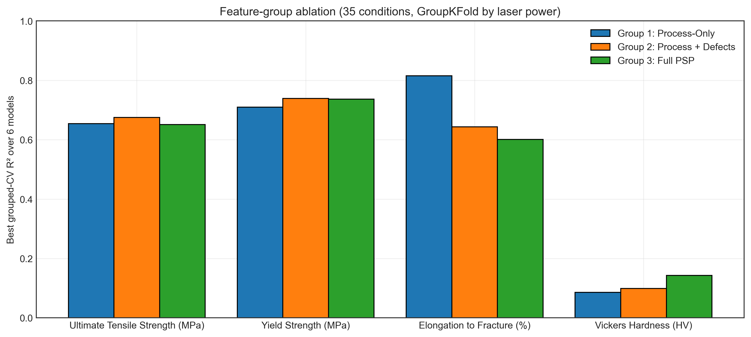
Results: Validation and Model Benchmark
35 XCT conditions, 6 models, 3 feature groups, GroupKFold by laser power
Key numbers (grouped CV)
• P and v only: R² = 0.65 UTS, 0.71 yield, 0.81 elongation
• Adding pore features: UTS 0.68, yield 0.74; elongation drops to 0.64
• Porosity from P and v: best R² = -0.06, not predictable
• Hardness: best R² = 0.14; spread between conditions (12.7 HV) is below indent scatter (19.1 HV)
• Random vs grouped CV: random scored higher for only 1 of 6 models on UTS, so no consistent optimism here
11

Slide 12
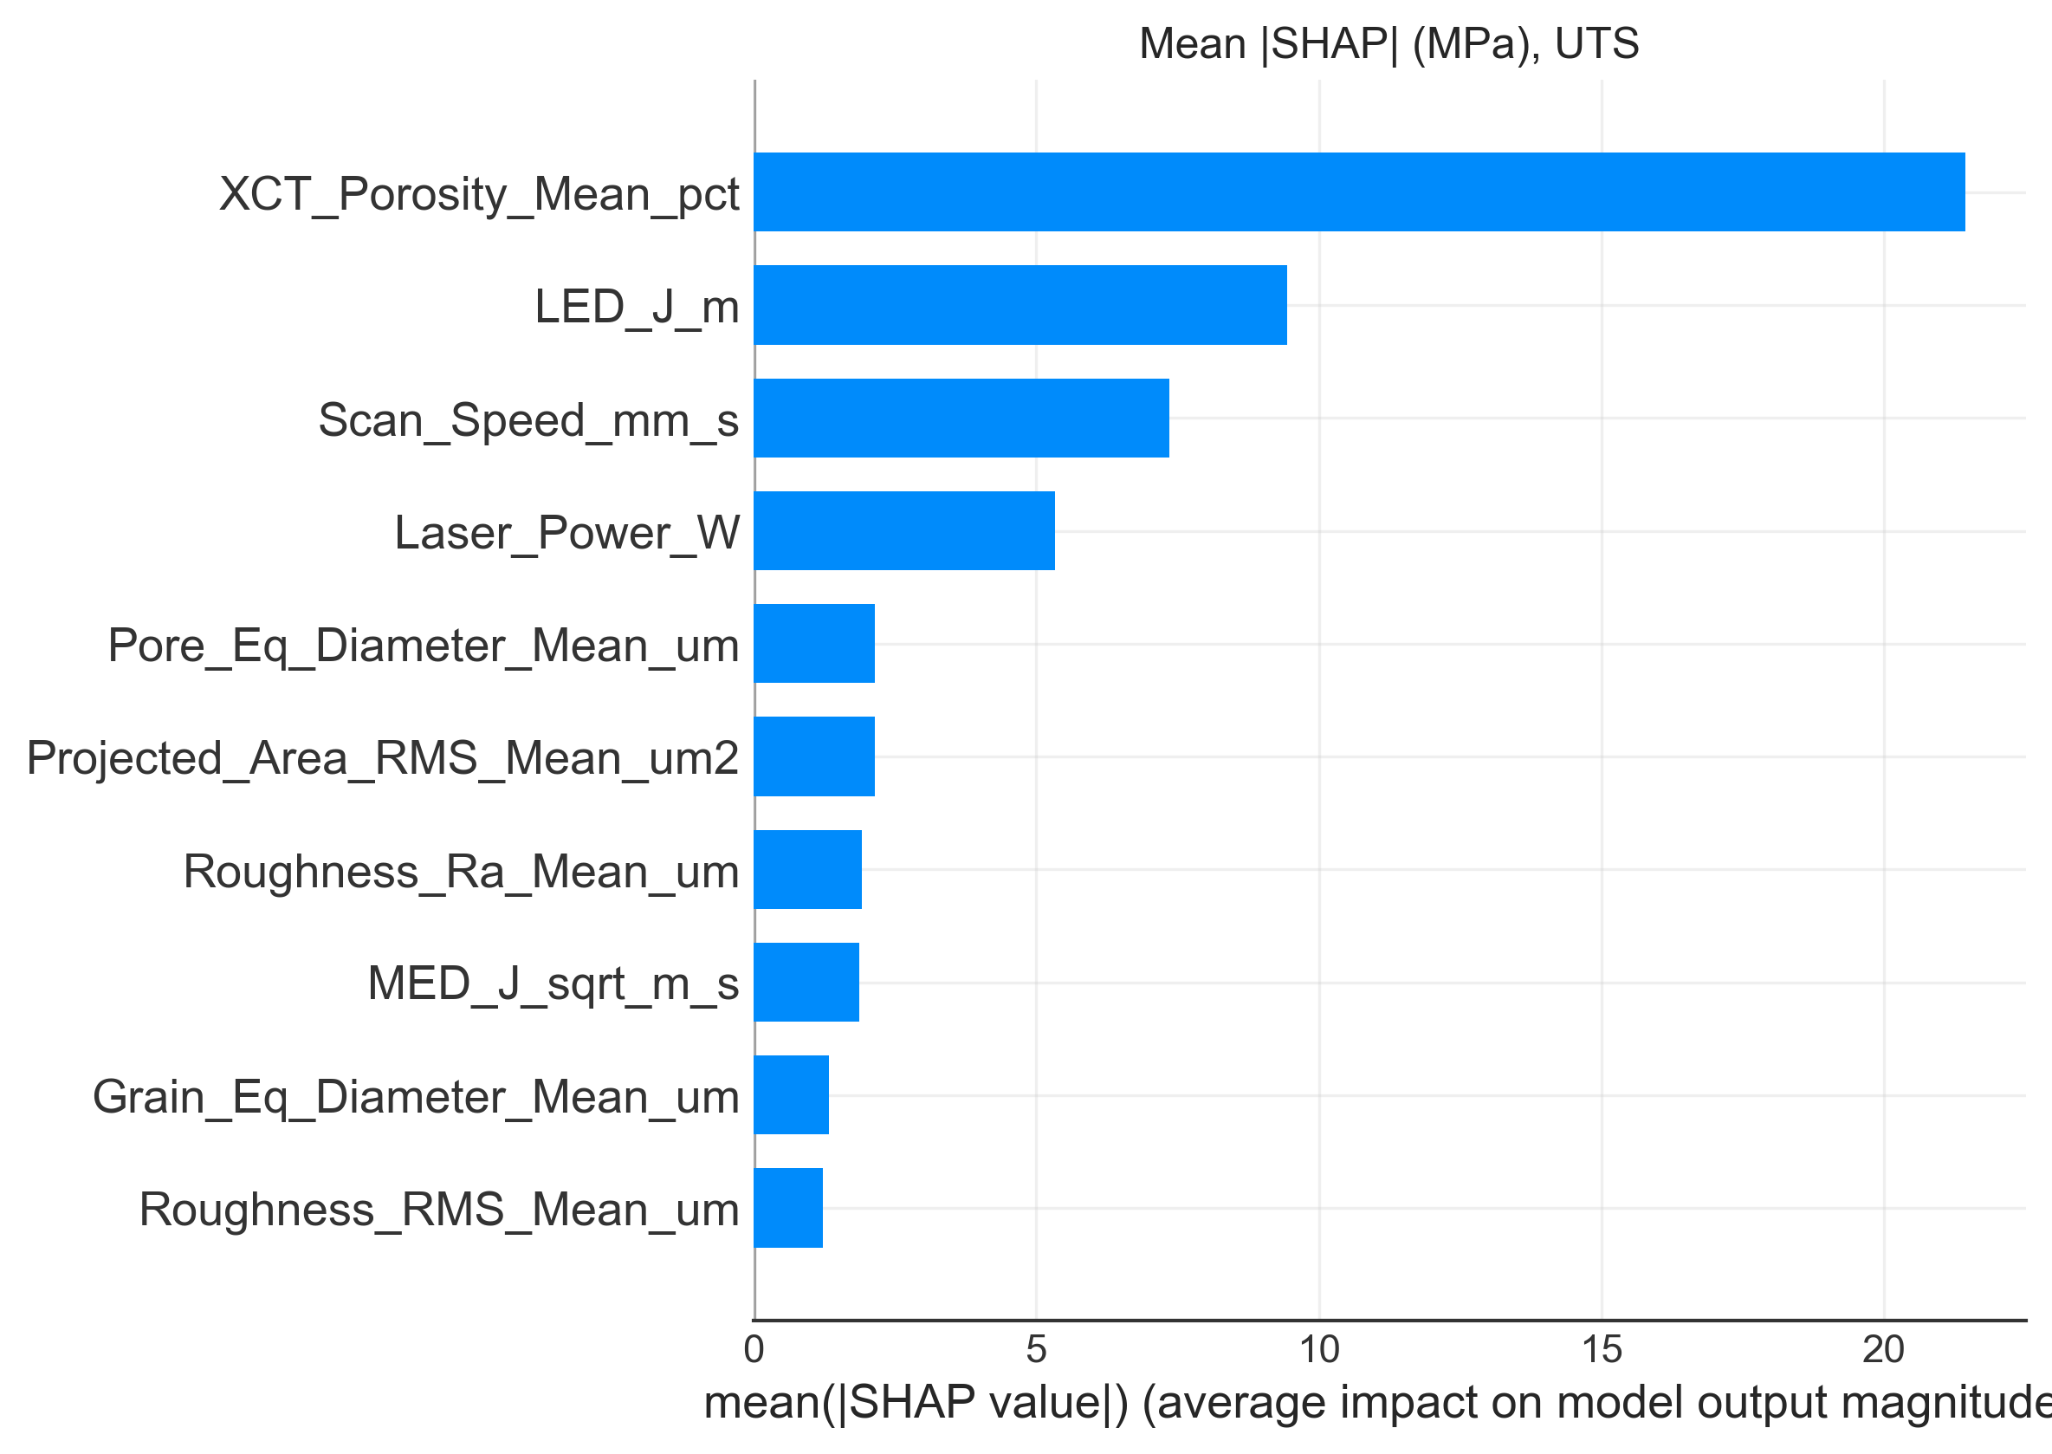
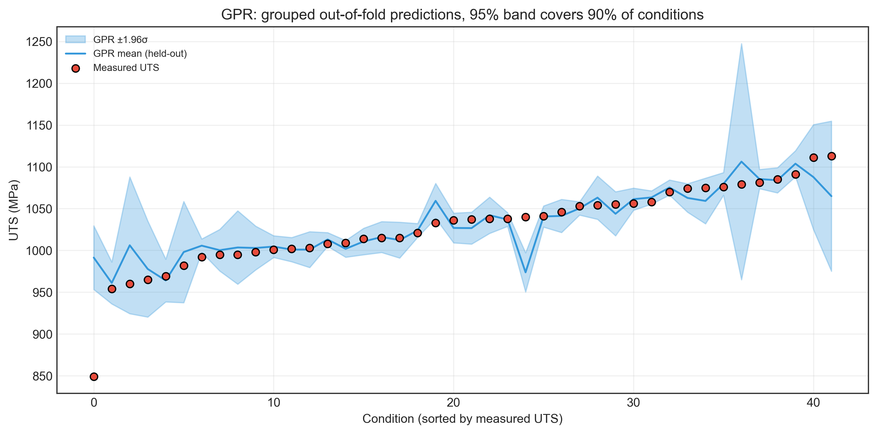
Results: Explainability and Uncertainty
SHAP on XGBoost (UTS, 15 features); intervals from held-out power groups
What the numbers say
• XCT porosity is the largest SHAP contributor (mean |SHAP| 21 MPa, down to -85 MPa for the most porous set); higher LED lowers predicted UTS
• Gaussian process 95 % band covers 90 % of held-out conditions; MC dropout only 81 % (too narrow)
• Cross-conformal: 95 % coverage at the 90 % level, but intervals ≈ 118 MPa wide
12

Slide 13
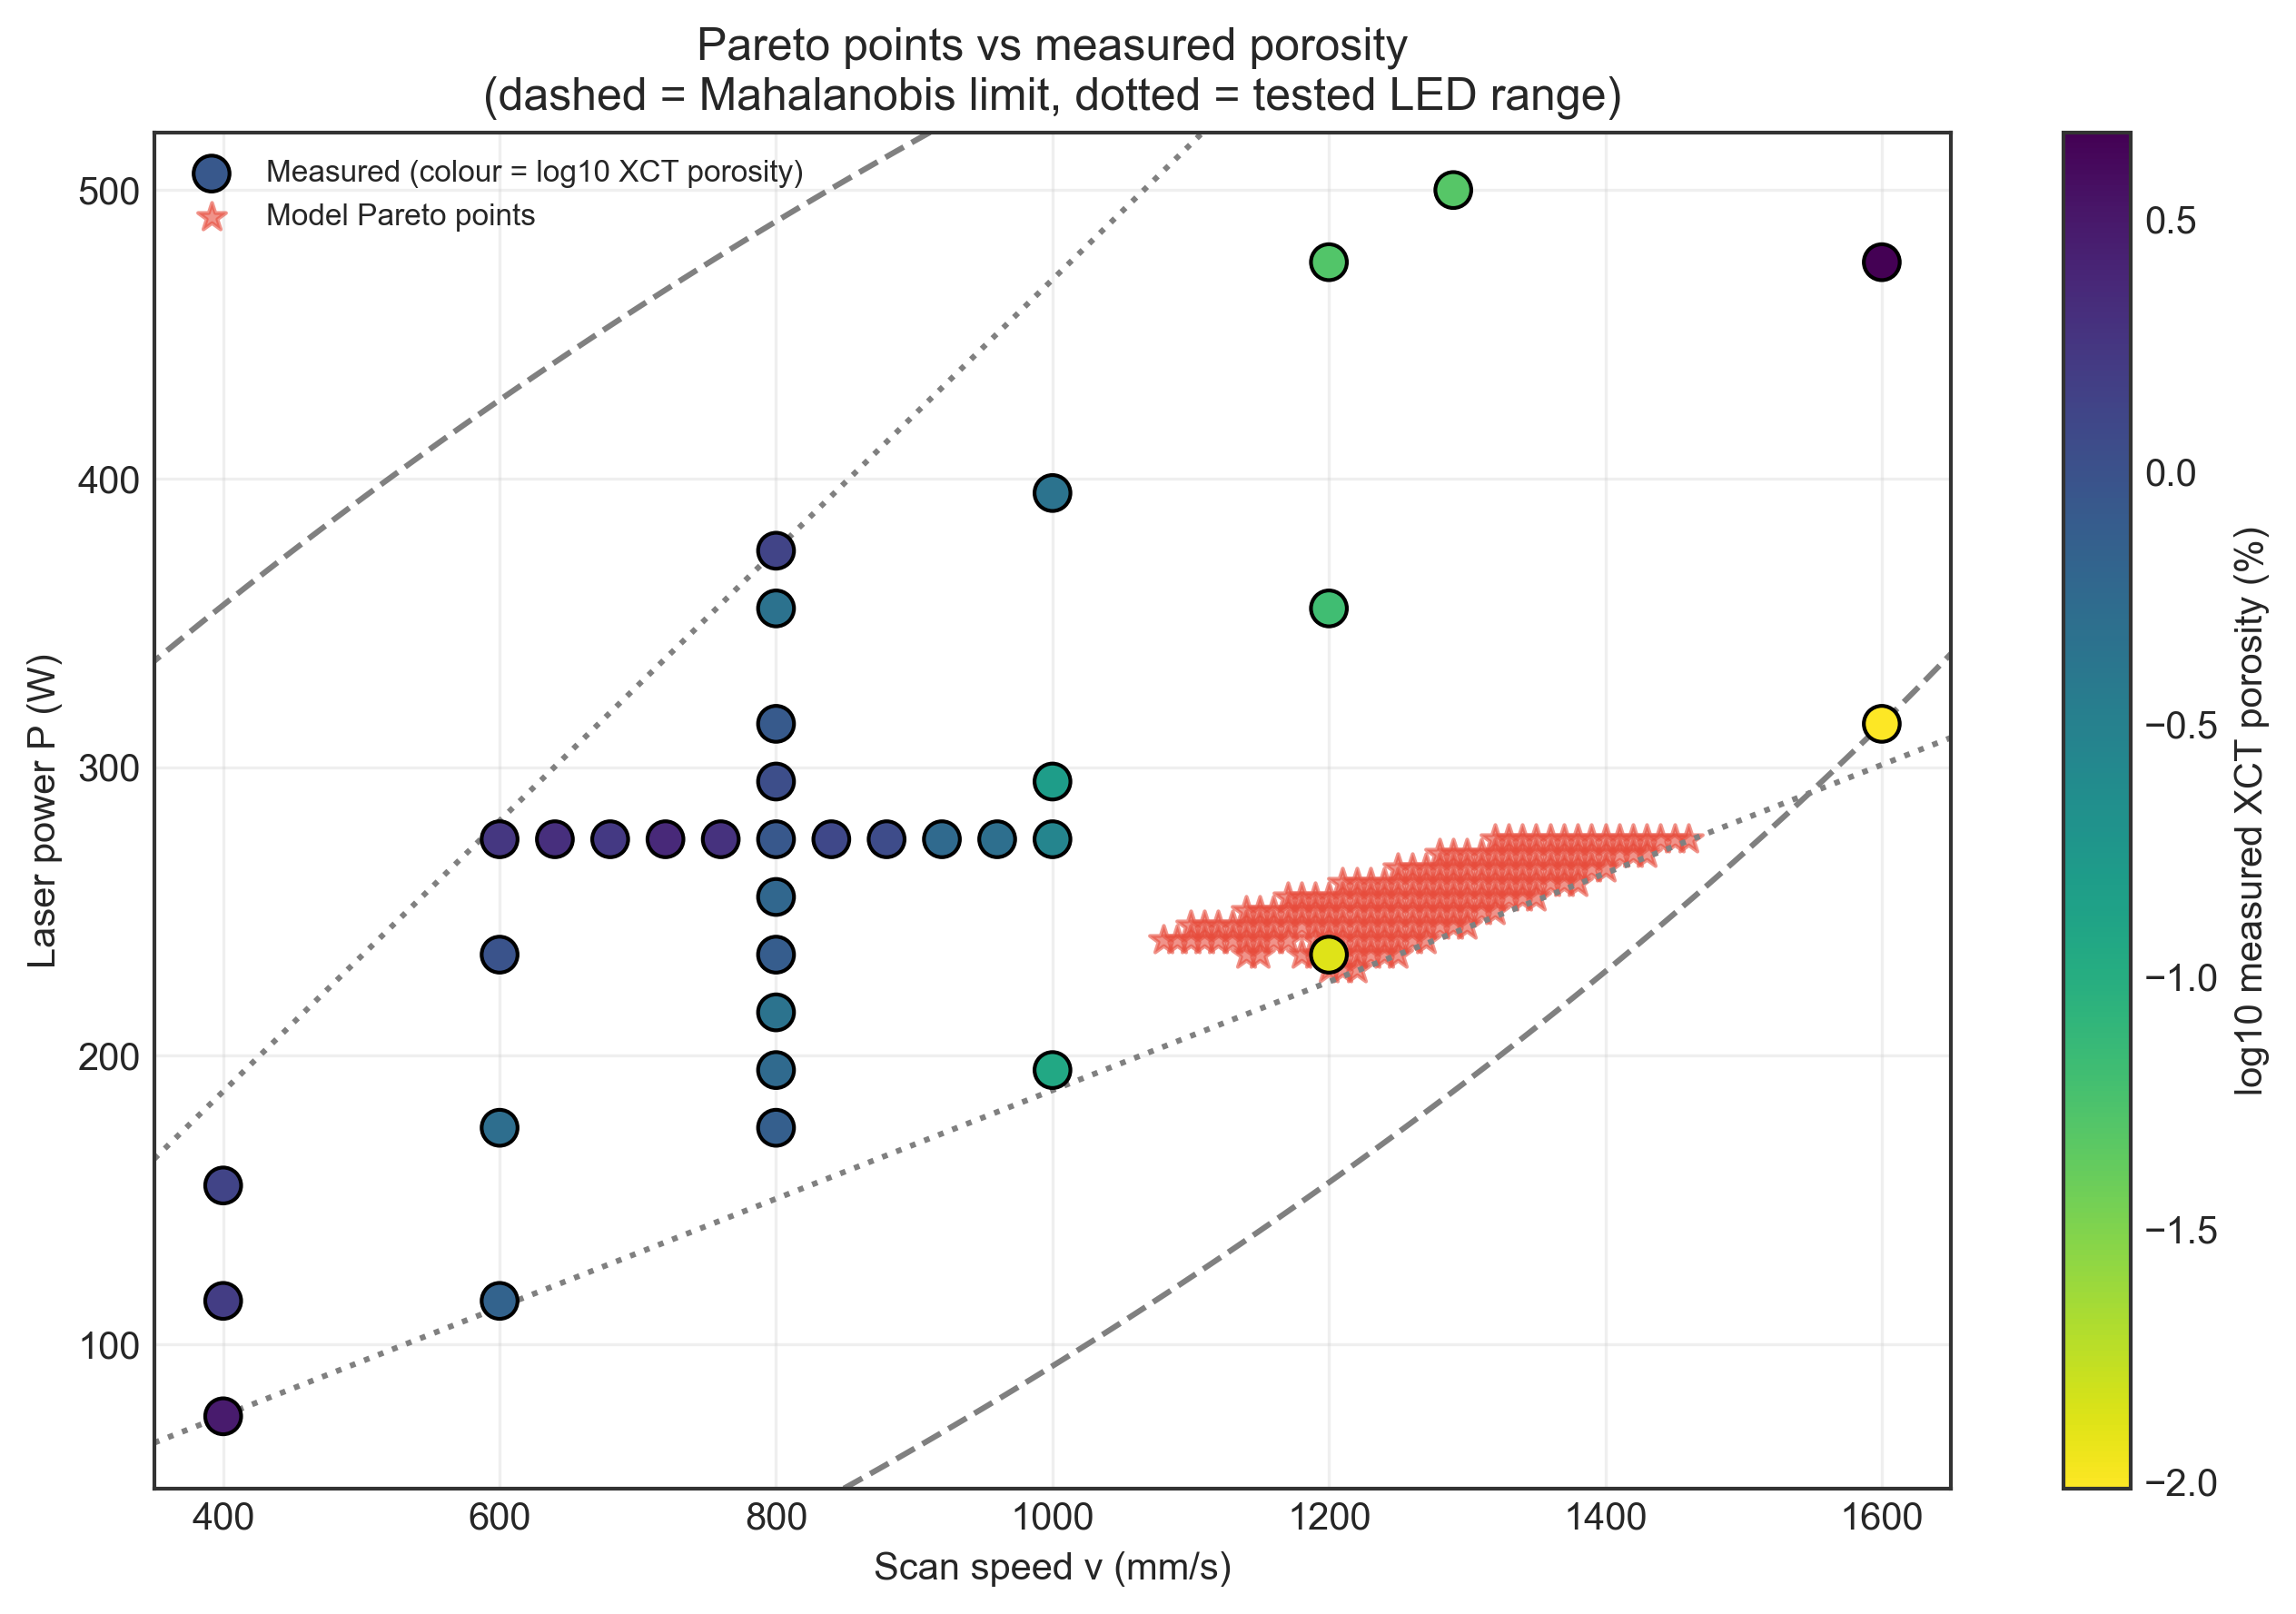
Results: Process Search and Data Check
Pareto search for min porosity, max UTS, max elongation inside the tested region
Findings
• Pareto set: P = 230–275 W, v = 1080–1460 mm/s, LED = 188–223 J/m
• Contains measured set 41 (235 W, 1200 mm/s): UTS 1113 MPa, elongation 15.38 %, porosity 0.0132 %
• Suggestions confirm the measured best region; they must be built and tested before use
• Data check: the printed Table 8 headers swap yield strength and UTS; corrected using the Zenodo files
13

Slide 14
Project Takeaway
What we found
DATASET
42 LPBF conditions
QUESTION
Can we predict reliably?
METHOD
ML + grouped validation
TRUST
Explainability + uncertainty
OUTPUT
Constrained optimization
Main message
Laser power and scan speed alone predict strength and ductility at unseen power levels (grouped R² 0.65–0.81); pore and grain features add little. Porosity and hardness could not be predicted. Uncertainty is quantified, and the process search, kept inside the tested region, points to 230–275 W and 1080–1460 mm/s, where the best measured specimen lies.
14

Slide 15
References
Luo, Q., Yin, L., Simpson, T. W., & Beese, A. M. (2023) — Dataset of process-structure-property feature relationship for laser powder bed fusion additive manufactured Ti-6Al-4V material.
Data in Brief, Volume 46, Article 108911 — selected as the main experimental dataset/reference for this project.
Luo, Q., Yin, L., Simpson, T. W., & Beese, A. M. (2022) — Effect of processing parameters on pore structures, grain features, and mechanical properties in Ti-6Al-4V by laser powder bed fusion.
Additive Manufacturing (2022) — used to understand relationships between LPBF processing parameters, pore structures, grain features and mechanical properties.
Zenodo Dataset — Record 6587905 — public dataset containing the processed feature table and supporting experimental data.
The Luo et al. papers and the Zenodo files are the technical sources for all data used here.
15

Slide 16


