Slide 1
SMS Hunt

Slide 2
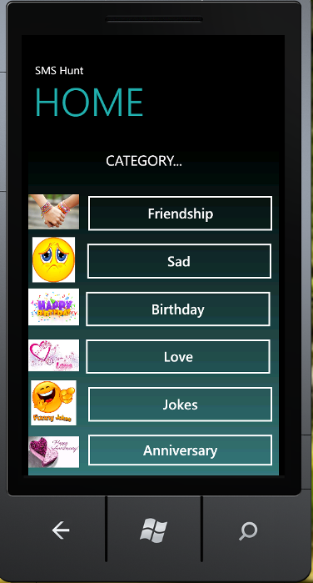
Home
Sms Hunt is a small sms Site for the users . All variety of fresh messages in different categories are available.

Slide 3
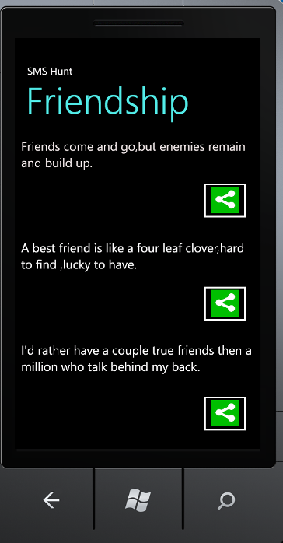
Category: Friendship
On selecting Share Button for any message various options will come to forward selected message.

Slide 4
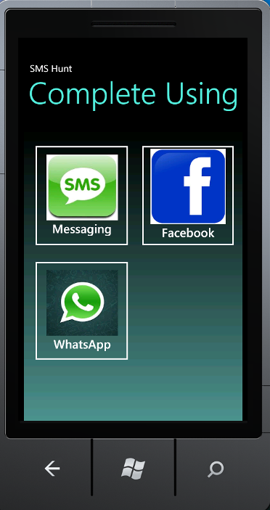
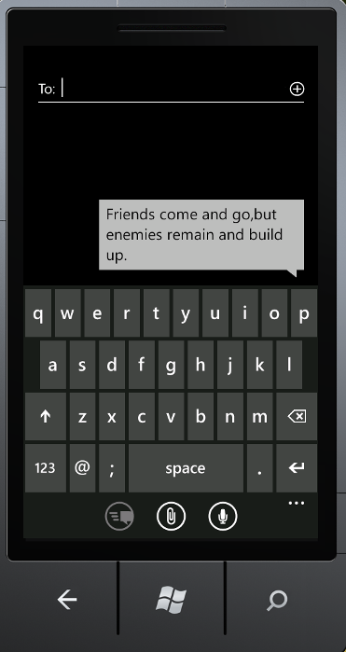
Messaging

Slide 5

Facebook

