Slide 1

SRM EASWARI ENGINEERING COLLEGE
(Autonomous) | Bharathi Salai, Ramapuram, Chennai - 600 089
Department of Information Technology
Subject: Full Stack Web Development (FSD) | Subject Code: [Subject Code]
VendorFlow
ENTERPRISE PROCUREMENT SYSTEM
Web-Based Platform Connecting Readers with Independent Bookstores
Submitted By
Submitted To
Sivaram Venugopal
Sai Lakshmi
Register No: 310624205263
Notes:
Introduce the project: BookBridge is a web platform that connects readers with independent bookstores - discover books, find nearby stores and compare recorded local prices and stock.

Slide 2
VENDORFLOW : ENTERPRISE PROCUREMENT SYSTEM
Project Work (Phase-I) — Review 1 & 2 | Department of Information Technology
• Project Requirements & Scope Definition
• Three-Tier System Architecture & Data Flow
• UML Use Case Model & Actor Interactions
• MongoDB Entity-Relationship (ER) Schema Design
• Core Module Breakdown & Role-Based Access Control (RBAC)
• Full MERN Technology Stack & Implementation Frameworks
• UI Design, User Interaction & Process Workflows
• Frontend Component Architecture & Client State Management
• Backend REST API Architecture & FSM Transition Engine
• Database Modeling, Indexing & Collections
• Implementation Status & Module Completion Table
• Live Application Screenshots & Demonstration Slots
• Engineering Challenges Encountered & Solutions
• Future Milestones & Project References
Agenda

Slide 3
01
REQUIREMENTS
Functional & Non-Functional Requirements
Functional Requirements
Non-Functional Requirements
• Role-Based Access: Secure JWT authentication separating Admin, Buyer, and Vendor access.
• Supplier KYC Onboarding: Automated verification for trade details, PAN, and 15-digit GSTIN.
• Dynamic Purchase Order Builder: Real-time calculation of item subtotals and 18% statutory GST.
• Strict State Machine (FSM): 8-stage linear workflow (Draft to Closed) with no illegal skipping.
• Supplier Performance Scorecard: Automated rating across Quality, Delivery, Price, and Compliance.
• Audit Ledger: Append-only event history tracking every action, user ID, and state change.
• Performance: Sub-100ms database response using targeted compound indexes.
• Security: Passwords hashed with bcrypt (10 rounds); routes protected by Bearer token guards.
• Transactional Safety: Strict transition checks prevent out-of-sequence order updates.
• Interface Ergonomics: Clean, accessible interface built with Tailwind CSS and responsive components.
• High Availability: Cloud-native database hosting on MongoDB Atlas with automatic failover.
• Maintainability: Modular MVC code structure separating routes, controllers, and models.
Requirements

Slide 4
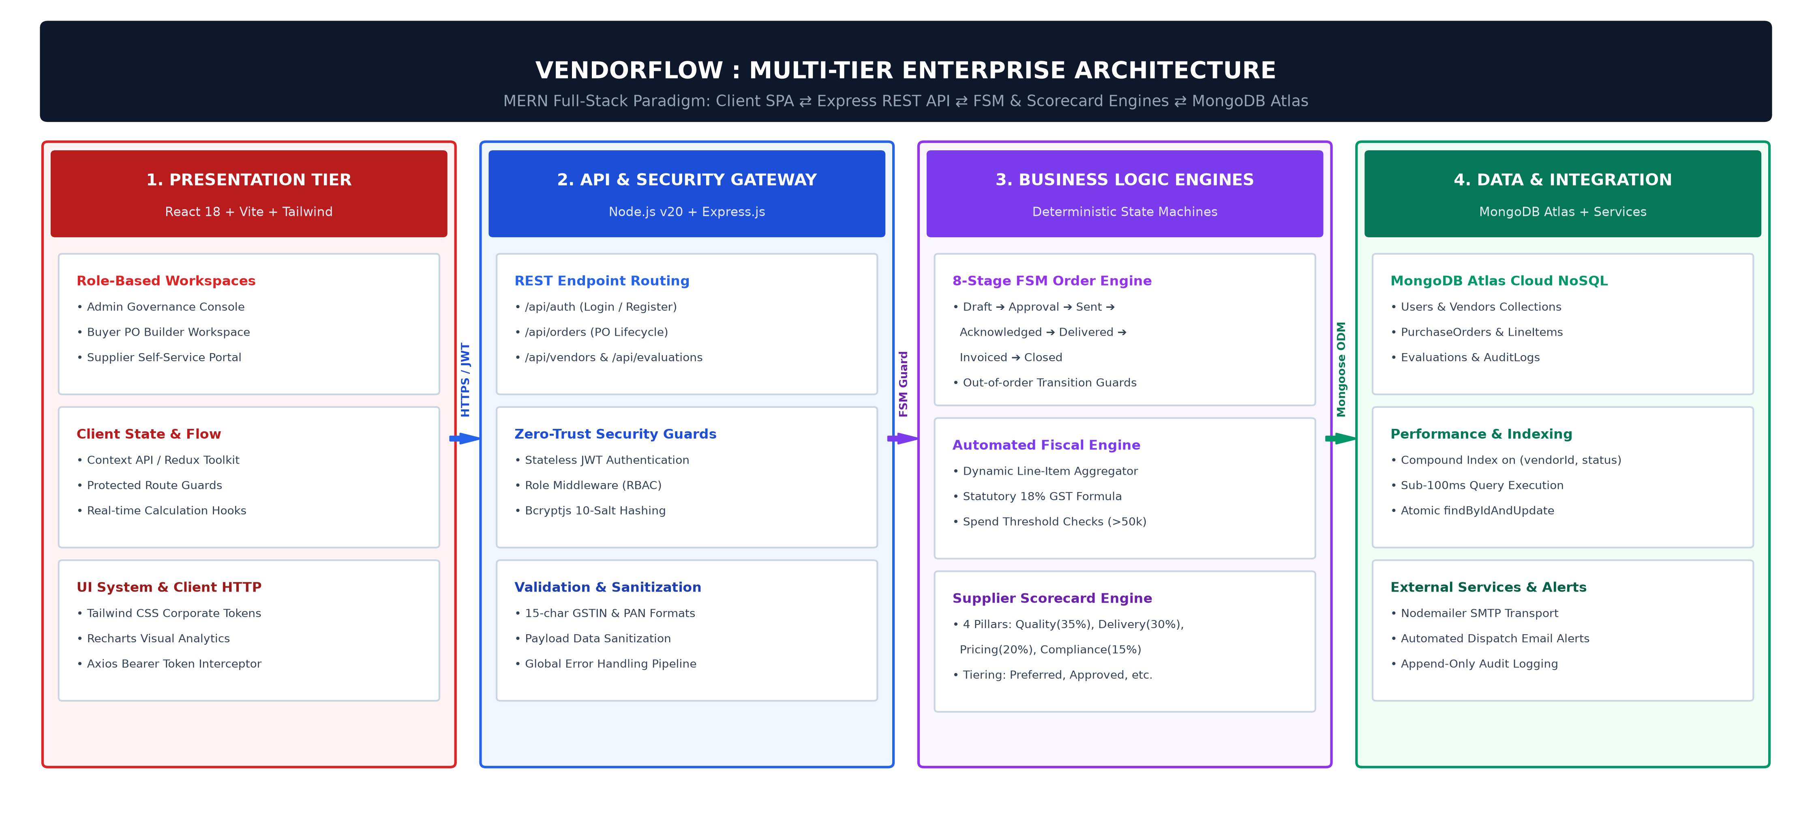
02
ARCHITECTURE
System Architecture (Detailed)

Slide 5
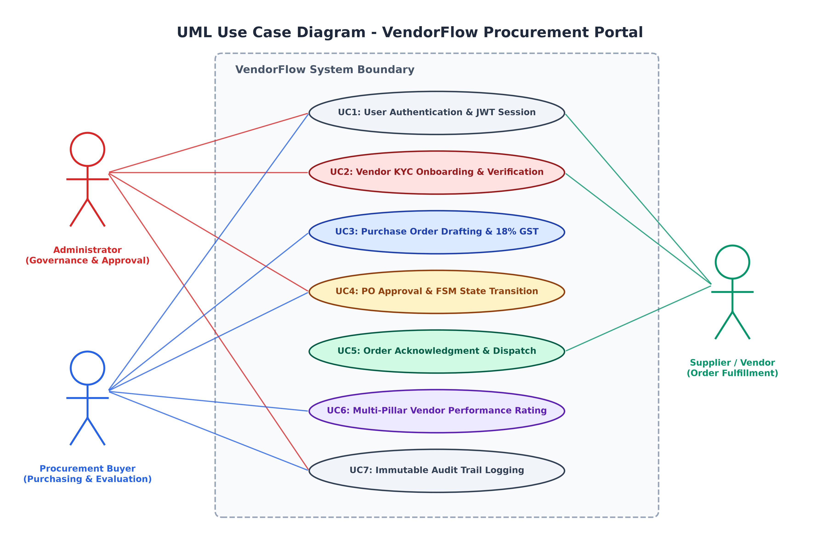
03
USE CASE
Use Case Diagram

Slide 6
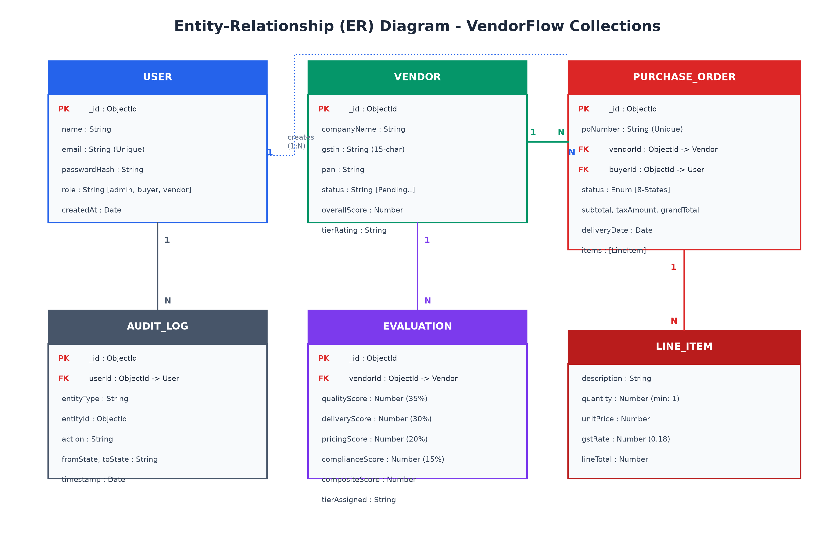
04
ER DIAGRAM
ER Diagram / Database Design

Slide 7
05
MODULES
Module Description
Module | Description | Key Functions
Authentication & RBAC | Issues stateless JWT tokens, verifies roles, and hashes passwords via bcrypt | register, login, verifyToken, authorizeRoles
Vendor Onboarding & KYC | Handles supplier registration, tax document checks (PAN & GSTIN), and status approval | createVendor, verifyTaxId, updateVendorStatus
PO Lifecycle & FSM | Manages the 8-stage state machine, dynamic line items, and automated 18% GST calculation | createPO, calculateTotals, updatePOStatus
Supplier Scorecard | Evaluates vendors across 4 weighted operational pillars and assigns performance tiers | evaluateSupplier, getVendorRating, updateTier
Audit & Notifications | Maintains an immutable change log and dispatches email alerts at critical milestones | logAuditEvent, sendPODispatchAlert, sendApprovalAlert
Modules

Slide 8
06
TECH STACK
Technology Stack
MongoDB Atlas: Cloud document database with compound indexing and native JSON/BSON storage
Express.js: Lightweight backend web framework providing modular REST routes and middleware
React 18 / Vite: Fast, component-driven client application with responsive state reactivity
Node.js (v20 LTS): Non-blocking asynchronous runtime executing high-concurrency event loops
NoSQL Database
Backend Framework
Frontend Library
Runtime Environment
• Mongoose (ODM with validation & virtuals)
• JWT & bcryptjs (Token auth & 10 salt rounds)
• Tailwind CSS & Lucide (Modern UI tokens)
• Nodemailer (SMTP email notification engine)
• Axios (HTTP client with auth interceptors)
• Postman & Overleaf (API tests & project thesis)
Tech Stack

Slide 9
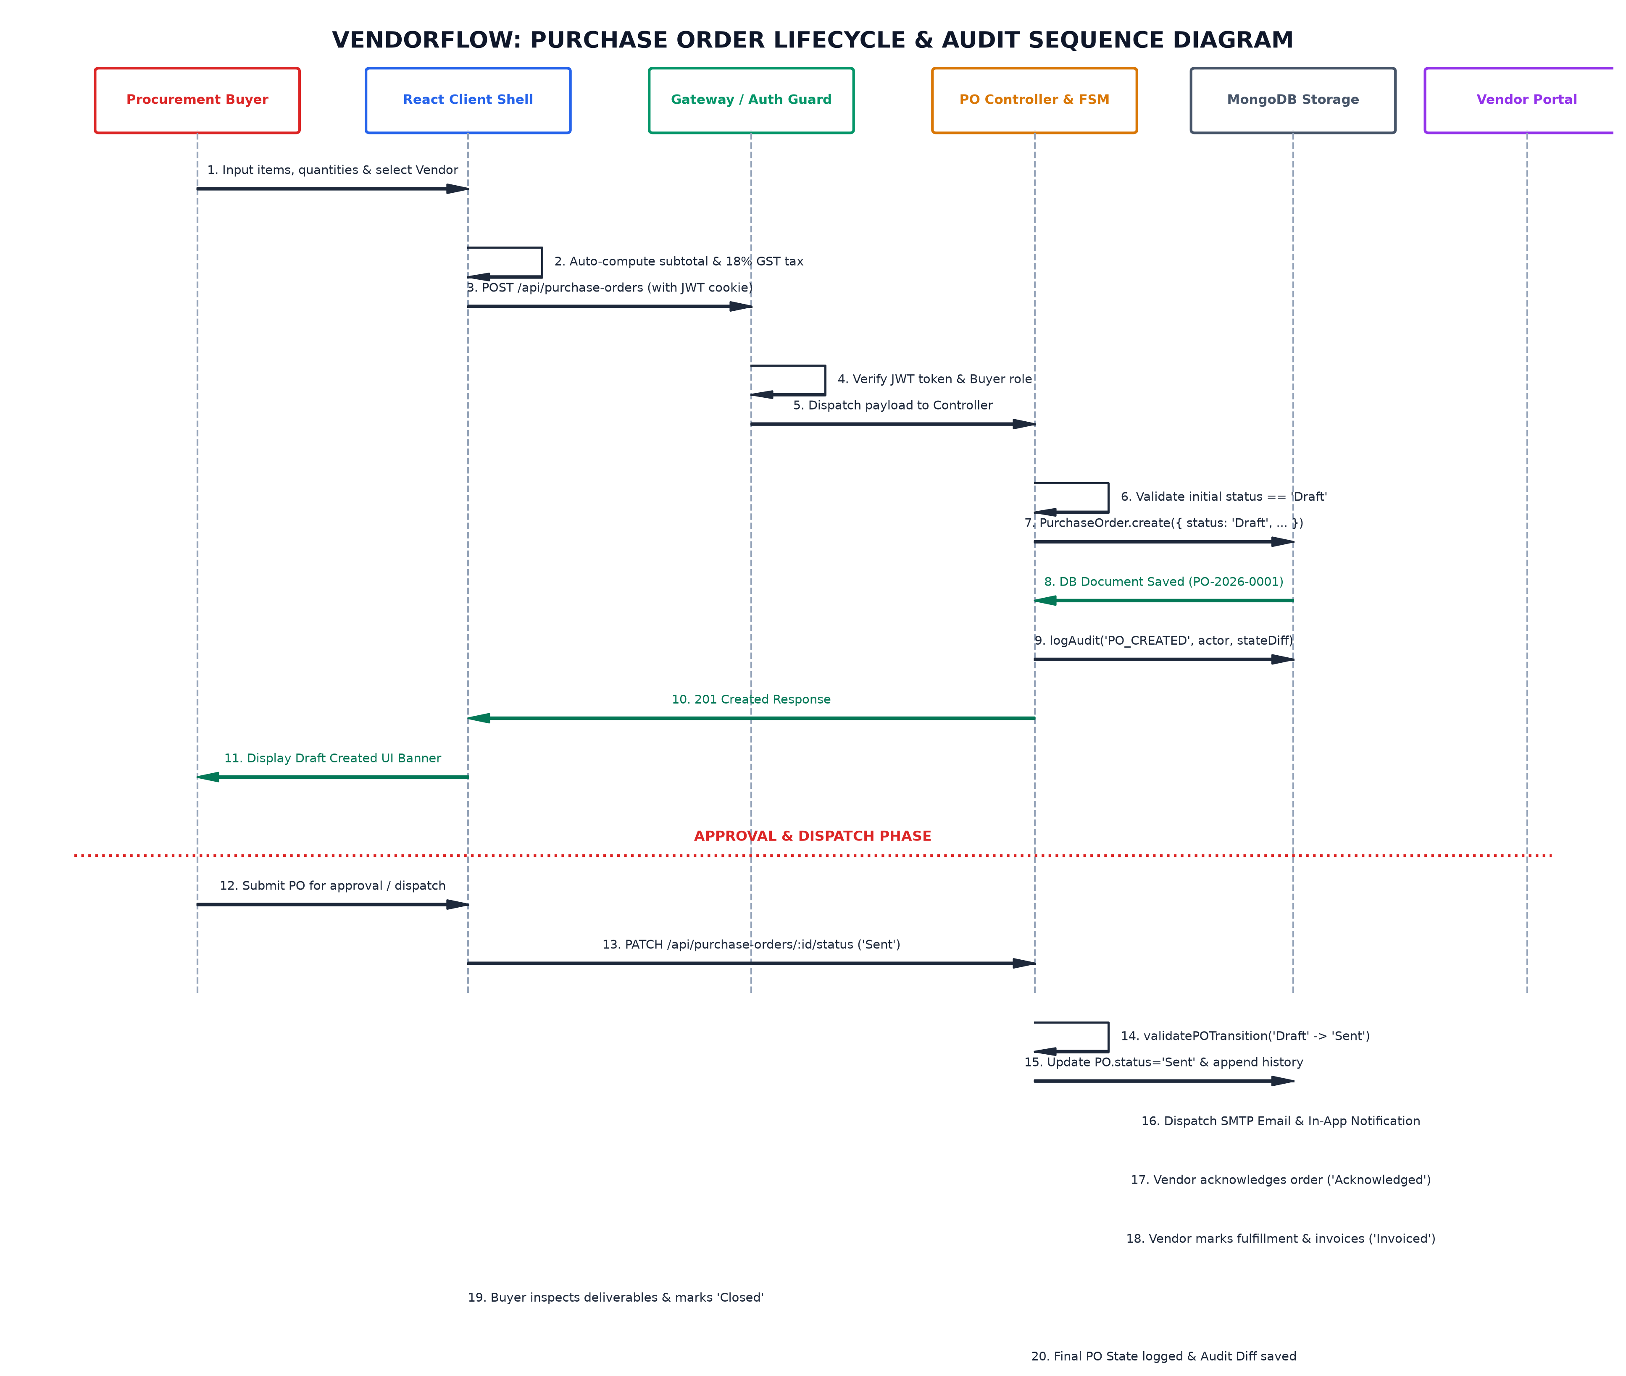
07
UI DESIGN
UI Design / Wireframes

Slide 10
• Single Page Application: Built with React 18 and Vite for fast builds and immediate Hot Module Replacement.
• Reusable Components: Modular UI components including POBuilder, VendorList, ScorecardCard, and StateStepper.
• Live Calculation Hooks: Automatically recalculates line totals, statutory 18% GST, and overall expenditure in real time.
• Role-Protected Routes: React Router v6 guards block unauthorized users from accessing pages outside their assigned role.
• API Communication: Axios handles API requests with interceptors that attach the JWT token to every outbound header.
• Clean Corporate Styling: Tailored with Tailwind CSS using consistent white-and-red design tokens and Lucide icons.
08
FRONTEND
Frontend Development
Frontend

Slide 11
09
BACKEND
• MVC Architecture: Node.js and Express server organized into separate routes, controllers, models, and middleware.
• Modular Endpoints: Distinct routers manage authentication, purchase orders, vendor profiles, and audit logging.
• Deterministic FSM Engine: Server-side validation table guarantees orders only progress through legal states (Draft to Closed).
• Token-Based Security: Generates signed JSON Web Tokens for sessions and salts passwords with bcrypt (10 rounds).
• Route Protection: verifyToken and authorizeRoles middleware verify permissions before controllers execute any logic.
• Centralized Error Handling: Custom error middleware catches validation issues and returns clear JSON error messages.
Backend Development
Backend

Slide 12
10
DATABASE
• Cloud-Hosted Database: Runs on MongoDB Atlas, providing automated backups, scalability, and JSON-native BSON storage.
• Mongoose Schemas: Data models defined with schema-level validation for Users, Vendors, PurchaseOrders, Evaluations, and Logs.
• Clear Entity Relationships: Leverages MongoDB ObjectId references to connect orders with buyers and suppliers cleanly.
• Embedded Sub-Documents: Line items and status histories are stored directly inside the order document for atomic updates.
• Query Performance: Compound indexes on frequently queried fields like { vendorId: 1, status: 1 } ensure sub-100ms lookups.
• Audit Traceability: Append-only collection logs user IDs, action names, timestamps, and previous/new states for all changes.
Database Integration
Database

Slide 13
11
API
API Development
Method | Endpoint | Description
POST | /api/auth/login | Authenticates user credentials and returns a signed JWT token
POST | /api/orders | Creates a new purchase order with automatic 18% GST calculation
PUT | /api/orders/:id/status | Validates and transitions order state, recording an audit log entry
POST | /api/vendors | Onboards a new supplier with PAN and statutory 15-char GSTIN checks
POST | /api/evaluations | Submits performance scores across 4 pillars and updates the vendor tier
GET | /api/audit-logs | Fetches immutable system audit records filtered by entity or user
API

Slide 14
12
STATUS
Module-wise Implementation Status
Functional Module | Key Implementation Deliverables | Progress | Validation Status
User Authentication & RBAC | Stateless JWT token pipeline, role-based route guards for Admin, Buyer, and Vendor | 100% Completed | Verified via Postman
Purchase Order Builder | Dynamic line-item creation, real-time subtotal and statutory 18% GST calculation | 100% Completed | End-to-End Verified
FSM State Machine Engine | 8-stage linear workflow (Draft to Closed) with server-side transition lookup guards | 100% Completed | Guard Tests Passed
Supplier KYC Onboarding | Self-service onboarding modal, PAN and 15-character GSTIN format validation | 90% Completed | Functional in UI
Supplier Scorecard Engine | Objective 4-pillar weighted evaluation model with automated tier classification | 90% Completed | Algorithm Verified
Audit & Email Alerts | Append-only change ledger with Nodemailer SMTP dispatch for order milestones | 70% Completed | SMTP Pipeline Ready
Status

Slide 15
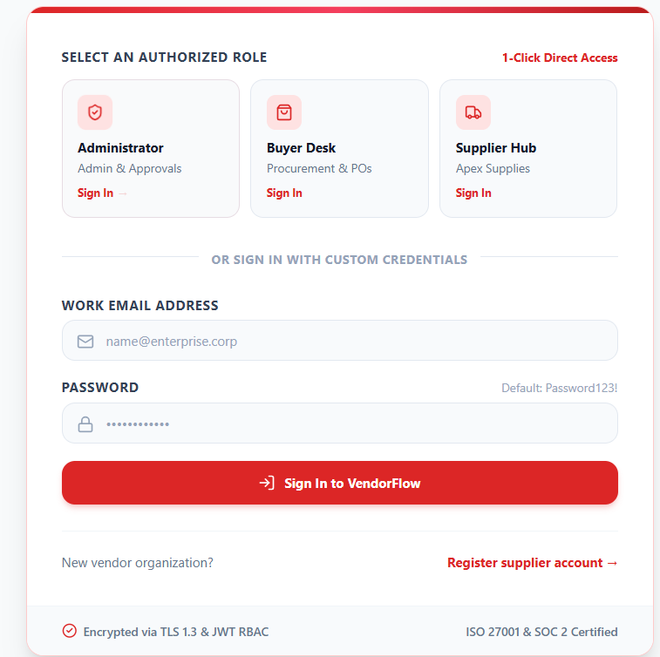
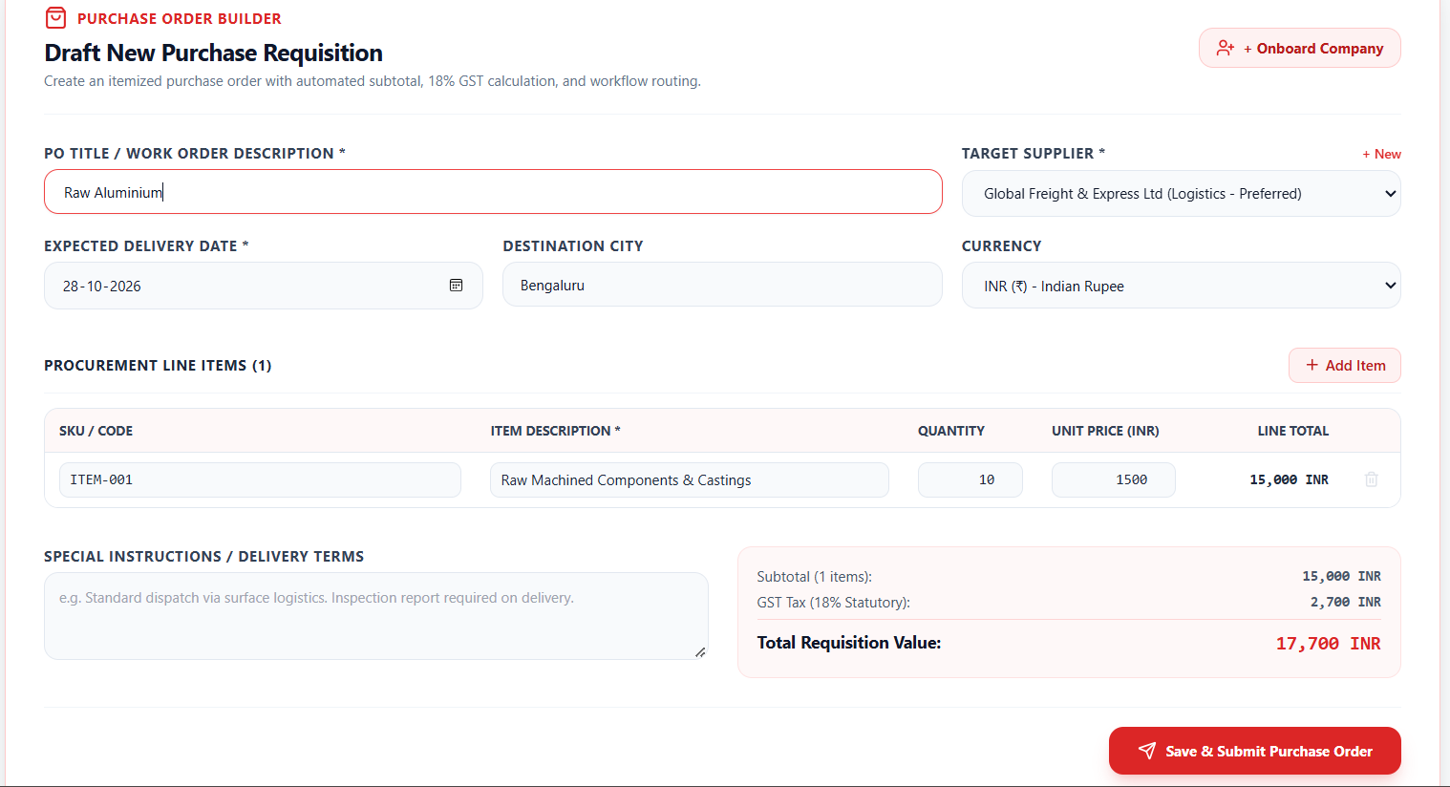
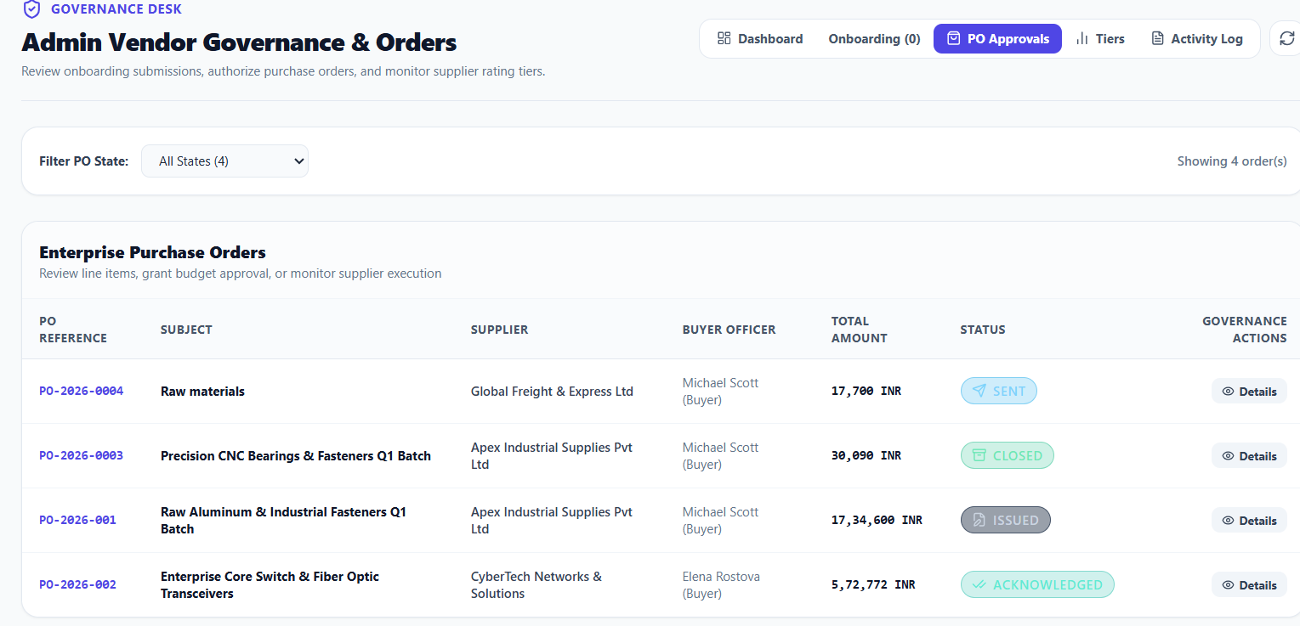
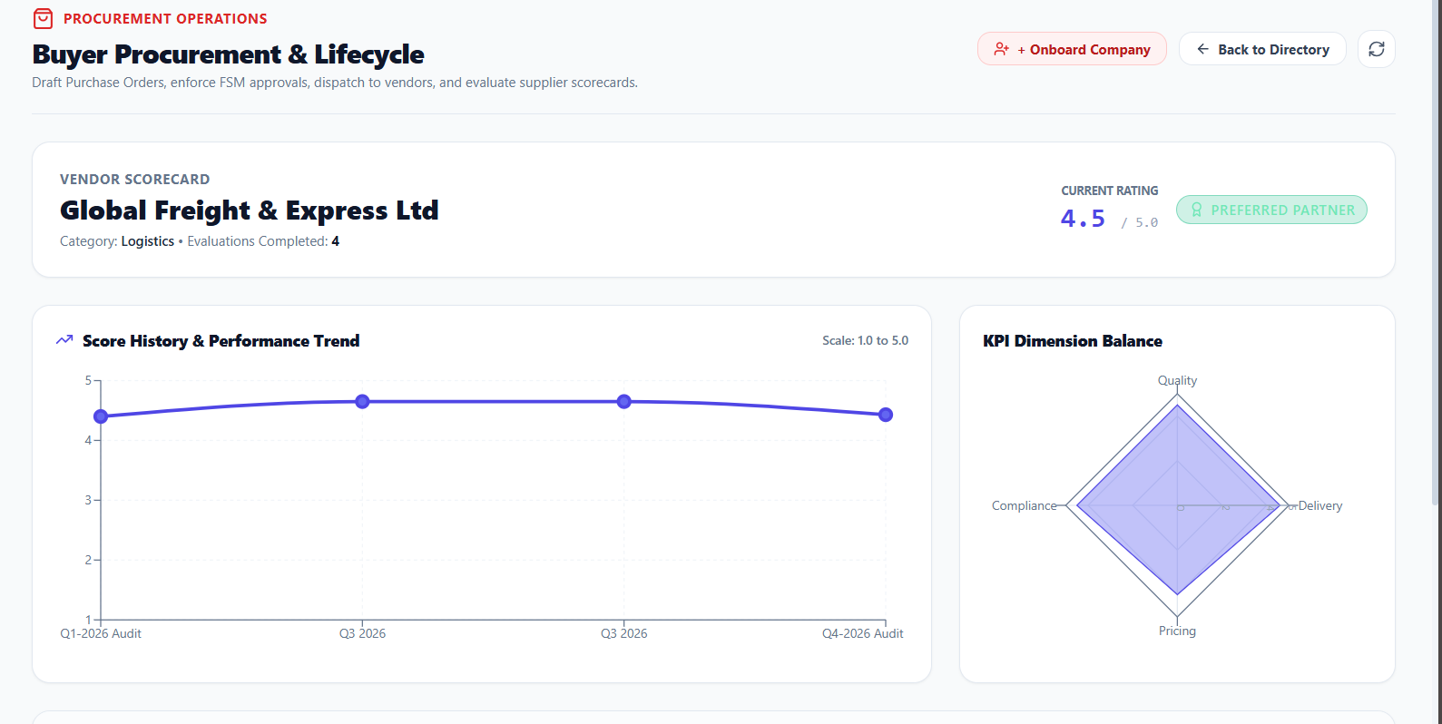
13
SCREENSHOTS
Screenshots
1. User Authentication & Role Switcher
2. Interactive PO Builder & 18% GST Engine
Automated line-item totaling with real-time statutory CGST (9%) + SGST (9%) breakdown
• Role-Based Access Control: Strict isolation between Admin, Buyer & Supplier.
• 1-Click Direct Demo Access: Instant persona sign-in for faculty review & demo.
• Security & Compliance: JWT tokens, TLS 1.3 transport & bcrypt encryption.
3. Enterprise Purchase Order Governance
Live order lifecycle tracking, state transitions (Issued, Acknowledged, Closed) & approvals
4. Dynamic 4-Pillar Scorecard & Radar Trends
Composite supplier rating across Quality (35%), Delivery (30%), Pricing (20%), Compliance (15%)
Screenshots

Slide 16
14
CHALLENGES
Challenges Faced & Solutions
Challenge | Solution Adopted
Preventing unauthorized order state leaps | Enforced a server-side finite state machine dictionary that strictly blocks invalid transitions
Accurate real-time tax calculation during drafting | Implemented custom React hooks to compute item subtotals and 18% GST synchronously
Eliminating subjective vendor performance reviews | Formulated an objective weighted scorecard combining Quality (35%), Delivery (30%), Price (20%), and Compliance (15%)
Aligning frontend form data with Mongoose schemas | Normalized property names (vendorId, deliveryDate) across client DTOs and server validators
Challenges

Slide 17
15
NEXT STEPS
• Automated OCR Invoice Matching: Integrate Tesseract / Document AI to extract data from uploaded invoice PDFs and verify three-way matching against purchase orders.
• Real-Time WebSockets: Connect client and server via Socket.io for instantaneous alerts when an order is approved or acknowledged, avoiding manual refreshes.
• Banking & Payment Integration: Implement corporate payment webhooks to automate disbursements once goods receipts and invoices are reconciled.
• Predictive Spend Analytics: Add lightweight forecasting models to help procurement buyers anticipate seasonal demand and negotiate bulk discounts.
• Cloud Production Deployment: Deploy the React frontend to Vercel and the Express backend to Render, backed by a production MongoDB Atlas cluster.
Remaining Work & Plan

Slide 18
16
NEXT STEPS
References
# | Reference
1 | Chopra, S., & Meindl, P. (2016). Supply Chain Management: Strategy, Planning, and Operation, 6th ed., Pearson Education.
2 | Monczka, R. M., et al. (2020). Purchasing and Supply Chain Management, 7th ed., Cengage Learning, Boston.
3 | Fowler, M. (2018). Patterns of Enterprise Application Architecture, Addison-Wesley Professional.
4 | Goods and Services Tax Network (GSTN), Ministry of Finance, Govt of India (2023). Standard Operating Procedures for Invoicing.
Next Steps

