Slide 1


Univ Logo
Web based platform for Geo-Spatial Big Data Analytics
21/05/2019-12/07/2019
Siva, Vaibhav, Garvit, Chetan, Shreyas and Nrupesh
Guided By: Mr. P.S. Singh & Mr. Nilay Nishant
Bachelor of Engineering in Computer Science
BITS Pilani
Notes:
NORTH EASTERN SPACE APPLICATIONS CENTRE

Slide 2
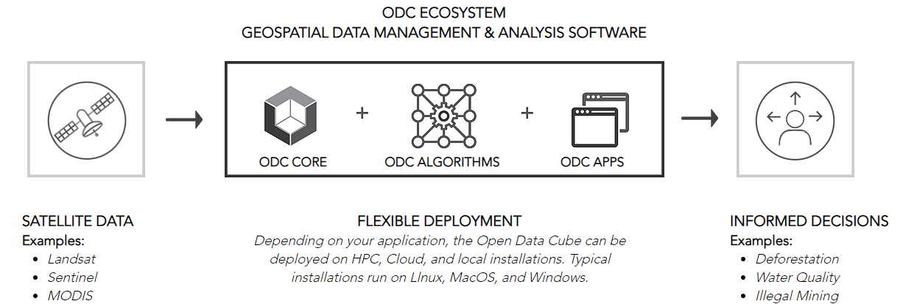
Introduction
A Datacube is a multi-dimensional ("n-D") array of values. Typically, it is applied in contexts where these arrays are massively larger than the hosting computer's main memory; examples include time series of image data.
DataCubes are aiming to realize the full potential of earth observation(EO) data repositories by addressing Volume, Velocity, and Variety challenges, providing access to large spatio-temporal data in an analysis ready form.
Notes:
Lato
NORTH EASTERN SPACE APPLICATIONS CENTRE

Slide 3
Land Cover Classification
Land cover is the physical material at the surface of the earth. Land covers include grass, asphalt, trees, bare ground, water, etc.
There are two primary methods for capturing information on land cover: field survey and analysis of remotely sensed imagery. Land change models can be built from these types of data to assess future shifts in land cover.
In this project we have tried to classify the land cover into various classes using the Random Forest Classification using simple Machine Learning techniques.

Slide 4
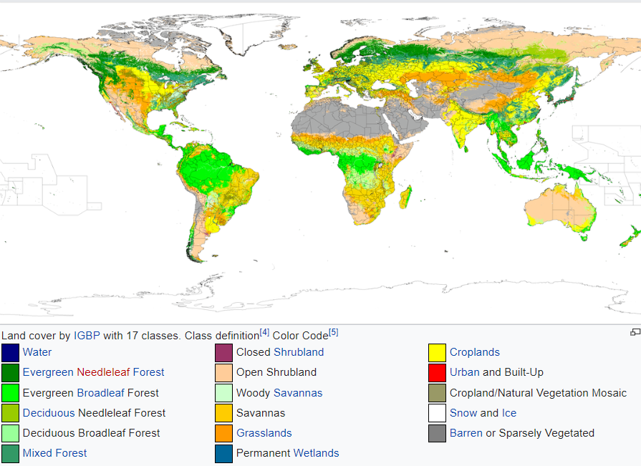

Slide 5

Objective
Creating an online platform for the Geospatial applications on the EO Data obtained by satellites using Open Data Cube.
Creation of the Deep Learning Algorithms (Notebooks) for manipulating the data over a particular region in the world.
Developing an interactive website using which the user can customize the results of the data as per his need.
Efficient time series analyses to support land change applications.
Notes:
Lato
NORTH EASTERN SPACE APPLICATIONS CENTRE

Slide 6
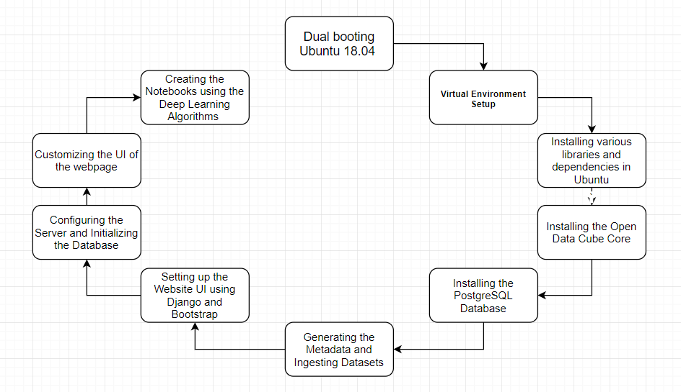
Methodology
Notes:
NORTH EASTERN SPACE APPLICATIONS CENTRE

Slide 8
Python Notebook Creation for
Classification
GDAL - Geospatial Data Abstraction Library Library with useful functions to read raster data. Some useful funtions are:
Open
GetDriver
GetRasterBand
GetGeoTransform
What is Matplotlib?
Matplotlib is a Python 2D plotting library which produces publication quality figures in a variety of hardcopy formats and interactive environments across platforms.
What is Numpy?
NumPy is the fundamental package for scientific computing with Python:
A powerful N-dimensional array object
Tools for integrating C/C++ and Fortran code

Slide 9
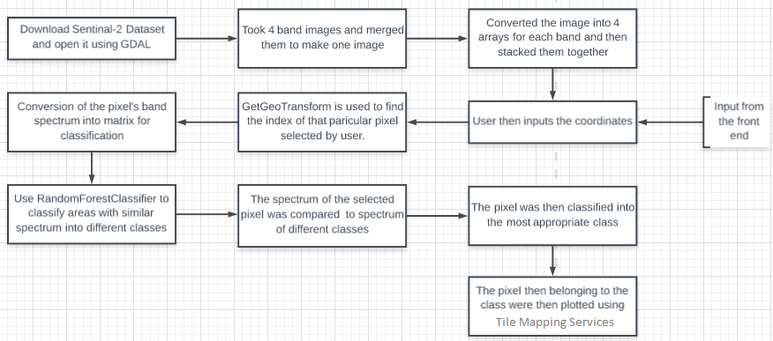

Slide 10
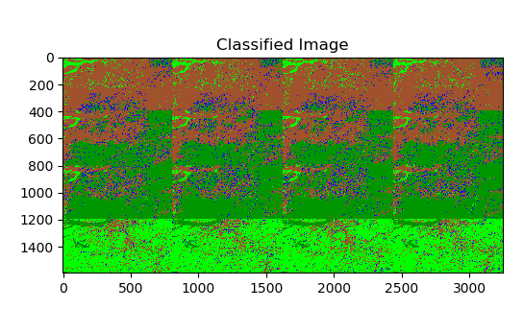
Notes:
10

Slide 11
Datasets and Tools Used
The Data Cube UI is a full stack Python web application used to perform analysis on raster datasets like Landsat 7 and GPM using the Data Cube. Our UI is a good tool for demonstrating the Data Cube capabilities and some possible applications and architectures. The UI's core technologies are:
Django: Web framework, ORM, template processor, entire MVC stack
Data Cube: API for data access and analysis
PostgreSQL: Database backend for both the Data Cube
Bootstrap 3/Materialize: Simple, standard, and easy front end styling
RasterIO/GDAL: Geospatial imagery processing
Sklearn, Matplotlib, Numpy: Deep Learning Notebook and Data Processing
Notes:
Lato
NORTH EASTERN SPACE APPLICATIONS CENTRE

Slide 12
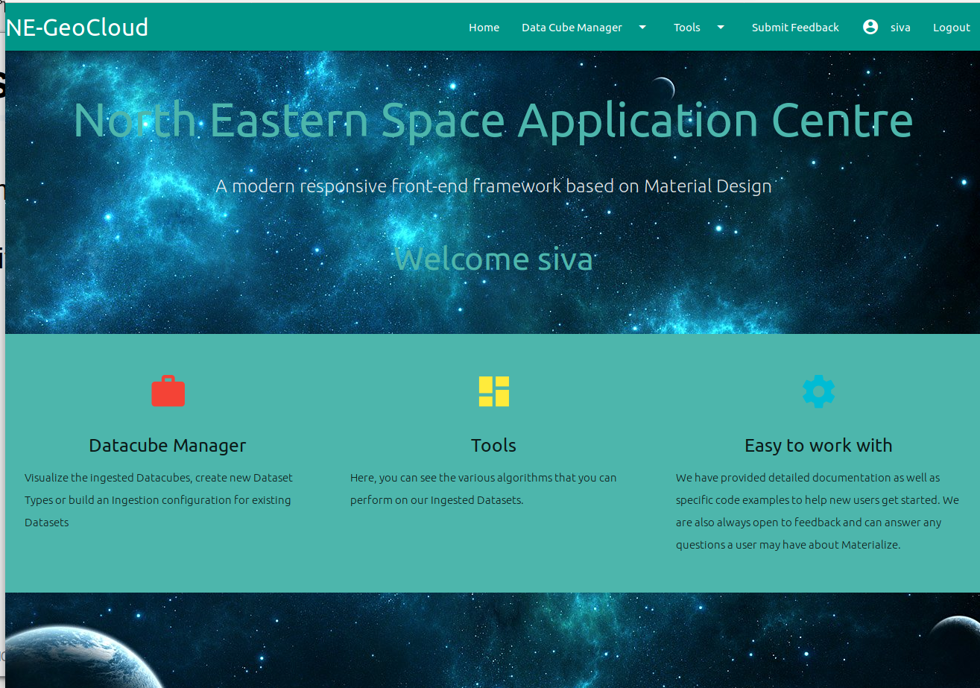
RS 1
Notes:
NORTH EASTERN SPACE APPLICATIONS CENTRE

Slide 13
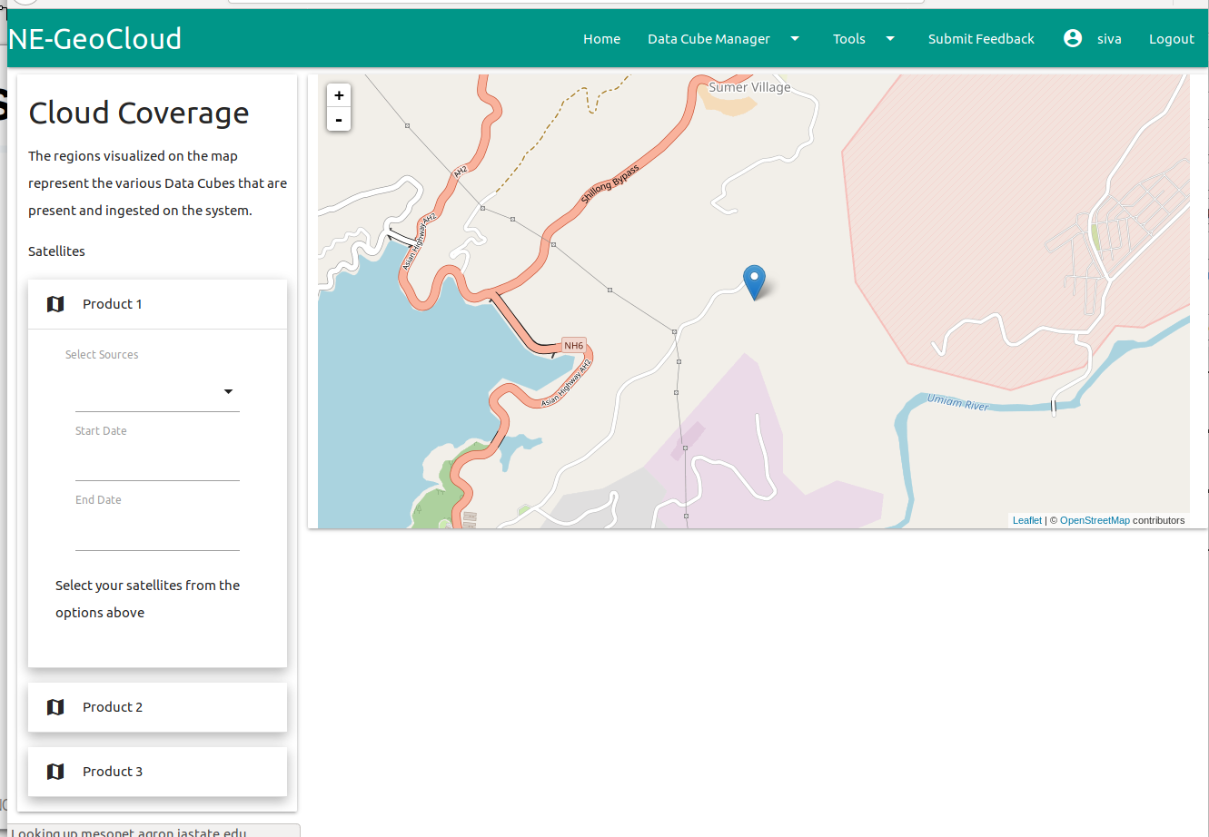
RS 2
Notes:
13

Slide 14
Discussion
We have reworked the UI using Material Design.
We are changing the backend structure so that it supports python notebooks which can be written by any scientist.
We have implement Deep Learning algorithms on the Ingested products.
Notes:
NORTH EASTERN SPACE APPLICATIONS CENTRE

Slide 15
Challenges faced and Motivation
The setup was challenging over a variety of different platforms and frameworks to be integrated.
There were times where we had to begin the project from scratch due to improper installation of few libraries.
One of the current challenges is reworking the UI and the functionality of an existing repository to fit our needs.
One of the major problems in the Deep Learning part was the processing power of the laptop. Since the dataset was very large, the computer hung a couple of times due to the CPU and GPU limitations.

Slide 16
Future Scope
We can use this platform to perform various deep learning techniques such as:
Road Detection.
Classification Of Forest.
Finding illegal Mines.
Water Quality.
House detection.
Vehicle Detection.
Notes:
NORTH EASTERN SPACE APPLICATIONS CENTRE

Slide 17
Selected References
J. Ross, B. Killough, T. Dhu, M.Paget, Open Data Cube and the Committee on Earth Observation Satellites DataCube Initiative, IAC, 2017.
Brian Killough, Overview of the open data cube initiative,2019.
Open Data Cube Website:
https://www.opendatacube.org
Open Data Cube GitHub Repository:
https://github.com/opendatacube
Open Data Cube web-based User Interface:
http://ec2-52-201-154-0.compute-1.amazonaws.com
GDAL Documentation:
https://gdal.org/
Notes:
NORTH EASTERN SPACE APPLICATIONS CENTRE

Slide 18
Thank You
Acknowledgements
We would like to acknowledge everyone who played a role in our project accomplishments.
First of all, our mentors Mr. P.S. Singh and Mr. Nilay Nishant each of whom has provided patient advice and guidance throughout the research process.
We would also like to thank our PS instructor Mr. D.Sriram for his unwavering support.
Student(s) email:
f20170153@hyderabad.bits-pilani.ac.in
f20170458@hyderabad.bits-pilani.ac.in
f20170834@goa.bits-pilani.ac.in
f20170591@goa.bits-pilani.ac.in
f20170941@goa.bits-pilani.ac.in
f20170767@goa.bits-pilani.ac.in
Notes:
NORTH EASTERN SPACE APPLICATIONS CENTRE

