Slide 1
E-Commerce Product Categorization using NLP
21AIE314 - AI in Natural Language Processing
Batch-A-Group-14

Slide 2
21AIE314 - AI in Natural Language Processing
Problem Statement:
The rapid growth of e-commerce necessitates efficient product classification to improve user experience and inventory management. This project aims to develop a machine learning model using Natural Language Processing (NLP) techniques to automatically classify e-commerce products based on their descriptions, enhancing accuracy and scalability in the categorization process.
Batch-A-Group-14
E-Commerce Product Categorization using NLP

Slide 3
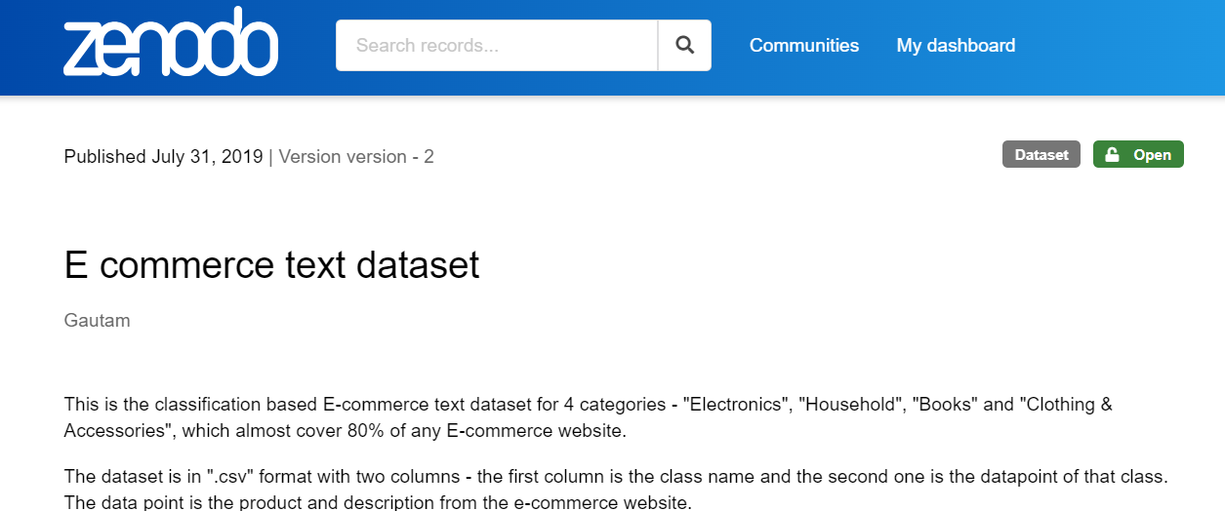
21AIE314 - AI in Natural Language Processing
Dataset:
https://zenodo.org/records/3355823
Batch-A-Group-14
E-Commerce Product Categorization using NLP

Slide 4
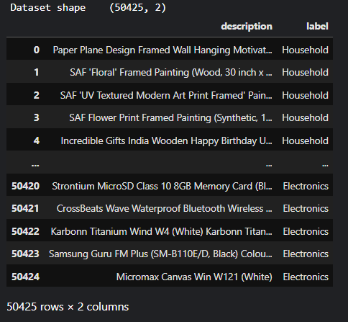
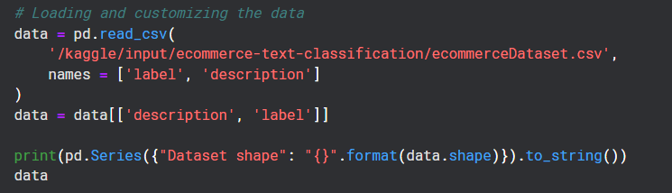
21AIE314 - AI in Natural Language Processing
Loading the Dataset:
Batch-A-Group-14
E-Commerce Product Categorization using NLP

Slide 5
21AIE314 - AI in Natural Language Processing
'Paper Plane Design Framed Wall Hanging Motivational Office Decor Art Prints (8.7 X 8.7 inch) - Set of 4 Painting made up in synthetic frame with uv textured print which gives multi effects and attracts towards it. This is an special series of paintings which makes your wall very beautiful and gives a royal touch. This painting is ready to hang, you would be proud to possess this unique painting that is a niche apart. We use only the most modern and efficient printing technology on our prints, with only the and inks and precision epson, roland and hp printers. This innovative hd printing technique results in durable and spectacular looking prints of the highest that last a lifetime. We print solely with top-notch 100% inks, to achieve brilliant and true colours. Due to their high level of uv resistance, our prints retain their beautiful colours for many years. Add colour and style to your living space with this digitally printed painting. Some are for pleasure and some for eternal bliss.so bring home this elegant print that is lushed with rich colors that makes it nothing but sheer elegance to be to your friends and family.it would be treasured forever by whoever your lucky recipient is. Liven up your place with these intriguing paintings that are high definition hd graphic digital prints for home, office or any room.'
Batch-A-Group-14
E-Commerce Product Categorization using NLP

Slide 6
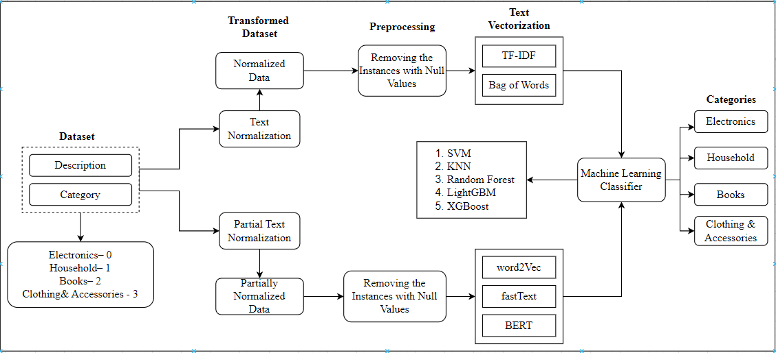
21AIE314 - AI in Natural Language Processing
Methodology:
Batch-A-Group-14
E-Commerce Product Categorization using NLP

Slide 7
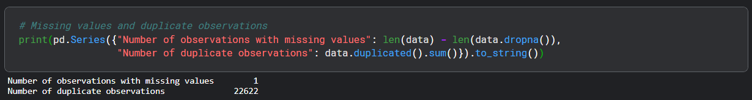
21AIE314 - AI in Natural Language Processing
Data Preprocessing:
Dropping duplicate observations and observations with missing Values:
Batch-A-Group-14
E-Commerce Product Categorization using NLP

Slide 8
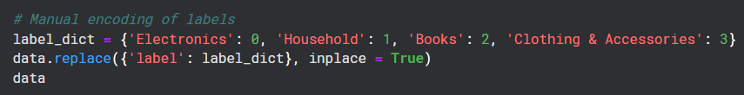
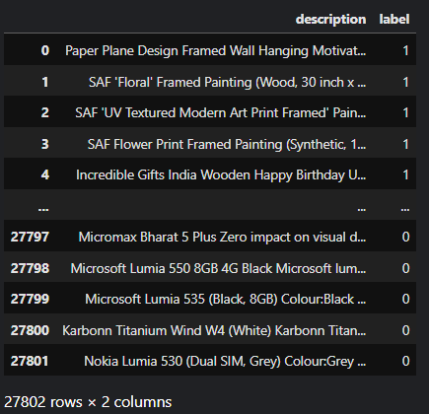
21AIE314 - AI in Natural Language Processing
Labels Encoding:
Electronics ↦ 0
Household ↦ 1
Books ↦ 2
Clothing & Accessories ↦ 3
Batch-A-Group-14
E-Commerce Product Categorization using NLP

Slide 9
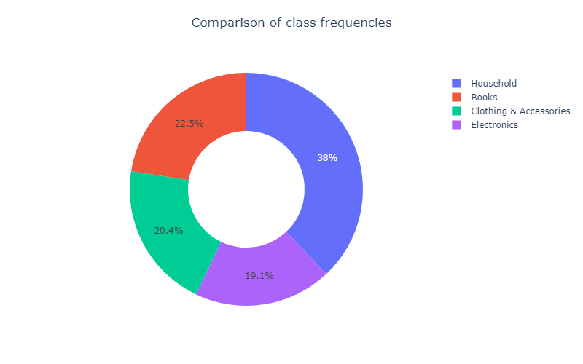
21AIE314 - AI in Natural Language Processing
Exploratory Data Analysis:
Batch-A-Group-14
E-Commerce Product Categorization using NLP

Slide 10
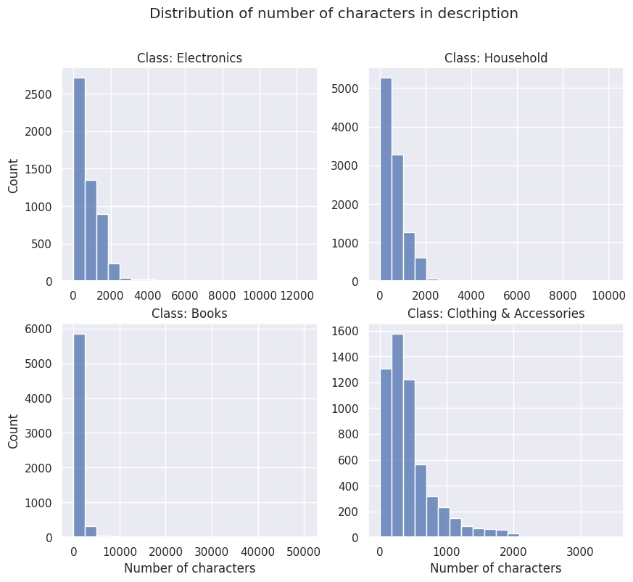
21AIE314 - AI in Natural Language Processing
Exploratory Data Analysis:
Batch-A-Group-14
E-Commerce Product Categorization using NLP

Slide 11
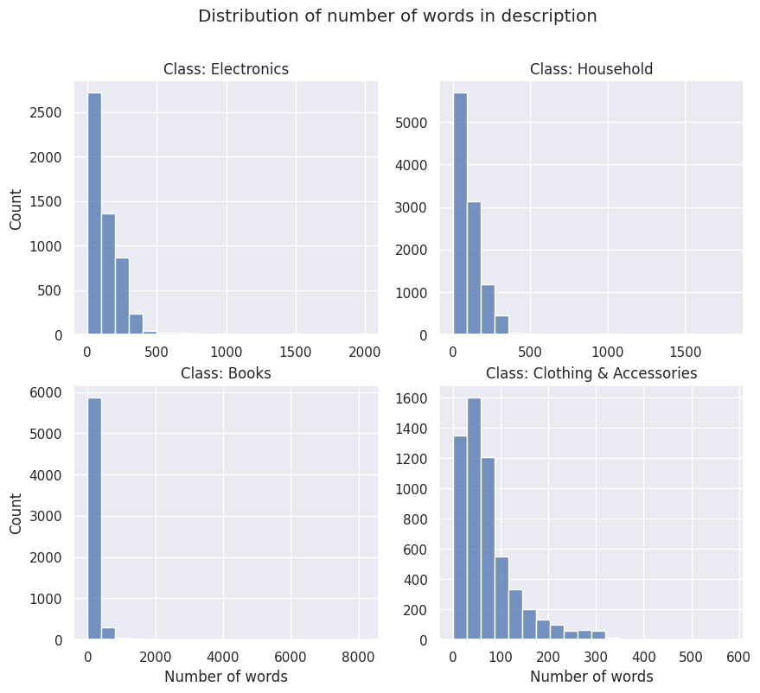
21AIE314 - AI in Natural Language Processing
Exploratory Data Analysis:
Batch-A-Group-14
E-Commerce Product Categorization using NLP

Slide 12
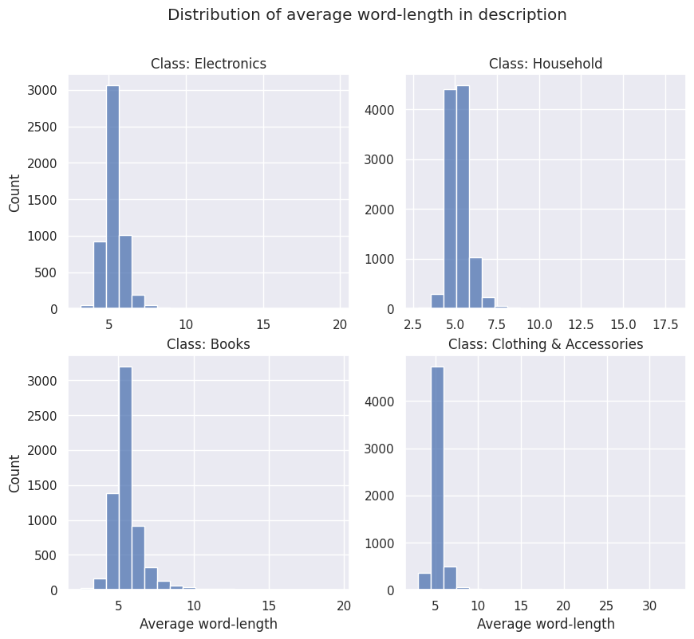
21AIE314 - AI in Natural Language Processing
Exploratory Data Analysis:
Batch-A-Group-14
E-Commerce Product Categorization using NLP

Slide 13
21AIE314 - AI in Natural Language Processing
Text Normalization:
Case Folding
1. Converting to lower case.
Text Cleaning
1. Removing Punctuations
2. Removing White Spaces
3. Removing HTML tags
4. Removing Emojis
5. Removing Unicode Characters
Text Abbreviation Handling
1. Replacing Acronyms with Original forms
2. Replacing Contractions with Original forms
Lexical Processing
1. Stemming
2. Lemmatization
Removing Non-alphabetic Words
Part-of-speech Tagging
Batch-A-Group-14
E-Commerce Product Categorization using NLP
Notes:
Case Folding.

Slide 14
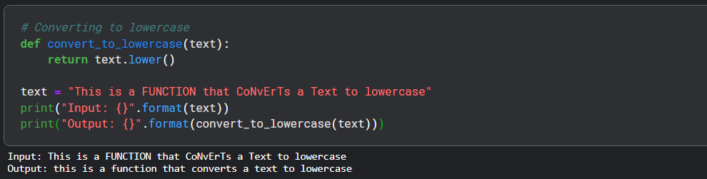
21AIE314 - AI in Natural Language Processing
Text Normalization:
Case Folding - Converting to lower case.
Batch-A-Group-14
E-Commerce Product Categorization using NLP
Notes:
Case Folding.

Slide 15
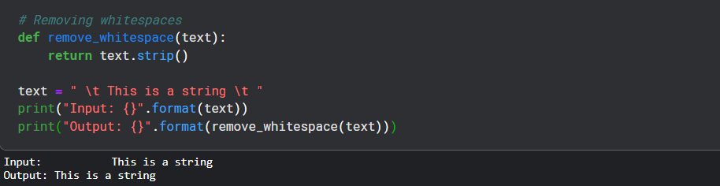
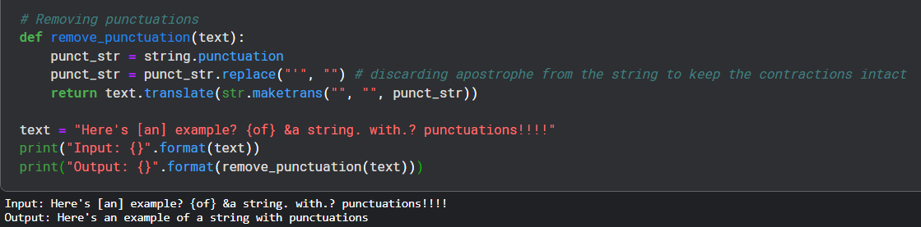
21AIE314 - AI in Natural Language Processing
Text Cleaning – Removing Whitespaces
Text Cleaning – Removing Punctuations
Batch-A-Group-14
E-Commerce Product Categorization using NLP
Notes:
Text Cleaning

Slide 16
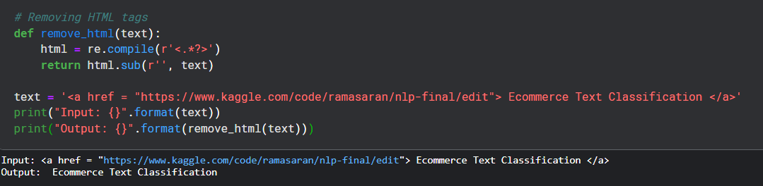
21AIE314 - AI in Natural Language Processing
Text Cleaning – Removing HTML tags.
Batch-A-Group-14
E-Commerce Product Categorization using NLP
Notes:
Text Cleaning

Slide 17
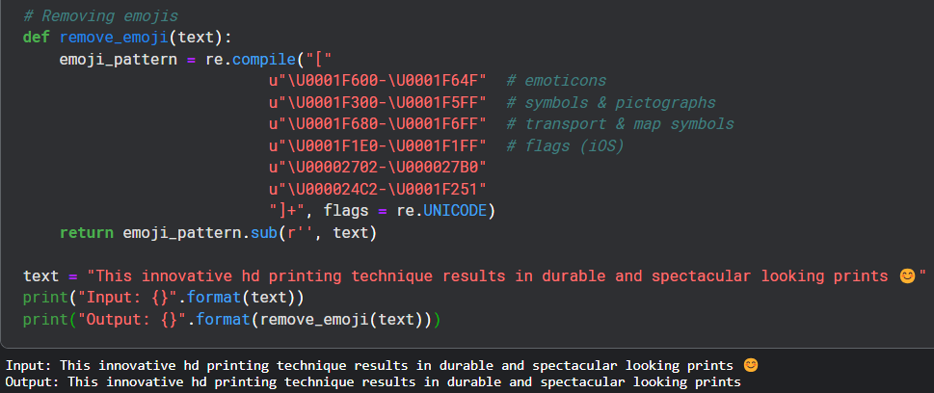
21AIE314 - AI in Natural Language Processing
Text Cleaning – Removing Emojis
Batch-A-Group-14
E-Commerce Product Categorization using NLP
Notes:
Text Cleaning

Slide 18
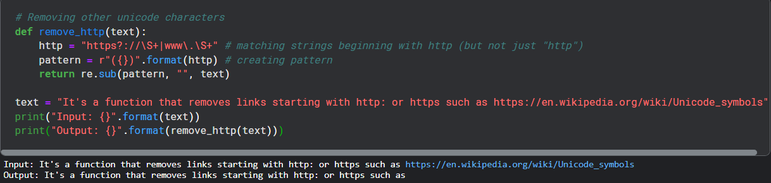
21AIE314 - AI in Natural Language Processing
Text Cleaning – Removing Unicode Characters:
Batch-A-Group-14
E-Commerce Product Categorization using NLP
Notes:
Text Cleaning

Slide 19
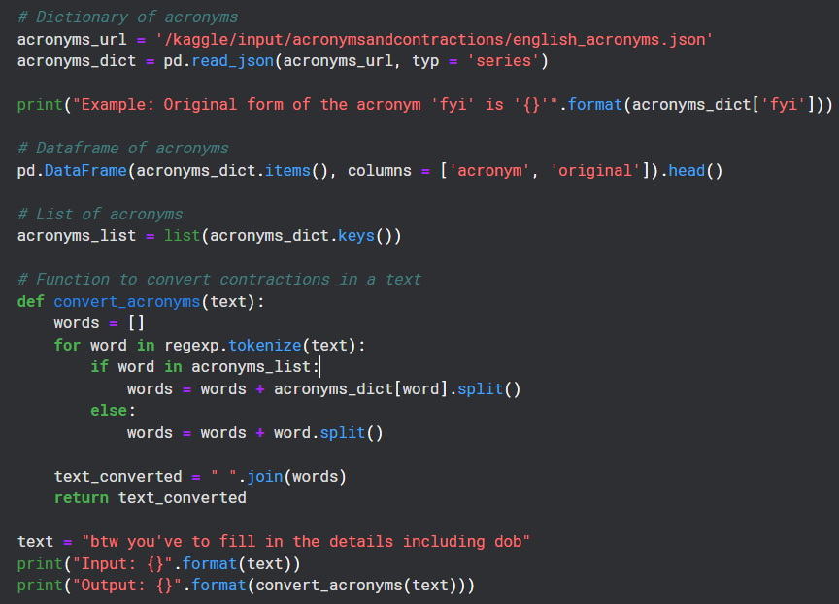
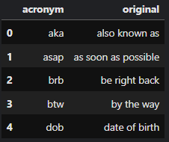
21AIE314 - AI in Natural Language Processing
Text Abbreviation Handling - Replacing Acronyms with Original forms:
Batch-A-Group-14
E-Commerce Product Categorization using NLP
Notes:
Text Abbreviation Handling - Acronyms

Slide 20
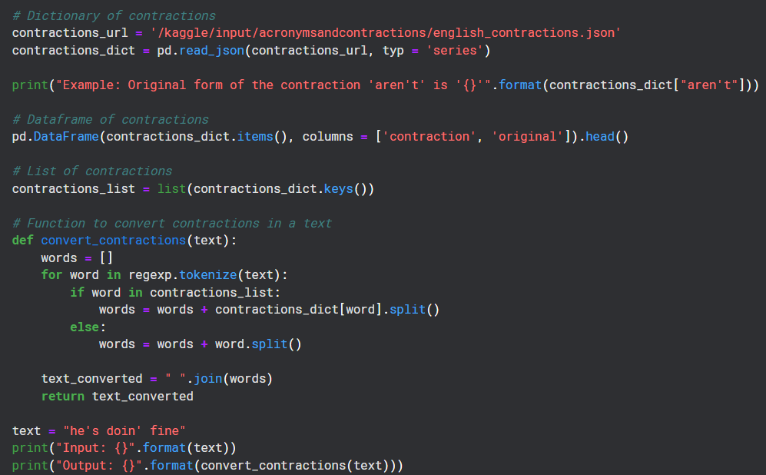
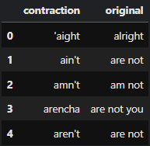
21AIE314 - AI in Natural Language Processing
Text Abbreviation Handling - Replacing Contractions with Original forms:
Batch-A-Group-14
E-Commerce Product Categorization using NLP
Notes:
Text Abbreviation Handling - Contractions

Slide 21
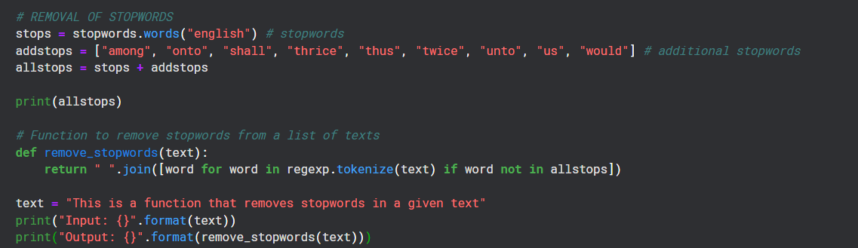
21AIE314 - AI in Natural Language Processing
Removing Stop Words:
Batch-A-Group-14
E-Commerce Product Categorization using NLP

Slide 22
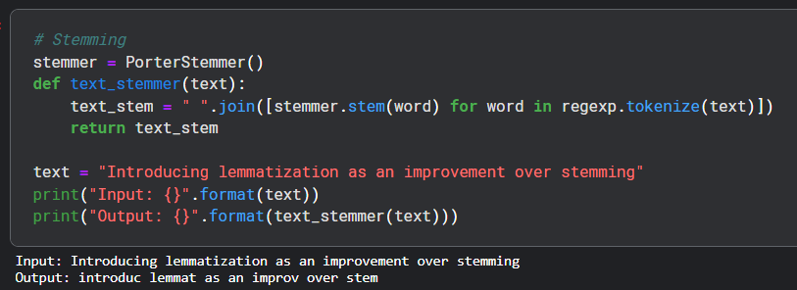
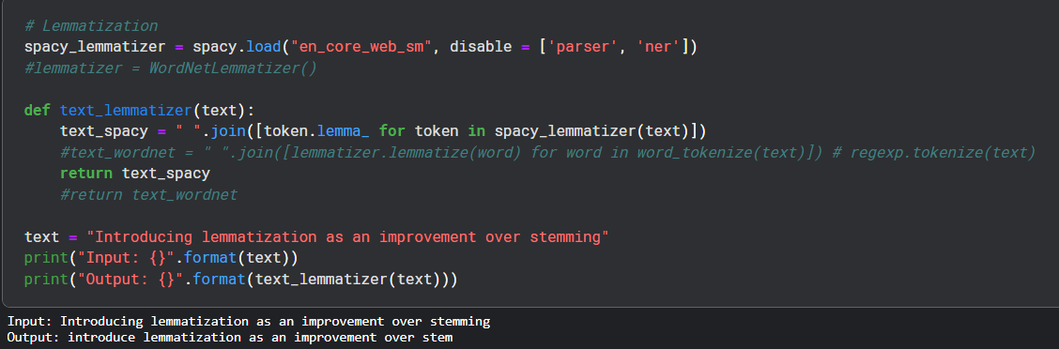
21AIE314 - AI in Natural Language Processing
Lexical Processing:
1. Stemming
2. Lemmatization
Batch-A-Group-14
E-Commerce Product Categorization using NLP

Slide 23
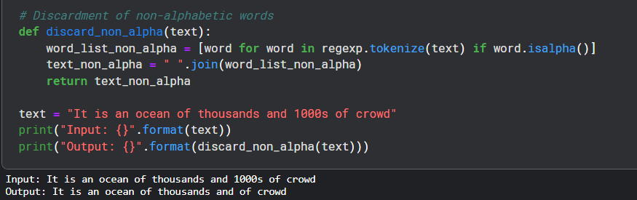
21AIE314 - AI in Natural Language Processing
Removing Non-Alphabetic Words:
Batch-A-Group-14
E-Commerce Product Categorization using NLP

Slide 24
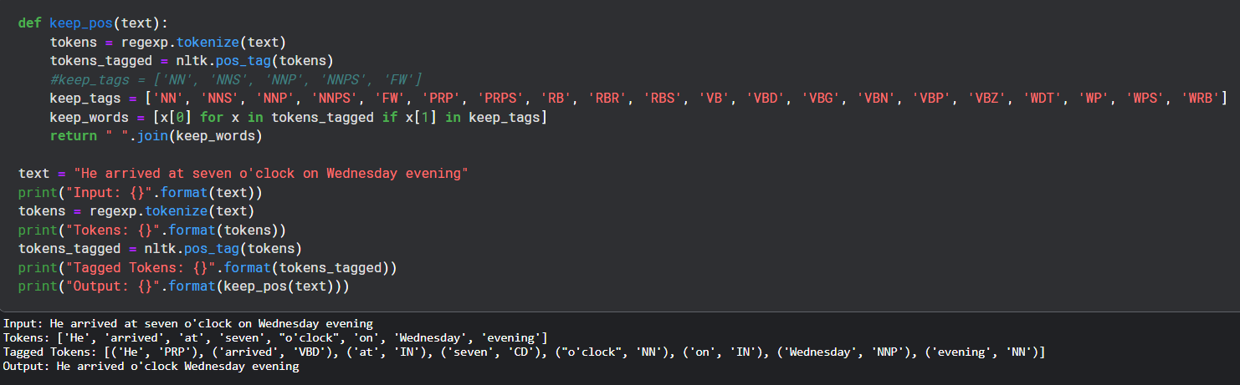
21AIE314 - AI in Natural Language Processing
POS TAGGING:
Batch-A-Group-14
E-Commerce Product Categorization using NLP

Slide 25
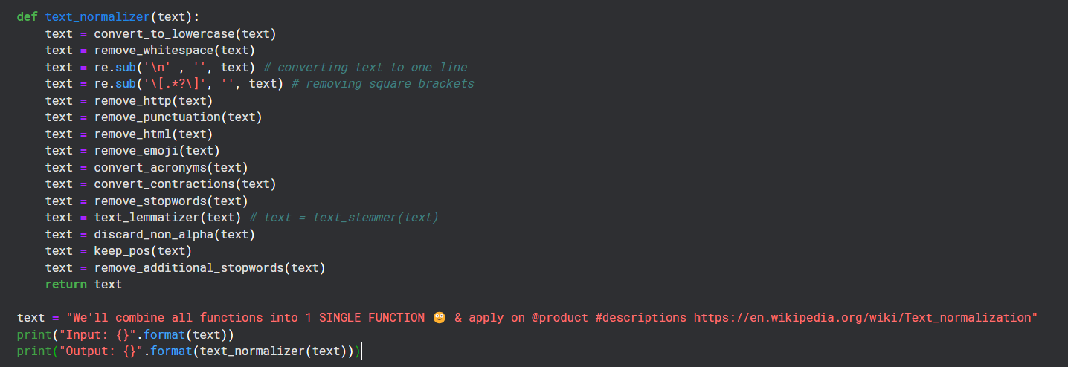
21AIE314 - AI in Natural Language Processing
Batch-A-Group-14
E-Commerce Product Categorization using NLP

Slide 26
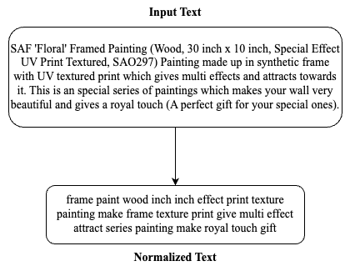
21AIE314 - AI in Natural Language Processing
Batch-A-Group-14
E-Commerce Product Categorization using NLP

Slide 27
21AIE314 - AI in Natural Language Processing
Term Frequency-Inverse Document Frequency (TF-IDF):
Definition:
Term Frequency-Inverse Document Frequency (TF-IDF) is a numerical statistic used in information retrieval and text mining to reflect the importance of a word in a document relative to a collection of documents (corpus).
Purpose:
To identify and rank the importance of words in documents, helping to distinguish important words from less significant ones.
Batch-A-Group-14
E-Commerce Product Categorization using NLP

Slide 28
21AIE314 - AI in Natural Language Processing
Term Frequency:
Term frequency (TF) is how often a word appears in a document, divided by how many words there are.
TF(t) = (Number of times term t appears in a document) / (Total number of terms in the document)
Term frequency is how common a word is
Inverse Document Frequency:
Inverse document frequency (IDF) is how unique or rare a word is
IDF(t) = log(Total number of documents / Number of documents with term t in it)
TF-IDF(t,d,D)=TF(t,d)×IDF(t,D)
Batch-A-Group-14
E-Commerce Product Categorization using NLP

Slide 29
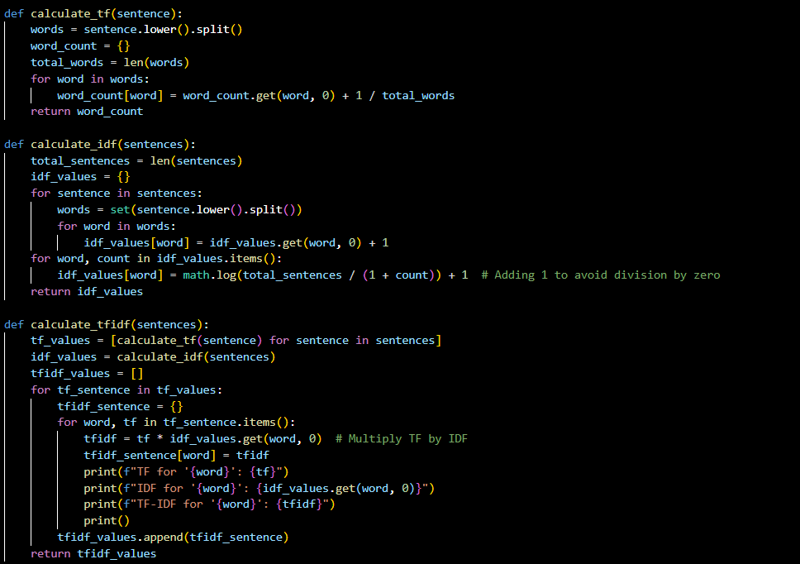
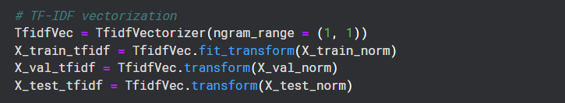
21AIE314 - AI in Natural Language Processing
Batch-A-Group-14
E-Commerce Product Categorization using NLP

Slide 30
21AIE314 - AI in Natural Language Processing
Bag of Words:
Definition:
Bag of Words (BoW) is a simple and widely used model in natural language processing (NLP) that represents text as a collection (bag) of words, disregarding grammar and word order but keeping multiplicity.
Purpose:
To convert text into numerical features that can be used in machine learning algorithms.
Example:
Documents:
Document 1: "The cat sat on the mat."
Document 2: "The dog sat on the log."
Vocabulary: [cat, dog, log, mat, on, sat, the]
 | cat | dog | log | mat | on | sat | The
Doc1 | 1 | 0 | 0 | 1 | 1 | 1 | 2
Doc2 | 0 | 1 | 1 | 0 | 1 | 1 | 2
Batch-A-Group-14
E-Commerce Product Categorization using NLP

Slide 31
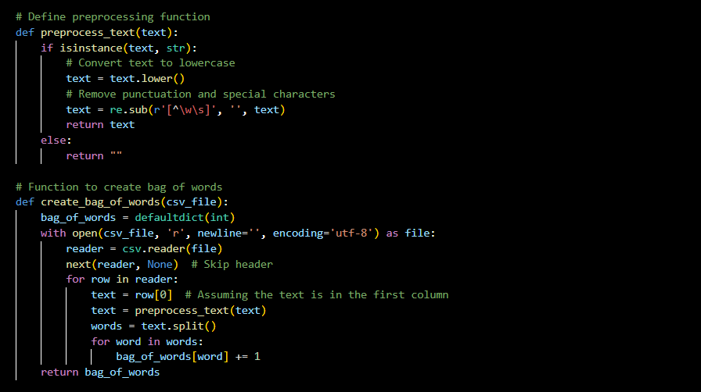
21AIE314 - AI in Natural Language Processing
Batch-A-Group-14
E-Commerce Product Categorization using NLP

Slide 32
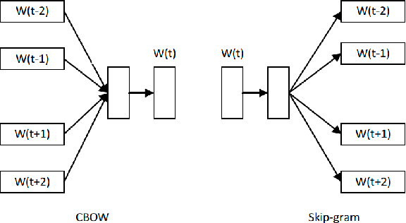
21AIE314 - AI in Natural Language Processing
Word2Vec:
Word2vec was created by a team from Google led by Tomas Mikolov in 2013
It is a shallow, two-layer neural network, trained to reconstruct linguistic contexts of words
Word2vec has two architectures:
1) Continuous Bag-of-Words,
2) Skip-gram
Batch-A-Group-14
E-Commerce Product Categorization using NLP

Slide 33

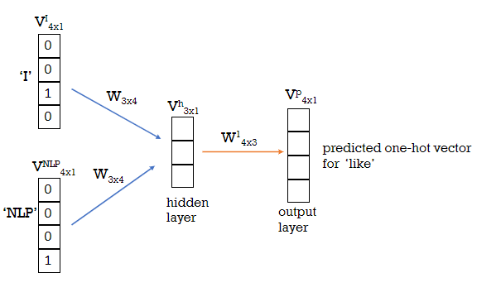
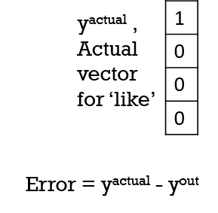
21AIE314 - AI in Natural Language Processing
CBOW:
Let us take a small vocabulary {like,topics, I, NLP}
Assume the corpus only contains one sentence, ‘I like NLP topics’
Let us select a window-size of 3
Batch-A-Group-14
E-Commerce Product Categorization using NLP

Slide 34
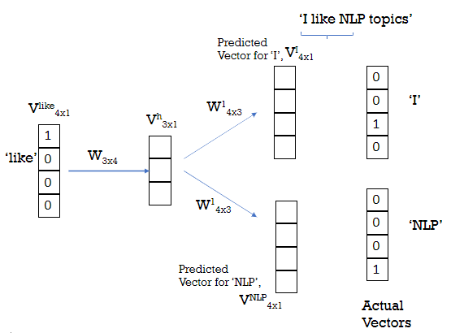
21AIE314 - AI in Natural Language Processing
Skip Gram:
Predict the context words from the target word
Batch-A-Group-14
E-Commerce Product Categorization using NLP

Slide 35
21AIE314 - AI in Natural Language Processing
To get word embedding of a particular word :
Updated weight matrix : W_{3x4}
1
0
0
0
w00 | w01 | w02 | w03
w10 | w11 | w12 | w13
w20 | w21 | w22 | w23
w00
w10
w20
x
=
Word vector or word embedding for that particular word
One hot vector of a particular word
Batch-A-Group-14
E-Commerce Product Categorization using NLP

Slide 36
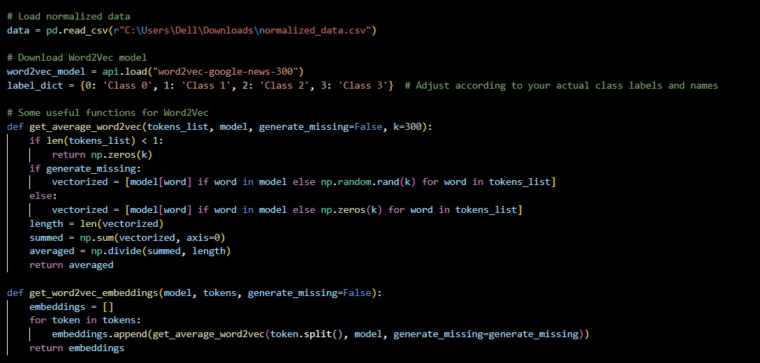
21AIE314 - AI in Natural Language Processing
Batch-A-Group-14
E-Commerce Product Categorization using NLP

Slide 37
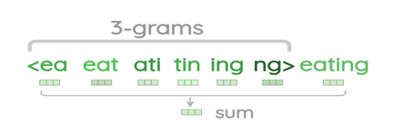
21AIE314 - AI in Natural Language Processing
FastText:
FastText is a library developed by Facebook’s AI Research (FAIR) lab for efficient learning of word representations and text classification.
Subword Information:
Unlike traditional Word2Vec, which learns embeddings for entire words, FastText breaks words into n-grams (subwords) and learns embeddings for these n-grams.
For example, consider word ‘eating ’
The approach appends start (<) and end (>)tags to the word, <eating>
The n-grams for n=3, fastText represent the word using
Batch-A-Group-14
E-Commerce Product Categorization using NLP

Slide 38
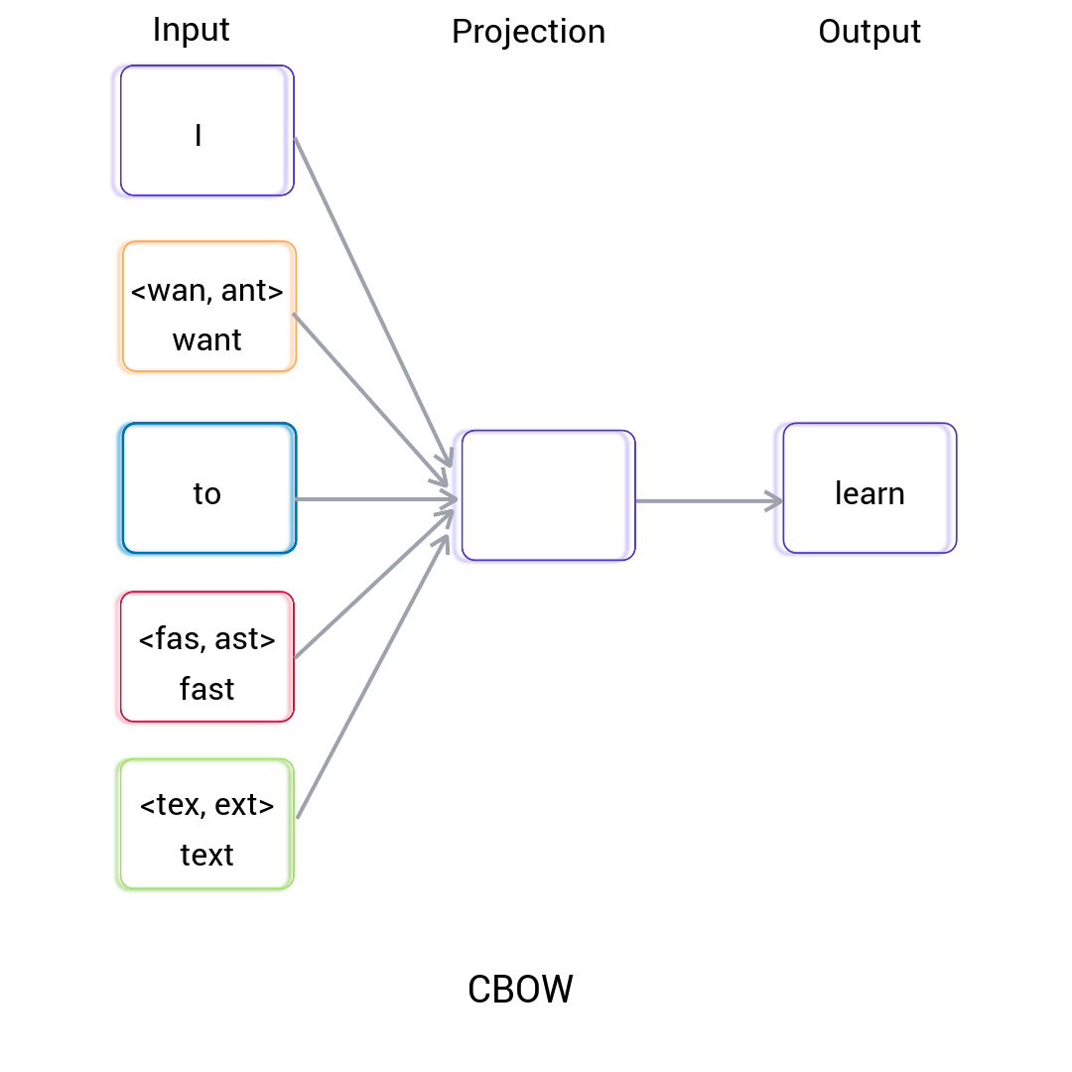
21AIE314 - AI in Natural Language Processing
FastText supports both CBOW and Skip-gram models.
Continuous Bag Of Words (CBOW):
we take the context of the target word as input and predict the word that occurs in the context.
For example, in the sentence “ I want to learn FastText.” In this sentence, the words “I,” “want,” “to,” and “FastText” are given as input, and the model predicts “learn” as output.
Batch-A-Group-14
E-Commerce Product Categorization using NLP

Slide 39
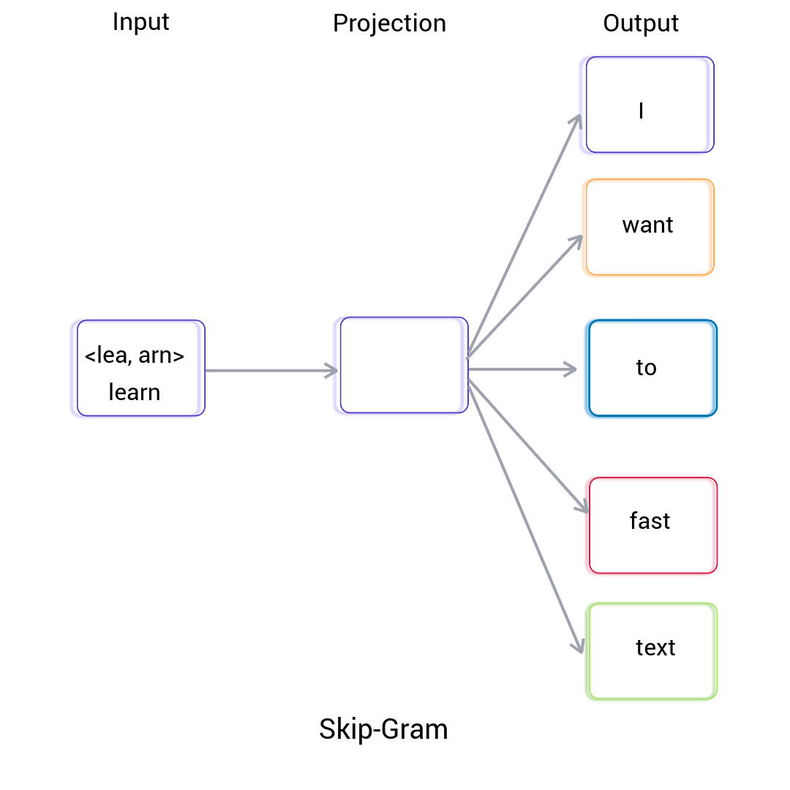
21AIE314 - AI in Natural Language Processing
Skip-gram works like CBOW, but the input is the target word, and the model predicts the context of the given the word. It also uses neural networks for training.
Batch-A-Group-14
E-Commerce Product Categorization using NLP

Slide 40
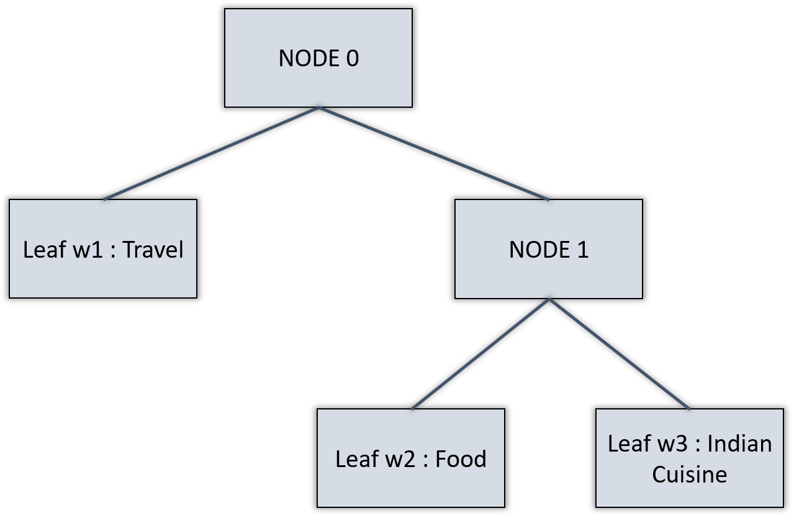
21AIE314 - AI in Natural Language Processing
Training Process:
FastText uses a hierarchical SoftMax or negative sampling to train word representations efficiently.
It optimizes a loss function to learn vector representations of words.
Hierarchical Classifier used by FastText:
In this method, it represents the labels in a binary tree. Every node in the binary tree represents a probability. A label is represented by the probability along the path to that given label. This means that the leaf nodes of the binary tree represent the labels.
Batch-A-Group-14
E-Commerce Product Categorization using NLP

Slide 41
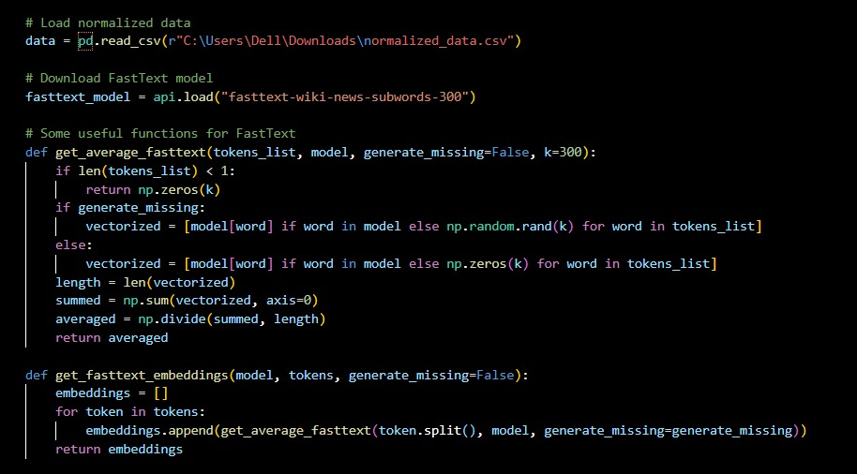
21AIE314 - AI in Natural Language Processing
Batch-A-Group-14
E-Commerce Product Categorization using NLP

Slide 42
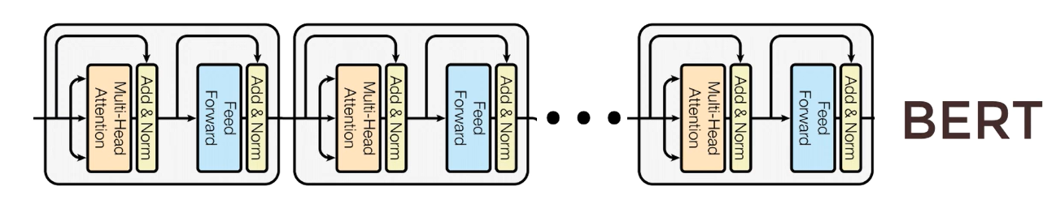
21AIE314 - AI in Natural Language Processing
BERT:
What is BERT?
BERT (Bidirectional Encoder Representations from Transformers) is a pre-trained transformer-based model introduced by Google in 2018.
It's designed to understand the bidirectional context of words in a sentence, capturing both left and right context simultaneously.
Key Features:
Utilizes a transformer architecture, which allows for parallel processing of words in a sentence.
Pre-trained on large corpora of text, enabling it to learn rich language representations.
Supports fine-tuning on specific downstream tasks with minimal task-specific architecture changes.
We are using BERT-base-uncased model. It has 12 Layers, 768 hidden, 12-heads and 110M parameters.
Stacking of Encoders part from Transformers:-
Batch-A-Group-14
E-Commerce Product Categorization using NLP

Slide 43
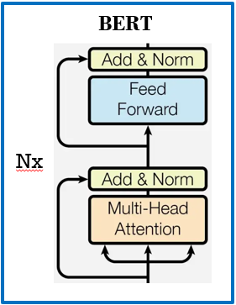
21AIE314 - AI in Natural Language Processing
Key Phases involving in BERT :
Pretraining – The goal is to make the BERT learn about the language and Context.
Finetuning
Pretraining:
Masked Language Model (MLM)
The [MASK1] brown fox [MASK2] over the lazy dog.
[MASK1] = quick [MASK2] = jumped
Next Sentence Prediction (NSP)
A: Vicky is a cool dude
B: He lives in Ohio
Yes, Sentence B follows Sentence A.
Batch-A-Group-14
E-Commerce Product Categorization using NLP

Slide 44
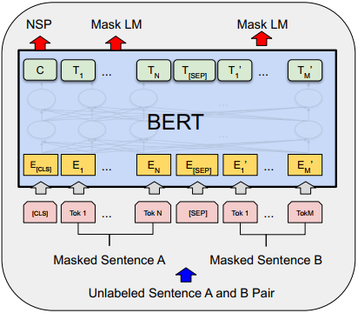
21AIE314 - AI in Natural Language Processing
Pretraining:
Binary Value C
Initial Embeddings
Word Token Inputs
Batch-A-Group-14
E-Commerce Product Categorization using NLP
Notes:
Each token is a word. Some tokens are masked.
These tokens are converted into embedding using pretrained embedding
Each T in the output side is the word vectors.

Slide 45
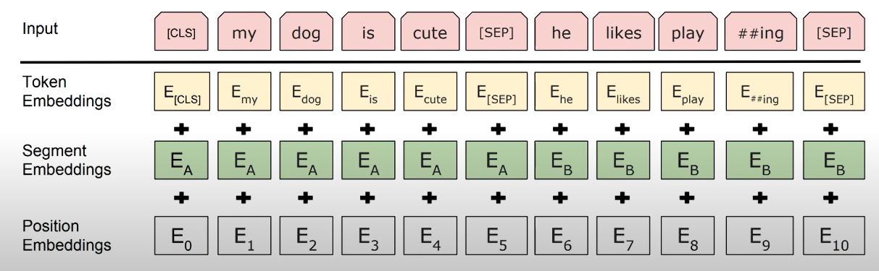
21AIE314 - AI in Natural Language Processing
How Tokens are converted into Initial Word embeddings?
Batch-A-Group-14
E-Commerce Product Categorization using NLP
Notes:
Token Embeddings – Wordpieces – 30k Vocabulary
Segment Embeddings - Sentence Number encoded into a Vector
Position of a word within that sentence that is encoded into that vector.

Slide 46
21AIE314 - AI in Natural Language Processing
Actual word (one hot encoded, 30,000 elements)
Compare with Cross Entropy Loss
For [MASK]ed words only
Softmax Layer with 30,000 neurons
Predicted Word
Batch-A-Group-14
E-Commerce Product Categorization using NLP
Notes:
All of the word vectors have same size and all of them are generated simultaneously
Once pretraining is completed the BERT now has an notion of the language.

Slide 47
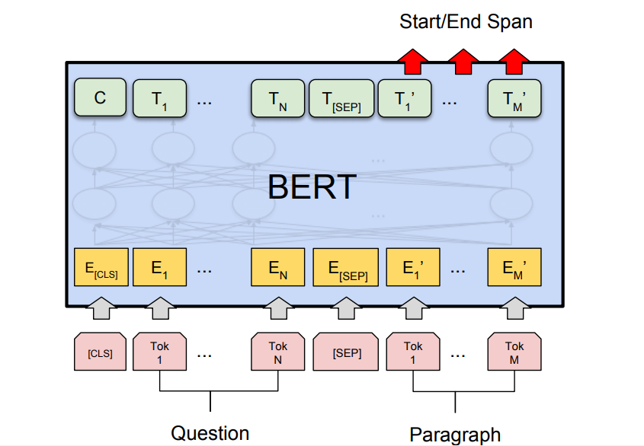
21AIE314 - AI in Natural Language Processing
Finetuning:
Batch-A-Group-14
E-Commerce Product Categorization using NLP
Notes:
Each token is a word. Some tokens are masked.
These tokens are converted into embedding using pretrained embedding
Each T in the output side is the word vectors.

Slide 48
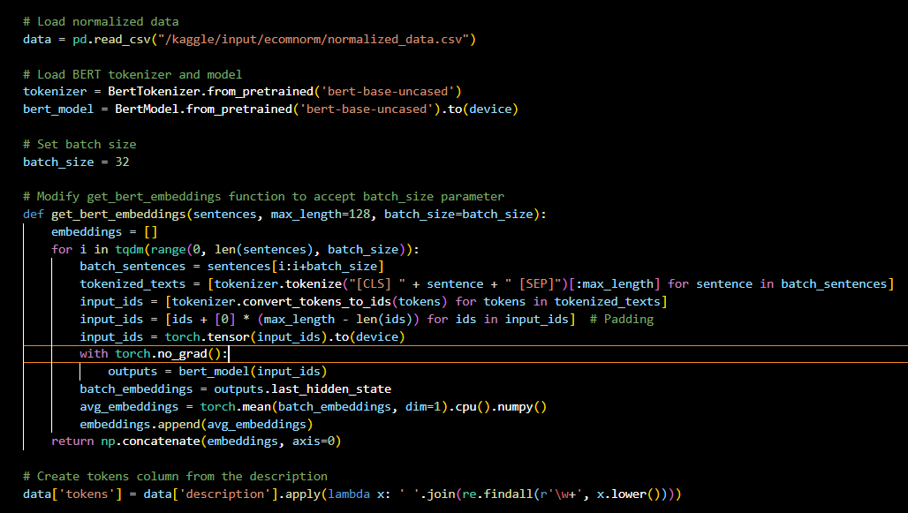
21AIE314 - AI in Natural Language Processing
Batch-A-Group-14
E-Commerce Product Categorization using NLP

Slide 49
21AIE314 - AI in Natural Language Processing
Thank You!
Batch-A-Group-14
E-Commerce Product Categorization using NLP

