Slide 1
21AIE312-Deep Learning for Signal and Image Processing End Semester Project Review Batch – A – Group – 14
Kidney Disease Classification using Deep Learning Architectures
Course Instructor:
Dr. Mithun Kumar Kar,
Department of AI,
Amrita School of Artificial Intelligence,
Coimbatore.

Slide 2
Kidney Disease Classification using Deep Learning Architectures
Team Members:
Names | Roll Numbers
Mummidi Devi Siva Rama Saran | CB.EN.U4AIE21034
Akshayaa B K | CB.EN.U4AIE21002
R Sai Raghavendra | CB.EN.U4AIE21049
N Poornima | CB.EN.U4AIE21042
Batch-A-Group-14

Slide 3
Kidney Disease Classification using Deep Learning Architectures
Introduction:
Early detection of kidney diseases is crucial for effective treatment and patient outcomes.
Using a Kaggle dataset containing CT images of kidneys classified as Normal, Cyst, Tumor, and Stone.
Aim: Develop a model to accurately classify different kidney conditions.
Enhances diagnostic accuracy, aiding healthcare professionals in early diagnosis.
Supports timely medical intervention, improving patient outcomes and reducing healthcare costs.
Methodology involves data preprocessing, model training, and evaluation.
Batch-A-Group-14

Slide 4
Kidney Disease Classification using Deep Learning Architectures
Dataset Description and Preparation:
The dataset initially comprised 12,446 CT scan images of kidneys, categorized into four classes: Normal (5,077 images), Cyst (3,709 images), Stone (1,377 images), and Tumor (2,283 images).
Upon analysis, a significant class imbalance was evident, with the Stone class having notably fewer images compared to others, potentially affecting the model's ability to accurately classify this class.
To address this imbalance, data augmentation techniques were employed specifically for the Stone class. These techniques included random horizontal and vertical flips, rotations up to 15 degrees, and adjustments to color jitter (brightness, contrast, saturation, hue).
The augmentation process effectively increased the number of images in the Stone class from 1,377 to 2,200, ensuring a more balanced representation of this class in the dataset.
Additionally, to create a balanced dataset for training and evaluation, the number of images in the Normal, Cyst, and Tumor classes were reduced to 2,200 each, aligning with the augmented size of the Stone class.
Consequently, the final dataset comprised 8,800 images in total, with each class (Normal, Cyst, Stone, Tumor) containing 2,200 images, providing a balanced foundation for training and evaluating the classification model.
Batch-A-Group-14

Slide 5
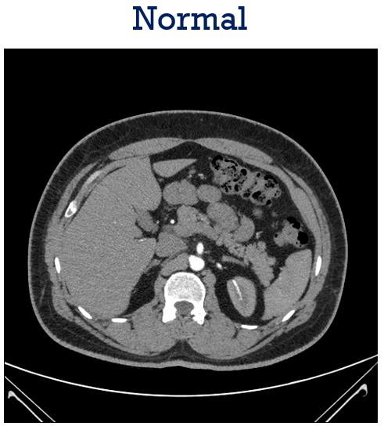
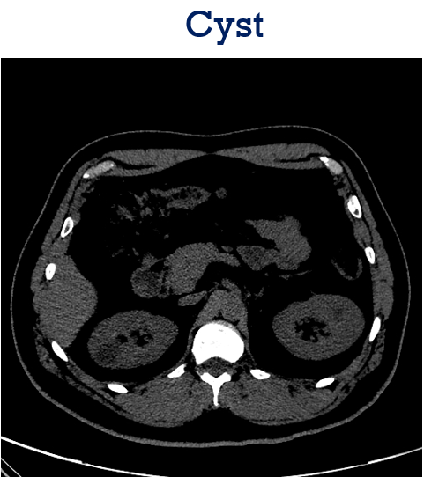
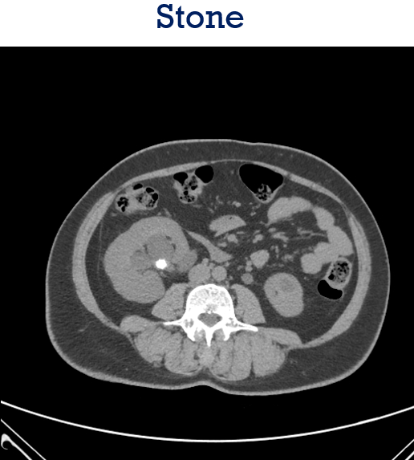
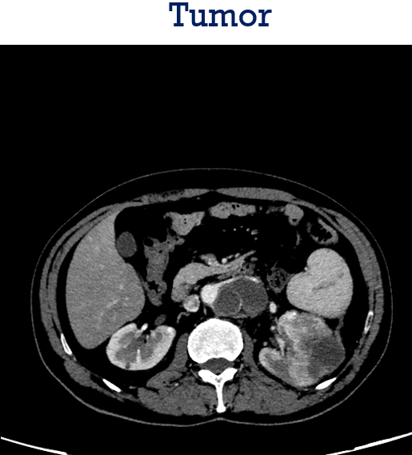
Kidney Disease Classification using Deep Learning Architectures
Dataset Description and Preparation:
Batch-A-Group-14

Slide 6
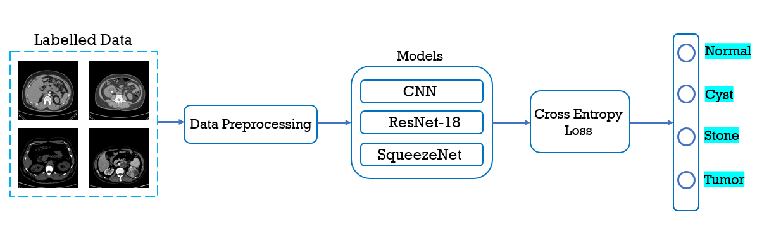
Kidney Disease Classification using Deep Learning Architectures
Flow Diagram of Proposed Approach:
Batch-A-Group-14

Slide 7
Kidney Disease Classification using Deep Learning Architectures
Models:
CNN (Convolutional Neural Network):
Employs alternating convolutional and pooling layers to extract hierarchical features.
Utilizes fully connected layers for classification tasks at the end of the network.
ResNet18 (Residual Network):
Introduces residual connections enabling the training of very deep networks.
Achieves state-of-the-art performance on image classification tasks with relatively fewer parameters.
SqueezeNet:
Features "fire modules" combining squeeze and expand layers to minimize parameters.
Employs 1x1 convolutions to reduce the number of input channels before applying larger convolutional kernels, reducing computational cost.
Efficiently utilizes model compression techniques to achieve lightweight yet accurate deep neural networks.
Batch-A-Group-14

Slide 8
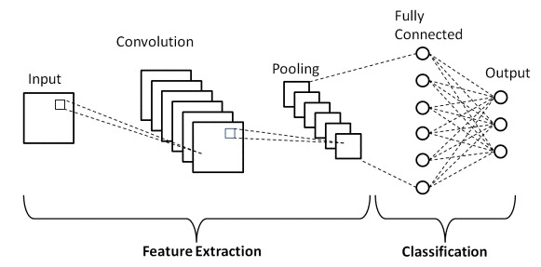
Kidney Disease Classification using Deep Learning Architectures
Model Architecture - CNN:
Batch-A-Group-14
Notes:
Input Image (3 channels)
Conv1 (32 filters, 3×3)
ReLU
Max Pooling (2×2)
Conv2 (64 filters, 3×3)
ReLU
Max Pooling (2×2)
Conv3 (128 filters, 3×3)
ReLU
Max Pooling (2×2)
Fully Connected Layers
Flatten
FC1 (512 units)
ReLU
Dropout FC2(4 units)

Slide 9
Kidney Disease Classification using Deep Learning Architectures
Layers description in CNN
Layer | Filter Size | Input Size | Output Size
Input | - | 512x512x3 | 224x224x3
Conv2D_1 | 3x3 | 224x224x3 | 224x224x32
MaxPooling2D_1 | 2x2 | 224x224x32 | 112x112x32
Conv2D_2 | 3x3 | 112x112x32 | 112x112x64
MaxPooling2D_2 | 2x2 | 112x112x64 | 56x56x64
Conv2D_3 | 3x3 | 56x56x64 | 56x56x128
MaxPooling2D_3 | 2x2 | 56x56x128 | 28x28x128
Flatten | - | 28x28x128 | 100352
Fully Connected (FC1) | - | 100352 | 512
Dropout | - | 512 | 512
Fully Connected (FC2) | - | 512 | 4
Batch-A-Group-14
Notes:
Input Image (3 channels)
Conv1 (32 filters, 3×3)
ReLU
Max Pooling (2×2)
Conv2 (64 filters, 3×3)
ReLU
Max Pooling (2×2)
Conv3 (128 filters, 3×3)
ReLU
Max Pooling (2×2)
Fully Connected Layers
Flatten
FC1 (512 units)
ReLU
Dropout FC2(4 units)

Slide 10
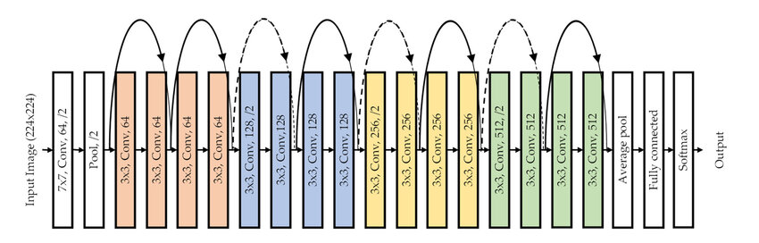
Kidney Disease Classification using Deep Learning Architectures
Model Architecture – ResNet18:
Batch-A-Group-14

Slide 11
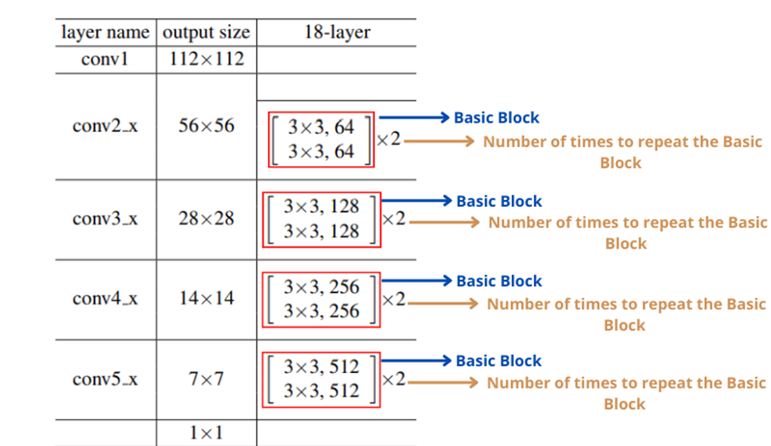
Kidney Disease Classification using Deep Learning Architectures
Model Architecture – ResNet18:
7 x 7, 64, stride 2, padding 3
3 x 3 max pool, stride 2
Batch-A-Group-14

Slide 12
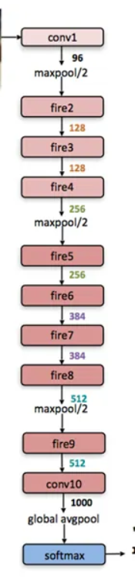
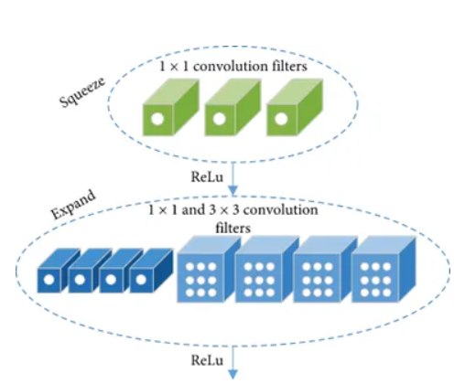
Kidney Disease Classification using Deep Learning Architectures
Model Architecture - SqueezeNet:
Fire module
Batch-A-Group-14

Slide 13
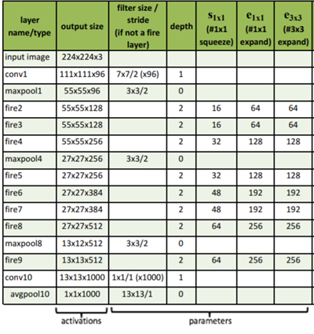
Kidney Disease Classification using Deep Learning Architectures
Model Architecture - SqueezeNet:
Batch-A-Group-14

Slide 14
Kidney Disease Classification using Deep Learning Architectures
Simulation Architecture:
Platform & Tools:
Library: PyTorch
Platform: Kaggle
Hardware: P100 GPU acceleration
Hyperparameters:
Optimizer: ADAM
Learning Rate: 0.001
Batch size: 32
Training Parameters:
Epochs: 100
Dropout Value: 0.5
Batch-A-Group-14

Slide 15
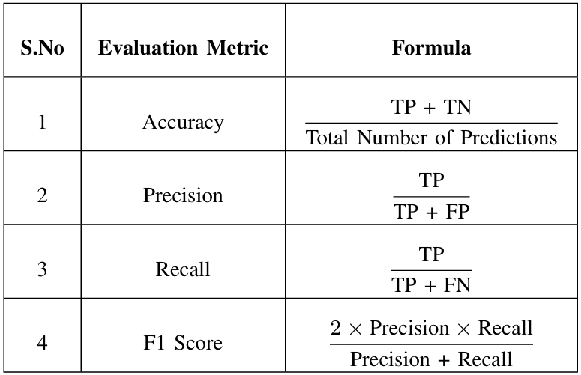
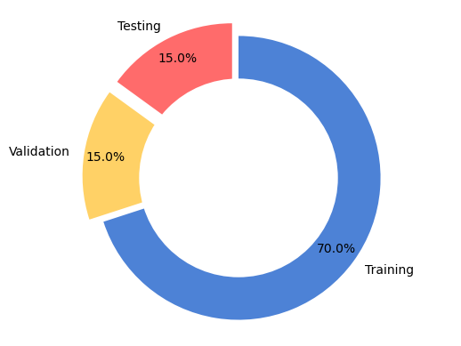
Kidney Disease Classification using Deep Learning Architectures
Data Split and Evaluation Metrics:
Batch-A-Group-14

Slide 16
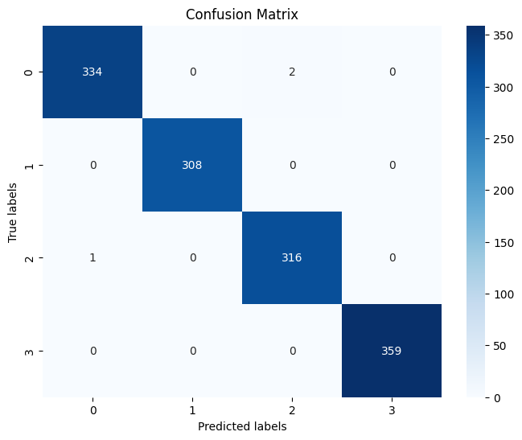
Kidney Disease Classification using Deep Learning Architectures
Results and Discussions - CNN:
Accuracy | 0.9977
Precision | 0.9976
Recall | 0.9977
F1-Score | 0.9977
Batch-A-Group-14

Slide 17
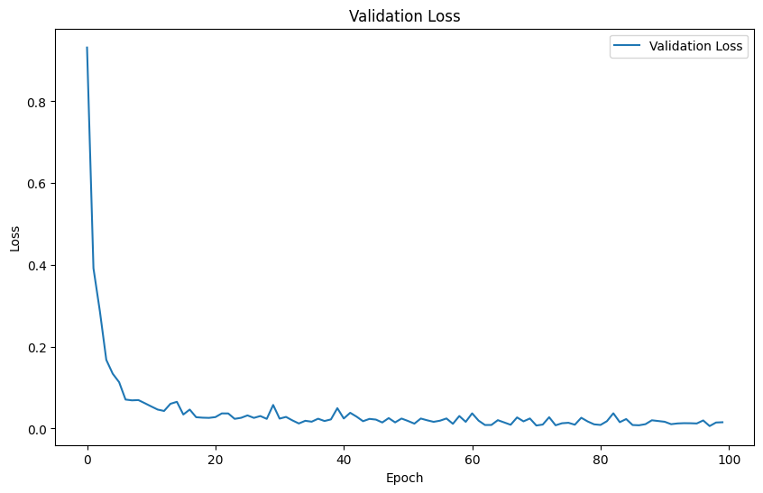
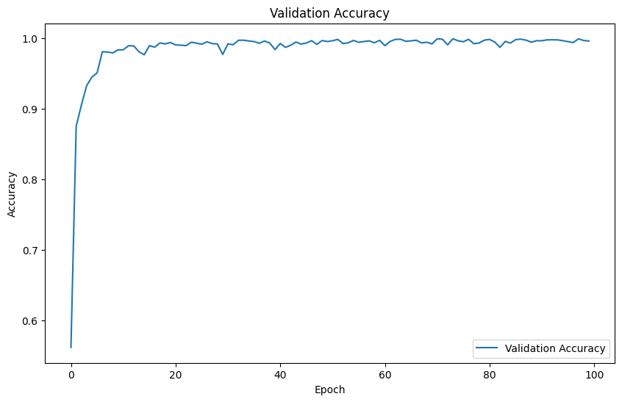
Kidney Disease Classification using Deep Learning Architectures
Results and Discussions - CNN:
Batch-A-Group-14

Slide 18
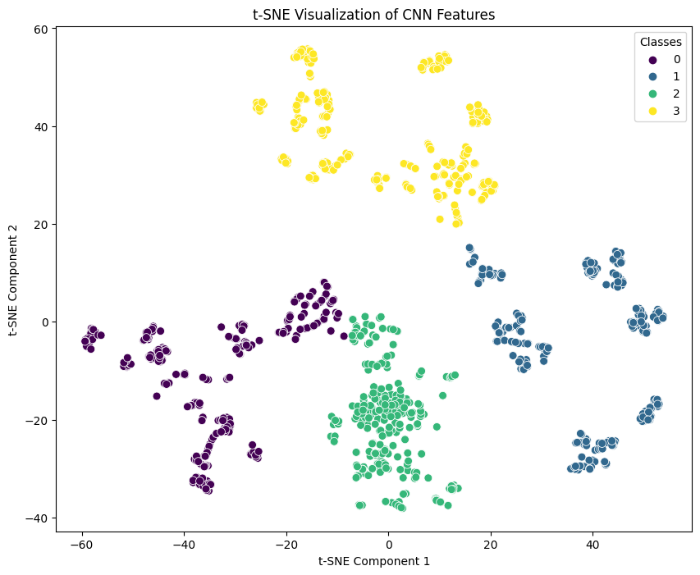
Kidney Disease Classification using Deep Learning Architectures
Results and Discussions - CNN:
Batch-A-Group-14

Slide 19

Kidney Disease Classification using Deep Learning Architectures
Results and Discussions – ResNet18:
Accuracy | 0.9992
Precision | 0.9992
Recall | 0.9991
F1-Score | 0.9991
Batch-A-Group-14

Slide 20
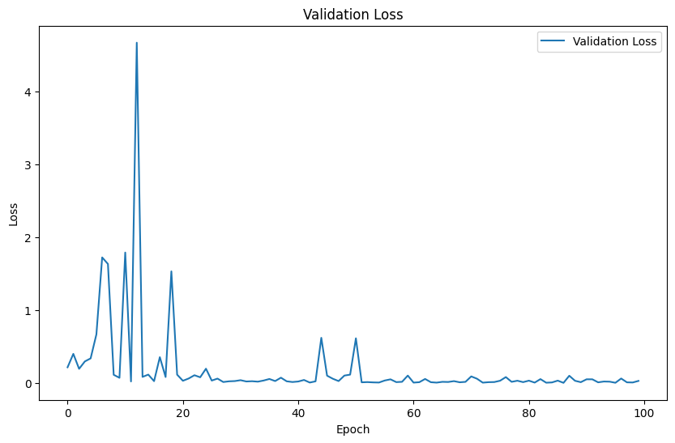
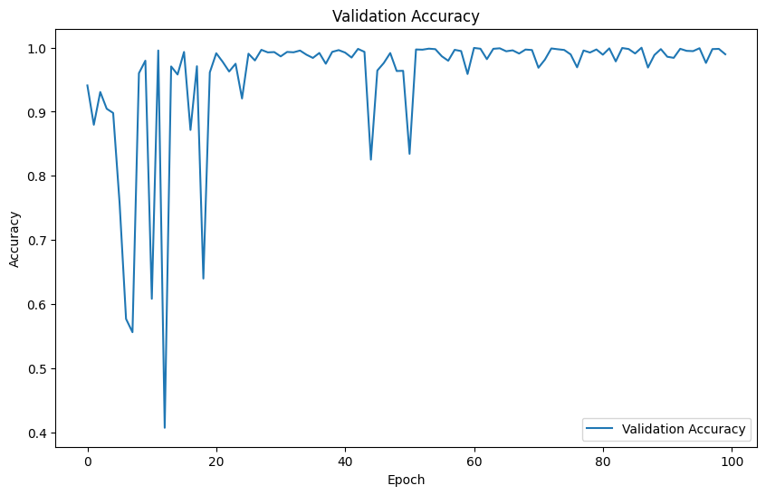
Kidney Disease Classification using Deep Learning Architectures
Results and Discussions – ResNet18:
Batch-A-Group-14

Slide 21
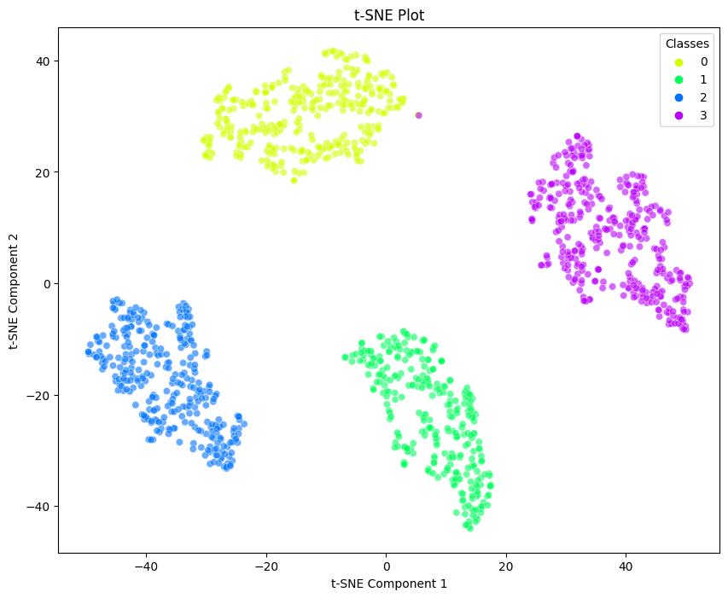
Kidney Disease Classification using Deep Learning Architectures
Results and Discussions – ResNet18:
Batch-A-Group-14

Slide 22

Kidney Disease Classification using Deep Learning Architectures
Results and Discussions - SqueezeNet:
Accuracy | 0.9977
Precision | 0.9977
Recall | 0.9976
F1-Score | 0.9975
Batch-A-Group-14

Slide 23
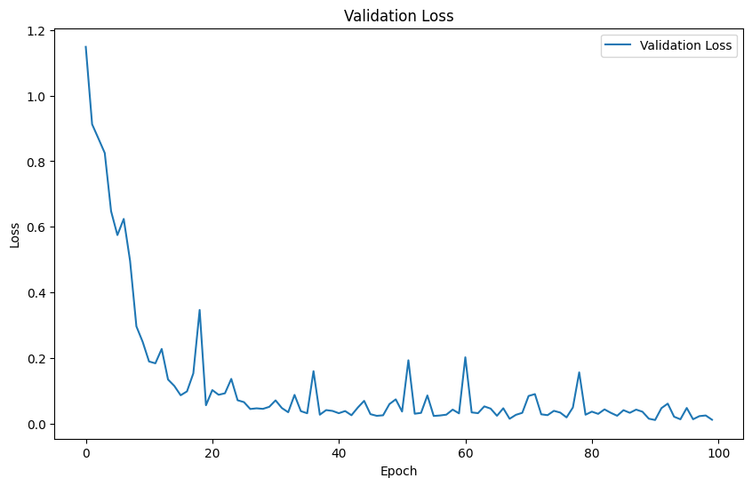
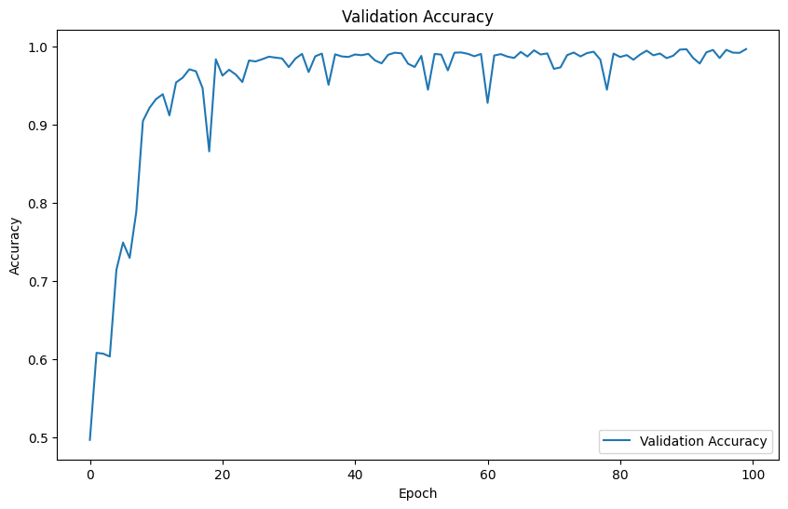
Kidney Disease Classification using Deep Learning Architectures
Results and Discussions - SqueezeNet:
Batch-A-Group-14

Slide 24
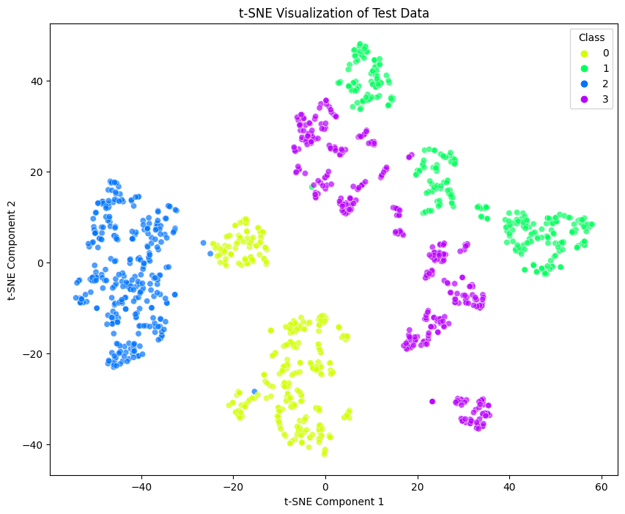
Kidney Disease Classification using Deep Learning Architectures
Results and Discussions - SqueezeNet:
Batch-A-Group-14

