Slide 1
21AIE305 – Introduction to Cloud Computing End Semester Project Review Batch – A – Group – 14
Kidney Cloud Care: Harnessing the Power of the Cloud for Lifesaving Diagnostics
Course Instructor:
Mr. Ranjith,
Department of AI,
Amrita School of Artificial Intelligence,
Coimbatore.

Slide 2
Kidney Cloud Care: Harnessing the Power of the Cloud for Lifesaving Diagnostics
Team Members:
Names | Roll Numbers
Mummidi Devi Siva Rama Saran | CB.EN.U4AIE21034
Akshayaa B K | CB.EN.U4AIE21002
R Sai Raghavendra | CB.EN.U4AIE21049
N Poornima | CB.EN.U4AIE21042
Batch-A-Group-14

Slide 3
Kidney Cloud Care: Harnessing the Power of the Cloud for Lifesaving Diagnostics
Introduction:
Kidney CloudCare is a cloud-based project aimed at detecting kidney disease using a deep learning model deployed on AWS EC2.
The model has been trained on a dataset containing both normal and tumor kidney samples, allowing it to effectively differentiate between healthy and diseased tissue.
By leveraging AWS cloud services and a continuous integration/continuous deployment (CI/CD) pipeline through GitHub Actions, the project ensures a streamlined and efficient deployment process.
The deployment pipeline includes several key steps: creating an IAM user with specific access permissions, establishing an ECR repository to store the Docker image, launching an EC2 instance, installing Docker, and configuring the EC2 instance as a self-hosted runner for GitHub Actions.
Sensitive information is securely managed using GitHub Secrets. The deployment process involves building a Docker image of the application, pushing it to the ECR repository, launching the EC2 instance, pulling the Docker image from ECR, and running the image on EC2 to deploy the kidney disease detection application.
This project showcases the integration of cloud computing and machine learning to provide a scalable, reliable, and efficient solution for kidney disease detection, leveraging AWS services to enhance healthcare diagnostics.
Batch-A-Group-14

Slide 4
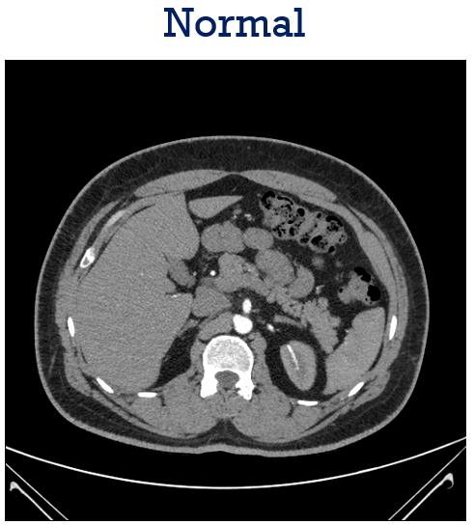
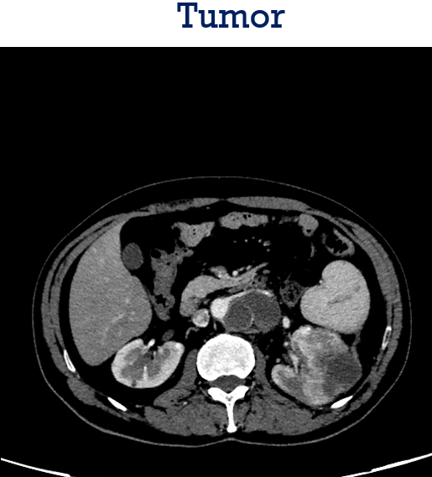
Kidney Cloud Care: Harnessing the Power of the Cloud for Lifesaving Diagnostics
Data
Batch-A-Group-14

Slide 5
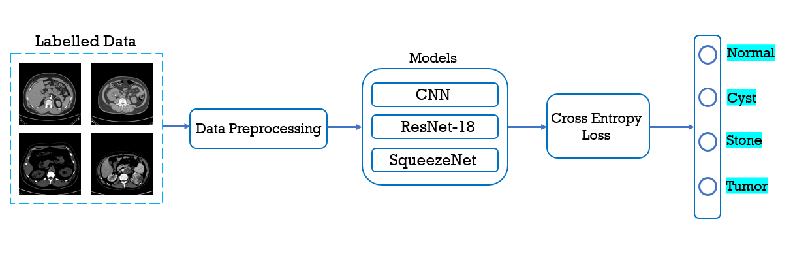
Kidney Cloud Care: Harnessing the Power of the Cloud for Lifesaving Diagnostics
Flow Diagram of Proposed Approach:
ResNet18
VGG16
Batch-A-Group-14

Slide 6


Kidney Cloud Care: Harnessing the Power of the Cloud for Lifesaving Diagnostics
FrontEnd
HTML: Foundational markup language for creating web page structures, providing building blocks like headings, paragraphs, links, images, and forms.
CSS: Style sheet language for controlling the layout, colors, fonts, and visual appearance of web pages, separating content from design for a clean codebase.
Batch-A-Group-14

Slide 7


Kidney Cloud Care: Harnessing the Power of the Cloud for Lifesaving Diagnostics
Backend
Python: High-level programming language known for readability and simplicity, used for server-side logic, handling frontend requests, and database interactions.
Flask: Lightweight Python web framework providing essentials for web development, such as routing and request handling, ideal for small to medium-sized applications.
Batch-A-Group-14

Slide 8

Kidney Cloud Care: Harnessing the Power of the Cloud for Lifesaving Diagnostics
Containerization
Docker: A platform that enables developers to package applications and their dependencies into portable containers. Docker ensures consistency across different environments (development, testing, production) by encapsulating the application along with its libraries, dependencies, and runtime environment. Containers are lightweight, isolated, and can be easily deployed and scaled.
Batch-A-Group-14

Slide 9

Kidney Disease Classification using Deep Learning Architectures
CI/CD Pipeline
GitHub Actions Setup: Setting up GitHub Actions for continuous integration and delivery.
GitHub Repository Configuration: Configuring the GitHub repository to work with the CI/CD pipeline.
Continuous Integration: Automating the integration of code changes, running tests, and building the application using GitHub Actions.
Batch-A-Group-14

Slide 10
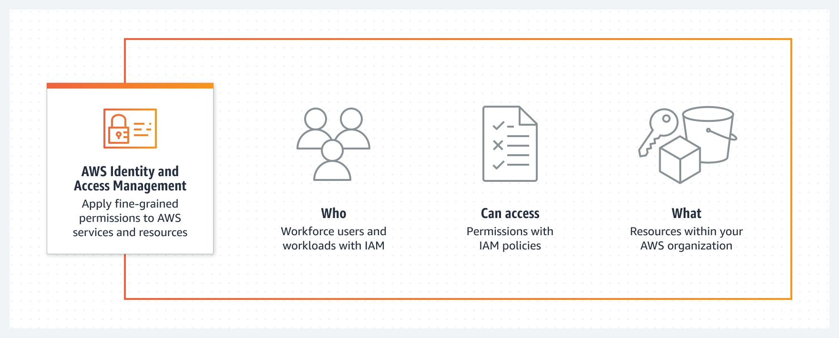
Kidney Disease Classification using Deep Learning Architectures
AWS – Identity and Access Management
Batch-A-Group-14

Slide 11
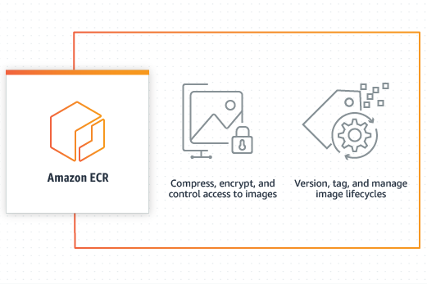
Kidney Disease Classification using Deep Learning Architectures
Amazon Elastic Container Registry
Batch-A-Group-14

Slide 12
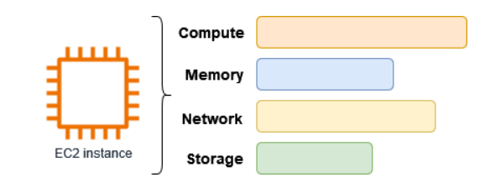
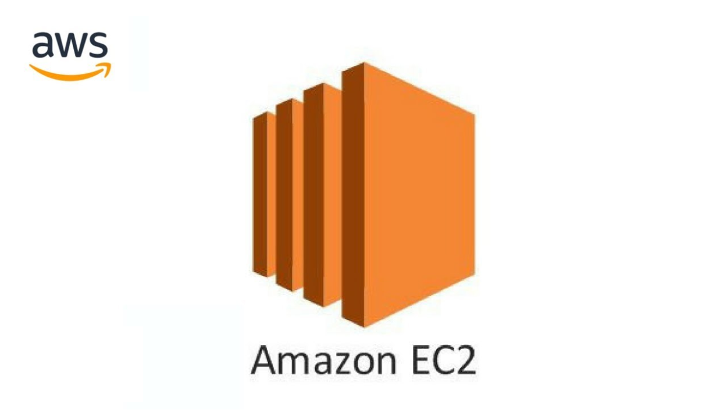
Kidney Disease Classification using Deep Learning Architectures
Amazon Elastic Compute Cloud (Amazon EC2)
Batch-A-Group-14

Slide 13
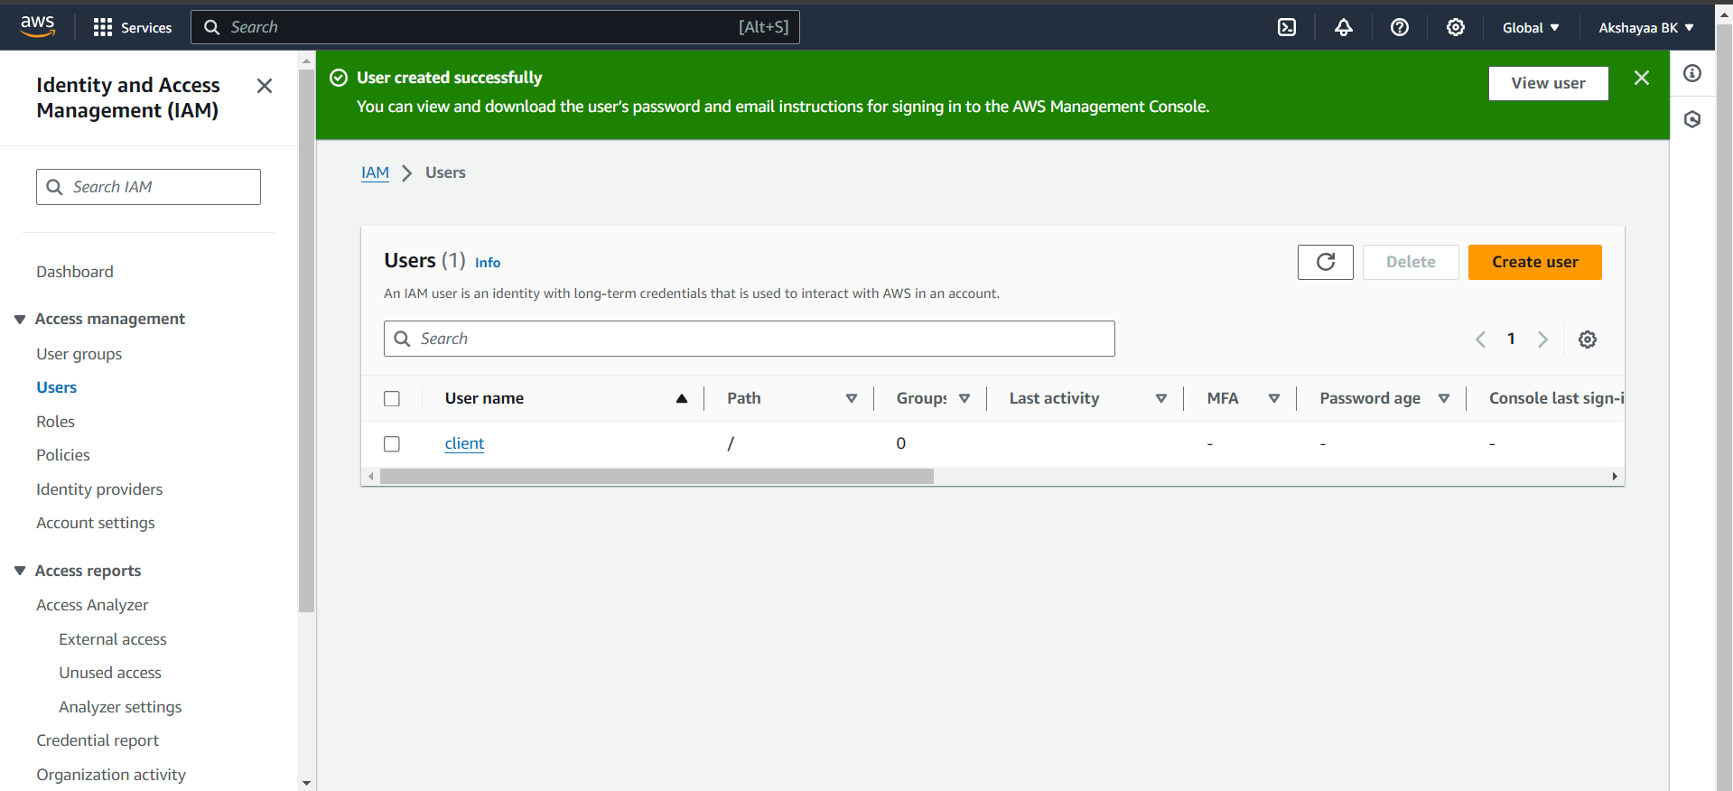
Kidney Disease Classification using Deep Learning Architectures
AWS SETUP
1) IAM User Setup: Setting up an Identity and Access Management (IAM) user in AWS to manage permissions and security.
Batch-A-Group-14

Slide 14
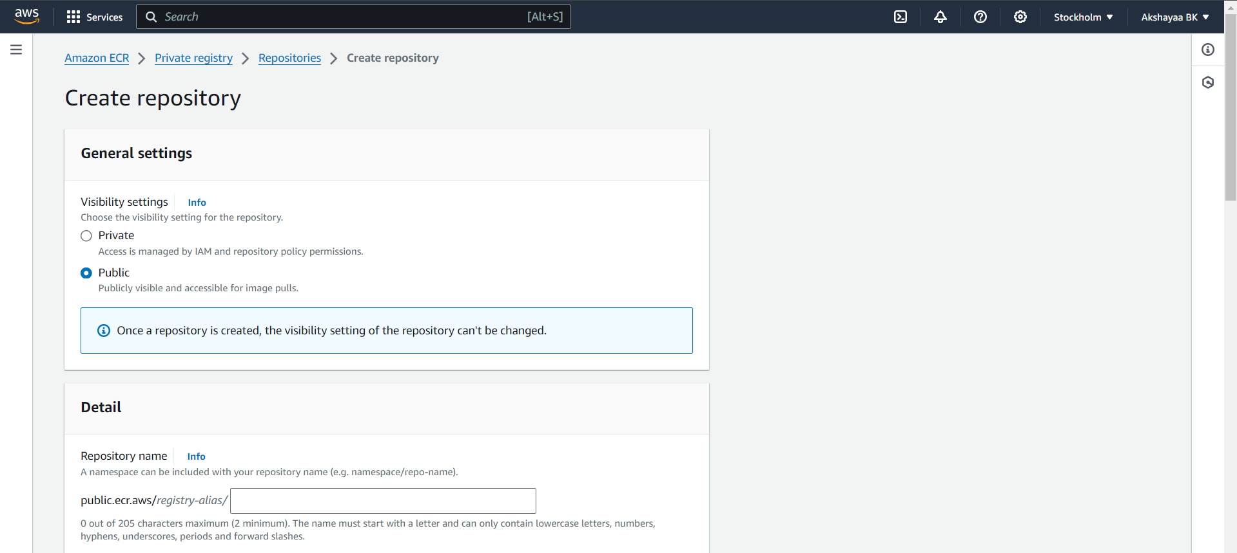
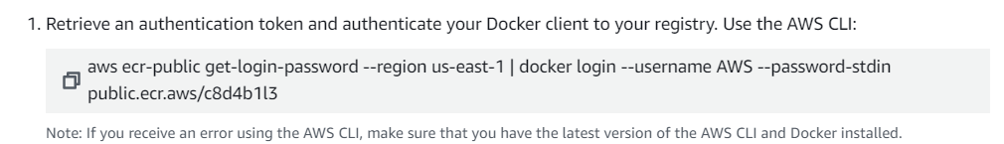
Kidney Disease Classification using Deep Learning Architectures
2) Docker Image Push to ECR: Pushing the Docker image to Amazon Elastic Container Registry (ECR), a fully managed Docker container registry.
Batch-A-Group-14

Slide 15
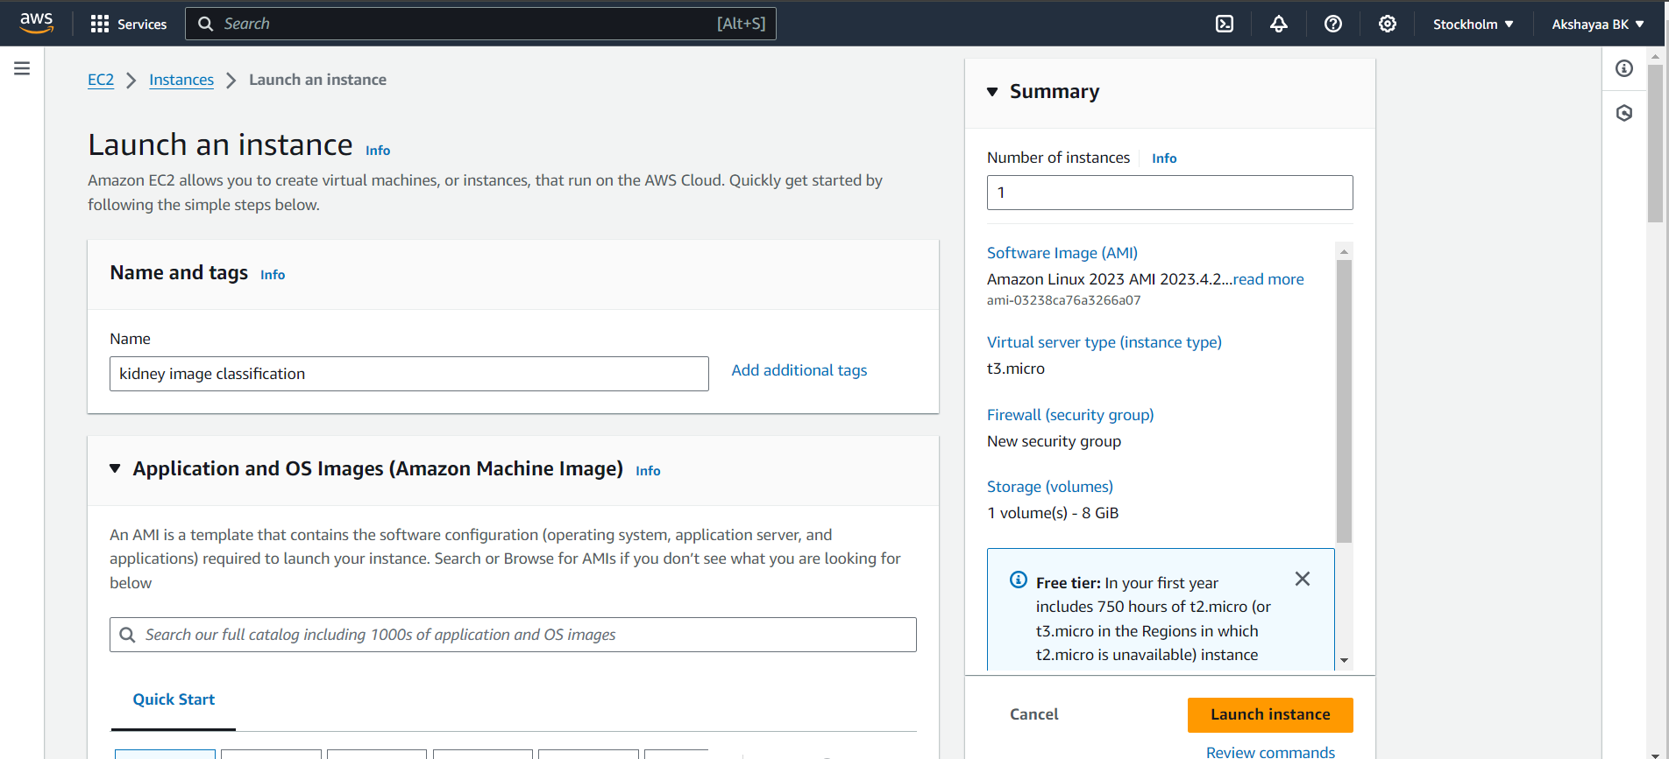
Kidney Disease Classification using Deep Learning Architectures
3) EC2 Instance Setup: Configuring an Amazon EC2 instance, which is a virtual server in Amazon's Elastic Compute Cloud.
Batch-A-Group-14

Slide 16
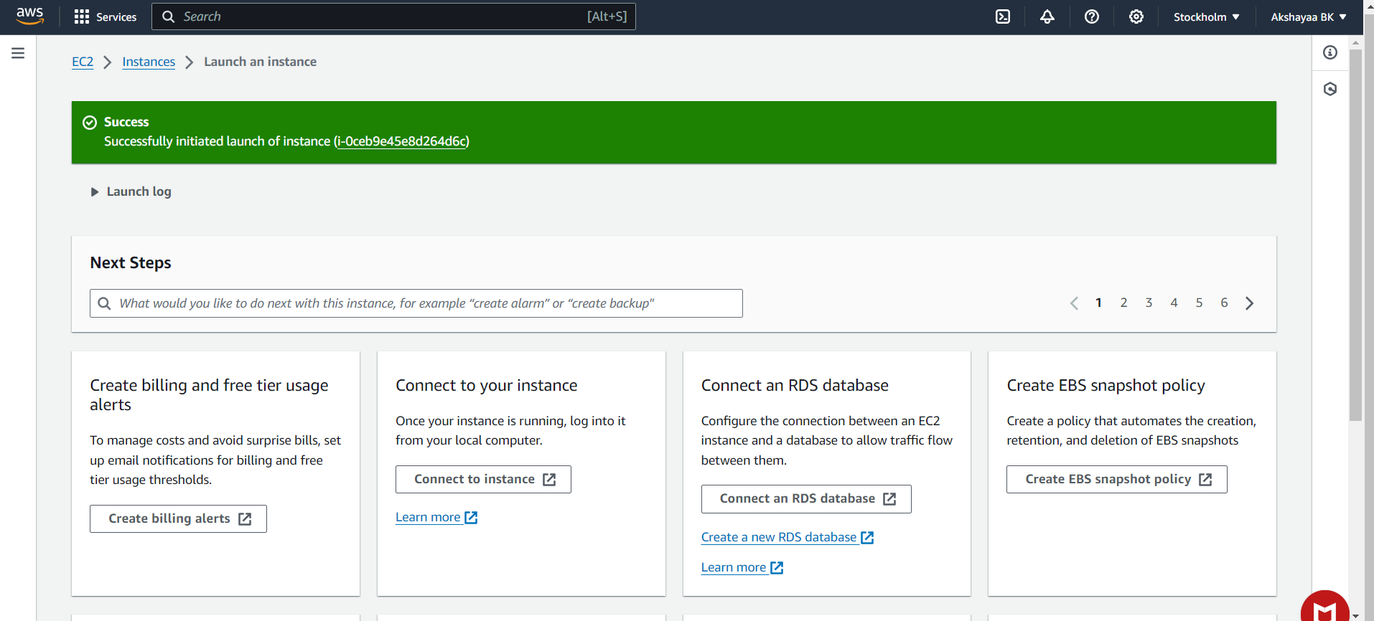
Kidney Disease Classification using Deep Learning Architectures
Batch-A-Group-14

Slide 17
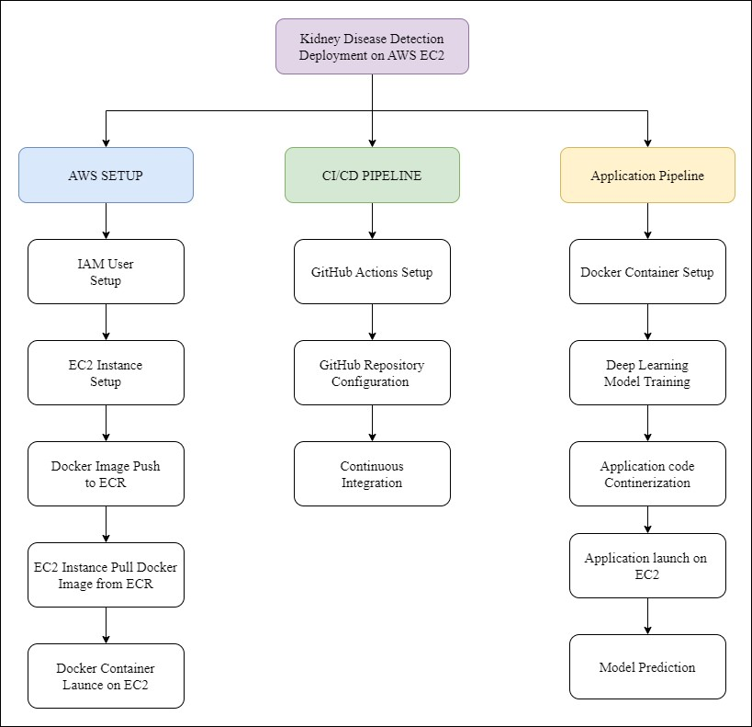
Kidney Cloud Care: Harnessing the Power of the Cloud for Lifesaving Diagnostics
Flow Diagram of Proposed Approach :
Batch-A-Group-14

Slide 18
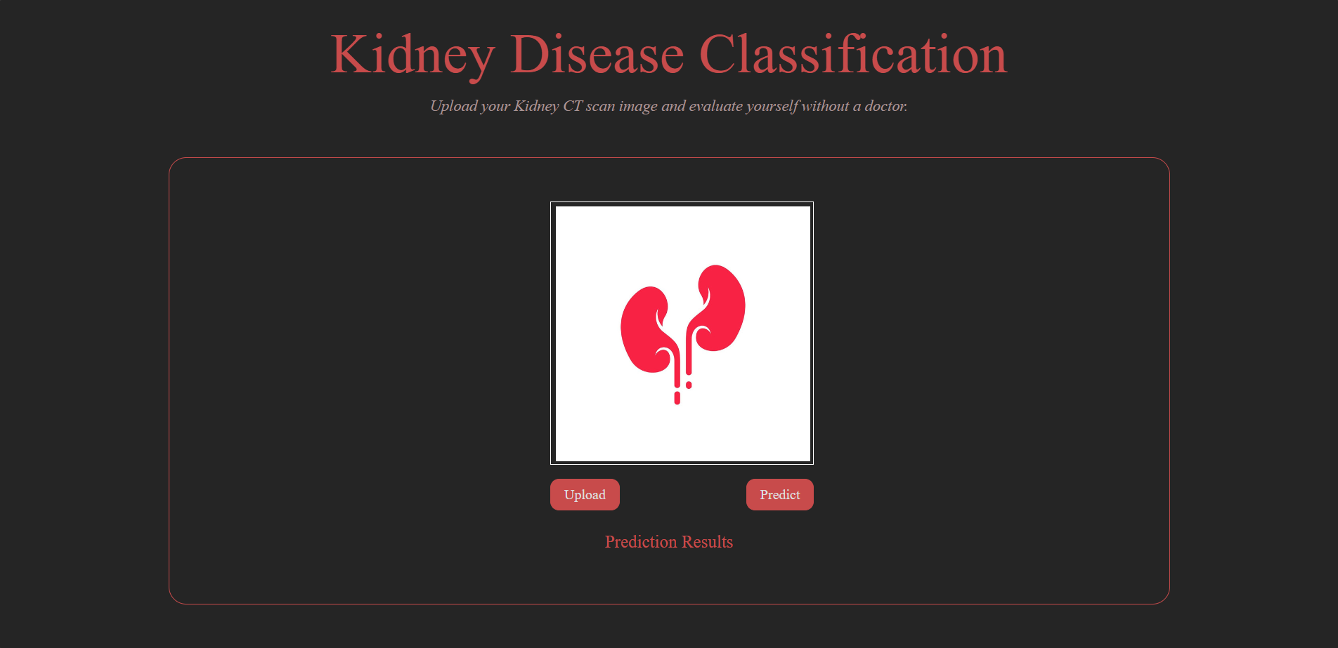
Kidney Disease Classification using Deep Learning Architectures
Batch-A-Group-14

Slide 19
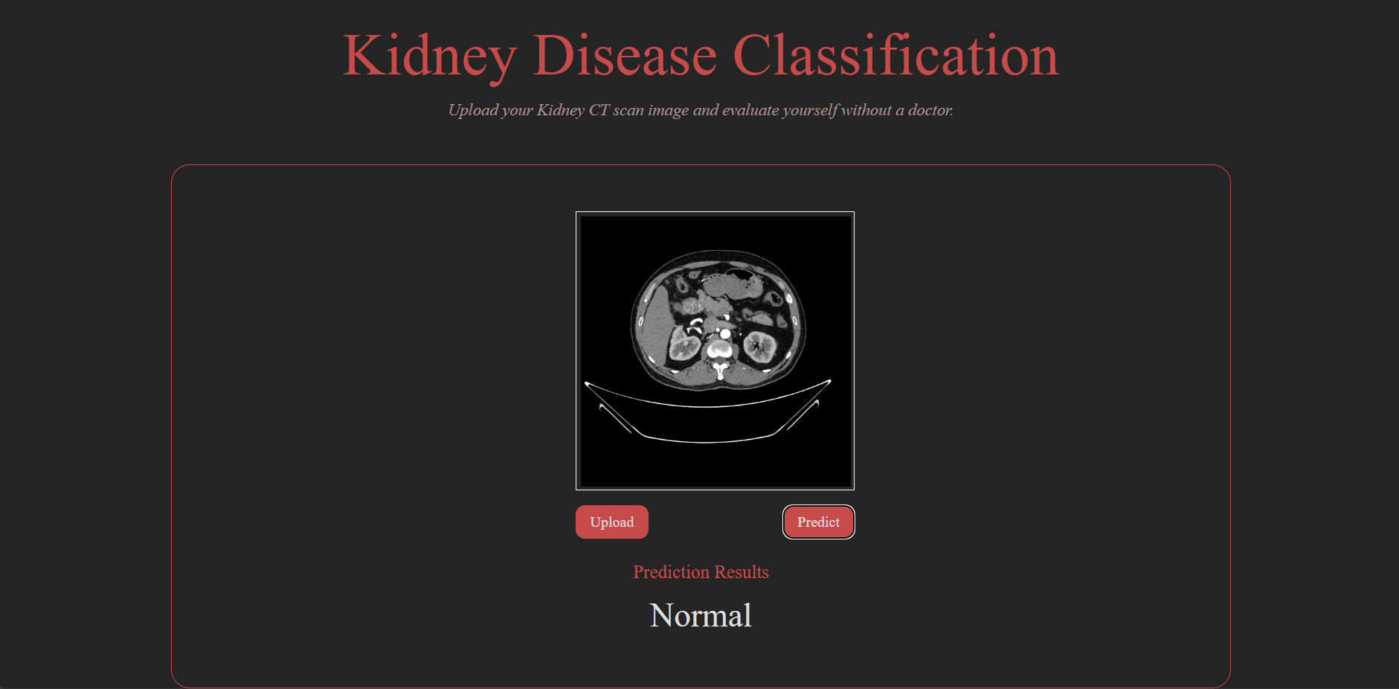
Kidney Disease Classification using Deep Learning Architectures
Batch-A-Group-14

Slide 20
Kidney Disease Classification using Deep Learning Architectures
Batch-A-Group-14

