Slide 1
Sivaranjani T
Final Project
3/21/2024 Annual Review

Slide 2
OBJECT DETECTION USING OPENCV
3/21/2024 Annual Review

Slide 3


AGENDA
Problem Statement
Project Overview
Who are the end users?
Solution and its values
The wow in my solution
Modelling
Results.
3/21/2024 Annual Review

Slide 4

PROBLEM STATEMENT
Develop a real-time object detection system using OpenCV that can accurately detect and localize objects within images or video streams.
The system should be capable of running in real-time on resource-constrained devices such as embedded systems or mobile devices while maintaining high accuracy and performance.
3/21/2024 Annual Review

Slide 5

PROJECT OVERVIEW
The primary objective of this project is to implement object detection using the OpenCV (Open Source Computer Vision) library.
Object detection is a fundamental task in computer vision that involves identifying and locating objects within an image or video frame.
OpenCV provides a robust framework for developing computer vision applications, making it an ideal choice for this project.
3/21/2024 Annual Review

Slide 6

WHO ARE THE END USERS?
Facial Recognition
Traffic Management
Agriculture
Sports Analytics
Augmented Reality
Industrial Automation
Surveillance Systems.
3/21/2024 Annual Review

Slide 7

YOUR SOLUTION AND ITS VALUE PROPOSITION
Community Support and Documentation
Rich Set of Features
Integration with Other Libraries and Frameworks
Versatility Across Platforms
Performance and Efficiency.
3/21/2024 Annual Review

Slide 8

THE WOW IN YOUR SOLUTION
Real-Time Performance
Accuracy and Reliability
Scalability and Flexibility
Ease of Use and Rapid Prototyping
Cross-Domain Applications
Integration with Emerging Technologies
Community Innovation and Collaboration.
3/21/2024 Annual Review
8

Slide 9
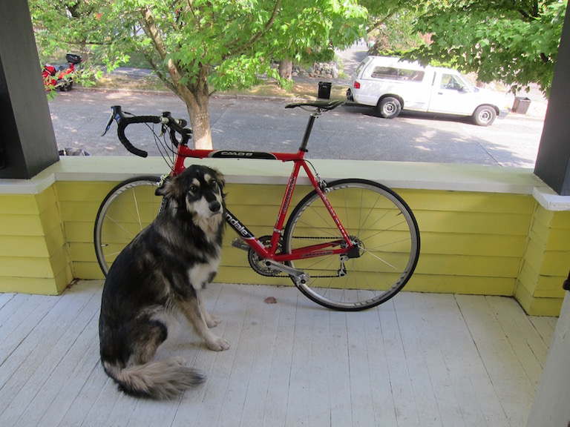
MODELLING
3/21/2024 Annual Review
9

Slide 10
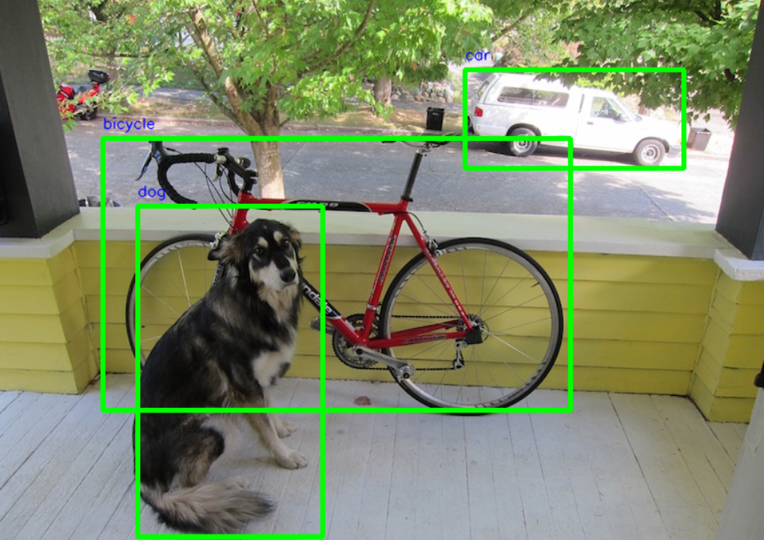
RESULTS
Demo Link
3/21/2024 Annual Review
10

