Slide 1

Decy Jarald 1768722
Sivaranjane Anandakrishnan 1876942

Slide 2
INTRODUCTION
Kitchen Inventory management system to keep track of your inventory and offer centralised view.
Effectively and Efficiently utilise the stock.
Calculate food cost.
Help you out in the smooth running of your kitchen.

Slide 3
WHY DO WE NEED THIS?
Automatic Management of stock.
Time saving in maintaining the records.
Tracking of expiry dates.
Control your costs.
Tracking near by supermarkets with GPS enable.

Slide 4
REQUIREMENTS
LANGUAGE - JAVA
DATABASE - SQLite
PLATFORM - ANDROID STUDIO 4
OS SUPPORT - ANDROID 11

Slide 5
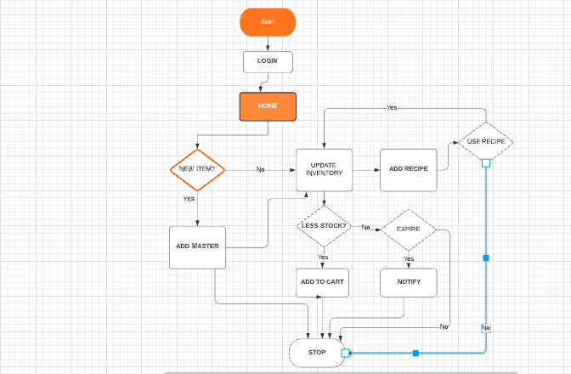
Functional Flow

Slide 6
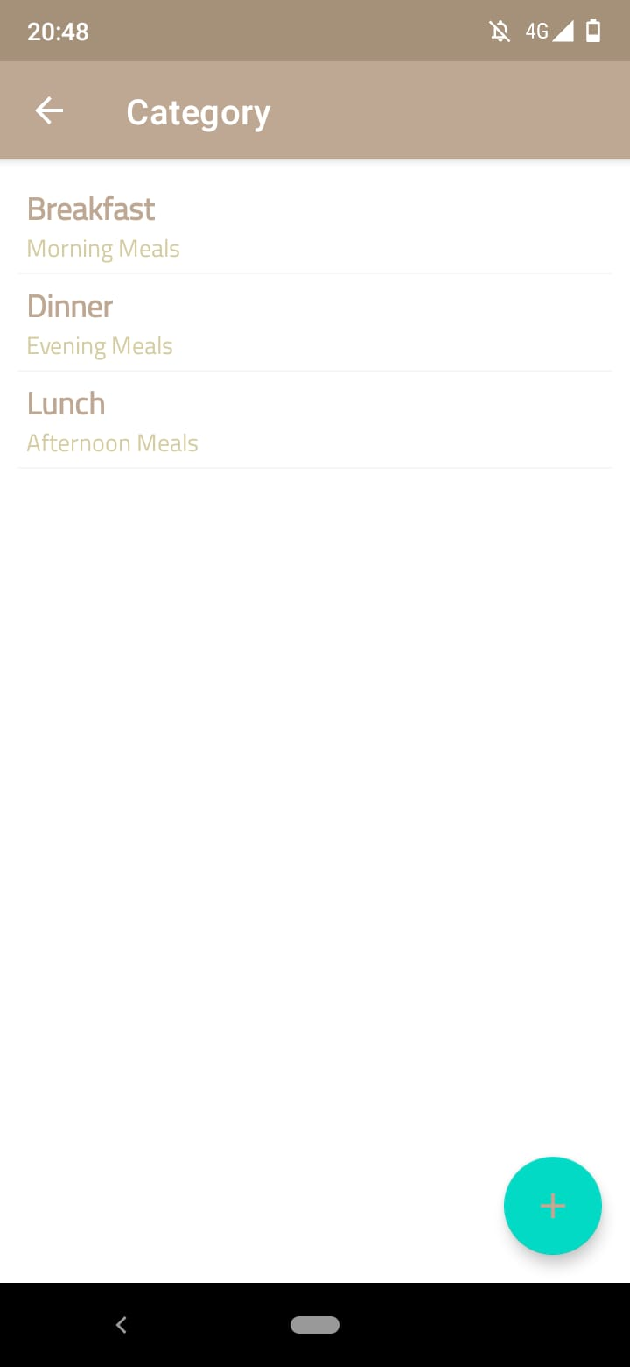
CATEGORY

Slide 7
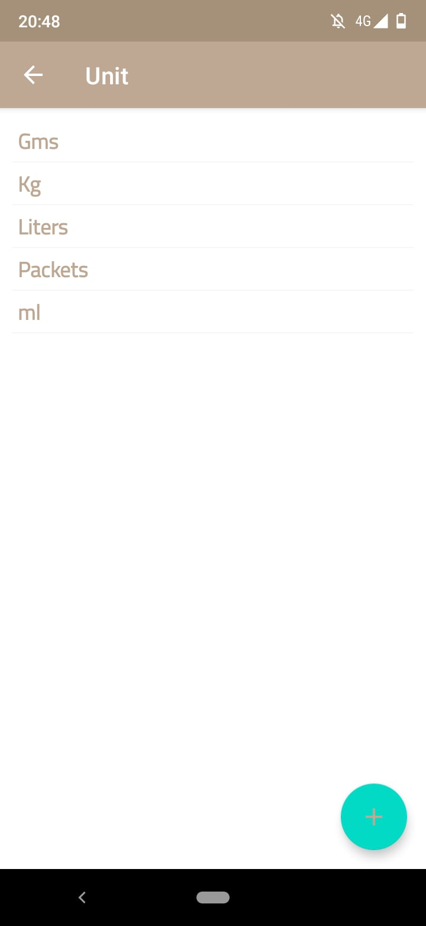
UNITS

Slide 8
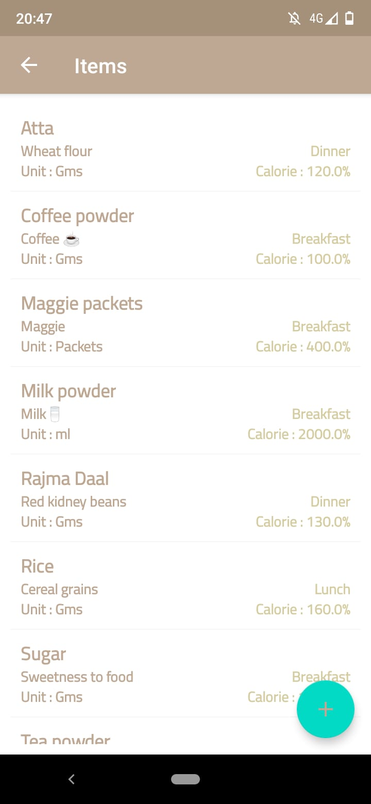
ITEMS

Slide 9
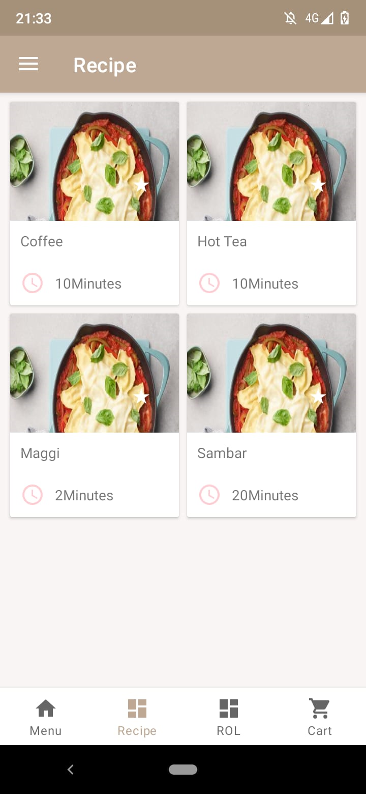
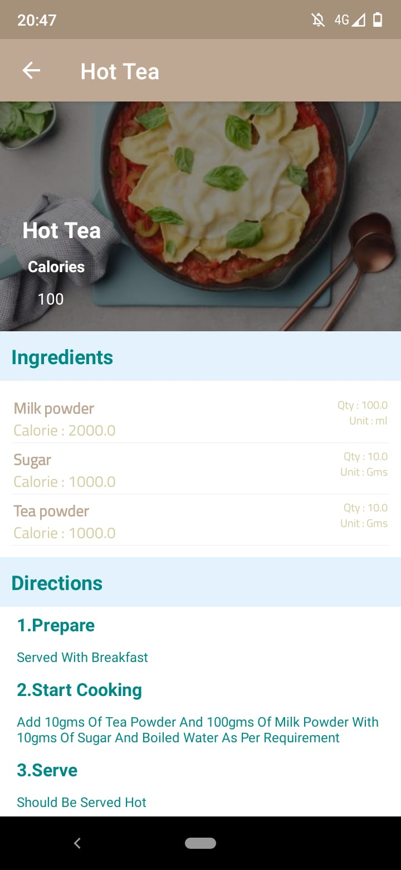
RECIPE

Slide 10
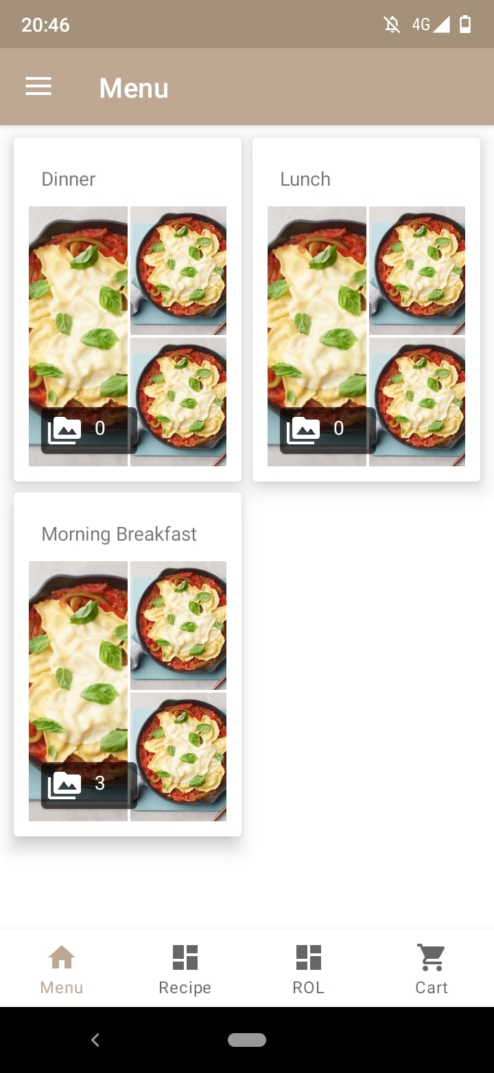
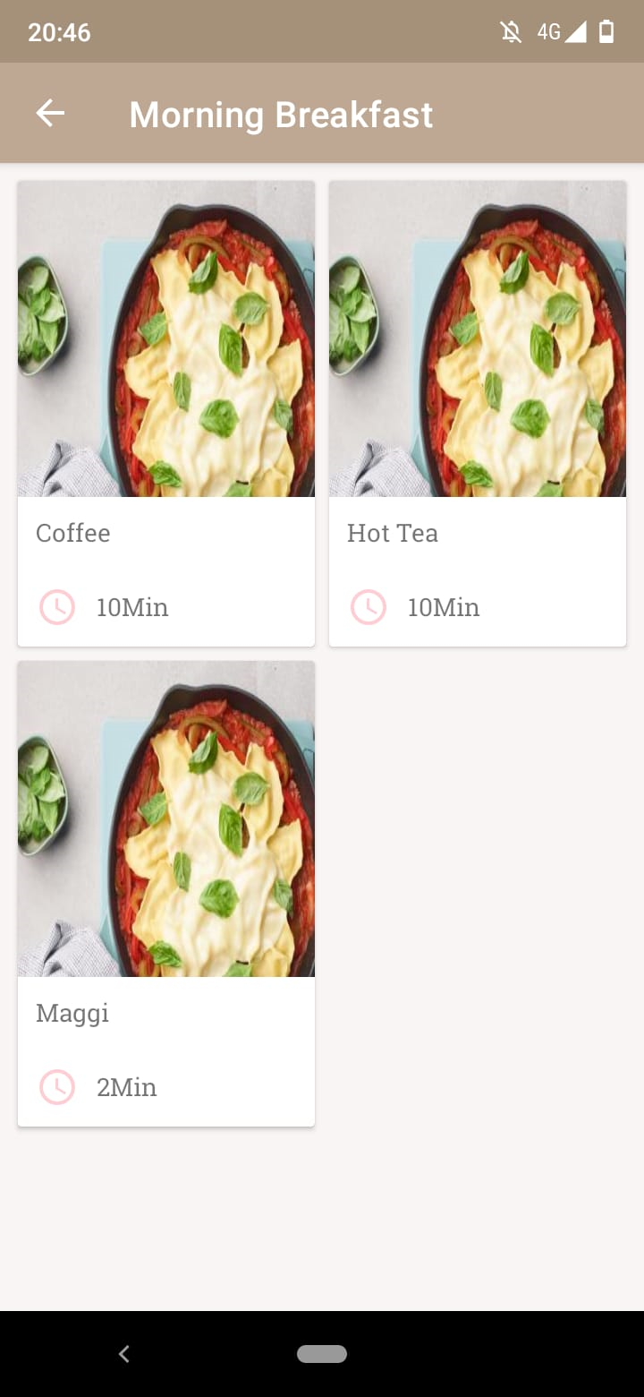
MENU

Slide 11
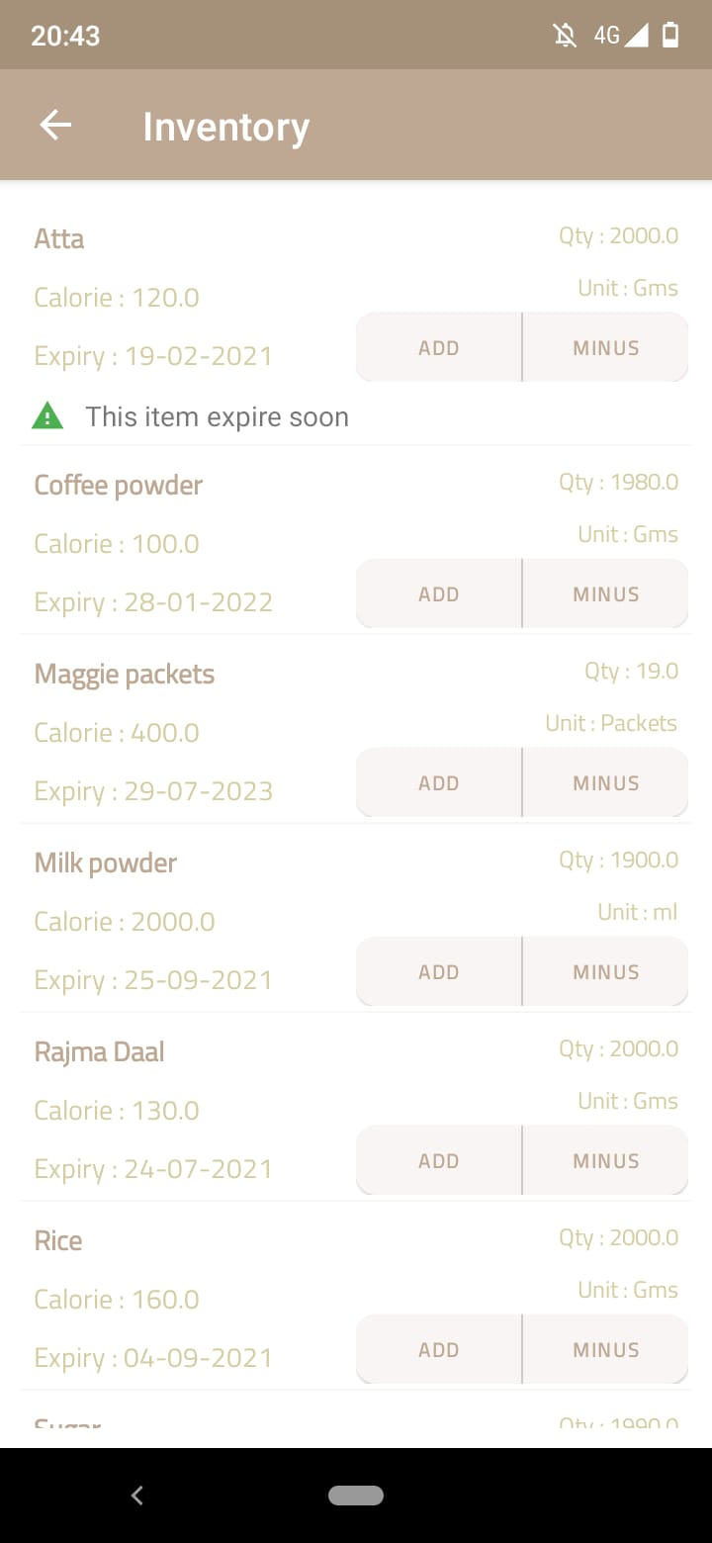
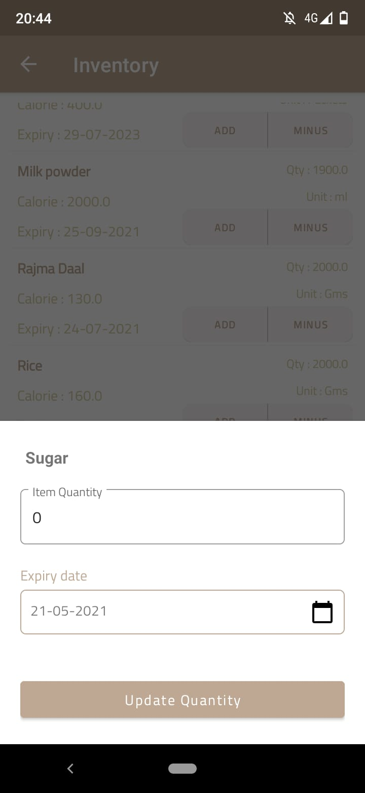
MY INVENTORY

Slide 12
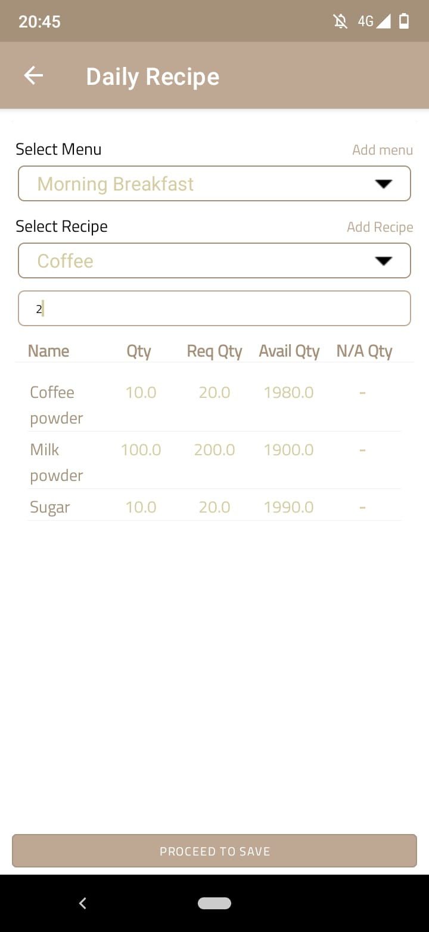
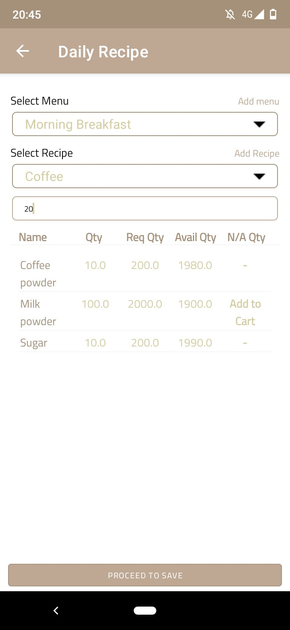
DAILY RECIPE

Slide 13
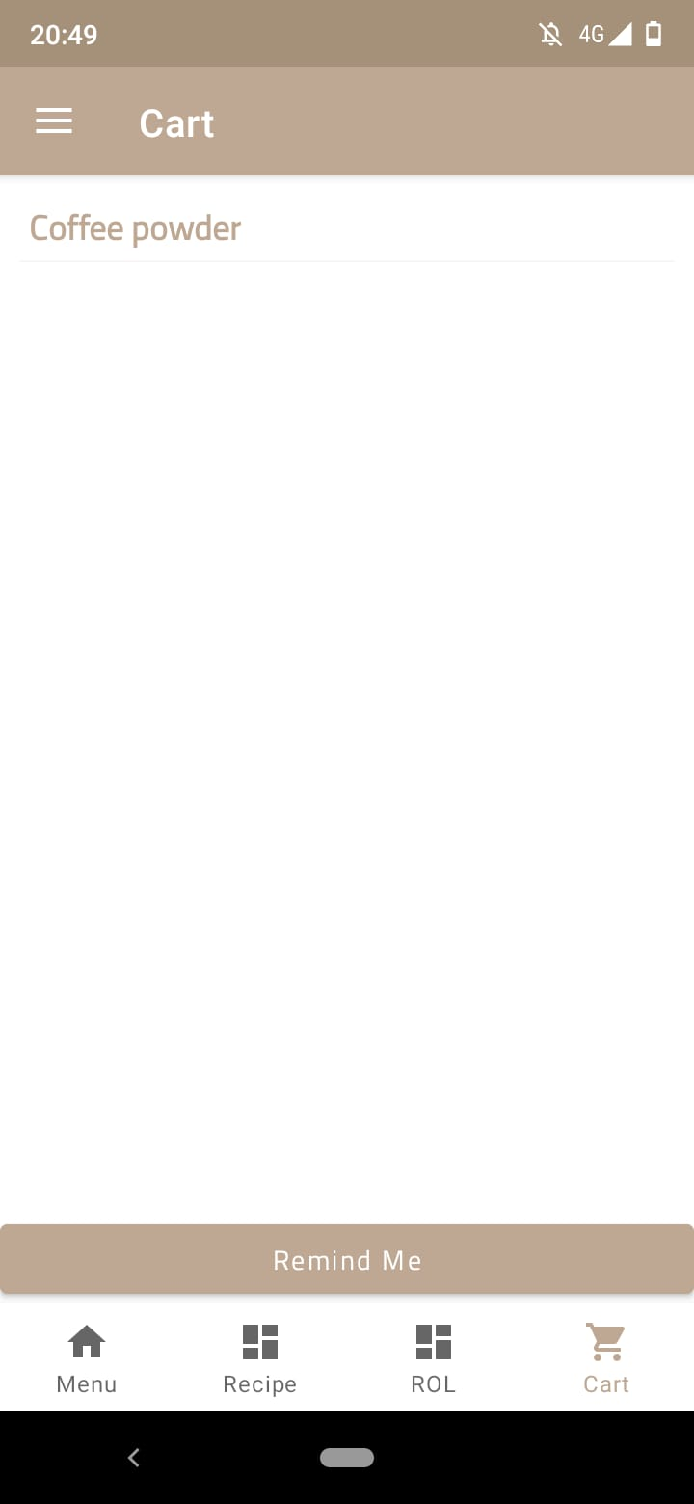
CART LIST

Slide 14
FUTURE PLAN
UI improvement
Hosting on Cloud
Scope of large scale use

Slide 15
Video Of The Project
https://drive.google.com/file/d/1OkGfb45IZm8_K4uvdIxWHAEA_blKB4l6/view?usp=sharing

Slide 16
THE END

