Slide 1

React & Node
Developed by, Sivaranjini S
Software Engineer - HTC Global Services

Slide 2
The Webinar Curve
Theory – Intro and fundamentals of React 😒
Practical - Live code development with React 😃
Comparing the Theory and Practical 😊

Slide 3

Introduction to React
What is React ?
Why should you use/learn React ?
What should you know before learning React ?

Slide 4
What is React ?
React is a JavaScript Library for building user interfaces for front-end web and mobile applications.
React is created by Jordan Walke, a Software Engineer in Facebook and it’s initially used for their news feed feature in 2011 and later on Instagram in 2012.
React is sometimes called as a Framework because of its features and behaviours.

Slide 5
Why should you use/learn React?
Reusable and independent UI components.
Virtual DOM
JSX
Currently the most desired technology for front end development.
Single Page Application
Can be used for mobile apps

Slide 6
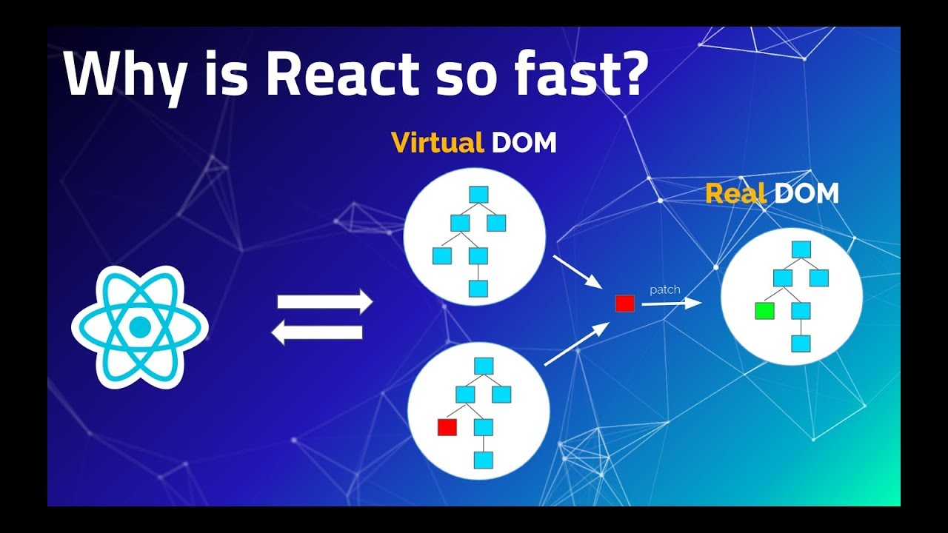

Slide 7
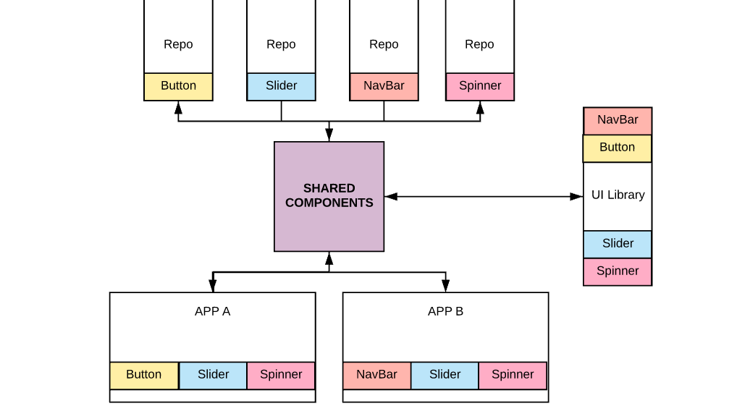

Slide 8
JSX
const name = ‘Sivaranjini’ const test = <p>Hello World {name} </p>;
JavaScript XML

Slide 9
What should you know before learning React?
JavaScript Basics (Objects, Arrays, Conditionals etc.,)
01
ES6 Features
02
Classes
Array and Object Destructuring
Array Methods – forEach, map, filter
Variables – let and const
Arrow Functions
Promises or Async and Await
Basic knowledge on NPM commands.
03

Slide 10
React Fundamentals
Components
State and Props
Lifecycle Methods

Slide 11
React Components
Class
Functional
Make use of ES6 class and extend the Component class in React.
Called as “stateful” components as they tend to implement logic and state. – Make use of state.
React lifecycle methods can be used inside class components.
Render method must.
Functional components are basic JavaScript functions.
Called as “stateless” components as they simply accept data and display them in some form. –
React lifecycle methods cannot be used inside functional components.
Return statement is must.

Slide 12
Class Component - Constructor
First executed method in Class Component
Default lifecycle method while mounting
Has super() to give to access to this variable
Syntax:
constructor(props){
super(props);
}

Slide 13
Class Component - Render
The render() method is the only required method in a class component
It is responsible for describing the view to be rendered to the browser
May / mayn’t contains return() method to display HTML components
Syntax:
render() {
return (
<div>This is Class component.</div>
);
}

Slide 14
Functional Component - Return
In the functional Components, the return value is the JSX code to render to the DOM tree
Return() is must in Functional Component as it need to return any HTML component
Syntax:
const Welcome=()=>
{
return (
<h1>Welcome to GeeksforGeeks</h1>
)
}

Slide 15
React State and Props
State
Object that holds a component’s data and control its behavior.
Can only be used in Class components only.
Props
Data that are passed from the parent which is read-only for the child.
Can be used in both class and functional component.

Slide 16
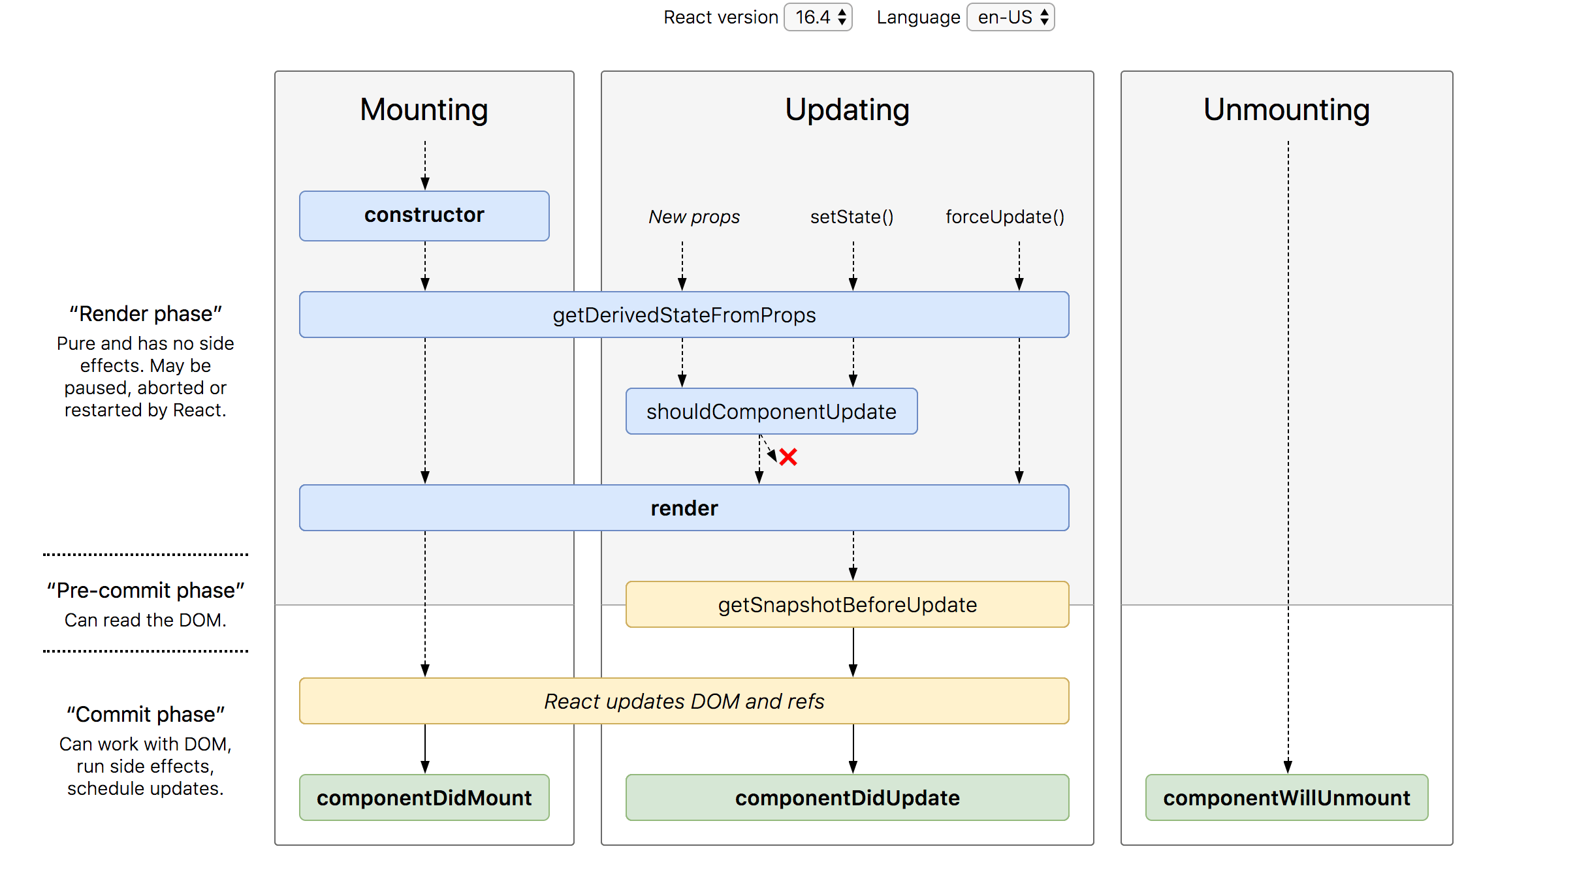
Lifecycle Methods

Slide 17
Installation – Node and create-react-app
Steps:
1. Install Node JS in your System (https://nodejs.org/en/)
2. Check node installed by typing node in cmd prompt
3. Install create-react-app globally.
npm install create-react-app –g
4. Create your react sample application
npx create-react-app app-name
5. cd app-name
6. yarn install : To install dependencies
7. yarn start : To start Application

Slide 18
Controlled Forms
Controlled data in a state variable
Single Source of Truth
Validation, Submission, Error Message handled manually

Slide 19
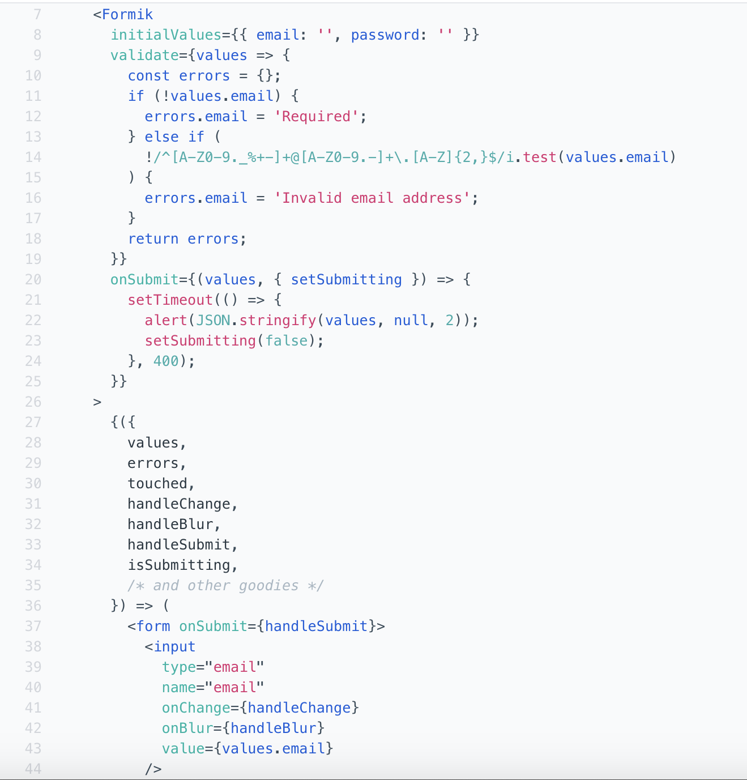
Uncontrolled Forms
Formik example of un-controlled Forms
Takes Initial Value, Validation, Submission methods as props
Return the value, error, handleChange and handleSubmit function which can be triggered in fields

Slide 20
React Events
Just like HTML, React can perform actions based on user events.
React has the same events as HTML: click, change, mouseover etc.
HTML : <button onchange=”search()” class=“” onclick=”submit()”>Search</button>
REACT: <button onChange={this.search} className={} onClick={()=> {this.search()}}>Search</button>

Slide 21
Axios API
Axios is a library that helps us make http request calls to external resources.
In our React applications we often need to retrieve data from external APIs so it can be displayed in our web pages
Axios is promise-based, which gives you the ability to take advantage of JavaScript's async and await for more readable asynchronous code.
Eg: We can make http GET, POST,PUT and DELETE calls via axios
Syntax:
axios.get(`https://jsonplaceholder.typicode.com/users`)
.then(res => { })

Slide 22
Refs
Refs provide a way to access DOM nodes or React elements created in the render method.
myRef = React.createRef();
<input type="text" ref={myRef} />

Slide 23
Keys
Keys help React identify which items have changed, are added, or are removed.
Keys should be given to the elements inside the array to give the elements a stable identity
<li key={number.toString()}> {number} </li>

Slide 24
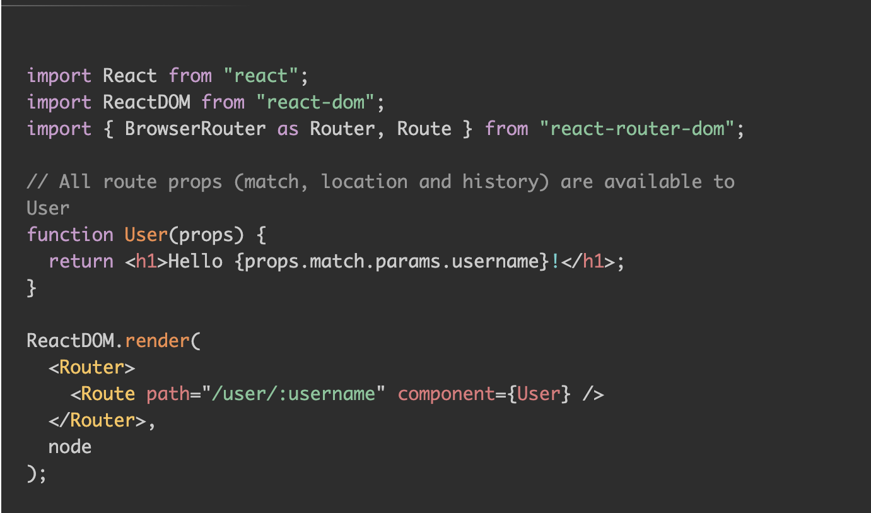
React Router
React Router is dynamic, client-side routing
Build a single-page web application without the page refreshing
Uses component structure to call components

Slide 25
React Styling
Styling can be done in three different ways,
Use traditional CSS framework (bootstrap, material etc) import and follow their semantics
Use component-based approach MaterialUI and Reactstrap.
Use your own styles.

Slide 26
Context
Allows you to share information to any component, by storing it in a central place and allowing access to any component that requests it
Provider => Provide the values, Consumers=> Consume the values
Context = React.createContext();
<Context.Provider>
<Context.Consumer>

Slide 27
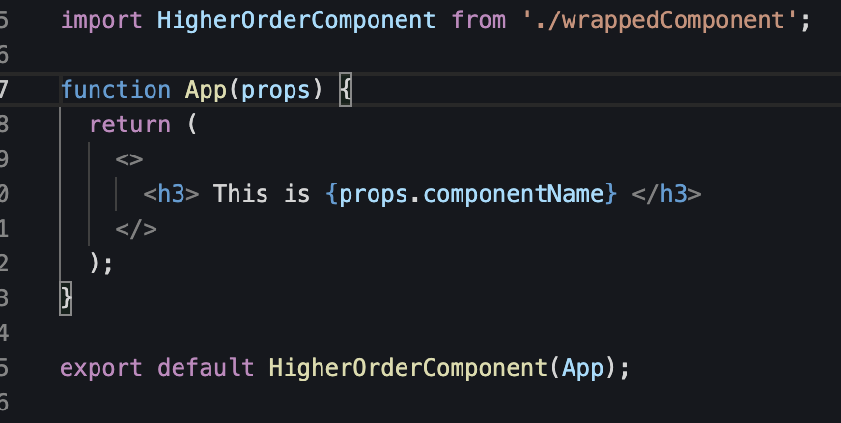
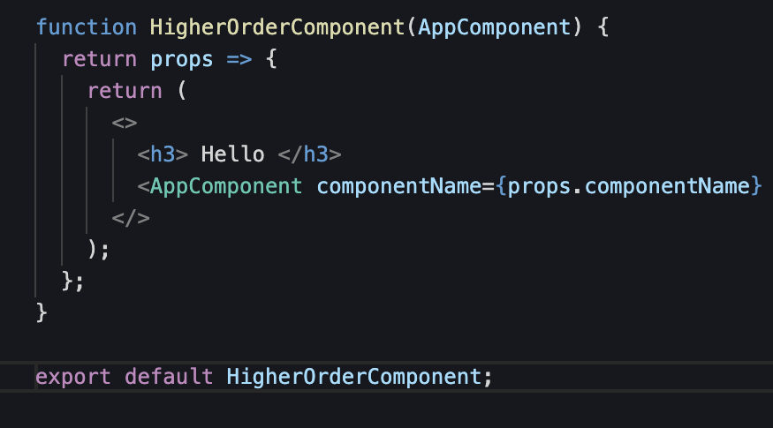
HOC – Higher Order Components
A higher-order component is a function that takes a component and returns a new component.

Slide 28
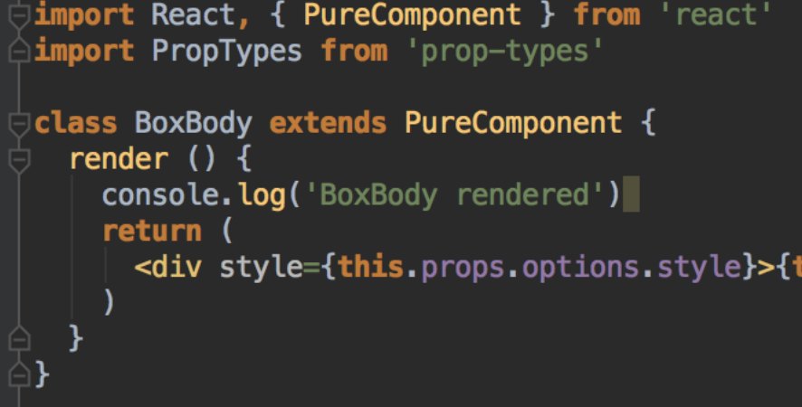
Pure Components
Higher Performance
Prevents re-render incase of same value
Un-able to prevent re-render in state objects
Applicable for class Component.

Slide 29

REACT HOOKS - BASIC
How to use state variable in Functional Component?
React Hooks helps us here…
Basic Hooks: Additional
useState 1. useReducer
useEffect 2. useRef
useContext

Slide 30
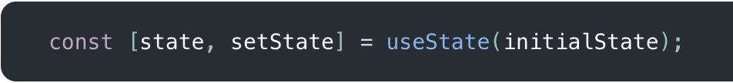
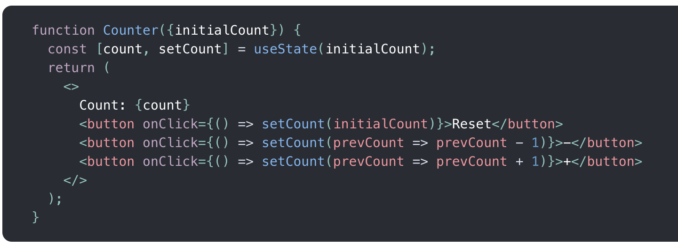
useState
Contains a Variable “state” and a function “setState” along with it to update the state.
setState accepts a new state value and re-render component.
Initial value of the state will be initialState, assigned by useState(5)
By pasing a function to setState, the function will receive the previous value, and return an updated value

Slide 31
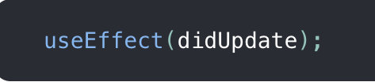
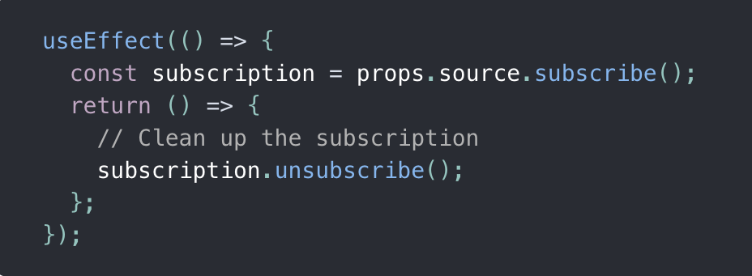
useEffect
Restrictions of Functional Component
Mutations, subscriptions, timers, logging, and other side effects are not allowed inside the main body of a function component which leads to confusing bugs and inconsistencies in the UI
useEffect solves above Restriction
The function passed to useEffect will run after the render is committed to the screen. By default, effects run after every completed render, but you can choose to fire them only when certain values have changed.

Slide 32

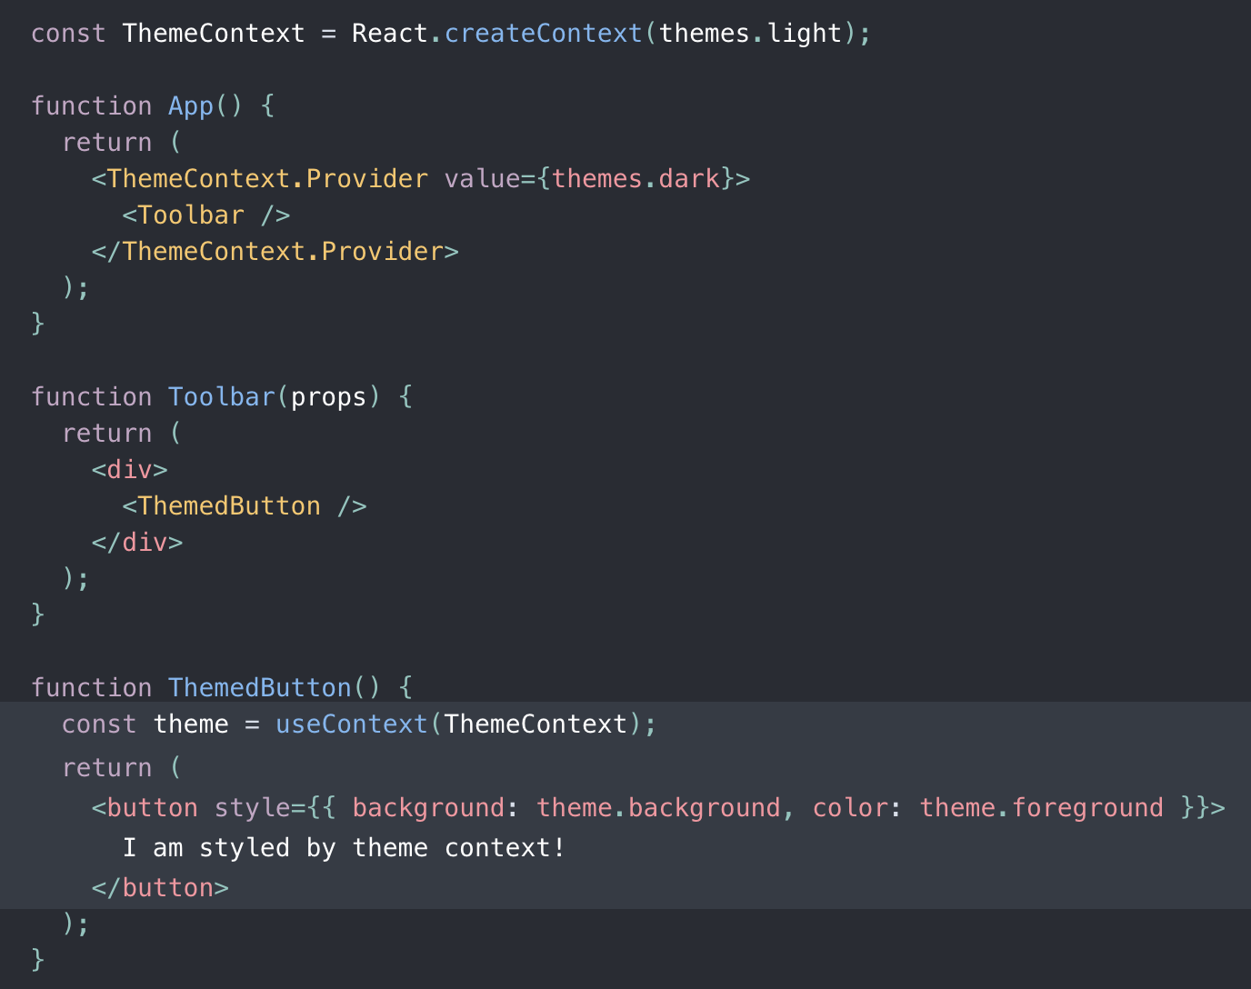
useContext
Accepts : Context object (React.createContext)
Returns : Current context value for that context
The current context value is determined by the value prop of the nearest <MyContext.Provider> above the calling component in the tree.
When the nearest <MyContext.Provider> above the component updates, this Hook will trigger a rerender with the latest context value passed to that MyContext provider.
Correct: useContext(MyContext)
Incorrect: useContext(MyContext.Consumer)
Incorrect: useContext(MyContext.Provider)

Slide 33
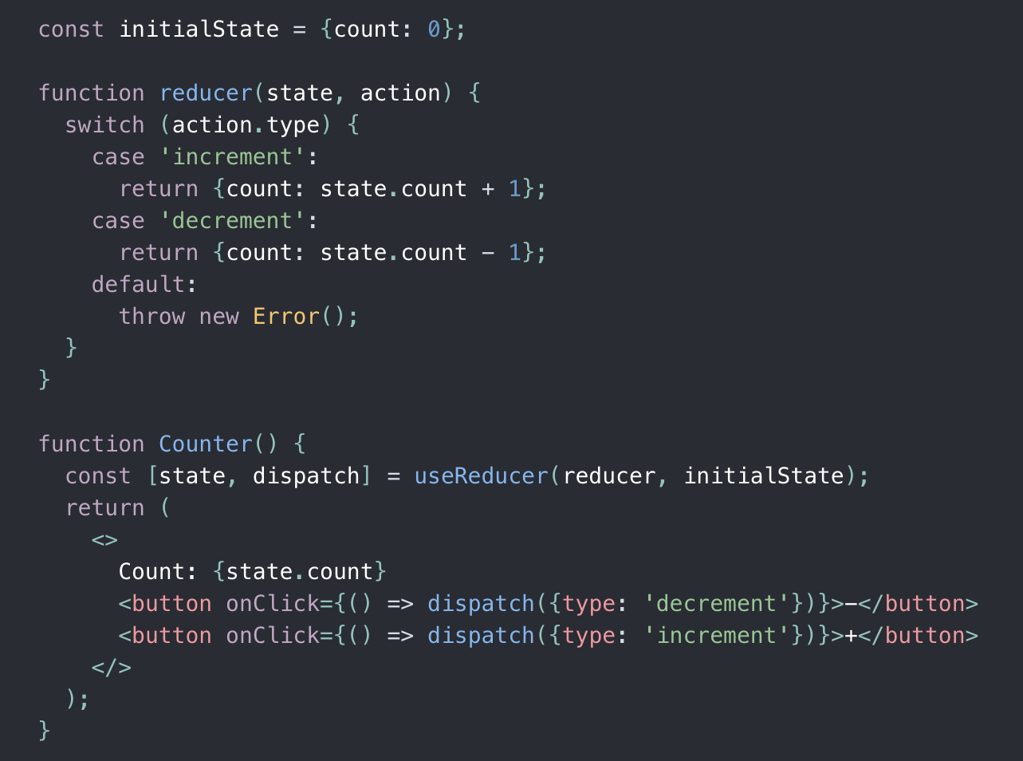
useReducer
Alternative to useState.
Accepts : reducer of type (state, action) => newState
Returns : current state paired with a dispatch method
useReducer is usually preferable to useState when you have complex state logic that involves multiple sub-values or when the next state depends on the previous one.
useReducer also lets you optimize performance for components that trigger deep updates because you can pass dispatch down instead of callbacks.

Slide 34

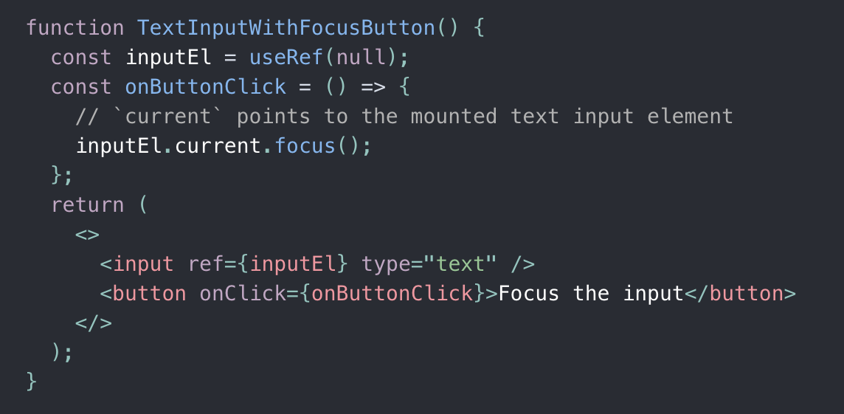
useRef
useRef returns a mutable ref object whose .current property is initialized to the passed argument (initialValue).
The returned object will persist for the full lifetime of the component.
Essentially, useRef is like a “box” that can hold a mutable value in its .current property.

Slide 35
REDUX - Features
Redux is said to be framework.
Every data and functions is stored in a store as states.
Single Store is maintained
Data is unidirectional
Use Case : Application which is having large data.
Redux is Scalability

Slide 36
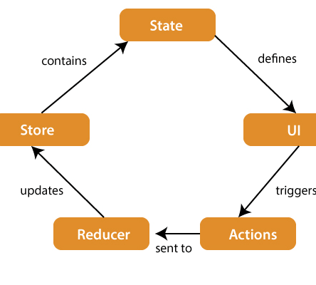
REDUX

Slide 37
Node JS
Node JS runs on V8. V8 is an open source JavaScript engine developed by Google.
Node JS is a single threaded application which makes it light weight. It uses event-driven , non-blocking I/O model.
Node JS is a server side Javascript Library.
Node JS is created by Ryan Dahl in 2009

Slide 38
Node JS - Async
Asynchronous programming in Node. js. Asynchronous I/O is a form of input/output processing that permits other processing to continue before the transmission has finished.

Slide 39
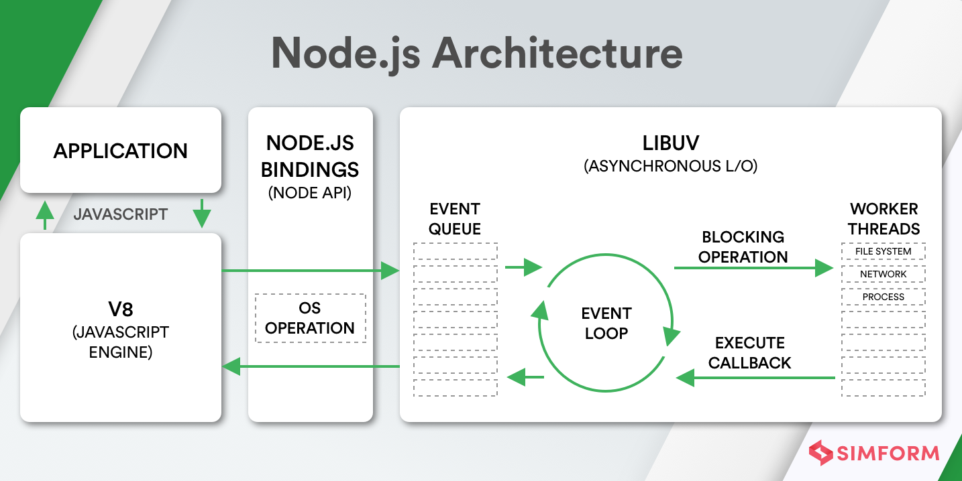

Slide 40
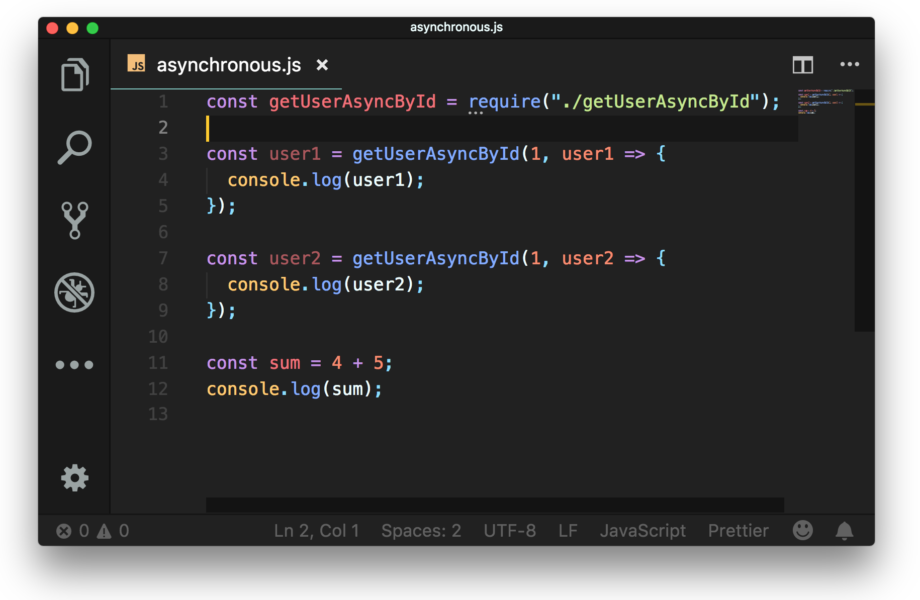

Slide 41
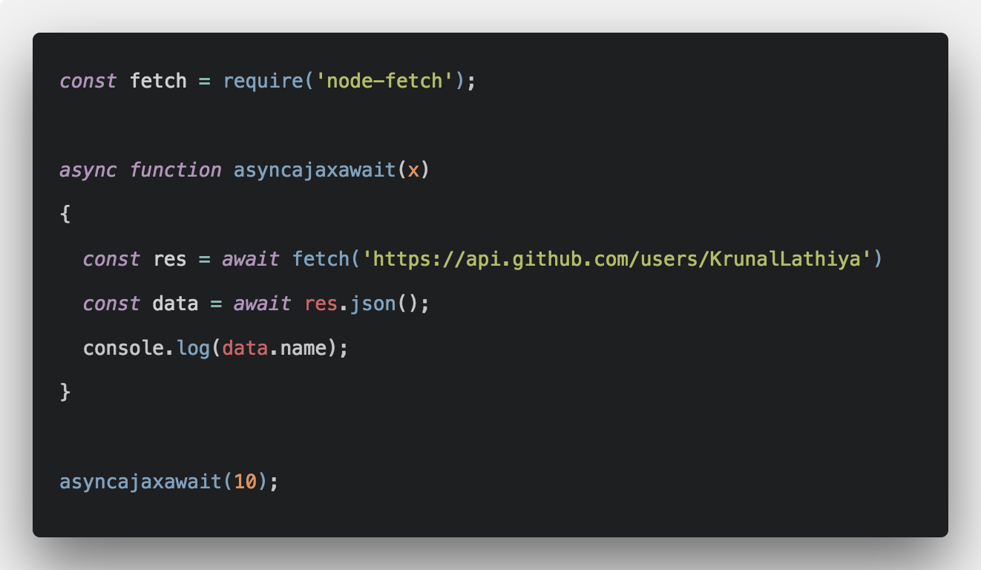

Slide 42
Node JS - NPM
NPM – Node Package Manager
Used to Maintain Dependencies
Packages are open source and anyone can import and export
Provides command line utility for package installation, version management, and dependency management.
https://www.npmjs.com/

Slide 43
Promises and Callbacks
Promises
Callbacks
Has three states Resolve, Reject, Pending
Promises give you back that control.
Node JS supports different promises.
Promises are one-shot devices and cannot be used for repeat notifications.
Doesn’t have states
Immediately call backed next function.
Call back hell
Synchronous notifications (such as the callback for Array. ... Notifications that may occur more than once

Slide 44
Express is a minimal and flexible Node.js web application framework that provides a robust set of features to develop web and mobile applications. The express framework is built on top of the node. js framework and helps in fast-tracking development of server-based applications. It's a web framework that let's you structure a web application to handle multiple different http requests at a specific url. Routes are used to divert users to different parts of the web applications based on the request made.
Node JS - Express
What is Express ?
Why EXPRESS?
What should you know before learning React ?

Slide 45
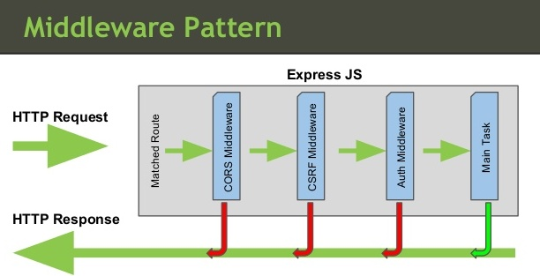
Middleware

Slide 46
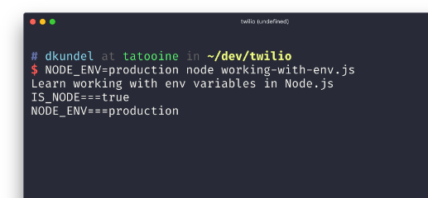
PROCESS ENV

Slide 47

DataBase
A database is an organized collection of structured information, or data, typically stored electronically in a computer system.

Slide 48
Types of Database
RELATIONAL : SQL
NON-RELATIONAL (NoSQL)

Slide 49
MySQL
MySQL is a relational database management system based on SQL – Structured Query Language.

Slide 50
DataTypes
CHAR(size)
VARCHAR(size)
BINARY()
BLOB(size)
ENUM(val1, val2, val3, ...)
BIT(size)
BOOL
TINYINT(size)
INT(size)
FLOAT(size)
DATETIME(fsp)
TIMESTAMP(fsp)

Slide 51
DDL : Data Definition Language
Change in Schema / Structure
CREATE
ALTER
DROP

Slide 52
DML : Data Manipulation Language
INSERT
UPDATE
DELETE
TRUNCATE

Slide 53
DQL : Data Query Language
Select
Where clause
DISTINCT
ORDER BY
LIMIT
OFFSET
ALIAS
CONDITION
AND
OR
NOT IN
IN
BETWEEN
LIKE

Slide 54
Aggregate Functions
1. COUNT
2. SUM
3. AVG
4. MIN
5. MAX

Slide 55
KEYS AND CONSTRAINTS
KEYS
PRIMARY KEY
FOREIGN KEY (MINIMISE DATA REDUNDANCY)
COMPOSITE KEY
CONSTRAINT
UNIQUE
NOT NULL
DEFAULT

Slide 56
JOINS
LEFT
RIGHT
INNER

Slide 57
NORMALIZATION
A technique of organizing the data into multiple related tables, to minimize the DATA REDUNDANCY

Slide 58
DATA REDUNDANCY
Repetation of data
Disadvantages
insertion
updation
deletion

Slide 59
1st Normal Form
SCALABLE TABLE DESIGN which can be easily extended
RULES
Each field SHOULD contain ATOMIC VALUE
A COLUMN SHOULD CONTAIN VALUES THAT ARE OF SAME TYPE
EACH COLUMN MUST CONTAIN UNIQUE NAME
ORDER IN WHICH DATA IS SAVED DOESN’T MATTER

Slide 60
2ND Normal Form
AVOID PARTIAL DEPENDENCY

Slide 61
3rd Normal Form
AVOID TRANSITIVE DEPENDENCY

Slide 62
MongoDB
MongoDB is a document-oriented database which stores data in JSON-like documents with dynamic schema. It means you can store your records without worrying about the data structure such as the number of fields or types of fields to store values. MongoDB documents are similar to JSON objects.
EG:- MongoDB, CouchDB, Cassandra etc.,

Slide 63
Collections, Fields, Documents
Tables - Collections
Columns - Fields
Rows - Documents

Slide 64
CREATING/SWITCHING TO DB
DELETING DATABASE
CREATE COLLECTION
DROP COLLECTION

Slide 65
DATATYPES
String - "dasasd", "dadas"
Integer - 12, 342
Boolean - True, False
Array - [1,2,3], [{ name: "guvi" }, { name: "Test" }]
Object - { age: 21 }
Date
Double - 34.44, 43.43242, 689
Timestamp

Slide 66
$group $project $match $limit $skip $sort
AGGREGATE FUNCTIONS

