Slide 1

EE 596-Design of a hybrid image &Video codec
KAJANANAN S. (E/18/165)

Slide 2
INTRODUCTION
Create a basic hybrid image and video codec using Matlab, incorporating essential coding tools such as DCT2, iDCT2, quantization, motion estimation/compensation, and entropy coding. Optimize the codec's performance by fine-tuning the parameters of these tools.

Slide 3
Encoder for image codec
Input
image
DCT
transform
Huffman
encoding
Compressed image data
Quantization
Store
Load the input image and convert it to grayscale.
Define the 3 level quantization matrix.
Perform the forward transform (DCT) on the grayscale image.
Quantize the DCT coefficients using the quantization matrix.
Perform entropy encoding (Huffman coding) on the quantized coefficients.
Save the binary encoded data to a file.

Slide 4
Decoder image codec
Decoded
image
IDCT
transform
Huffman
decoding
Compressed image data
Dequantization
Load the Huffman encoded data and dictionary
Perform entropy decoding (Huffman decoding) on the binary encoded data.
Reconstruct the quantized coefficients.
Perform the inverse transform (IDCT) on the reconstructed quantized coefficients.
Calculate the compression ratio and PSNR (Peak Signal-to-Noise Ratio) between the original and reconstructed images.

Slide 5
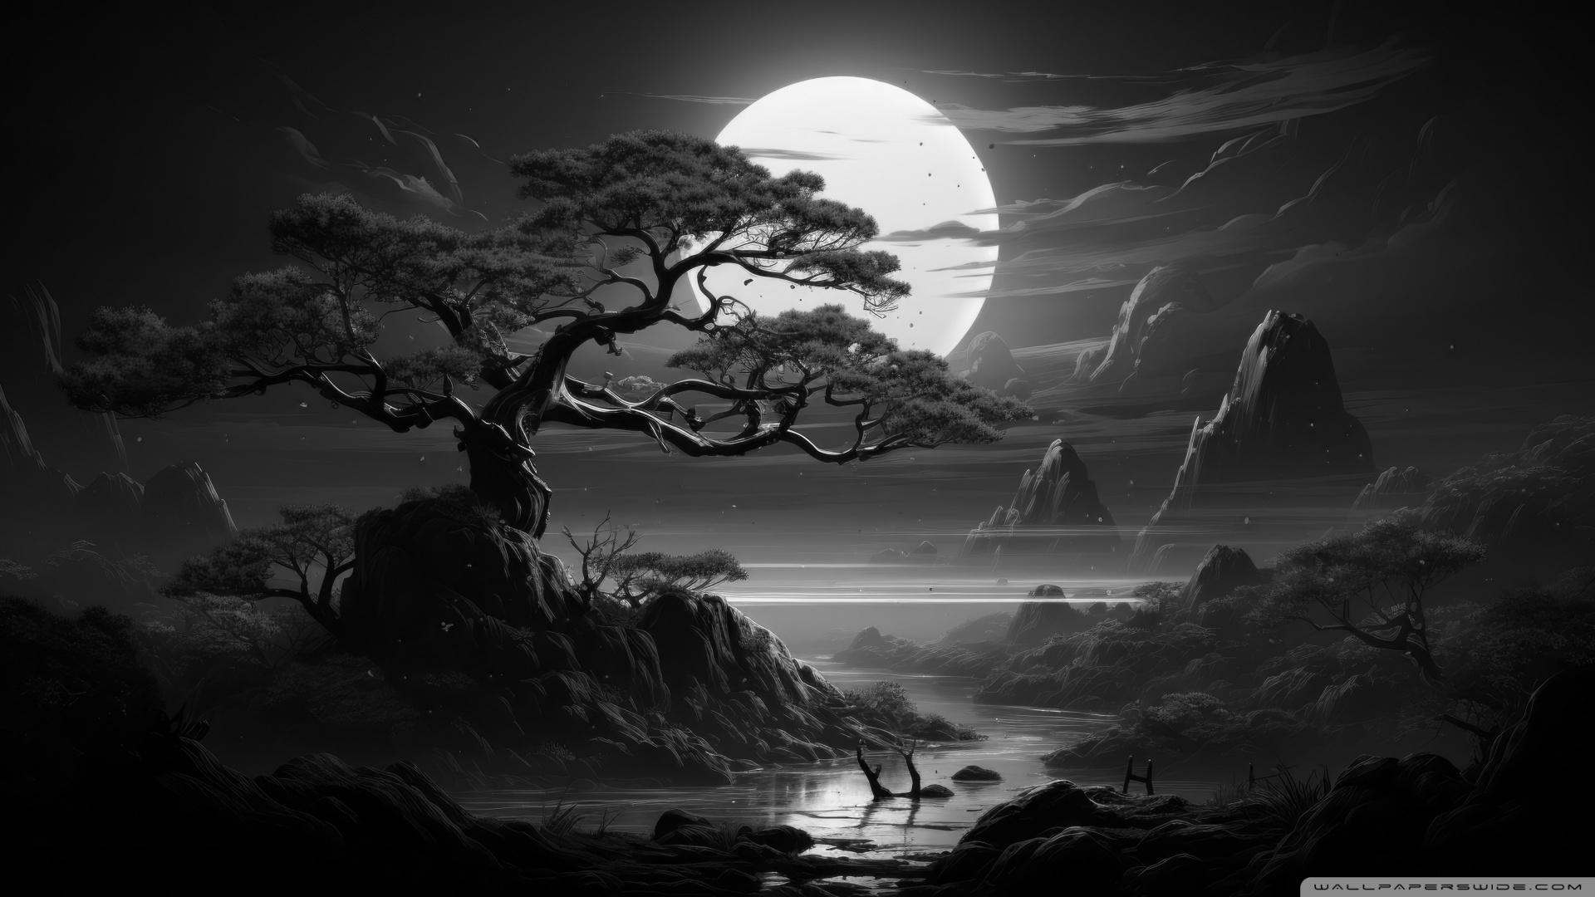
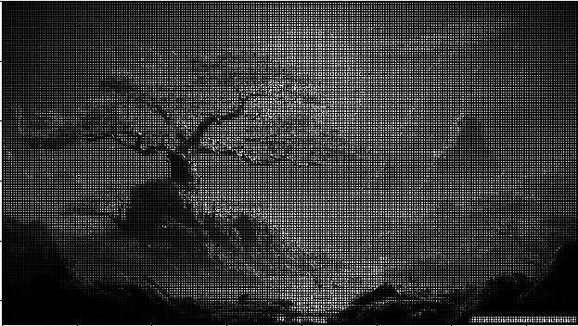

Results of Image coding
Image After DCT applied
Reconstructed Image(106kB)
Gray Image(164kB)

Slide 6

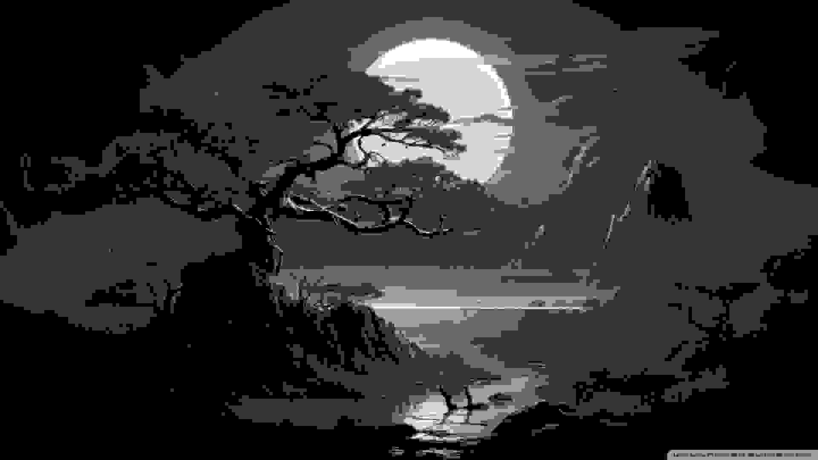
MIN QUANT
Image size=77.8 kB
MAX QUANT
Image size=31.8 kB
MID QUANT
Image size= 64 kB

Slide 7
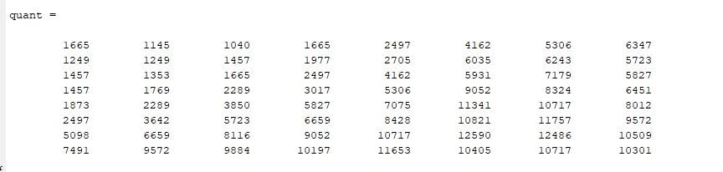
Bit rate of the channel = 165+ 300
= 165+300 =465 kbps

Slide 8
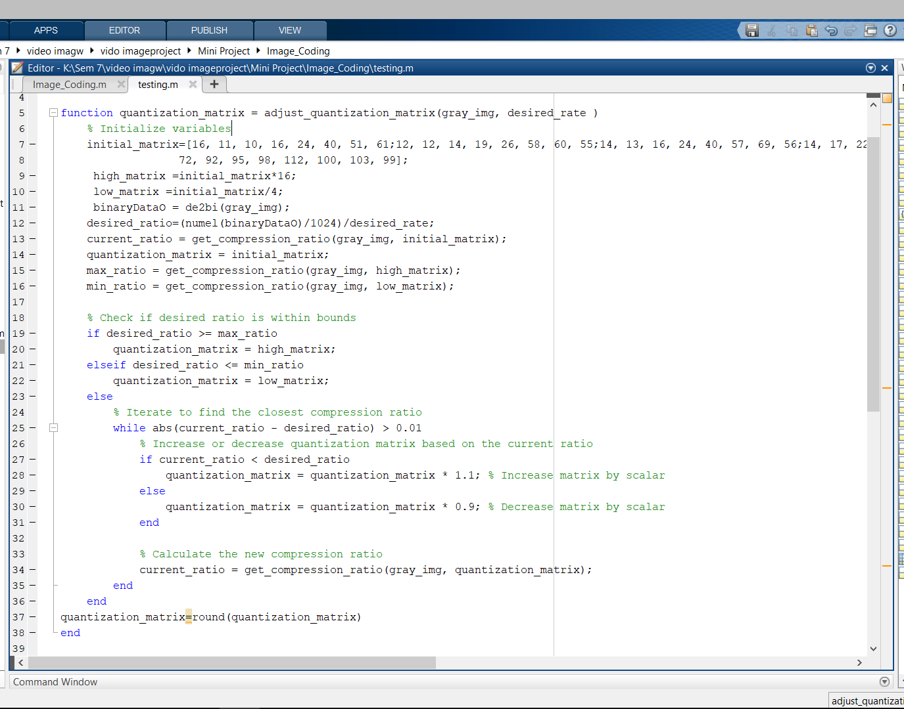
Iterative method
Initialize variables
Calculate desired,current compression ratio
If desired ratio is greater than or equal to maximum ratio
quantization_matrix = high_matrix
Otherwise
quantization_matrix = low_matrix
Else
While current ratio is not close enough to desired ratio
If current ratio is less than desired ratio
quantization_matrix = quantization_matrix * 1.1
Otherwise
quantization_matrix = quantization_matrix * 0.9
Calculate new compression ratio
End while
End if
Round quantization matrix

Slide 9
Video coding
Video compression is the process of reducing the total number of bits needed to represent a given image or video sequence.
Here I used 20 frames
Redundancy remove
Spatial redundancy – up sampling, down sampling
Temporal redundancy
Source coding redundancy

Slide 10
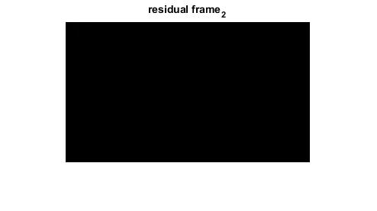
Encoder
Start
Read video frames ,resize ,gray conversion and Macroblock division
For each frame:
Calculate motion vectors using SAD and stored
Calculate residual by subtracting previous frame
For each frame:
apply down sampling
Encode the residuals using quantization and huffman
Store the dictionary and encoded residual
End
Residual frame_2

Slide 11

Decoder
Start
Load encoded data, dictionary and motion vectors
Initialize variables and parameters
Read encoded residuals from text file
For each frame:
Decode the residual & I using dictionary and quantization table
Store the decoded residual,I
Apply up sampling
For each frame:
Calculate predict frame using motion vectors and previous frame
Store the predicted frame Reconstruct final frames by adding decoded residuals to predicted frames
Apply deblocking filter to reconstructed images
Save filter applied reconstructed frames as a video
End
Predicted frame_2

Slide 12
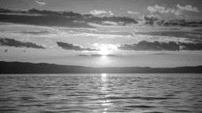

Results
Original Video(20 Frames)-190kB
Compressed Video(20 Frames)-156kB

Slide 13
Optimization
To remove spatial redundancy did down sampling(encoder) and up sampling(decoder)
Improve quality using Deblocking filters A deblocking filter is a video filter applied to decoded compressed video to improve visual quality and prediction performance by smoothing the sharp edges

Slide 14

THANK YOU

