Slide 1
MyFitnessTracker
Presented By : Team Paladins
Contributors: Murtaza Jabalpurwala
Gozal Henggardhani
Sivareddy Bodapati

Slide 2
Idealistic Goal:
We have seen the worst phase of our life facing the pandemic and strict to our homes.
How and Where to do the workouts?
Do not fear, MyFitnessTracker has a solution for you.

Slide 3
Proof of Concept
Back ground work :
Generating the data
Building a Deep Learning Classifier
Pass the Classfier to Media Pipe
Tracks the count, duration and calories
Ouptut :
Deploy to the App
Check the Result

Slide 4

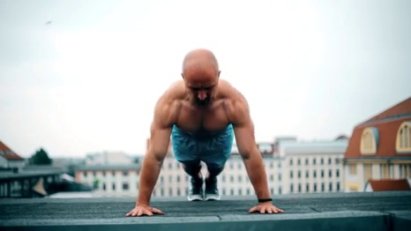
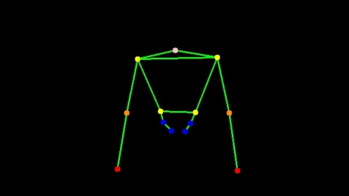
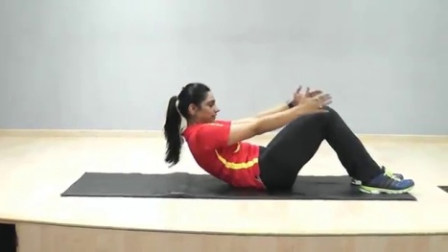
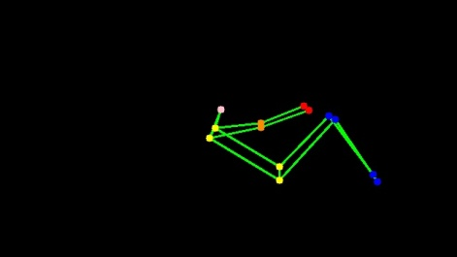
Pre-Process
Data Generation
Image extracted from online Youtube videos
500 images of PushUp & Situp extracted
Image is converted to skeleton image using OpenCv

Slide 5
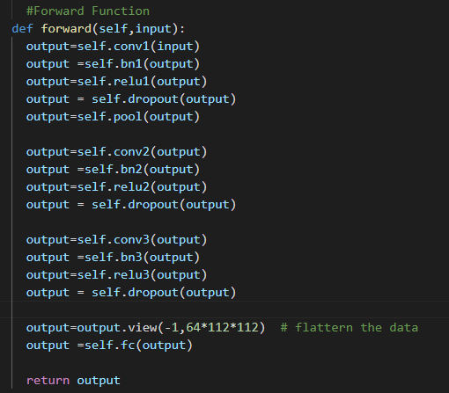

CNN Classifier
Pytorch Library is used to build the model.
CNN classifier is train with the preprocessed data.
Best Model is saved and used for post process and passing to the Media Pipe.

Slide 6
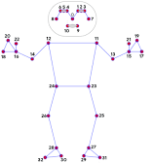
Media Pipe
OpenCv
Here we pass the classifier to the Media Pipe.
We can track the workout counts, duration and Calories burnt

Slide 7
Demo

Slide 8
