Slide 1

BRAIN TUMOR CLASSIFICATION USING GATED REINFORCEMENT LEARNING AND RED DEER OPTIMIZATION WITH XGBOOST
SIVAS D-24MCA1018 UNDER THE GUIDANCE OF DR. GANESH N

Slide 2
INTRODUCTION
Problem Statement:
Brain tumor diagnosis from MRI scans is time-consuming and requires expert precision. Automating slice-level classification helps reduce diagnostic time and error.
Objective:
To develop an intelligent pipeline that filters irrelevant MRI slices and classifies tumor-relevant slices using Gated Reinforcement Learning, Red Deer Optimization, and XGBoost.
Significance:
Enhances the accuracy and efficiency of brain tumor detection, supporting radiologists in clinical decision-making.

Slide 3
DATASET OVERVIEW
Data Type:
3D multi-modal MRI scans in NIfTI (.nii.gz) format
Modalities:
T1: Shows brain structure
T1Gd: Highlights active tumor regions
T2:Shows swelling and fluid
FLAIR: Shows lesions by hiding normal fluid signals
Structure:
Each patient folder contains 4 MRI modality scans and a corresponding segmentation mask
Typical volume dimensions: approximately 240×240×155

Slide 4
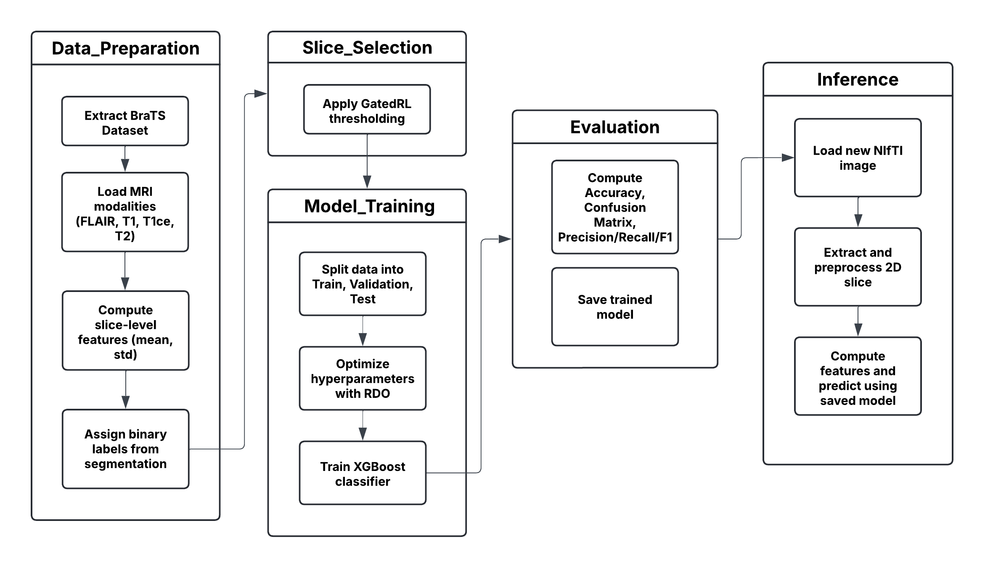

Slide 5
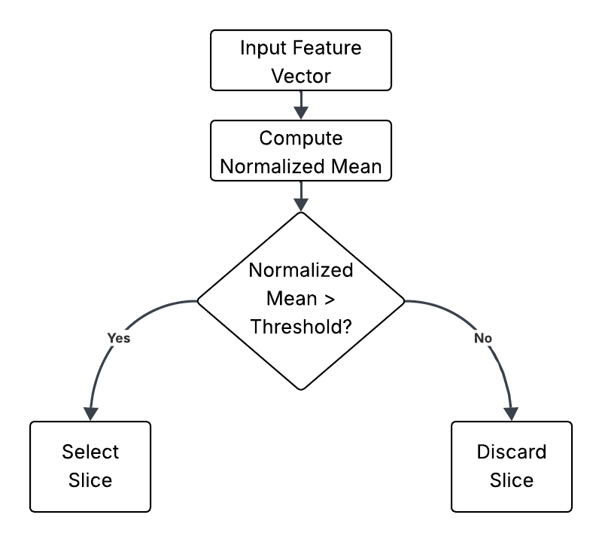

Slide 6
MODULES
Preprocessing Module:
Handles extraction of MRI data from NIfTI files
Normalizes and resizes images, ensuring uniform input dimensions
Feature Extraction Module:
Computes statistical features (mean, standard deviation) for each slice
Stacks features from multiple modalities to form an 8-dimensional feature vector per slice
Gated Reinforcement Learning (GatedRL) Module:
Implements a simple gating mechanism to filter slices based on normalized intensity
Selects slices likely to contain relevant tumor information

Slide 7
Hyperparameter Optimization Module (Red Deer Optimization):
Optimizes key parameters (learning rate, max depth) for the XGBoost classifier
Iteratively refines candidate solutions based on validation error
Classification Module (XGBoost):
Trains a gradient boosting model using optimized hyperparameters
Evaluates performance using training and validation metrics
Inference Module:
Loads the trained model to perform predictions on unseen MRI slices
Processes new images and outputs prediction scores indicating tumor presence

Slide 8
ALGORITHMS
Gated Deep Reinforcement Learning (GatedRL):
Implements a gating mechanism to pre-select slices based on intensity thresholds.Helps reduce noise by filtering out slices less likely to contain tumor information.
Red Deer Optimization (RDO):
An evolutionary-inspired algorithm that simulates red deer mating behaviors.Iteratively optimizes hyperparameters (learning rate and max depth) for the XGBoost model.Balances exploration and exploitation to refine candidate solutions based on validation error.
XGBoost (eXtreme Gradient Boosting):
A powerful ensemble learning method using gradient boosted decision trees.Efficiently handles high-dimensional, tabular data and achieves high predictive accuracy.

Slide 9
RESULTS
Classification Report:
Class 0 (Non-tumor):
Precision: ~0.86
Recall: ~0.88
F1-Score: ~0.87
Class 1 (Tumor):
Precision: ~0.86
Recall: ~0.84
F1-Score: ~0.85
Model Training:
Training accuracy increased steadily over boosting rounds (up to ~97.4% at the final epoch).
Test Accuracy: ~86.1%

Slide 10
COMPARATIVE ANALYSIS
Traditional CNN-based Models:
Often require extensive training and large datasets.May struggle with feature generalization when using 2D slices.
CNN + XGBoost Approaches:
Improve performance by leveraging deep features.However, hyperparameter tuning remains a challenge.
Proposed Method (GRL + RDO + XGBoost):
Effectively filters out non-informative slices.Enhances the quality of training data.
Efficient hyperparameter tuning for XGBoost.Balances exploration and exploitation, leading to robust model parameters.
Demonstrates high accuracy with optimized features and parameters.Provides reliable performance with a comprehensive evaluation.

Slide 11
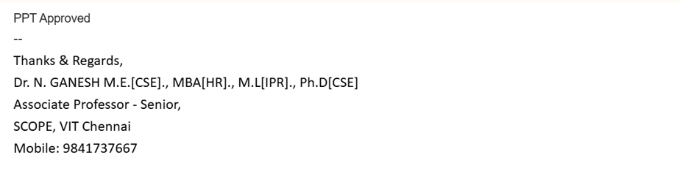
GUIDE’S APPROVAL

Slide 12
THANK YOU

