Slide 1
RECIPE PREPARATION AGENT
IBM HACKATHON PROJECT
Presented By:
Student name : Kudumala Ganga Siva Sai Reddy
College Name & Department : Siddharth Institute of Engineering and Technology & ECE

Slide 2
OUTLINE
Problem Statement
Technology used
Wow factor
End users
Result
Conclusion
Git-hub Link
Future scope
IBM Certifications

Slide 3
Problem Statement
Many individuals face challenges in preparing meals due to limited time, lack of cooking knowledge, and unavailability of specific ingredients, often leading to food waste and reliance on takeout. There is a need for an intelligent system that can suggest recipes based on available ingredients, provide substitutions, and offer step-by-step guidance, helping users prepare meals efficiently while reducing waste and accommodating dietary preferences. A Recipe Preparation Agent helps users cook meals using only the ingredients they have on hand.
Proposed Solution:
The proposed solution is a Recipe Preparation Agent powered by AI and Retrieval-Augmented Generation (RAG) that:
Accepts user input of available ingredients.
Suggests tailored recipes based on the given ingredients.
Provides step-by-step cooking instructions for easy meal preparation.
Offers ingredient substitutions to accommodate shortages or dietary needs.
Gives nutritional insights and cooking tips for healthier choices.

Slide 4
Technology used
IBM cloud lite services
Natural Language Processing (NLP)
Retrieval Augmented Generation (RAG)
IBM Granite model

Slide 5
IBM cloud services used
IBM Cloud Watsonx AI Studio
IBM Cloud Watsonx AI runtime
IBM Cloud Agent Lab
IBM Granite foundation model

Slide 6
Wow factors
AI-Powered Recipe Suggestions (RAG):
Uses Retrieval-Augmented Generation to fetch recipes from a large database and adapt them dynamically to the user’s
ingredients.
Ingredient Substitution Engine:
Suggests intelligent alternatives when an ingredient is missing (e.g., replace cream with yogurt for healthier options).
Dietary Preference & Allergy Handling:
Supports customization for vegan, keto, gluten-free diets, or allergen-free cooking.
Voice-Assisted Cooking Guide:
Provides real-time voice instructions while cooking, enabling hands-free interaction.
Nutritional Analysis:
Displays calories, macronutrients, and health tips for each recipe.
Smart Pantry Management:
Tracks available groceries, suggests recipes before items expire, and reduces food waste.
Multilingual Support:
Offers recipes and instructions in multiple languages for better accessibility.
Meal Planning & Shopping List Generator:
Creates weekly meal plans and auto-generates shopping lists based on missing ingredients.
Image Recognition (Optional AI Feature):
Allows users to click a photo of their pantry/fridge and automatically detect available ingredients.
Personalization Through Learning:
Learns user preferences over time to give better, personalized suggestions.

Slide 7
End users
Students and Working Professionals
Who have limited time and cooking skills but want quick, easy meal solutions.
Homemakers
Who want to explore new recipes using existing groceries efficiently.
Health-Conscious Individuals
Who follow specific diets (e.g., keto, vegan) and need customized meal options.
People with Dietary Restrictions or Allergies
Who need safe and suitable ingredient substitutions.
Elderly Individuals
Who require simple instructions and minimal effort cooking.
Budget-Conscious Users
Who want to minimize food waste and save money by using ingredients on hand.
Beginner Cooks
Who lack cooking experience and need guided, step-by-step help.
Busy Families
Who want to plan meals quickly and ensure efficient use of household groceries.

Slide 8
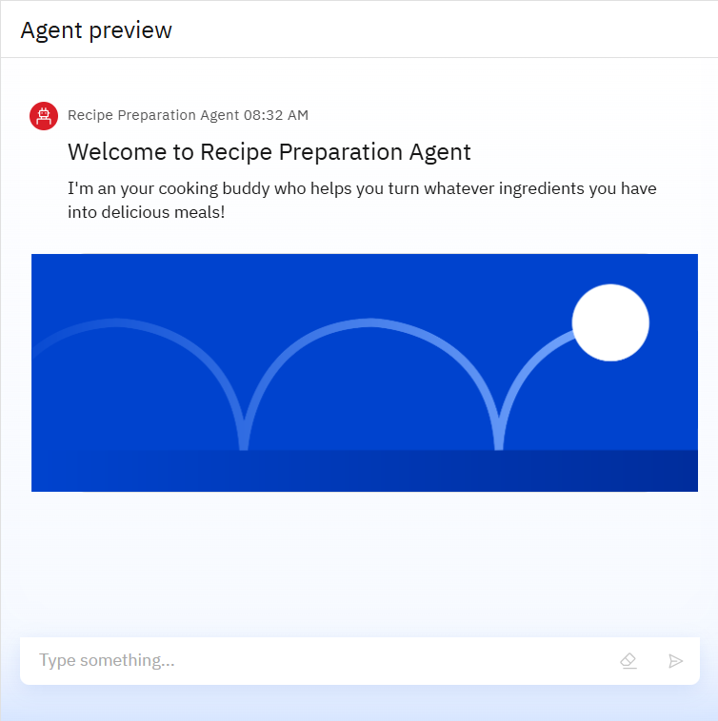
Results

Slide 9
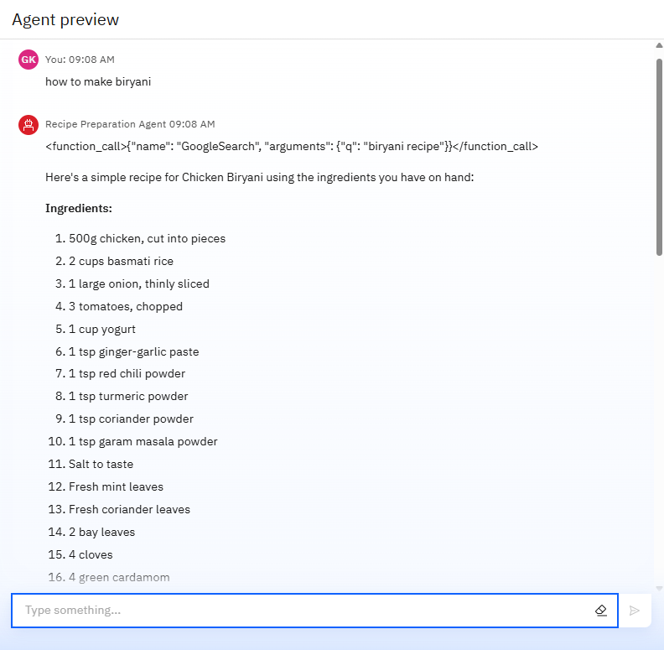
Results

Slide 10
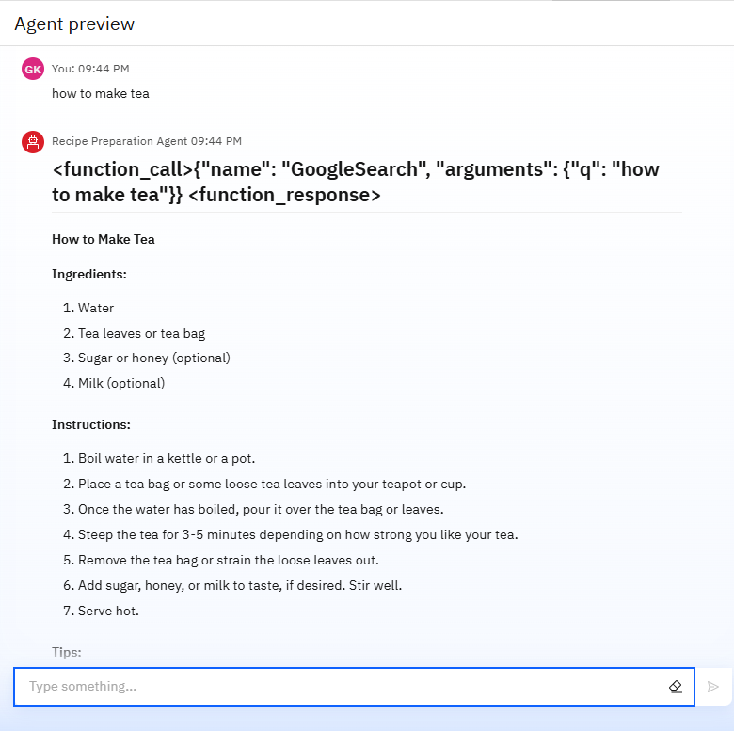
Results

Slide 11
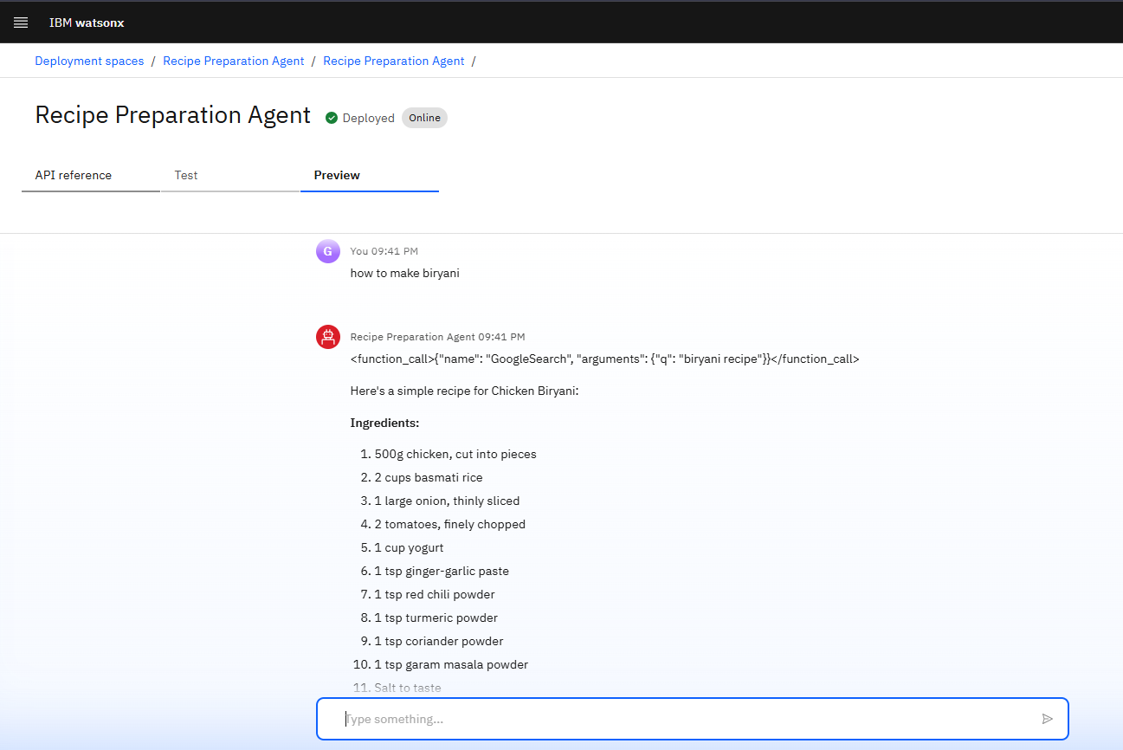
Results
Deployed AI Agent

Slide 12
Conclusion
✅ Simplifies meal preparation by providing personalized recipe suggestions.
✅ Reduces food waste by utilizing available ingredients efficiently.
✅ Saves time and money for users with busy schedules or limited cooking skills.
✅ Offers ingredient substitutions to handle shortages and dietary restrictions.
✅ Promotes healthier eating habits with nutritional insights.
✅ Provides step-by-step guidance suitable for beginners and experienced cooks.
✅ Enhances user convenience and accessibility through AI-driven features.
✅ Transforms cooking into an enjoyable and stress-free experience.

Slide 13
GitHub Link
https://github.com/Sivasaireddy04/Recipe_Preparation_Agent

Slide 14
Future scope
Integration with Smart Kitchen Appliances
Image-Based Ingredient Detection
AI-Powered Taste Personalization
Voice-Activated Virtual Cooking Assistant
Augmented Reality (AR) Cooking Mode
Advanced Nutritional & Health Tracking
Global Recipe Database Expansion
Smart Shopping Integration
Sustainability Insights

Slide 15
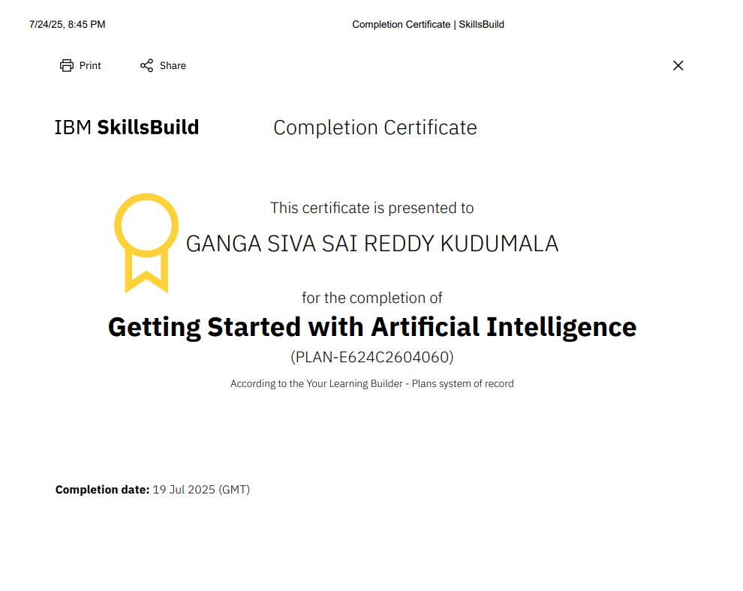
IBM Certifications

Slide 16
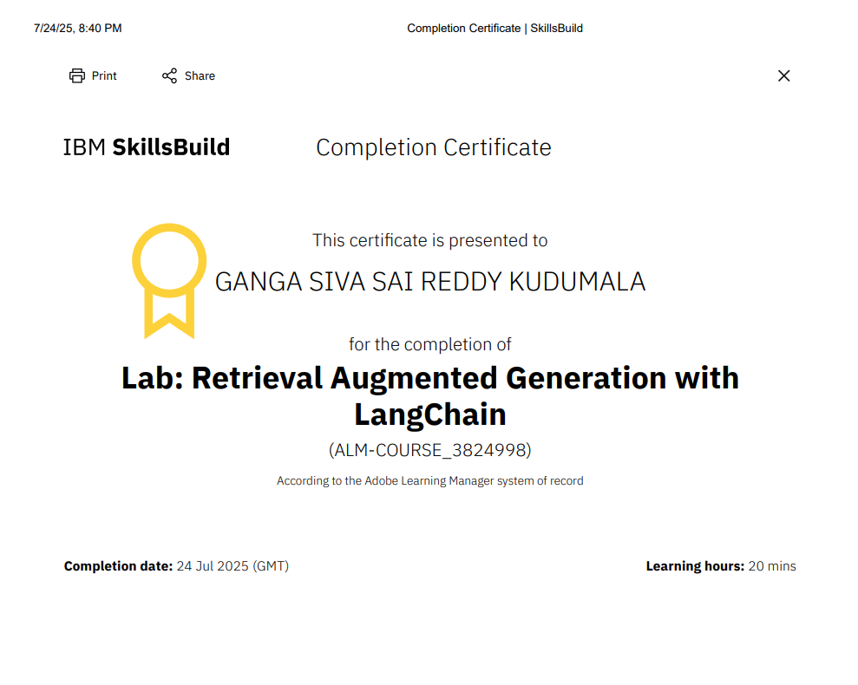

Slide 17
THANK YOU

