Slide 1

Financial Distress Prediction using Machine Learning
1

Slide 2

Team
01
Mentor
Ms. M. Kavitha,
AP, AI&DS
02
Mentee 1
Ganesh Kumar M
711619104010
03
Mentee 2
Sivasamy E
711619104044
04
Mentee 3
Subbukutty B
711619104049
2

Slide 3
Contents
01
Introduction
Problem Statement
02
03
Existing Solution
Propsed Solution
04
05
Literature Survey
Methodology
06
Source Code &
Sample Outputs
08
07
Data set Decision
09
Conclusion
Bibliography
10
3

Slide 4
Introduction
Machine learning
Financial Distress
When revenues or income no longer cover the financial obligations of an individual or an organization
Often a harbinger of bankruptcy and can cause lasting damage to one’s credit worthiness
It’s an application of AI
Computers observe and analyze
Predict based on previous patterns
Pre-programmed algorithms
4

Slide 5

Problem Statement
To build a predictive model that can accurately predict the likelihood of financial distress of companies which are listed in NSE and BSE
To think whether the investor should invest in that company or not
5

Slide 6
Existing Solution
Altman Z-Score
A formula to determine whether a company is headed for bankruptcy
Altman Z-Score =
1.2A + 1.4B + 3.3C + 0.6D + 1.0E
Where,
A = working capital / total assets
B = retained earnings / total assets
C = earnings before interest and tax / total assets
D = market value of equity / total liabilities
E = sales / total assets
6

Slide 7
Proposed Solution
Prediction using ML
Collect the financial data of all companies which are listed in the NSE and BSE
Calculate the financial ratios of the companies from the annual report that they have submitted for public view
Develop a dataset based on financial ratios and train the model
7

Slide 8
Literature Survey
Financial distress analysis in Indian Automobile Industry - Judging Financial Health of 12 Companies from Auto Ancillary Sector of India using Altman’s Z Score Model by Mrs. Rakhi Raizada Shrivastav and Dr.Srini R. Srinivasan - 2021
Altman Z-Score formula to find financial distress
Detection of Financial Distress In The Indian Automobile Industry by Ajay Kumar Patel, Shikha Jalota, Swati Sharma - 2021
Financial ratios such as solvency ratio, profitability ratio and others
8

Slide 9

Methodology
01
02
With bankrupted company’s value as a training set, predict the finanacial distress to other companies using ML algorithms.
Find the financial ratios for the bankrupted and non-bankrupted companies.
9

Slide 10
Data set
01
02
Liquidity ratio
Solvency ratio
Current asset
current liabilities
Total debt
Share holder’s equity
Financial Ratios
03
04
Return on assets
Return on equity
Net income
Total assets
Net income
Total share holder’s equity
10

Slide 11
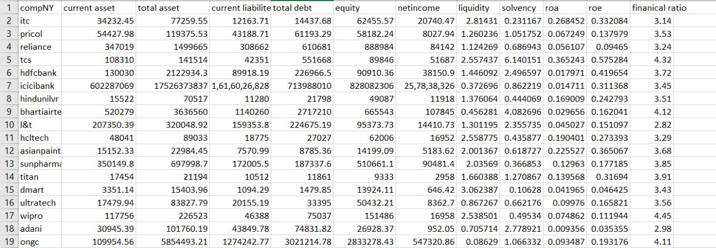
Data set
Sample dataset
11

Slide 12

D.V > 2.9
The company is financially stable.
D.V > 2.9 > 2.77
The company is on alert to work for the betterment in terms of solvency of the company.
Financial
Distress
D.V > 2.77 > 1.8
It depicts signs of grey areas in the company. The company may go bankrupt within in two years if no action is taken.
D.V < 1.8
Definite failure and closure of the company
12

Slide 13
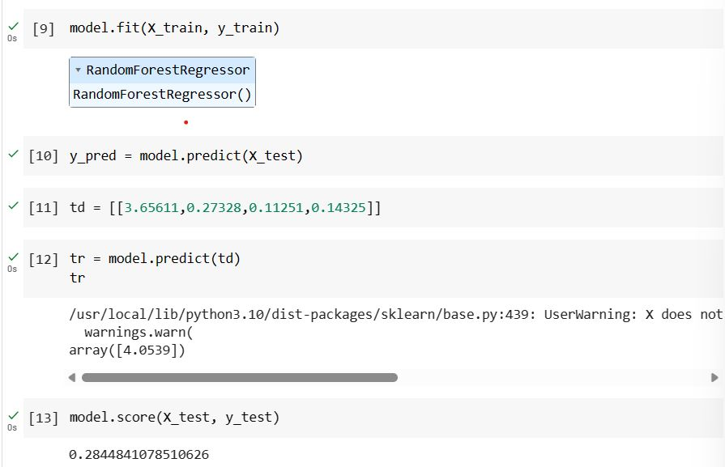
Source Code
Script area
13

Slide 14
Conclusion and Future work
01
Increase the accuracy by including various financial as well as non-financial ratios
02
Develop models that can adapt and update real-time data as new data
14

Slide 15
Bibliography
Rakhi, Mrs & Shrivastav, Raizada. (2014). Paper Title: FINANCIAL DISTRESS ANALYSIS IN INDIAN AUTOMOBILE INDUSTRY Subtitle: Judging Financial Health of 12 Companies from Auto Ancillary Sector of India using Altman's Z Score Model. 1.
Patel, Ajay & Sharma, Ms & Jalota, Shikha. (2021). DETECTION OF FINANCIAL DISTRESS IN THE INDIAN AUTOMOBILE INDUSTRY. Journal of Commerce and Accounting Research. 10. 32-41.
Wang, Nanxi. (2017). Bankruptcy Prediction Using Machine Learning. Journal of Mathematical Finance. 07. 908-918. 10.4236/jmf.2017.74049.
16

Slide 16
Bibliography
Ikpesu, Fredrick & Vincent, Olusegun & Dakare, Olamitunji. (2019). Financial Distress Overview, Determinants, and Sustainable Remedial Measures: Financial Distress. 10.4018/978-1-5225-9607-3.ch006.
Gill, Harsheen. (2022). Analysis of financial liquidity and predicting the bankruptcy risk of Indian cement companies. Journal of Management Research and Analysis. 9. 53-60. 10.18231/j.jmra.2022.012.
Xu, Kun & Zhao, Qilan & Bao, Xinzhong. (2015). Study on Early Warning of Enterprise Financial Distress — Based on Partial Least-squares Logistic Regression. Acta Oeconomica. 65. 3-16. 10.1556/032.65.2015.S2.2.
17

Slide 17
Bibliography
Ikpesu, Fredrick & Vincent, Olusegun & Dakare, Olamitunji. (2019). Financial Distress Overview, Determinants, and Sustainable Remedial Measures: Financial Distress. 10.4018/978-1-5225-9607-3.ch006.
Gill, Harsheen. (2022). Analysis of financial liquidity and predicting the bankruptcy risk of Indian cement companies. Journal of Management Research and Analysis. 9. 53-60. 10.18231/j.jmra.2022.012.
Xu, Kun & Zhao, Qilan & Bao, Xinzhong. (2015). Study on Early Warning of Enterprise Financial Distress — Based on Partial Least-squares Logistic Regression. Acta Oeconomica. 65. 3-16. 10.1556/032.65.2015.S2.2.
17

