Slide 1
Illuminating Insights for Global Electronics
Presented by: Sivasankaran

Slide 2
Introduction
Project Overview:
Goal: To analyze and derive actionable insights from sales, customer, and product data in the electronics retail industry.
Focus Areas: Customer behavior, sales trends, product performance, and operational efficiency.
Key Tools Used:
Data Analysis & Preprocessing: Python (Pandas, NumPy)
Data Management: SQL
Visualization: Power BI

Slide 3
Data Overview
DATASETS USED:
Sales Data: Includes order details, product information, and pricing.
Customer Data: Demographics, purchase history, and location.
Product Data: Specifications, categories, and pricing.
Store Data: Geographic and operational details.
Exchange Rates: Currency conversion rates

Slide 4
Analysis Overview
Key Tasks: Data Cleaning and Preparation Detailed Analysis: Gender, Growth Rate, Sales, and more
Objective: Analyze sales and customer data to enhance operational efficiency and drive business growth.
Visualization of Key Metrics Tools Used: Python (Data Cleaning), SQL (Data Management), Power BI (Visualization)

Slide 5
Data Cleaning and Preparation
Description: Overview of the data cleaning process.
Normalization: Removal of accents and special characters.
Encoding Correction: Handling encoding issues.
Data Integration: Merging datasets for comprehensive analysis.
Outcome: Clean, well-organized data ready for analysis.

Slide 6
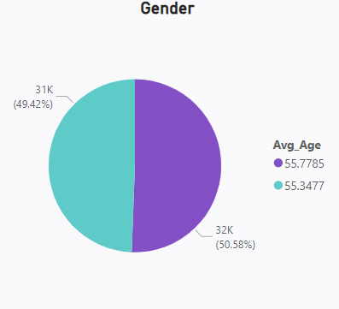
Gender-Based Analysis
Query: Sales distribution and growth rate by gender.
Key Insight: Gender-specific purchasing trends and their impact on sales.
Visual:
Conclusion: Tailoring marketing strategies based on gender-specific insights.

Slide 7
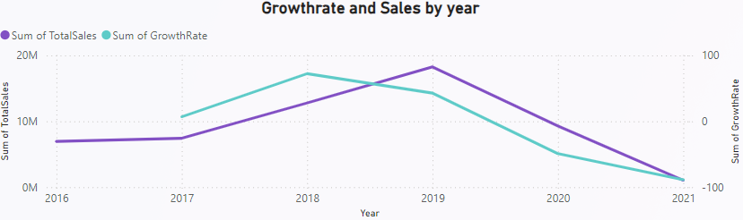
Sales Growth Rate
Query: Year-over-year and month-over-month sales growth.
Key Insight: Trends in sales growth, identifying peak and low performance periods.
Visual:
Conclusion: Strategies for leveraging growth trends and addressing periods of low growth.

Slide 8
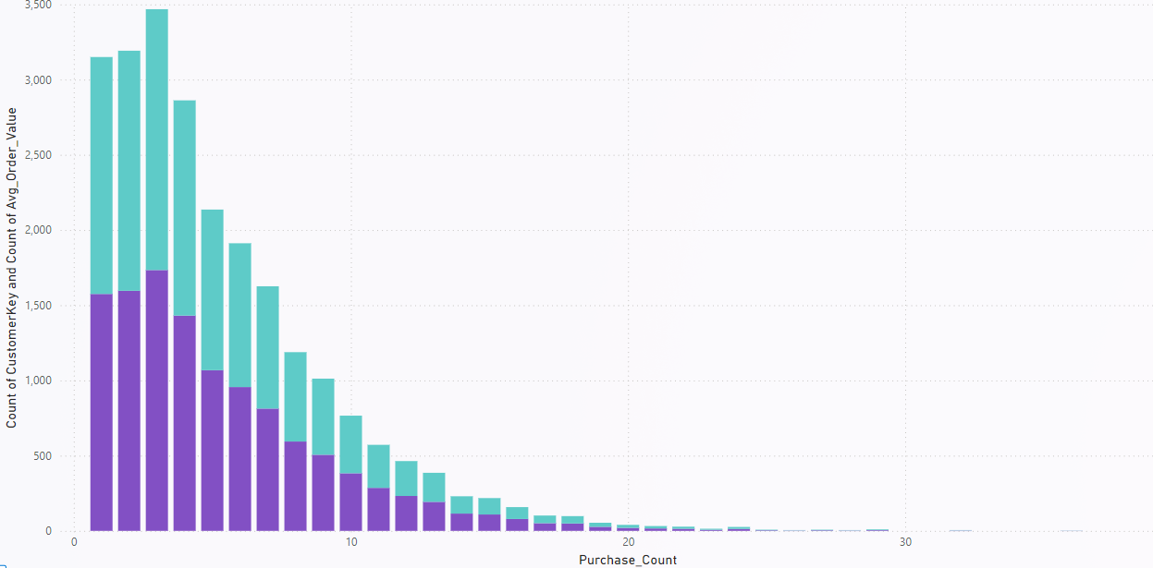
Orders and Customer Segmentation
Query: Analysis of orders and customer segmentation by purchase history.
Key Insight: Identifying key customer segments and their purchasing behavior.
Visual:
Conclusion: Recommendations for targeted marketing and customer engagement.

Slide 9
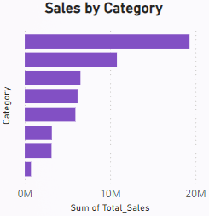
Sales by Category
Query: Sales performance across different product categories.
Key Insight: Performance of various categories, highlighting top and bottom performers.
Visual:
Conclusion: Inventory and promotional strategies based on category performance.

Slide 10
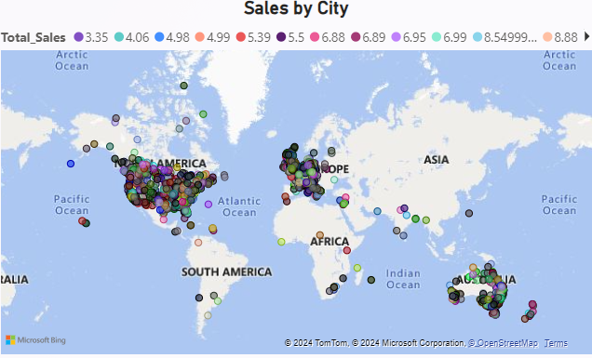
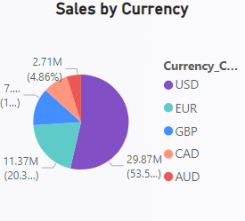
Sales by City and Currency
Query: Geographic and currency-based sales analysis.
Key Insights:
Sales by City: Identifying high and low-performing regions.
Sales by Currency: Impact of currency exchange on sales.
Visuals:
Conclusion: Regional marketing strategies and currency-based pricing adjustments.

Slide 11
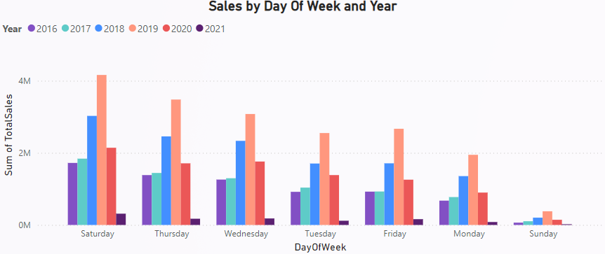
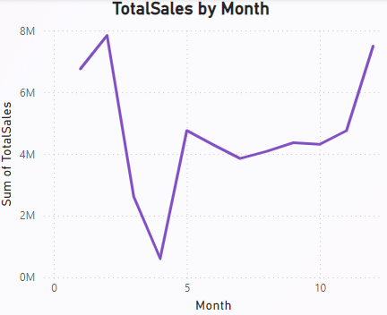
Sales by Time Period
Queries:
Day of the Week and Year: Sales patterns by day and year.
Month: Monthly sales trends.
Key Insights: Peak sales days and months.
Identifying seasonality and trends over time.
Visuals:

Slide 12
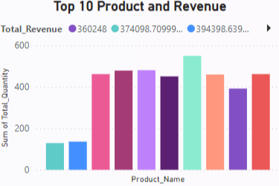
Top 10 Products by Revenue
Query: Revenue generated by the top 10 products.
Key Insight: Identifying high-revenue products and their impact on overall sales.
Visual:
Conclusion: Focus on high-performing products for strategic decisions and marketing efforts.

Slide 13
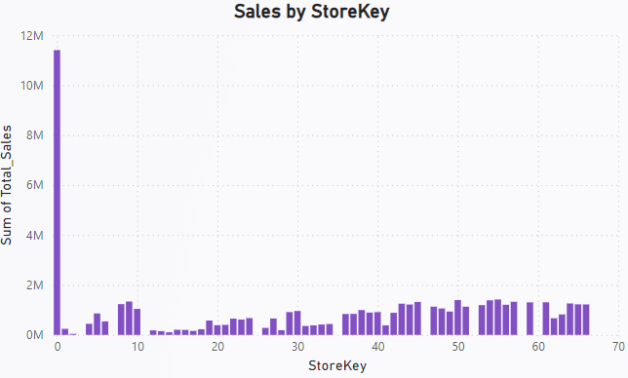
Sales by StoreKey
Sales Performance by Store
Objective: Analyze sales performance across various store locations to identify top-performing and underperforming stores.
Metrics: Total sales revenue per store, comparison of store performance.
Visual:

Slide 14
Summary & Recommendations
Summary of Key Findings: Key trends and insights from each analysis.
Marketing: Tailor strategies based on gender, geographic, and time-based insights.
Sales: Adjust pricing and promotions according to growth rates and category performance.
Operations: Optimize inventory and focus on top-performing products.
Future Work: Explore deeper into customer segmentation and product performance.

Slide 15
THANK YOU

