Slide 1

Application: Whisk & Drizzle
Type: Application Architecture View: Logical View Style: Layered Architecture Pattern
Users
Delivery Channels
Core Business Processes
Data And Information
Technology Enablers
Customer
Order Management
User Data
User Interface (React, Next.Js)
Order Process & Delivery Management
Inventory Management
Product Data
Connection for Database (MongoDB)
Browser Web Application
Dessert Manufacturing & Packaging
Payment Process Management
Order Data
Payment Gateway Integration (Stripe)
Customer Support Management
Feedback Data
Location API (Google API)
Marketing & Sales
Feedback Management
Location Data
Application Hosting Server (AWS EC2)
Finance Management
Delivery Personal
Delivery Personnel Data
Delivery Pipeline
Github & Jenkins
Delivery Management
Customer Support & Subscription

Slide 2
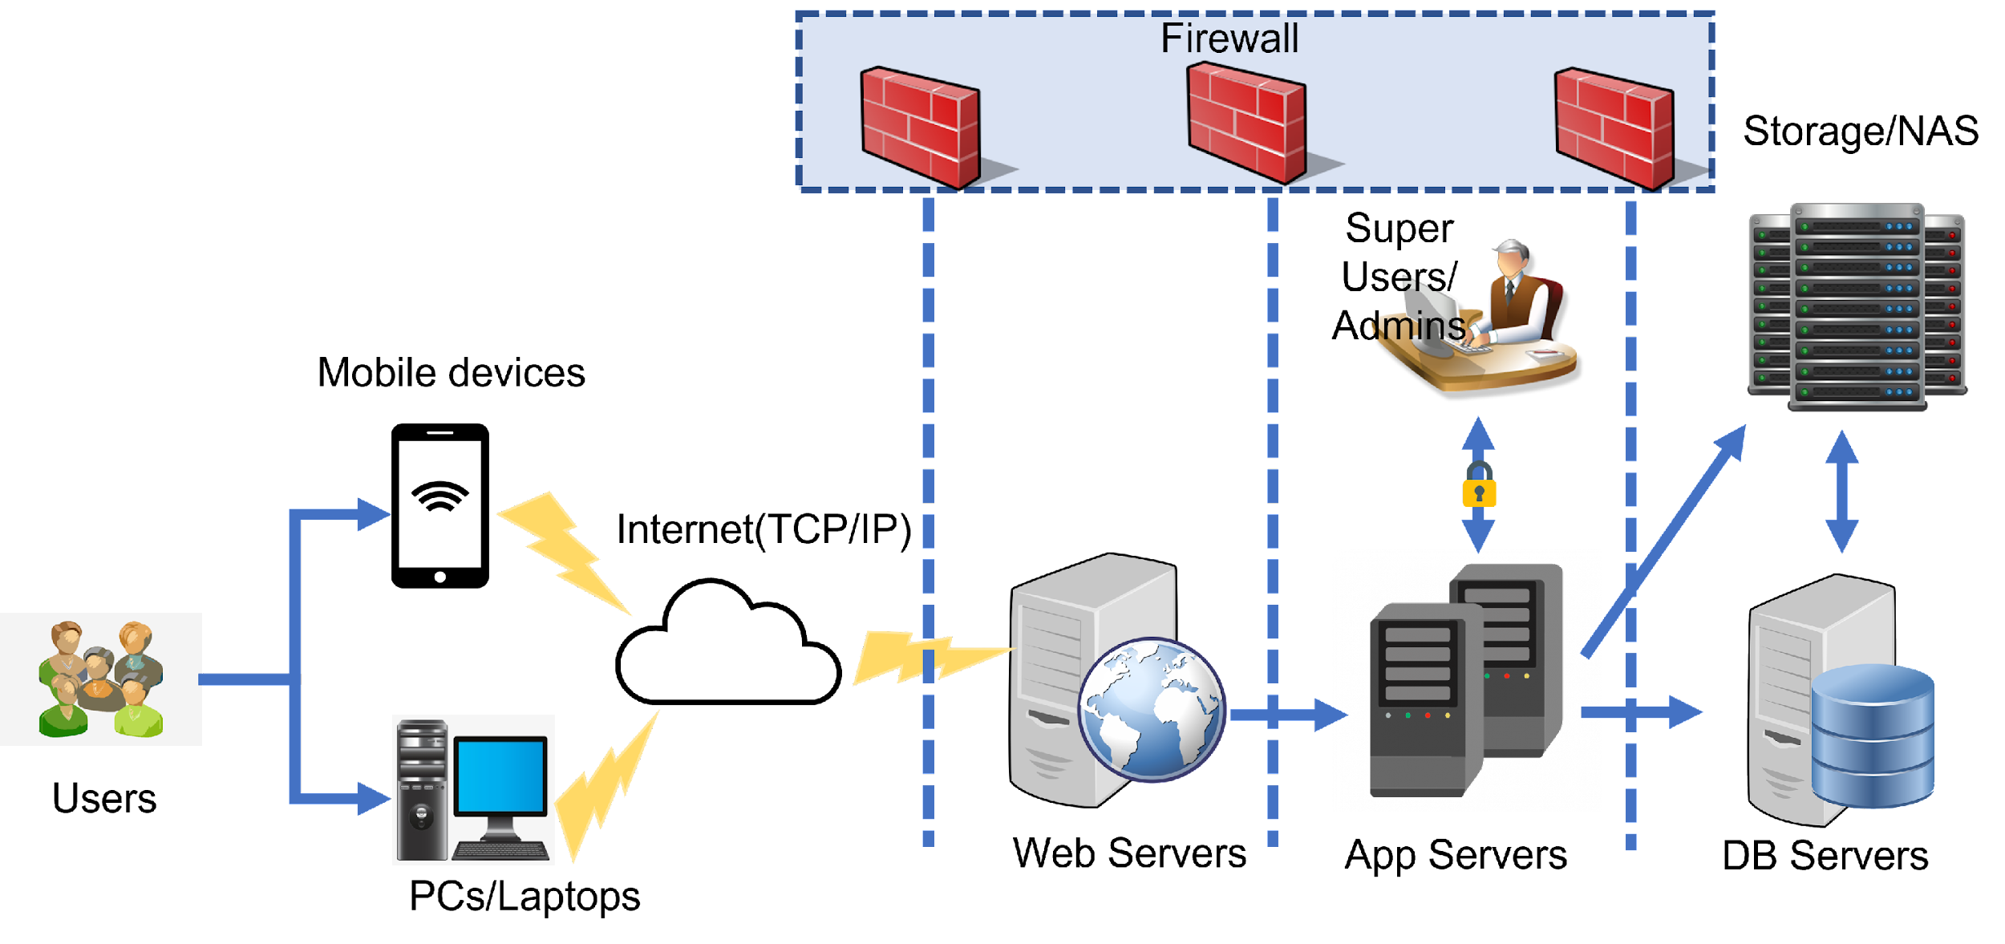
Application: Whisk & Drizzle Type: Application Architecture View: Process View Style: Client-Server Pattern

Slide 3
CLIENT (UI LAYER)
Applications Logic Layer
Customers
Delivery Personal
Super Users
(Admins:
Order Process & Delivery Management,
Dessert Manufacturing & Packaging
Marketing & Sales Finance Management Customer Support & Subscription
HTTP (over TCP/IP) + Web Sockets (for Real-time Updates)
Business Logic
Order Processing
Inventory Management
Payment Gateway
Google Maps API
(for Location)
Middleware between App & DB)
Data and Storage Layer
Data Access Layer (APIs)
MongoDB queries & File Storage Access
User Data (MongoDB)
Orders, Inventory Data
Payment Records
Media Files (Storage Server)
Retrieves and updates data
Communicates with DB Layer

