Slide 1
Whisk & Drizzle

Slide 2
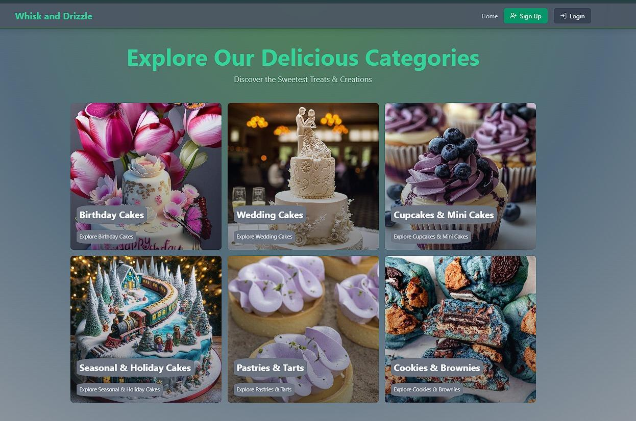
Main Navigation
Home:
This page introduces the website, detailing who we are, the benefits of joining, and what services or products we offer to potential users.
Menu:
This section provides a comprehensive list of categories available on the site, helping users easily navigate through the different offerings.
About:
Here, visitors can learn about the organization's history, mission, and values, giving them a deeper understanding of our purpose and philosophy.
Contact:
A straightforward contact page that invites users to reach out for any inquiries or support they may need, ensuring they can communicate effectively with us.
Log In:
A standard login page where users can securely access their accounts using their credentials, allowing them to engage with personalized features.
Sign Up:
This page enables new users to create an account by providing necessary information, granting them access to additional features and benefits.
Cart:
A dedicated page displaying products that users have added for purchase, allowing them to review their selections before proceeding to checkout.
Note: This Screenshot menu does not include all the option. We are going to add it later in the development

Slide 3
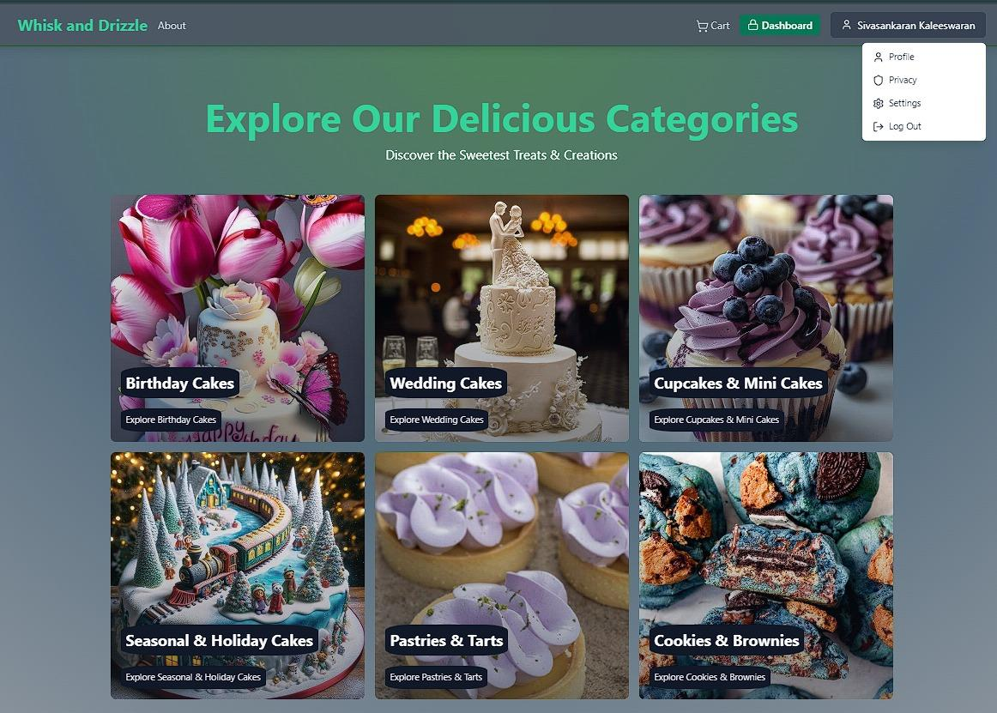
Post Login/Sign Up Navigation
Menu:
Maintains a list of categories, ensuring logged-in users can easily find products or services they are interested in.
Pick-Up:
A form for users to enter their address and contact number for order pickups, facilitating seamless coordination for product collection.
Personal Info:
A user-friendly interface where individuals can view and update their personal information, ensuring their account details are current.
Privacy & Data:
A section that outlines privacy policies and provides options for users to toggle privacy settings or delete their accounts if desired.
Settings:
An area for users to manage account settings, to change their password and update preferences.
Payment:
A dedicated page for adding new payment methods, ensuring users have a seamless experience when managing their transactions.
Note: This Screenshot menu does not include all the option. We are going to add it later in the development

Slide 4
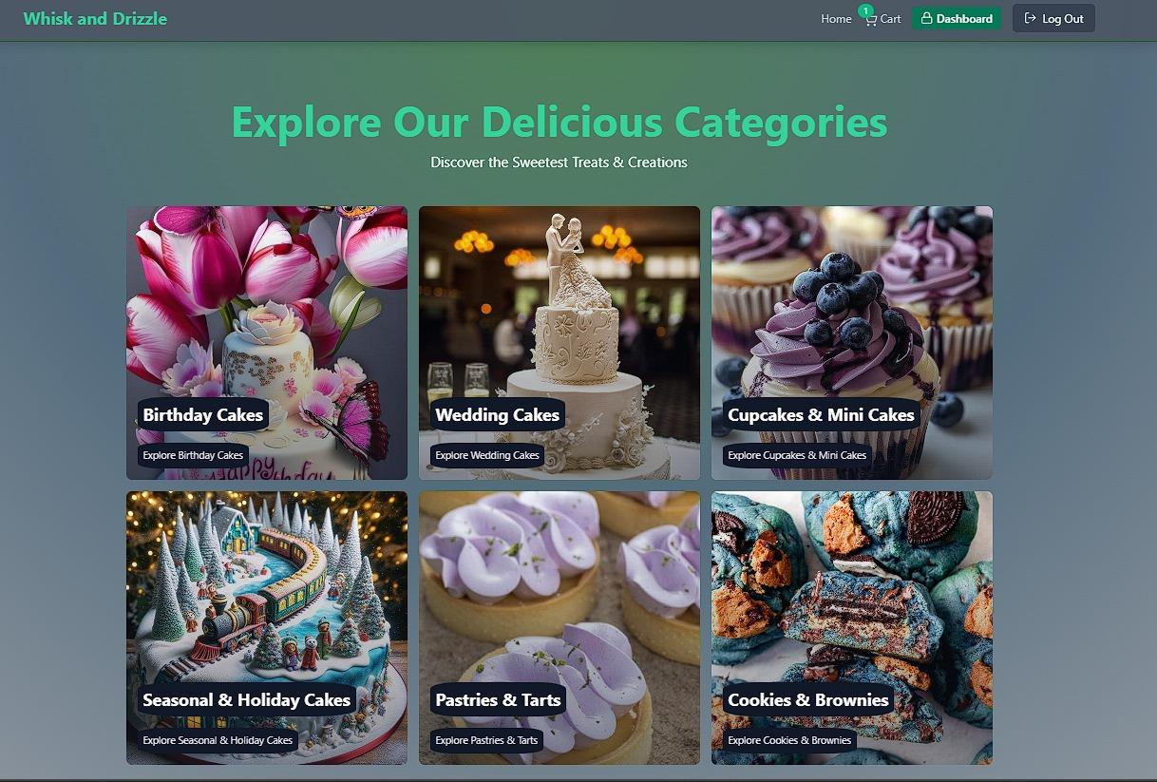
Admin Section
Add Product:
A functionality that allows administrators to introduce new products into the inventory, ensuring a dynamic and updated product offering.
Edit Product:
This feature enables admins to modify existing product details, ensuring accurate information and availability on the site.
Products (List):
A comprehensive listing of all products available on the site, along with their current status, providing admins with an overview of inventory management.

