Slide 1
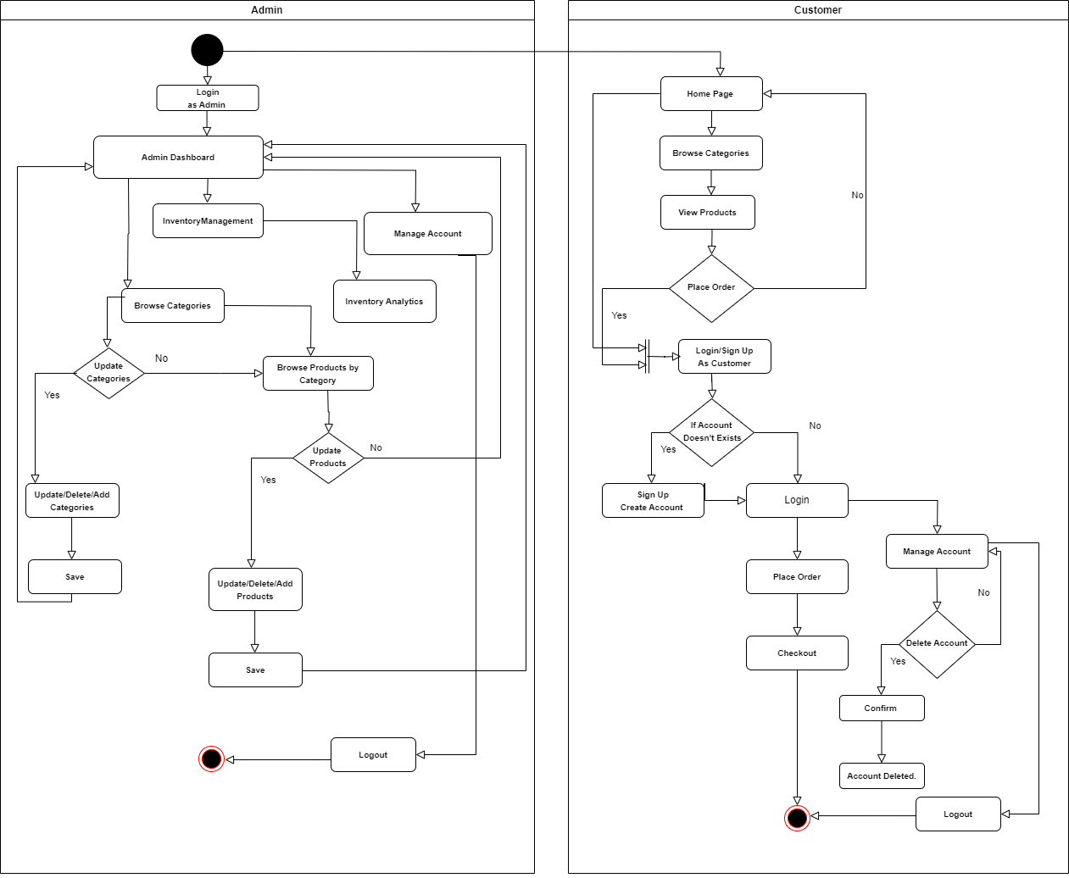
ACTIVITY DIAGRAM Whisk & Drizzle

