Slide 1
ContentNotifier
Get updated easily
By:
SIVASRI LAVETI (S180655)
DEVIKA KARRI (S180632)
DIVYA VUTA (S170180)
Under the guidance of :
Mr. Tammineni Anil Kumar,
Asst Prof,
Dept of CSE.

Slide 2
“ContentNotifier”
“An application to send a notification through an Email”
A Project Report Submitted In Partial Fulfillment Of The Requirements To
Rajiv Gandhi University of Knowledge Technologies, Srikakulam
For The Award Of Degree In
BACHELOR OF TECHNOLOGY
IN
COMPUTER SCIENCE AND ENGINEERING
Submitted by
L. Sivasri (s180655)
K. Devika (s180632)
V. Divya (s170180)
Under the Esteemed Guidance of
Mr.T. Anil Kumar, Assistant Professor
Department of Computer Science and Engineering,
RGUKT-SRIKAKULAM, ECHERLA.
April 2023
Andhra Pradesh, India

Slide 3
Abstract
Time is a valuable asset to human beings. Managing the time well, will let the people do multiple jobs intime. In today’s digital world, each and every work is virtualized and is being accessed through websites using the internet. The time required to know the presence of required data in a digital asset is quite hard. Manual checking of data might need more time and focus. In order to facilitate people with an easy way for data checking in the digital assets, this “ContentNotifier” project aims to provide a platform where the users can get the email notifications for the data they are searching for. This mainly helps the people to know the presence of data without checking manually. The software implemented will check for the data instead of the people who actually want the data. Those who are waiting for the upcoming data in corresponding webpages can use this platform. This project could make people comfortable in searching the data in digital assets.

Slide 4
Agenda:
Problem Statement
Proposed Solution
Objectives
Project Scope
Advantages

Slide 5
Problem Statement
Manual data checking in digital assets is time-consuming and inefficient, requiring constant monitoring and focus. There is a need for an automated solution that can proactively search for specific data and notify users when it becomes available, simplifying the process and saving time.

Slide 6
Objectives
To provide a notification of upcoming data through an email.
To reduce the time required for manual data checking.

Slide 7
Existing System
LexisNexis Content Notifier website can be found on the internet.
Disadvantages
● It can gather information by checking the details on various websites.
● It can be more time-consuming for checking multiple websites.

Slide 8
Proposed Solution
This project will help to those who are waiting for the upcoming data in corresponding webpages and to know the presence of data without checking manually.

Slide 9
Project Scope
Target users: This project aims to give content updates via email to a wide range of people who are waiting for upcoming data.
Accessibility: This project aims to give notification of searching data which is more accessible to a wide range of people. This includes providing free access to the platform.

Slide 10
OPERATING ENVIRONMENT
Operating System – Windows(version 10)
Editor – Jupyter Notebook(Anaconda)
Programming Languages – Python

Slide 11
ADVANTAGES
A. Time Saving
Faster results will be produce as notifications to your Gmail Account.
B. Easy to get the update
This will be used for easily get the content from the webpage.

Slide 12
Implementation
Libraries used:
MODULE NAME | PURPOSE
SMTP | To send mails to the user
urllib | To access the data of a webpage
re | To match the user required data with the webpage content
functools | To make functions work with other functions
schedule | To run python script automatically for multiple times
tkinter | To create a sample interface

Slide 13
Implementation...
2. Fetching and Matching the data
Code
page=urllib.request.urlopen(web_src)
data=page.read().decode("UTF-8")
results = re.findall(required,data)
Result
The data from the web_src is accessed successfully.
All matches for required data is stored in ‘results’ variable.

Slide 14
Implementation...
3. Checking matching data
Code
if (len(results)!=0):
Result
If the results doesn’t contains nothing - no matches for the data.

Slide 15
Implementation...
4. Sending mail
Code
# Create a secure connection to the SMTP server
server = smtplib.SMTP(smtp_server, smtp_port)
server.starttls()
server.login(sender_email, sender_password)
Result
Secure login of sender to the SMTP server

Slide 16
Implementation...
4. Sending mail
Code
# Send the email
server.sendmail(sender_email, recipient_email, f'The data {required}, you are looking for is just arrived. Check now here: {web_src}')
with open(file_path, 'w') as file:
file.write(f'{recipient_email}-{required}')
server.quit()
Result
Sent mail to the user
All the reciepent mail ids are stored

Slide 17
Implementation...
5. Taking user input
Code
r_mail = input("Reciever mail id:\t")
required = input("Required data:\t")
web_src = input("Web source link:\t")
Result
Takes input form the user

Slide 18
Implementation...
6. Automating the data checking
Code
schedule.every(10).seconds.do(partial(check,web_src,required,r_mail))
while(f'{r_mail}-{required}' not in f):
schedule.run_pending()
with open(file_path, 'r') as file:
f = file.read()
Result
Data checking done automatically for every interval of time if the user didn’t get notified for the content.

Slide 19
Using ContentNotifier
Ways to run:
Manual running of the script
Using task scheduler
Requirements:
Both methods requires the modules to be installed.

Slide 20
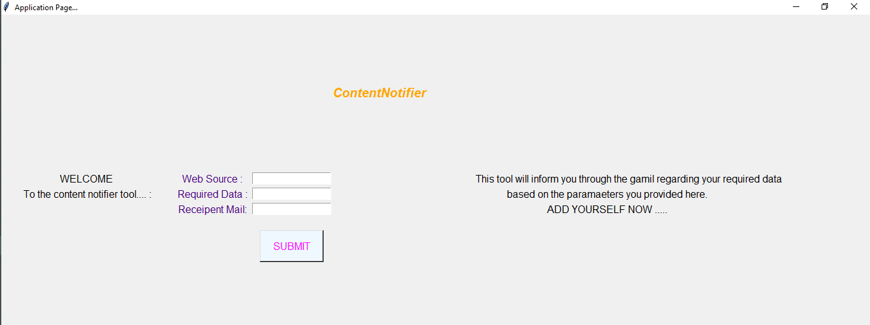
Interface Design and Implementation…

Slide 21
Implementation...
Creating Interface
Code
root = Tk()
root.title('Application Page...')
Result
Creates GUI and adds title

Slide 22
Implementation...
2. Taking input
Code
ws=Entry(root)
rd=Entry(root)
rm=Entry(root)
Result
User input through widgets

Slide 23
Implementation...
3. Data Validations
Code
re.fullmatch(re.compile(r'([A-Za-z0-9]+[.-_])*[A-Za-z0-9]+@[A-Za-z0-9-]+(\.[A-Z|a-z]{2,})+'),rm.get())
Result
User input through widgets

Slide 24
Implementation...
3. Validations
Code
try:
urllib.request.urlopen(ws.get())
except:
res = 1
Result
Checking whether a websource is scrapable or not

Slide 25
Implementation...
4. Adding user
Code
if(res==1):
op.config(text='Sorry the website data can\' be accessed')
ws.delete(0,END)
rd.delete(0,END)
rm.delete(0,END)
else:
op.config(text='Added Successfully.........')
Result
Adds user if res remains unchanged

Slide 26
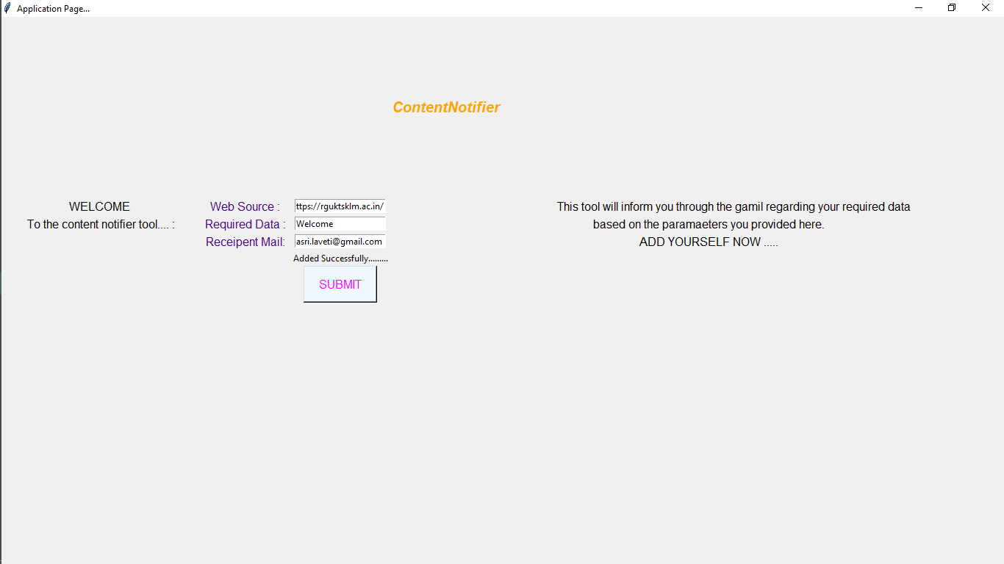
Results…
VALID CASE

Slide 27
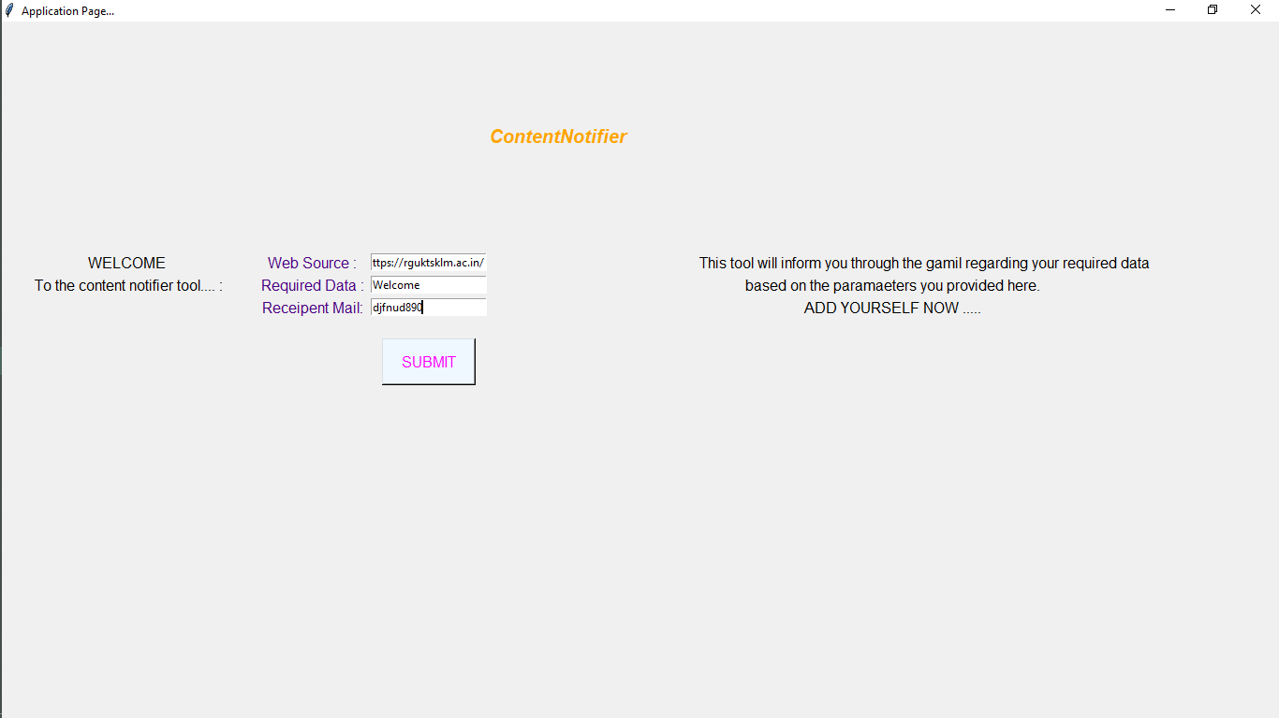
Results…
INVALID CASE - INPUT

Slide 28
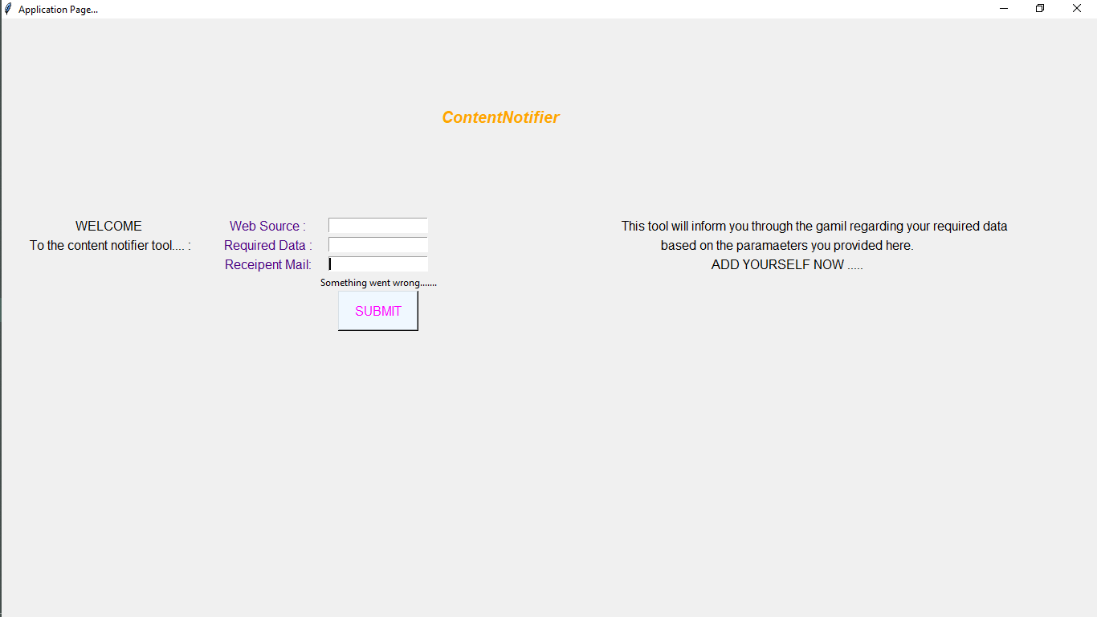
Results…
INVALID CASE - OUTPUT

Slide 29
THANK YOU
for your valuable time and attention

