Slide 1

WELCOME
ONE STOP DESTINATION FOR ALL YOUR MEDICAL NEEDS

Slide 2
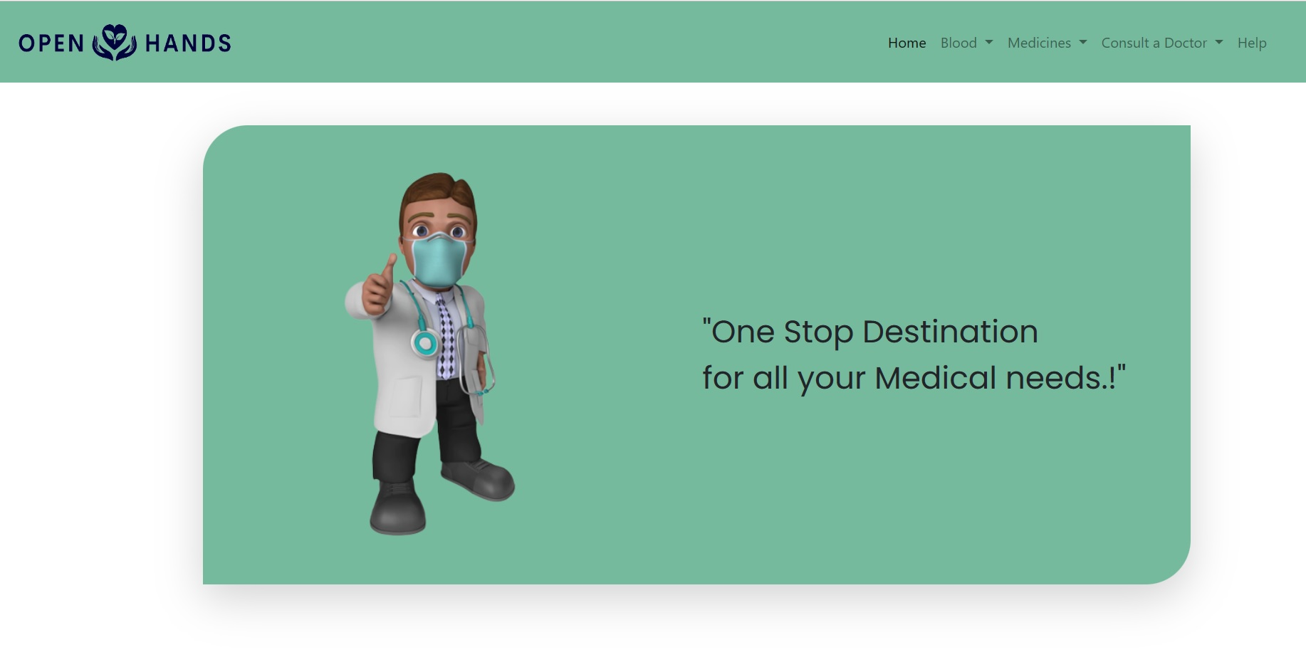

Slide 3


Slide 4
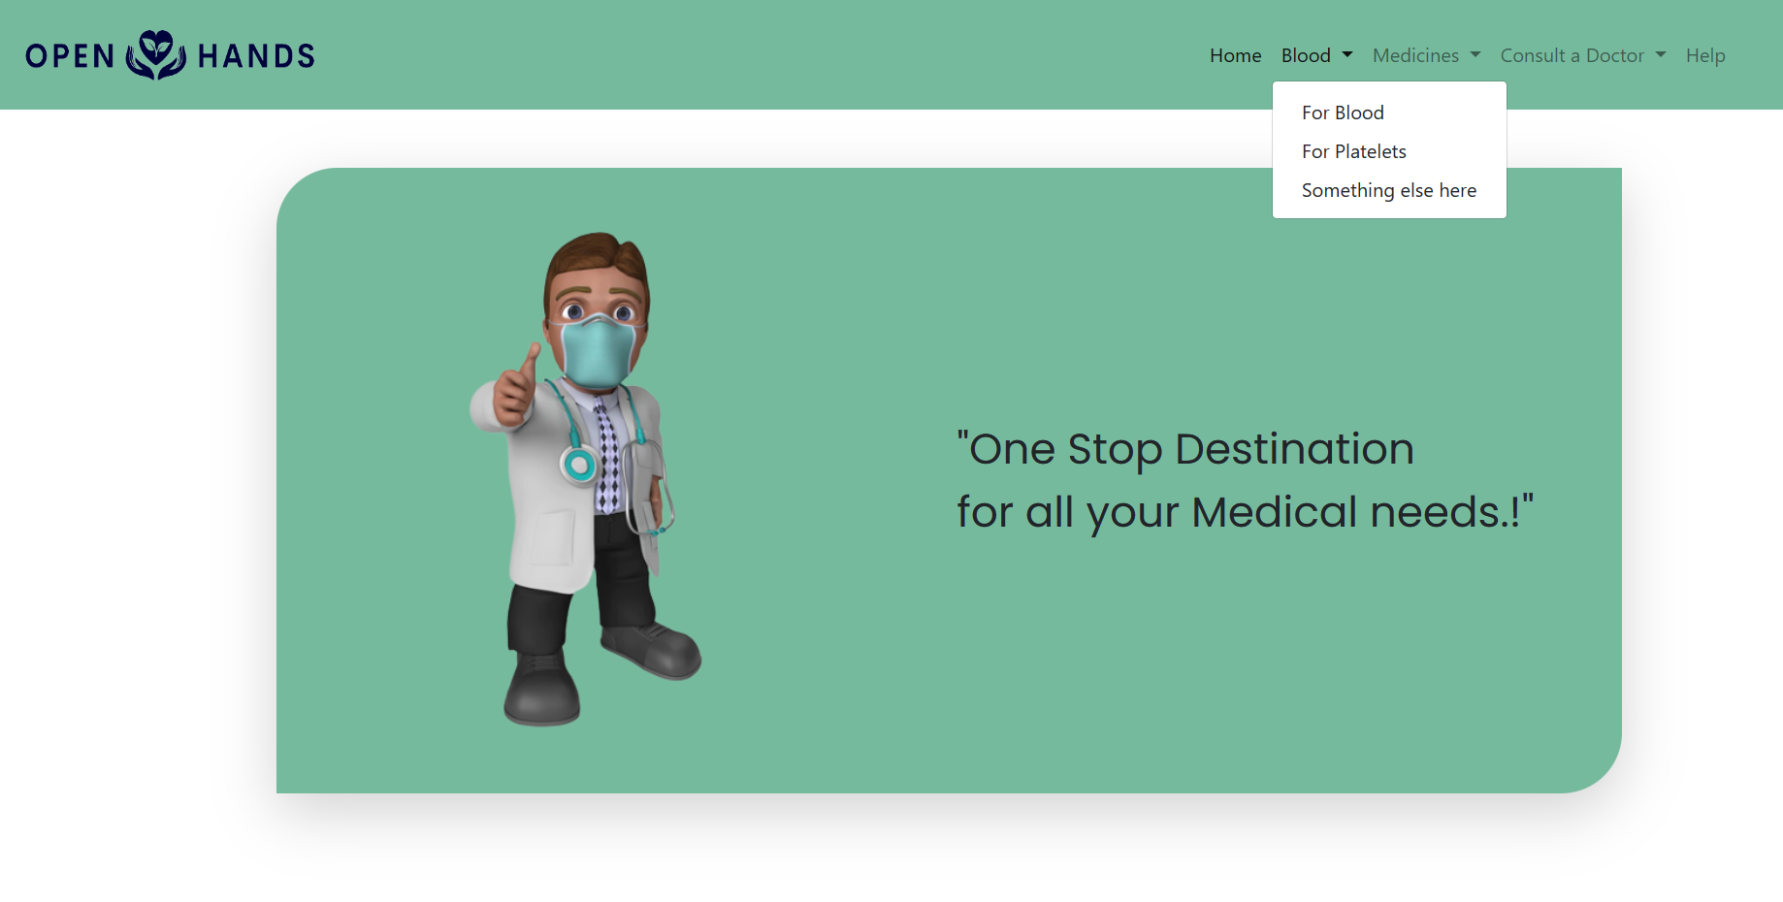

Slide 5
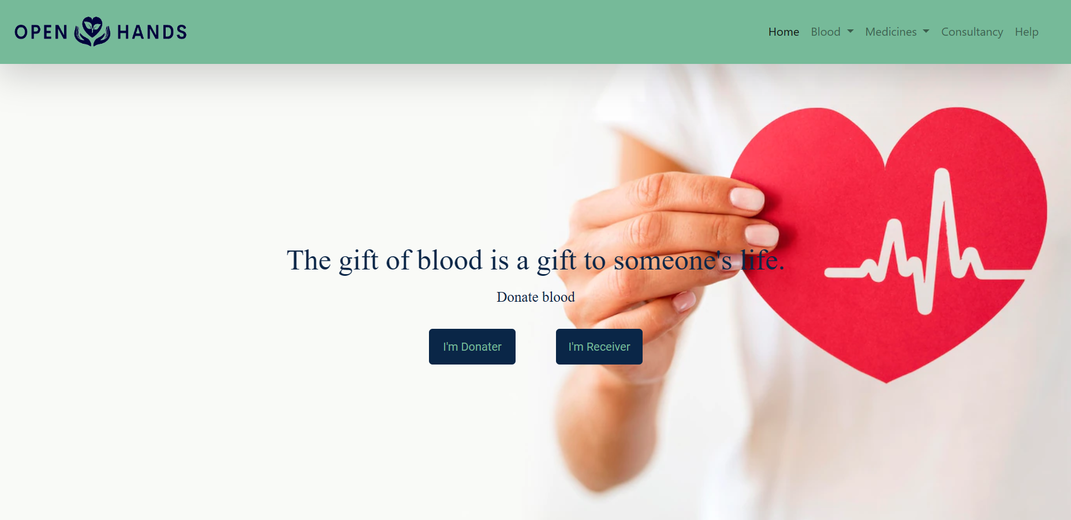

Slide 6
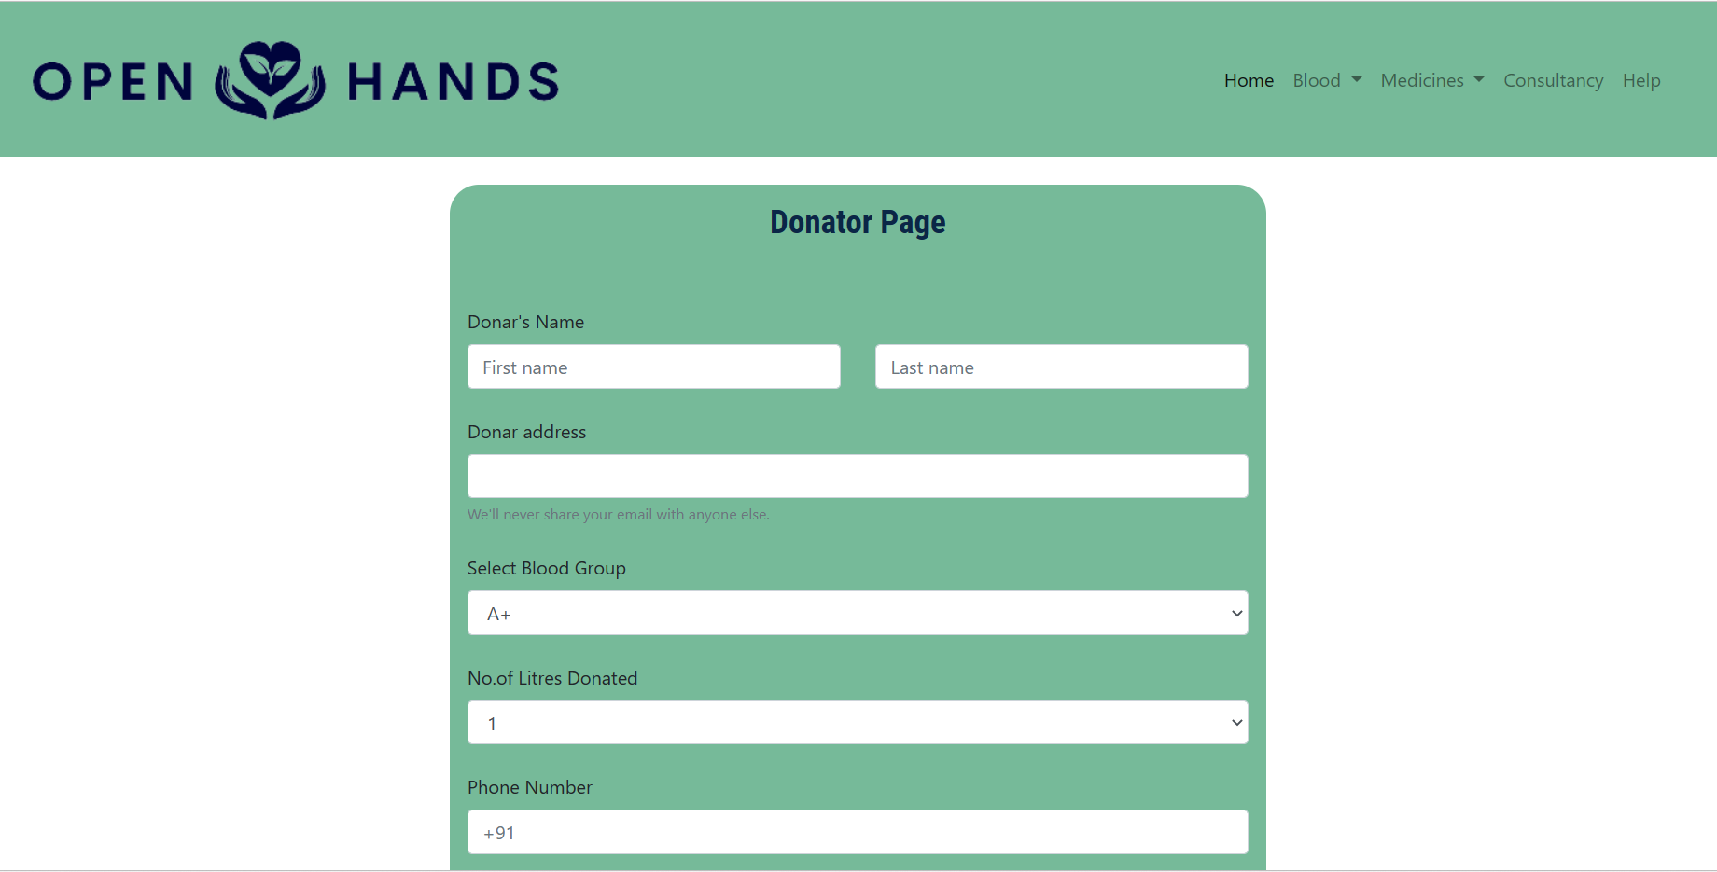

Slide 7
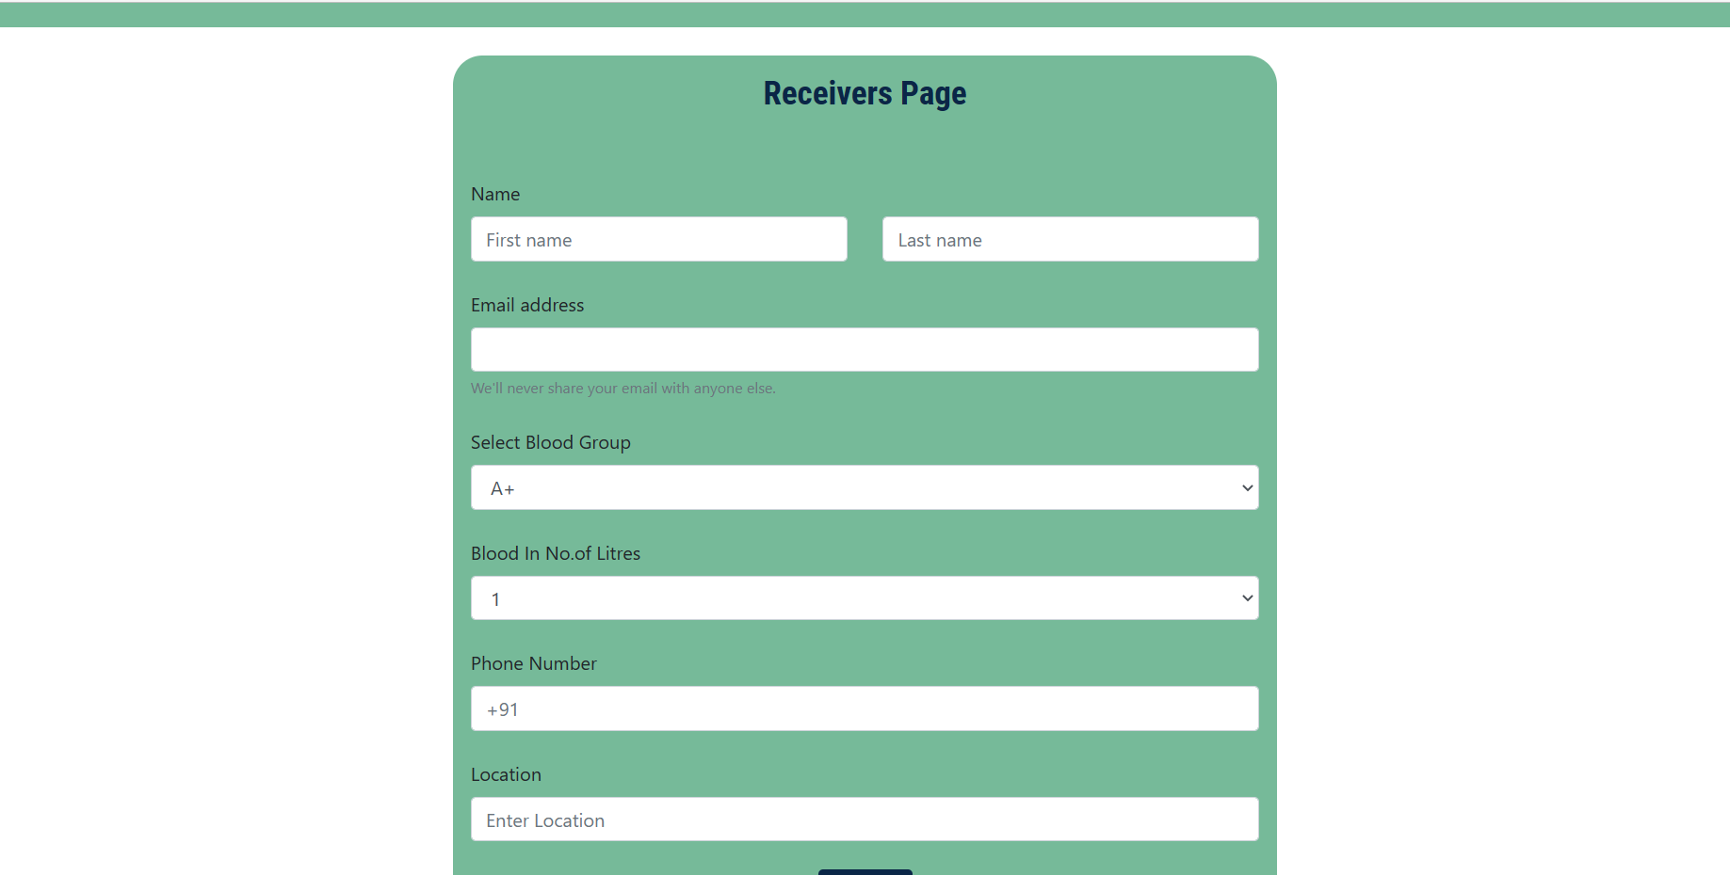

Slide 8


Slide 9
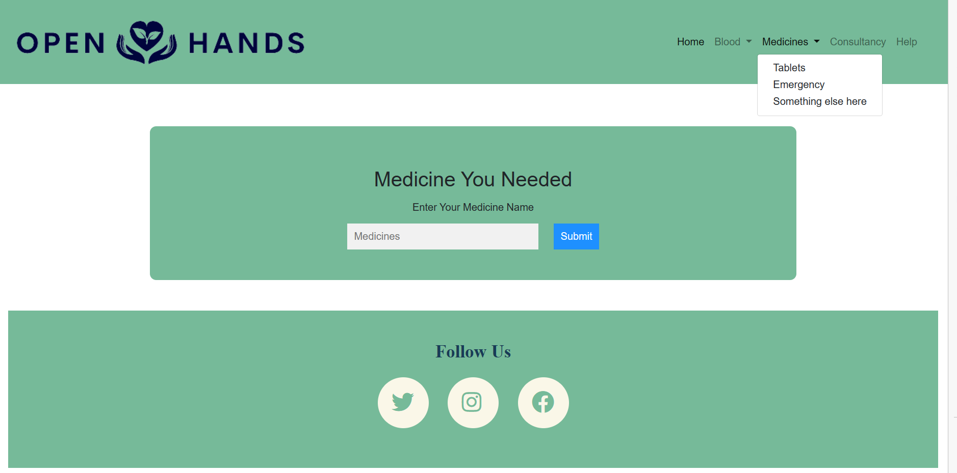

Slide 10
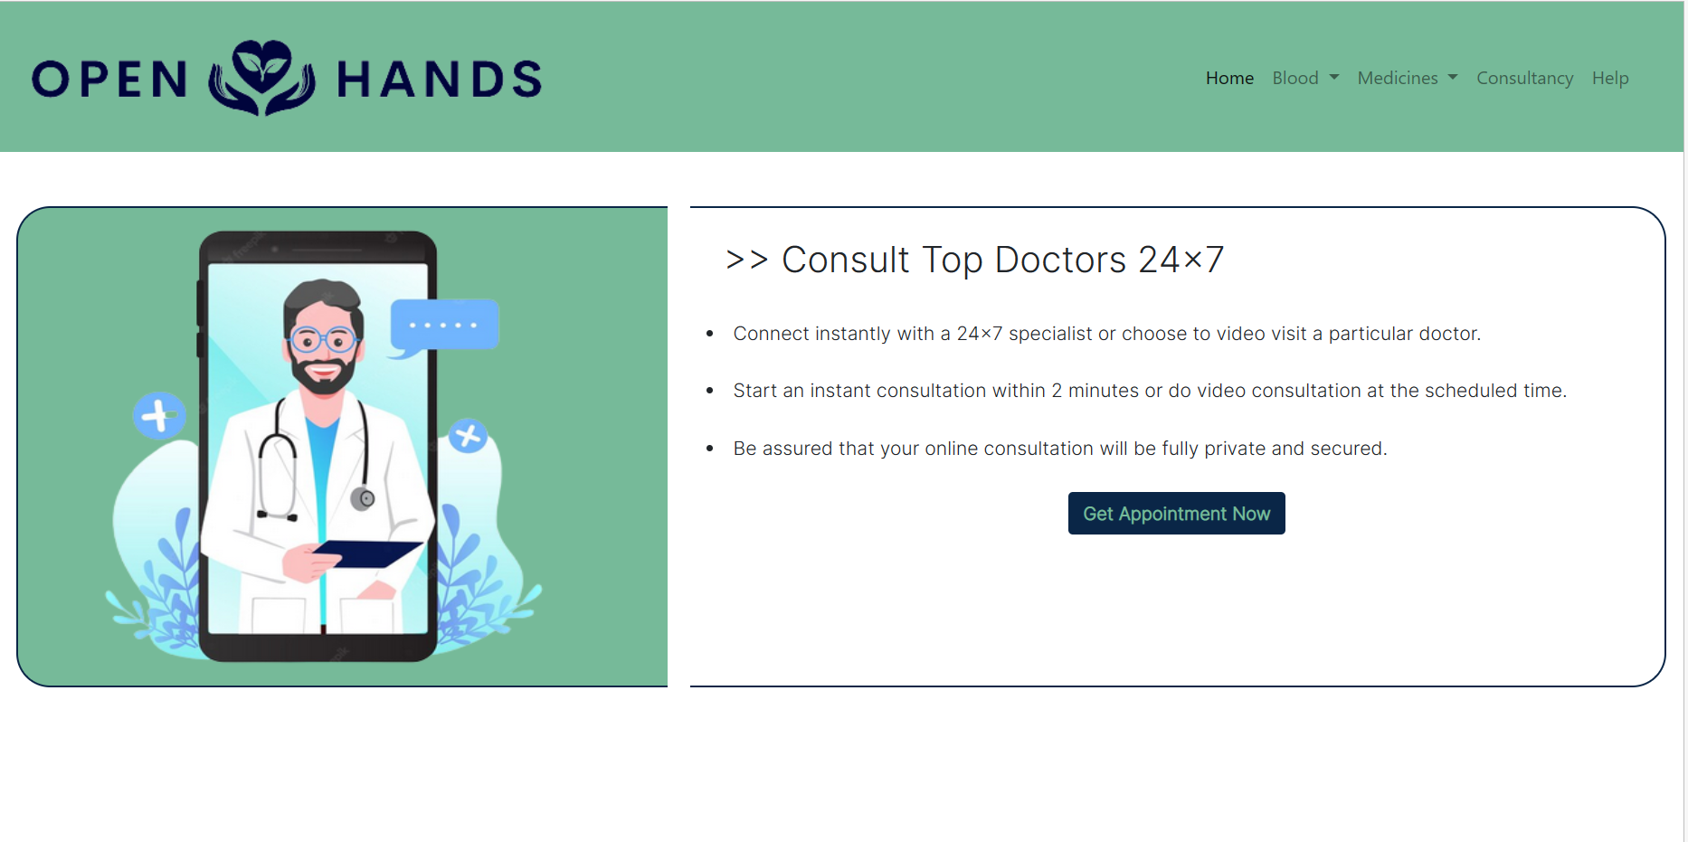

Slide 11
Thank You…
By Group members:
1)A.nithin -21A81A4301
2)Ch.Tarun Sai -21A81A4313
3)K.Varun -21A81A4323
4)Ch.Siva Teja -21A81A4311
5)M.Roshan Saikiran -21A81A4328

