Slide 1
BLACKTOOTH
Team name: DYNAMITE
Team Members:
S.Srevidya
B.Chandhini
B.Vinothini

Slide 2
ABSTRACT
Blacktooth is an audio based navigation app for the visually impaired people.
In this present world there are many visually impaired people and many of them are relying on guiding dogs and other people.
This app is use to sending voice message to the user through bluetooth module.

Slide 3
WORKING PRINCIPLE
The connects with the local microcontroller present in the cane stick through Bluetooth.
The micro controller uses HC-05 bluetooth module for communicating with the smart phone.
There are 3 ultrasonic sensors fixed in the cane stick which will continuously probe the area around the user and sends the information regarding obstacle to the user.
If there is any possible chances of the colliding with the obstacle then the microcontroller sends some code to the smart phone.
The smart phone will receive this code and process it. According to the received code the app gives some voice message to the user.
The user can use these codes as guidance for navigating in both indoor and outdoor environments.

Slide 4
Example codes and voice messages
‘A’------------> ‘obstacle to the right’
‘B’------------> ‘obstacle to the left’
‘C’------------> ‘obstacle to the front’
For any other data received the app will give the voice message “walk walk”, meaning there are no obstacles and the user can walk freely.

Slide 5
System diagram for blacktooth
Cane stick
(micro controller)
Ultrasonic sensor
HC-05 Bluetooth
smart phone
Voice message
user

Slide 6
MICROCONTROLLER
Micro controller is a computer present in a single integrated circuit which is dedicated to perform one task and execute one specific application.
It contains memory, programmable input/output peripherals as well as processor.
Program used by microcontroller is stored in ROM.

Slide 7
ULTRASONIC SENSOR
Ultra sonic sensors are transducers that convert ultrasound waves to electrical signals or vice versa.
These device work on a principle similar to that of transducers used in radar and sonar systems, which evaluate attributes of a target by interpreting the echoes from radio or sound waves, respectively.
Active ultra sonic sensors generate high frequency sound waves and evaluate the echo which is received back by the sensor, measuring the time interval between sending the signal and receiving the echo to determine the distance to an object.

Slide 8
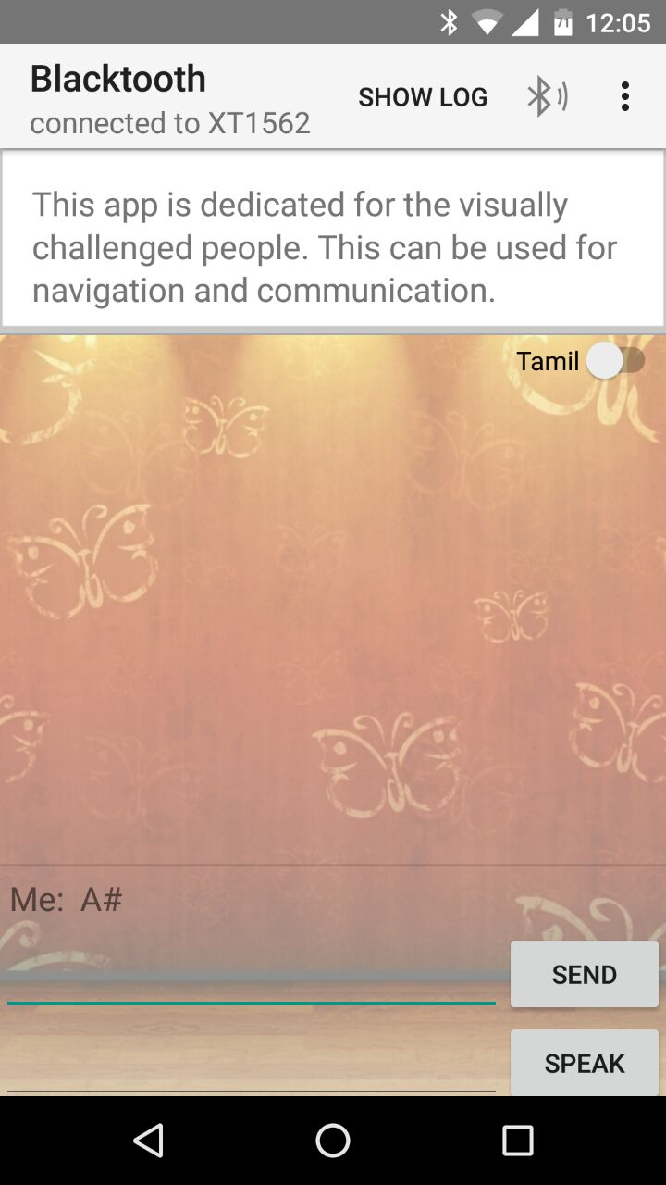
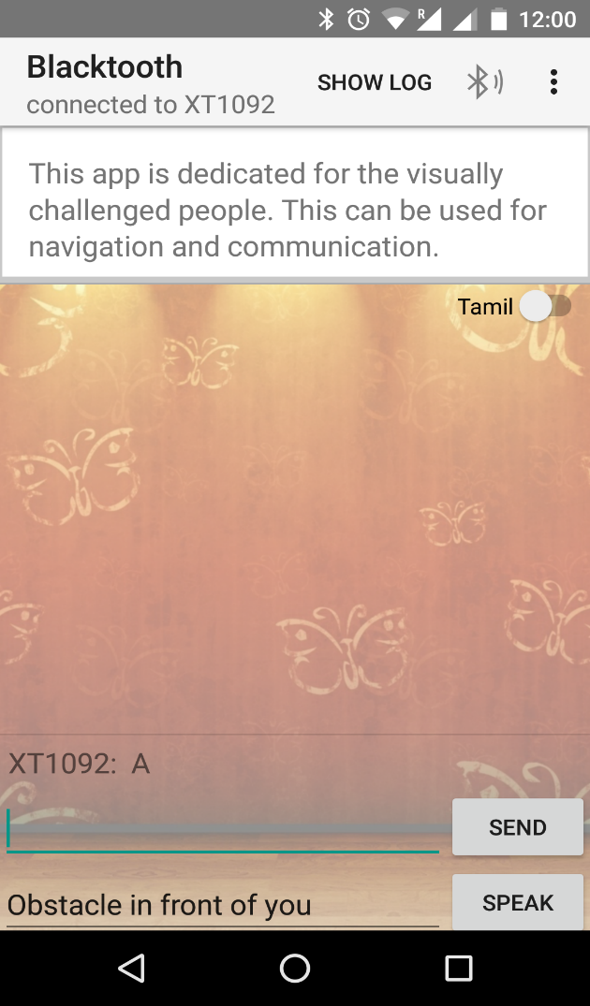
Screenshots:
Sender
Receiver

Slide 9
Applications
There by using this app the visually impaired people can navigate freely without the need of others and it also motivates them.
In future this app can be modified and many voice messages can included without any difficulty such as traffic light signal status, location status and many.

