Slide 1
Snack Ordering

Slide 2
AdminActivity.kt
package com.example.snackordering
import android.icu.text.SimpleDateFormat
import android.os.Bundle import android.util.Log
import androidx.activity.ComponentActivity import androidx.activity.compose.setContent import androidx.compose.foundation.Image import androidx.compose.foundation.layout.*
import androidx.compose.foundation.lazy.LazyColumn import androidx.compose.foundation.lazy.LazyRow import androidx.compose.foundation.lazy.items
import androidx.compose.material.MaterialTheme import androidx.compose.material.Surface
import androidx.compose.material.Text
import androidx.compose.runtime.Composable import androidx.compose.ui.Modifier
import androidx.compose.ui.graphics.Color import androidx.compose.ui.layout.ContentScale import androidx.compose.ui.res.painterResource import androidx.compose.ui.unit.dp
import androidx.compose.ui.unit.sp
import com.example.snackordering.ui.theme.SnackOrderingTheme import java.util.*
class AdminActivity : ComponentActivity() {
private lateinit var orderDatabaseHelper: OrderDatabaseHelper override fun onCreate(savedInstanceState: Bundle?) {
super.onCreate(savedInstanceState) orderDatabaseHelper = OrderDatabaseHelper(this) setContent {
SnackOrderingTheme {
// A surface container using the 'background' color from the theme Surface(
modifier = Modifier.fillMaxSize(),
color = MaterialTheme.colors.background
) {
val data=orderDatabaseHelper.getAllOrders(); Log.d("swathi" ,data.toString())

Slide 3
val order = orderDatabaseHelper.getAllOrders()
ListListScopeSample(order)
}
}
}
}
}
@Composable
fun ListListScopeSample(order: List<Order>) { Image(
painterResource(id = R.drawable.order), contentDescription = "", alpha =0.5F,
contentScale = ContentScale.FillHeight)
Text(text = "Order Tracking", modifier = Modifier.padding(top = 24.dp, start = 106.dp, bottom = 24.dp ), color = Color.White, fontSize = 30.sp)
Spacer(modifier = Modifier.height(30.dp)) LazyRow(
modifier = Modifier
.fillMaxSize()
.padding(top = 80.dp),
horizontalArrangement = Arrangement.SpaceBetween
){
item {
LazyColumn {
items(order) { order ->
Column(modifier = Modifier.padding(top = 16.dp, start = 48.dp, bottom = 20.dp)) { Text("Quantity: ${order.quantity}")
Text("Address: ${order.address}")
}
}
}
}
}
}
LoginActivity.kt
package com.example.snackordering

Slide 4
import android.content.Context
import android.content.Intent import android.os.Bundle
import androidx.activity.ComponentActivity
import androidx.activity.compose.setContent import androidx.compose.foundation.Image import androidx.compose.foundation.layout.* import androidx.compose.material.*
import androidx.compose.runtime.* import androidx.compose.ui.Alignment import androidx.compose.ui.Modifier
import androidx.compose.ui.graphics.Color
import androidx.compose.ui.layout.ContentScale import androidx.compose.ui.res.painterResource import androidx.compose.ui.text.font.FontFamily import androidx.compose.ui.text.font.FontWeight import androidx.compose.ui.unit.dp
import androidx.compose.ui.unit.sp
import androidx.core.content.ContextCompat
import com.example.snackordering.ui.theme.SnackOrderingTheme
class LoginActivity : ComponentActivity() {
private lateinit var databaseHelper: UserDatabaseHelper override fun onCreate(savedInstanceState: Bundle?) {
super.onCreate(savedInstanceState)
databaseHelper = UserDatabaseHelper(this) setContent {
SnackOrderingTheme {
// A surface container using the 'background' color from the theme Surface(
modifier = Modifier.fillMaxSize(),
color = MaterialTheme.colors.background
) {
LoginScreen(this, databaseHelper)
}
}
}
}
}
@Composable
fun LoginScreen(context: Context, databaseHelper: UserDatabaseHelper) {

Slide 5
Image(painterResource(id = R.drawable.order), contentDescription = "",
alpha =0.3F,
contentScale = ContentScale.FillHeight,
)
var username by remember { mutableStateOf("") }
var password by remember { mutableStateOf("") } var error by remember { mutableStateOf("") }
Column(
modifier = Modifier.fillMaxSize(), horizontalAlignment = Alignment.CenterHorizontally, verticalArrangement = Arrangement.Center
) {
Text(
fontSize = 36.sp,
fontWeight = FontWeight.ExtraBold, fontFamily = FontFamily.Cursive, color = Color.White,
text = "Login"
)
Spacer(modifier = Modifier.height(10.dp))
TextField(
value = username,
onValueChange = { username = it }, label = { Text("Username") }, modifier = Modifier.padding(10.dp)
.width(280.dp)
)
TextField(
value = password,
onValueChange = { password = it }, label = { Text("Password") },
modifier = Modifier.padding(10.dp)
.width(280.dp)
)

Slide 6
if (error.isNotEmpty()) {
Text(
text = error,
color = MaterialTheme.colors.error,
modifier = Modifier.padding(vertical = 16.dp)
)
}
Button(
onClick = {
if (username.isNotEmpty() && password.isNotEmpty()) {
val user = databaseHelper.getUserByUsername(username) if (user != null && user.password == password) {
error = "Successfully log in" context.startActivity(
Intent(
context, MainPage::class.java
)
)
//onLoginSuccess()
}
if (user != null && user.password == "admin") { error = "Successfully log in"
context.startActivity( Intent(
context, AdminActivity::class.java
)
)
}
else {
error = "Invalid username or password"
}
} else {
error = "Please fill all fields"
}
},
modifier = Modifier.padding(top = 16.dp)

Slide 7
) {
Text(text = "Login")
}
Row {
TextButton(onClick = {context.startActivity( Intent(
context, MainActivity::class.java
)
)}
)
{ Text(color = Color.White,text = "Sign up") } TextButton(onClick = {
})
{
Spacer(modifier = Modifier.width(60.dp)) Text(color = Color.White,text = "Forget password?")
}
}
}
}
private fun startMainPage(context: Context) {
val intent = Intent(context, MainPage::class.java) ContextCompat.startActivity(context, intent, null)
}
MainPage.kt
package com.example.snackordering
import android.annotation.SuppressLint
import android.content.Context import android.os.Bundle import android.widget.Toast
import androidx.activity.ComponentActivity import androidx.activity.compose.setContent import androidx.annotation.DrawableRes import androidx.annotation.StringRes import androidx.compose.foundation.Image
import androidx.compose.foundation.background

Slide 8
import androidx.compose.foundation.layout.*
import androidx.compose.foundation.shape.CircleShape
import androidx.compose.foundation.shape.RoundedCornerShape import androidx.compose.material.*
import androidx.compose.material.icons.Icons import androidx.compose.material.icons.filled.* import androidx.compose.runtime.Composable import androidx.compose.ui.Alignment
import androidx.compose.ui.Modifier import androidx.compose.ui.draw.clip import androidx.compose.ui.graphics.Color
import androidx.compose.foundation.lazy.LazyColumn import androidx.compose.foundation.lazy.items
import androidx.compose.material.Text import androidx.compose.ui.unit.dp
import androidx.compose.ui.graphics.RectangleShape import androidx.compose.ui.layout.ContentScale import androidx.compose.ui.platform.LocalContext import androidx.compose.ui.res.painterResource
import androidx.compose.ui.res.stringResource import androidx.compose.ui.text.font.FontWeight import androidx.compose.ui.unit.sp
import androidx.core.content.ContextCompat.startActivity
import com.example.snackordering.ui.theme.SnackOrderingTheme
import android.content.Intent as Intent1
class MainPage : ComponentActivity() {
override fun onCreate(savedInstanceState: Bundle?) { super.onCreate(savedInstanceState)
setContent { SnackOrderingTheme {
// A surface container using the 'background' color from the theme Surface(
modifier = Modifier.fillMaxSize(),
color = MaterialTheme.colors.background
) {
FinalView(this)
val context = LocalContext.current
//PopularFoodColumn(context)

Slide 9
}
}
}
}
}
@Composable
fun TopPart() {
Row(
modifier = Modifier
.fillMaxWidth()
.background(Color(0xffeceef0)), Arrangement.SpaceBetween
) {
Icon(
imageVector = Icons.Default.Add, contentDescription = "Menu Icon", Modifier
.clip(CircleShape)
.size(40.dp), tint = Color.Black,
)
Column(horizontalAlignment = Alignment.CenterHorizontally) {
Text(text = "Location", style = MaterialTheme.typography.subtitle1, color = Color.Black) Row {
Icon(
imageVector = Icons.Default.LocationOn, contentDescription = "Location",
tint = Color.Red,
)
Text(text = "Accra" , color = Color.Black)
}
}
Icon(
imageVector = Icons.Default.Notifications, contentDescription = "Notification Icon",
Modifier
.size(45.dp), tint = Color.Black,
)

Slide 10
}
}
@Composable
fun CardPart() {
Card(modifier = Modifier.size(width = 310.dp, height = 150.dp), RoundedCornerShape(20.dp)) { Row(modifier = Modifier.padding(10.dp), Arrangement.SpaceBetween) {
Column(verticalArrangement = Arrangement.spacedBy(12.dp)) { Text(text = "Get Special Discounts")
Text(text = "up to 85%", style = MaterialTheme.typography.h5) Button(onClick = {}, colors = ButtonDefaults.buttonColors(Color.White)) {
Text(text = "Claim voucher", color = MaterialTheme.colors.surface)
}
}
Image(
painter = painterResource(id = R.drawable.food_tip_im),
contentDescription = "Food Image", Modifier.size(width = 100.dp, height = 200.dp)
)
}
}
}
@Composable
fun PopularFood(
@DrawableRes drawable: Int, @StringRes text1: Int, context: Context
) {
Card(
modifier = Modifier
.padding(top=20.dp, bottom = 20.dp, start = 65.dp)
.width(250.dp)
) {
Column(
verticalArrangement = Arrangement.Top, horizontalAlignment = Alignment.CenterHorizontally
) {
Spacer(modifier = Modifier.padding(vertical = 5.dp)) Row(

Slide 11
modifier = Modifier
.fillMaxWidth(0.7f), Arrangement.End
) {
Icon(
imageVector = Icons.Default.Star, contentDescription = "Star Icon", tint = Color.Yellow
)
Text(text = "4.3", fontWeight = FontWeight.Black)
}
Image(
painter = painterResource(id = drawable),
contentDescription = "Food Image", contentScale = ContentScale.Crop, modifier = Modifier
.size(100.dp)
.clip(CircleShape)
)
Text(text = stringResource(id = text1), fontWeight = FontWeight.Bold) Row(modifier = Modifier.fillMaxWidth(0.7f), Arrangement.SpaceBetween) {
/*TODO Implement Prices for each card*/ Text(
text = "$50",
style = MaterialTheme.typography.h6, fontWeight = FontWeight.Bold,
fontSize = 18.sp
)
IconButton(onClick = {
//var no=FoodList.lastIndex;
//Toast.
val intent = Intent1(context, TargetActivity::class.java) context.startActivity(intent)
}) {
Icon(
imageVector = Icons.Default.ShoppingCart, contentDescription = "shopping cart",
)
}

Slide 12
}
}
}
}
private val FoodList = listOf(
R.drawable.sandwish to R.string.sandwich, R.drawable.sandwish to R.string.burgers, R.drawable.pack to R.string.pack,
R.drawable.pasta to R.string.pasta, R.drawable.tequila to R.string.tequila, R.drawable.wine to R.string.wine, R.drawable.salad to R.string.salad, R.drawable.pop to R.string.popcorn
).map { DrawableStringPair(it.first, it.second) }
private data class DrawableStringPair(
@DrawableRes val drawable: Int, @StringRes val text1: Int
)
@Composable
fun App(context: Context) {
Column(
modifier = Modifier
.fillMaxSize()
.background(Color(0xffeceef0))
.padding(10.dp),
verticalArrangement = Arrangement.Top, horizontalAlignment = Alignment.CenterHorizontally
) {
Surface(modifier = Modifier, elevation = 5.dp) { TopPart()
}
Spacer(modifier = Modifier.padding(10.dp)) CardPart()

Slide 13
Spacer(modifier = Modifier.padding(10.dp))
Row(modifier = Modifier.fillMaxWidth(), Arrangement.SpaceBetween) {
Text(text = "Popular Food", style = MaterialTheme.typography.h5, color = Color.Black) Text(text = "view all", style = MaterialTheme.typography.subtitle1, color = Color.Black)
}
Spacer(modifier = Modifier.padding(10.dp)) PopularFoodColumn(context) // <- call the function with parentheses
}
}
@Composable
fun PopularFoodColumn(context: Context) {
LazyColumn(
modifier = Modifier.fillMaxSize(), content = {
items(FoodList) { item ->
PopularFood(context = context,drawable = item.drawable, text1 = item.text1) abstract class Context
}
},
verticalArrangement = Arrangement.spacedBy(16.dp))
}
@SuppressLint("UnusedMaterialScaffoldPaddingParameter") @Composable
fun FinalView(mainPage: MainPage) { SnackOrderingTheme {
Scaffold() {
val context = LocalContext.current App(context)
}
}
}
Order.kt
package com.example.snackordering
import androidx.room.ColumnInfo
import androidx.room.Entity import androidx.room.PrimaryKey

Slide 14
@Entity(tableName = "order_table")
data class Order(
@PrimaryKey(autoGenerate = true) val id: Int?, @ColumnInfo(name = "quantity") val quantity: String?, @ColumnInfo(name = "address") val address: String?,
)
OrderDao.kt
package com.example.snackordering
import androidx.room.*
@Dao
interface OrderDao {
@Query("SELECT * FROM order_table WHERE address= :address")
suspend fun getOrderByAddress(address: String): Order?
@Insert(onConflict = OnConflictStrategy.REPLACE)
suspend fun insertOrder(order: Order)
@Update
suspend fun updateOrder(order: Order)
@Delete
suspend fun deleteOrder(order: Order)
}
OrderDatabase
package com.example.snackordering
import android.content.Context
import androidx.room.Database import androidx.room.Room
import androidx.room.RoomDatabase
@Database(entities = [Order::class], version = 1)
abstract class OrderDatabase : RoomDatabase() {
abstract fun orderDao(): OrderDao

Slide 15
companion object {
@Volatile
private var instance: OrderDatabase? = null
fun getDatabase(context: Context): OrderDatabase {
return instance ?: synchronized(this) {
val newInstance = Room.databaseBuilder( context.applicationContext, OrderDatabase::class.java, "order_database"
).build()
instance = newInstance newInstance
}
}
}
}
OrderDatabaseHelper
package com.example.snackordering
import android.annotation.SuppressLint
import android.content.ContentValues import android.content.Context
import android.database.Cursor
import android.database.sqlite.SQLiteDatabase import android.database.sqlite.SQLiteOpenHelper
class OrderDatabaseHelper(context: Context) :
SQLiteOpenHelper(context, DATABASE_NAME, null,DATABASE_VERSION){
companion object {
private const val DATABASE_VERSION = 1
private const val DATABASE_NAME = "OrderDatabase.db"
private const val TABLE_NAME = "order_table"
private const val COLUMN_ID = "id"
private const val COLUMN_QUANTITY = "quantity" private const val COLUMN_ADDRESS = "address"

Slide 16
}
override fun onCreate(db: SQLiteDatabase?) {
val createTable = "CREATE TABLE $TABLE_NAME (" +
"${COLUMN_ID} INTEGER PRIMARY KEY AUTOINCREMENT, " + "${COLUMN_QUANTITY} Text, " +
"${COLUMN_ADDRESS} TEXT " + ")"
db?.execSQL(createTable)
}
override fun onUpgrade(db: SQLiteDatabase?, oldVersion: Int, newVersion: Int) {
db?.execSQL("DROP TABLE IF EXISTS $TABLE_NAME")
onCreate(db)
}
fun insertOrder(order: Order) {
val db = writableDatabase val values = ContentValues()
values.put(COLUMN_QUANTITY, order.quantity) values.put(COLUMN_ADDRESS, order.address) db.insert(TABLE_NAME, null, values)
db.close()
}
@SuppressLint("Range")
fun getOrderByQuantity(quantity: String): Order? { val db = readableDatabase
val cursor: Cursor = db.rawQuery("SELECT * FROM $TABLE_NAME WHERE $COLUMN_QUANTITY = ?", arrayOf(quantity)) var order: Order? = null
if (cursor.moveToFirst()) { order = Order(
id = cursor.getInt(cursor.getColumnIndex(COLUMN_ID)),
quantity = cursor.getString(cursor.getColumnIndex(COLUMN_QUANTITY)), address = cursor.getString(cursor.getColumnIndex(COLUMN_ADDRESS)),
)
}
cursor.close()

Slide 17
db.close()
return order
}
@SuppressLint("Range")
fun getOrderById(id: Int): Order? { val db = readableDatabase
val cursor: Cursor = db.rawQuery("SELECT * FROM $TABLE_NAME WHERE $COLUMN_ID = ?", arrayOf(id.toString())) var order: Order? = null
if (cursor.moveToFirst()) { order = Order(
id = cursor.getInt(cursor.getColumnIndex(COLUMN_ID)),
quantity = cursor.getString(cursor.getColumnIndex(COLUMN_QUANTITY)), address = cursor.getString(cursor.getColumnIndex(COLUMN_ADDRESS)),
)
}
cursor.close() db.close() return order
}
@SuppressLint("Range")
fun getAllOrders(): List<Order> {
val orders = mutableListOf<Order>() val db = readableDatabase
val cursor: Cursor = db.rawQuery("SELECT * FROM $TABLE_NAME", null) if (cursor.moveToFirst()) {
do {
val order = Order(
id = cursor.getInt(cursor.getColumnIndex(COLUMN_ID)),
quantity = cursor.getString(cursor.getColumnIndex(COLUMN_QUANTITY)), address = cursor.getString(cursor.getColumnIndex(COLUMN_ADDRESS)),
)
orders.add(order)
} while (cursor.moveToNext())
}
cursor.close() db.close() return orders
}
}

Slide 18
RegisterActivity
package com.example.snackordering
import android.content.Context
import android.content.Intent import android.os.Bundle
import androidx.activity.ComponentActivity import androidx.activity.compose.setContent import androidx.compose.foundation.Image import androidx.compose.foundation.layout.* import androidx.compose.material.*
import androidx.compose.runtime.* import androidx.compose.ui.Alignment import androidx.compose.ui.Modifier
import androidx.compose.ui.graphics.Color import androidx.compose.ui.layout.ContentScale import androidx.compose.ui.res.painterResource import androidx.compose.ui.text.font.FontFamily import androidx.compose.ui.text.font.FontWeight import androidx.compose.ui.unit.dp
import androidx.compose.ui.unit.sp
import androidx.core.content.ContextCompat
import com.example.snackordering.ui.theme.SnackOrderingTheme
class MainActivity : ComponentActivity() {
private lateinit var databaseHelper: UserDatabaseHelper override fun onCreate(savedInstanceState: Bundle?) {
super.onCreate(savedInstanceState) databaseHelper = UserDatabaseHelper(this) setContent {
SnackOrderingTheme {
// A surface container using the 'background' color from the theme Surface(
modifier = Modifier.fillMaxSize(),
color = MaterialTheme.colors.background
) {
RegistrationScreen(this,databaseHelper)
}

Slide 19
}
}
}
}
@Composable
fun RegistrationScreen(context: Context, databaseHelper: UserDatabaseHelper) {
Image(
painterResource(id = R.drawable.order), contentDescription = "", alpha =0.3F,
contentScale = ContentScale.FillHeight,
)
var username by remember { mutableStateOf("") }
var password by remember { mutableStateOf("") } var email by remember { mutableStateOf("") }
var error by remember { mutableStateOf("") }
Column(
modifier = Modifier.fillMaxSize(), horizontalAlignment = Alignment.CenterHorizontally, verticalArrangement = Arrangement.Center
) {
Text(
fontSize = 36.sp,
fontWeight = FontWeight.ExtraBold, fontFamily = FontFamily.Cursive, color = Color.White,
text = "Register"
)
Spacer(modifier = Modifier.height(10.dp))
TextField(
value = username,
onValueChange = { username = it }, label = { Text("Username") }, modifier = Modifier

Slide 20
.padding(10.dp)
.width(280.dp)
)
TextField(
value = email,
onValueChange = { email = it }, label = { Text("Email") }, modifier = Modifier
.padding(10.dp)
.width(280.dp)
)
TextField(
value = password,
onValueChange = { password = it }, label = { Text("Password") }, modifier = Modifier
.padding(10.dp)
.width(280.dp)
)
if (error.isNotEmpty()) {
Text(
text = error,
color = MaterialTheme.colors.error,
modifier = Modifier.padding(vertical = 16.dp)
)
}
Button(
onClick = {
if (username.isNotEmpty() && password.isNotEmpty() && email.isNotEmpty()) { val user = User(
id = null,
firstName = username, lastName = null,
email = email, password = password

Slide 21
)
databaseHelper.insertUser(user)
error = "User registered successfully"
// Start LoginActivity using the current context context.startActivity(
Intent(
context, LoginActivity::class.java
)
)
} else {
error = "Please fill all fields"
}
},
modifier = Modifier.padding(top = 16.dp)
) {
Text(text = "Register")
}
Spacer(modifier = Modifier.width(10.dp)) Spacer(modifier = Modifier.height(10.dp))
Row() {
Text(
modifier = Modifier.padding(top = 14.dp), text = "Have an account?"
)
TextButton(onClick = { context.startActivity(
Intent(
context, LoginActivity::class.java
)
)
})
{
Spacer(modifier = Modifier.width(10.dp)) Text(text = "Log in")
}
}
}

Slide 22
}
private fun startLoginActivity(context: Context) {
val intent = Intent(context, LoginActivity::class.java) ContextCompat.startActivity(context, intent, null)
}
TargetActivity
package com.example.snackordering
import android.content.Context
import android.content.Intent import android.os.Bundle
import android.util.Log import android.widget.Toast
import androidx.activity.ComponentActivity import androidx.activity.compose.setContent import androidx.compose.foundation.Image import androidx.compose.foundation.background import androidx.compose.foundation.layout.*
import androidx.compose.foundation.text.KeyboardActions import androidx.compose.foundation.text.KeyboardOptions import androidx.compose.material.*
import androidx.compose.runtime.* import androidx.compose.ui.Alignment import androidx.compose.ui.Modifier
import androidx.compose.ui.graphics.Color import androidx.compose.ui.layout.ContentScale
import androidx.compose.ui.platform.LocalContext
import androidx.compose.ui.platform.textInputServiceFactory import androidx.compose.ui.res.painterResource
import androidx.compose.ui.text.input.KeyboardType
import androidx.compose.ui.tooling.preview.Preview import androidx.compose.ui.unit.dp
import androidx.core.content.ContextCompat
import com.example.snackordering.ui.theme.SnackOrderingTheme
class TargetActivity : ComponentActivity() {
private lateinit var orderDatabaseHelper: OrderDatabaseHelper override fun onCreate(savedInstanceState: Bundle?) {
super.onCreate(savedInstanceState)

Slide 23
orderDatabaseHelper = OrderDatabaseHelper(this)
setContent { SnackOrderingTheme {
// A surface container using the 'background' color from the theme Surface(
modifier = Modifier
.fillMaxSize()
.background(Color.White)
) {
Order(this, orderDatabaseHelper)
val orders = orderDatabaseHelper.getAllOrders() Log.d("swathi", orders.toString())
}
}
}
}
}
@Composable
fun Order(context: Context, orderDatabaseHelper: OrderDatabaseHelper){ Image(painterResource(id = R.drawable.order), contentDescription = "",
alpha =0.5F,
contentScale = ContentScale.FillHeight) Column(
horizontalAlignment = Alignment.CenterHorizontally, verticalArrangement = Arrangement.Center) {
val mContext = LocalContext.current
var quantity by remember { mutableStateOf("") } var address by remember { mutableStateOf("") } var error by remember { mutableStateOf("") }
TextField(value = quantity, onValueChange = {quantity=it},
label = { Text("Quantity") },
keyboardOptions = KeyboardOptions(keyboardType = KeyboardType.Number), modifier = Modifier
.padding(10.dp)
.width(280.dp))

Slide 24
Spacer(modifier = Modifier.padding(10.dp))
TextField(value = address, onValueChange = {address=it},
label = { Text("Address") }, modifier = Modifier
.padding(10.dp)
.width(280.dp))
Spacer(modifier = Modifier.padding(10.dp))
if (error.isNotEmpty()) {
Text(
text = error,
color = MaterialTheme.colors.error,
modifier = Modifier.padding(vertical = 16.dp)
)
}
Button(onClick = {
if( quantity.isNotEmpty() and address.isNotEmpty()){ val order = Order(
id = null,
quantity = quantity, address = address
)
orderDatabaseHelper.insertOrder(order)
Toast.makeText(mContext, "Order Placed Successfully", Toast.LENGTH_SHORT).show()}
},
colors = ButtonDefaults.buttonColors(backgroundColor = Color.White))
{
Text(text = "Order Place", color = Color.Black)
}
}
}
private fun startMainPage(context: Context) {
val intent = Intent(context, LoginActivity::class.java)

Slide 25
ContextCompat.startActivity(context, intent, null)
}
User
package com.example.snackordering
import androidx.room.ColumnInfo
import androidx.room.Entity import androidx.room.PrimaryKey
@Entity(tableName = "user_table")
data class User(
@PrimaryKey(autoGenerate = true) val id: Int?, @ColumnInfo(name = "first_name") val firstName: String?, @ColumnInfo(name = "last_name") val lastName: String?, @ColumnInfo(name = "email") val email: String?, @ColumnInfo(name = "password") val password: String?,
)
UserDao
package com.example.snackordering
import androidx.room.*
@Dao
interface UserDao {
@Query("SELECT * FROM user_table WHERE email = :email")
suspend fun getUserByEmail(email: String): User?
@Insert(onConflict = OnConflictStrategy.REPLACE)
suspend fun insertUser(user: User)
@Update
suspend fun updateUser(user: User)
@Delete
suspend fun deleteUser(user: User)
}

Slide 26
UserDatabase
package com.example.snackordering
import android.content.Context
import androidx.room.Database import androidx.room.Room
import androidx.room.RoomDatabase
@Database(entities = [User::class], version = 1)
abstract class UserDatabase : RoomDatabase() {
abstract fun userDao(): UserDao
companion object {
@Volatile
private var instance: UserDatabase? = null
fun getDatabase(context: Context): UserDatabase {
return instance ?: synchronized(this) {
val newInstance = Room.databaseBuilder( context.applicationContext, UserDatabase::class.java, "user_database"
).build()
instance = newInstance newInstance
}
}
}
}
UserDatabaseHelper
package com.example.snackordering
import android.annotation.SuppressLint
import android.content.ContentValues import android.content.Context
import android.database.Cursor
import android.database.sqlite.SQLiteDatabase

Slide 27
import android.database.sqlite.SQLiteOpenHelper
class UserDatabaseHelper(context: Context) :
SQLiteOpenHelper(context, DATABASE_NAME, null, DATABASE_VERSION) {
companion object {
private const val DATABASE_VERSION = 1
private const val DATABASE_NAME = "UserDatabase.db"
private const val TABLE_NAME = "user_table"
private const val COLUMN_ID = "id"
private const val COLUMN_FIRST_NAME = "first_name"
private const val COLUMN_LAST_NAME = "last_name" private const val COLUMN_EMAIL = "email"
private const val COLUMN_PASSWORD = "password"
}
override fun onCreate(db: SQLiteDatabase?) {
val createTable = "CREATE TABLE $TABLE_NAME (" + "$COLUMN_ID INTEGER PRIMARY KEY AUTOINCREMENT, " + "$COLUMN_FIRST_NAME TEXT, " +
"$COLUMN_LAST_NAME TEXT, " + "$COLUMN_EMAIL TEXT, " + "$COLUMN_PASSWORD TEXT" + ")"
db?.execSQL(createTable)
}
override fun onUpgrade(db: SQLiteDatabase?, oldVersion: Int, newVersion: Int) {
db?.execSQL("DROP TABLE IF EXISTS $TABLE_NAME")
onCreate(db)
}
fun insertUser(user: User) {
val db = writableDatabase val values = ContentValues()
values.put(COLUMN_FIRST_NAME, user.firstName)
values.put(COLUMN_LAST_NAME, user.lastName) values.put(COLUMN_EMAIL, user.email) values.put(COLUMN_PASSWORD, user.password)

Slide 28
db.insert(TABLE_NAME, null, values)
db.close()
}
@SuppressLint("Range")
fun getUserByUsername(username: String): User? { val db = readableDatabase
val cursor: Cursor = db.rawQuery("SELECT * FROM $TABLE_NAME WHERE $COLUMN_FIRST_NAME = ?", arrayOf(username))
var user: User? = null
if (cursor.moveToFirst()) { user = User(
id = cursor.getInt(cursor.getColumnIndex(COLUMN_ID)),
firstName = cursor.getString(cursor.getColumnIndex(COLUMN_FIRST_NAME)), lastName = cursor.getString(cursor.getColumnIndex(COLUMN_LAST_NAME)), email = cursor.getString(cursor.getColumnIndex(COLUMN_EMAIL)),
password = cursor.getString(cursor.getColumnIndex(COLUMN_PASSWORD)),
)
}
cursor.close() db.close() return user
}
@SuppressLint("Range")
fun getUserById(id: Int): User? { val db = readableDatabase
val cursor: Cursor = db.rawQuery("SELECT * FROM $TABLE_NAME WHERE $COLUMN_ID = ?", arrayOf(id.toString())) var user: User? = null
if (cursor.moveToFirst()) { user = User(
id = cursor.getInt(cursor.getColumnIndex(COLUMN_ID)),
firstName = cursor.getString(cursor.getColumnIndex(COLUMN_FIRST_NAME)),
lastName = cursor.getString(cursor.getColumnIndex(COLUMN_LAST_NAME)), email = cursor.getString(cursor.getColumnIndex(COLUMN_EMAIL)),
password = cursor.getString(cursor.getColumnIndex(COLUMN_PASSWORD)),
)
}
cursor.close() db.close()
return user
}

Slide 29
@SuppressLint("Range")
fun getAllUsers(): List<User> {
val users = mutableListOf<User>() val db = readableDatabase
val cursor: Cursor = db.rawQuery("SELECT * FROM $TABLE_NAME", null) if (cursor.moveToFirst()) {
do {
val user = User(
id = cursor.getInt(cursor.getColumnIndex(COLUMN_ID)),
firstName = cursor.getString(cursor.getColumnIndex(COLUMN_FIRST_NAME)), lastName = cursor.getString(cursor.getColumnIndex(COLUMN_LAST_NAME)),
email = cursor.getString(cursor.getColumnIndex(COLUMN_EMAIL)), password = cursor.getString(cursor.getColumnIndex(COLUMN_PASSWORD)),
)
users.add(user)
} while (cursor.moveToNext())
}
cursor.close() db.close() return users
}
}
THEME
Color
package com.example.snackordering.ui.theme
import androidx.compose.ui.graphics.Color
val Purple200 = Color(0xFFBB86FC)
val Purple500 = Color(0xFF6200EE) val Purple700 = Color(0xFF3700B3) val Teal200 = Color(0xFF03DAC5)
Shape
package com.example.snackordering.ui.theme
import androidx.compose.foundation.shape.RoundedCornerShape

Slide 30
import androidx.compose.material.Shapes
import androidx.compose.ui.unit.dp
val Shapes = Shapes(
small = RoundedCornerShape(4.dp), medium = RoundedCornerShape(4.dp), large = RoundedCornerShape(0.dp)
)
Theme
package com.example.snackordering.ui.theme
import androidx.compose.foundation.isSystemInDarkTheme
import androidx.compose.material.MaterialTheme import androidx.compose.material.darkColors import androidx.compose.material.lightColors import androidx.compose.runtime.Composable
private val DarkColorPalette = darkColors(
primary = Purple200, primaryVariant = Purple700, secondary = Teal200
)
private val LightColorPalette = lightColors(
primary = Purple500,
primaryVariant = Purple700, secondary = Teal200
/* Other default colors to override
background = Color.White, surface = Color.White, onPrimary = Color.White, onSecondary = Color.Black, onBackground = Color.Black, onSurface = Color.Black,
*/
)
@Composable
fun SnackOrderingTheme(

Slide 31
darkTheme: Boolean = isSystemInDarkTheme(),
content: @Composable () -> Unit
) {
val colors = if (darkTheme) { DarkColorPalette
} else {
LightColorPalette
}
MaterialTheme(
colors = colors, typography = Typography,
shapes = Shapes, content = content
)
}
Type
package com.example.snackordering.ui.theme
import androidx.compose.material.Typography
import androidx.compose.ui.text.TextStyle import androidx.compose.ui.text.font.FontFamily import androidx.compose.ui.text.font.FontWeight import androidx.compose.ui.unit.sp
// Set of Material typography styles to start with
val Typography = Typography( body1 = TextStyle(
fontFamily = FontFamily.Default, fontWeight = FontWeight.Normal, fontSize = 16.sp
)
/* Other default text styles to override button = TextStyle(
fontFamily = FontFamily.Default, fontWeight = FontWeight.W500, fontSize = 14.sp
),
caption = TextStyle(
fontFamily = FontFamily.Default,

Slide 32
fontWeight = FontWeight.Normal,
fontSize = 12.sp
)
*/
)

Slide 33
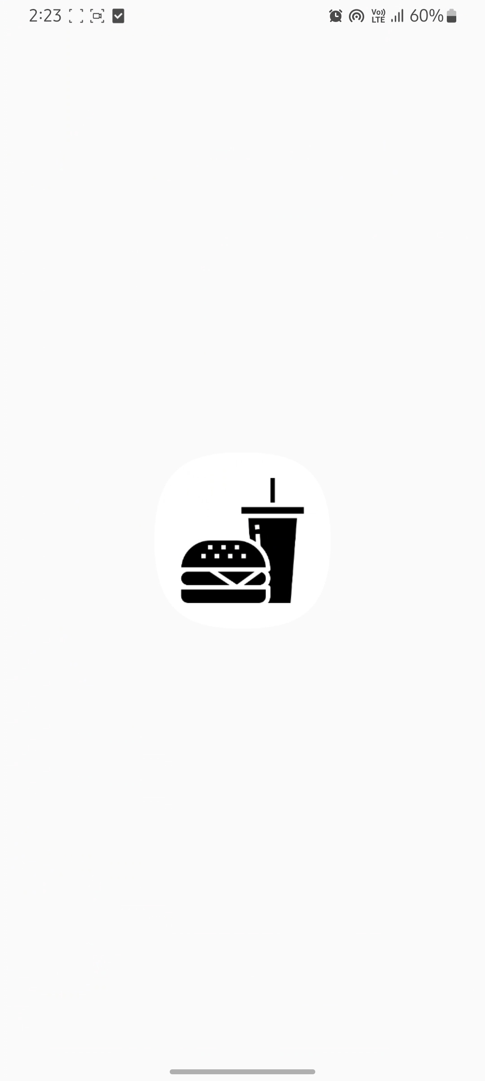

Slide 34
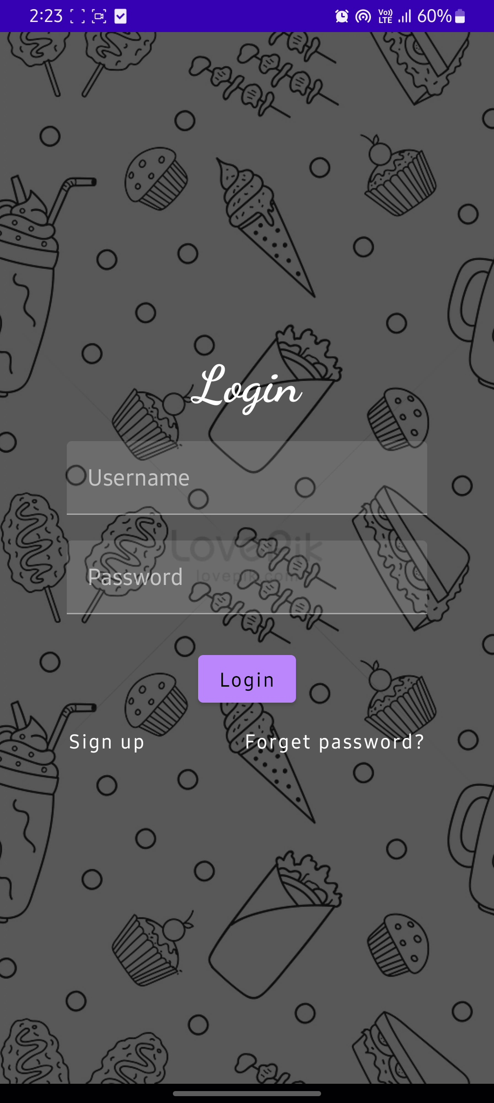

Slide 35
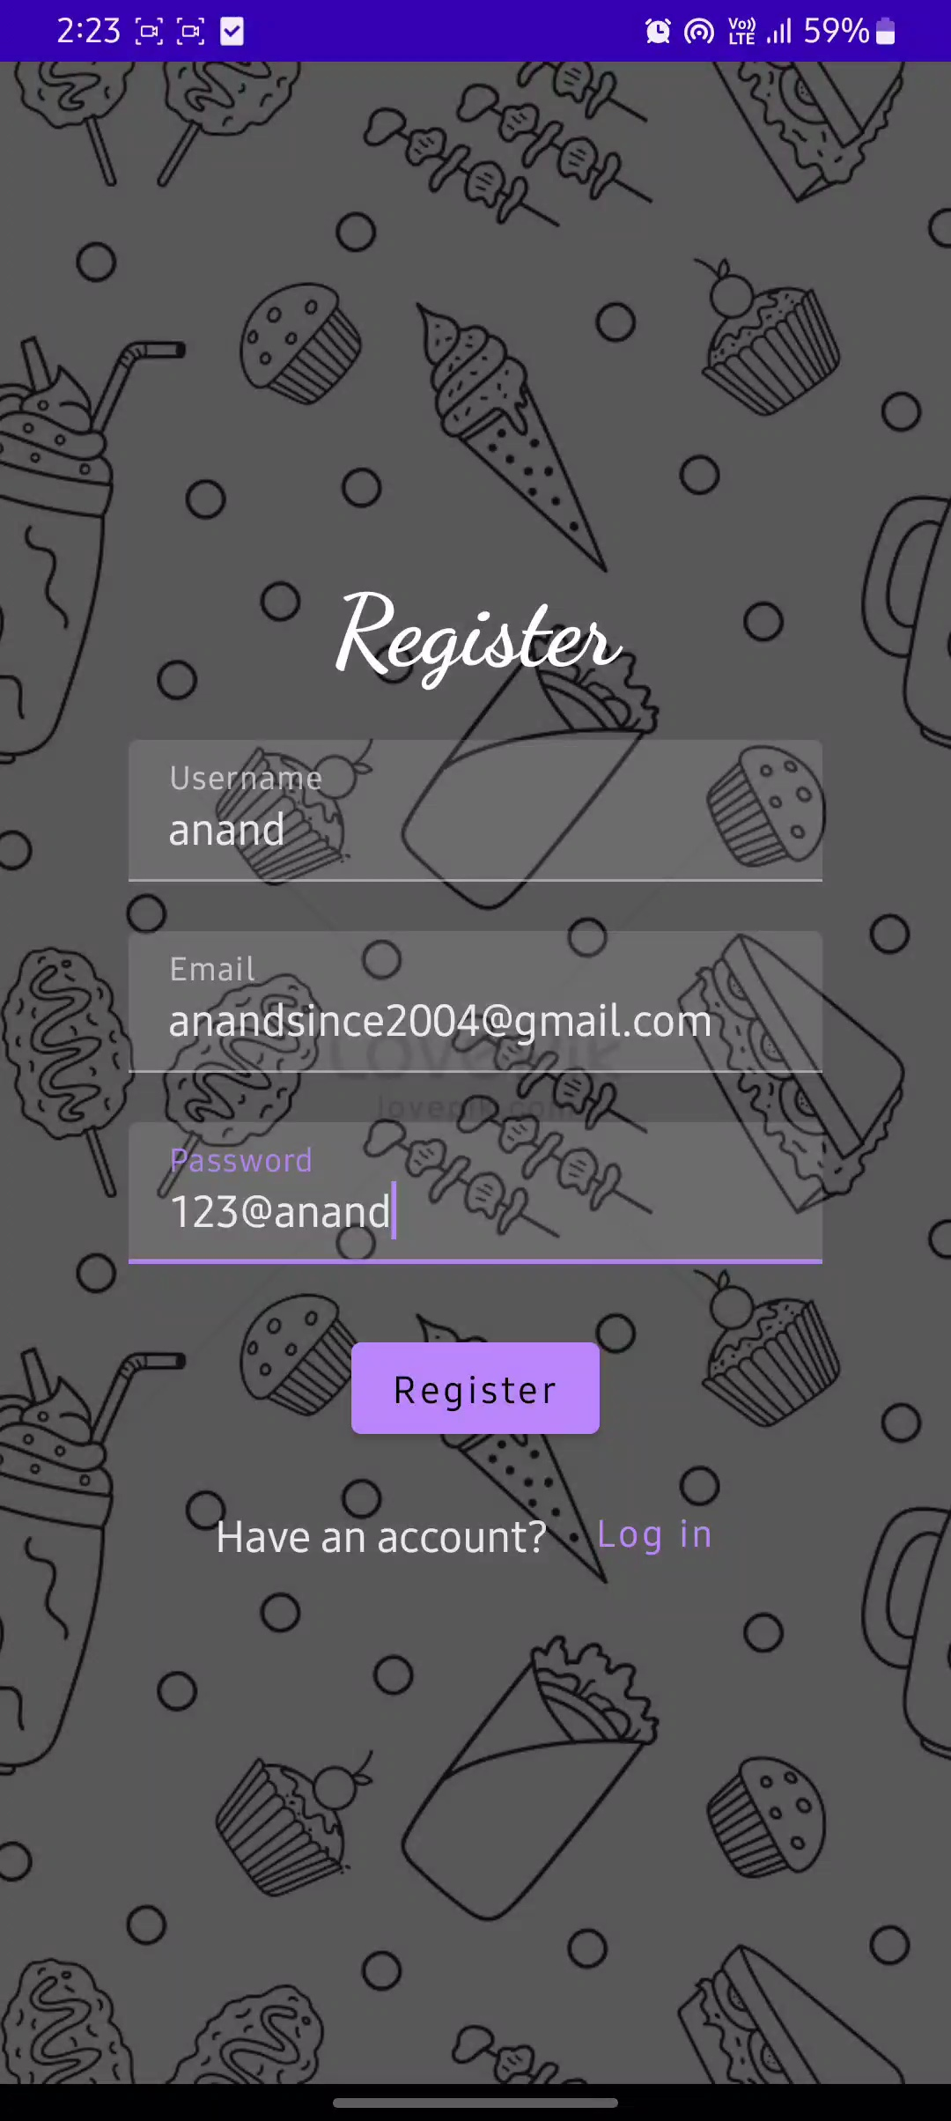

Slide 36
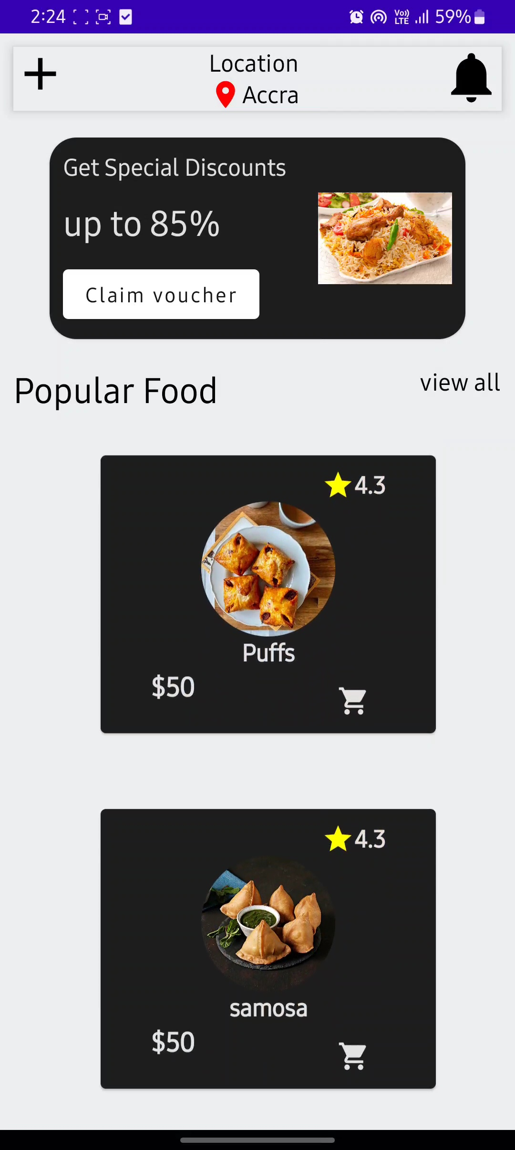

Slide 37
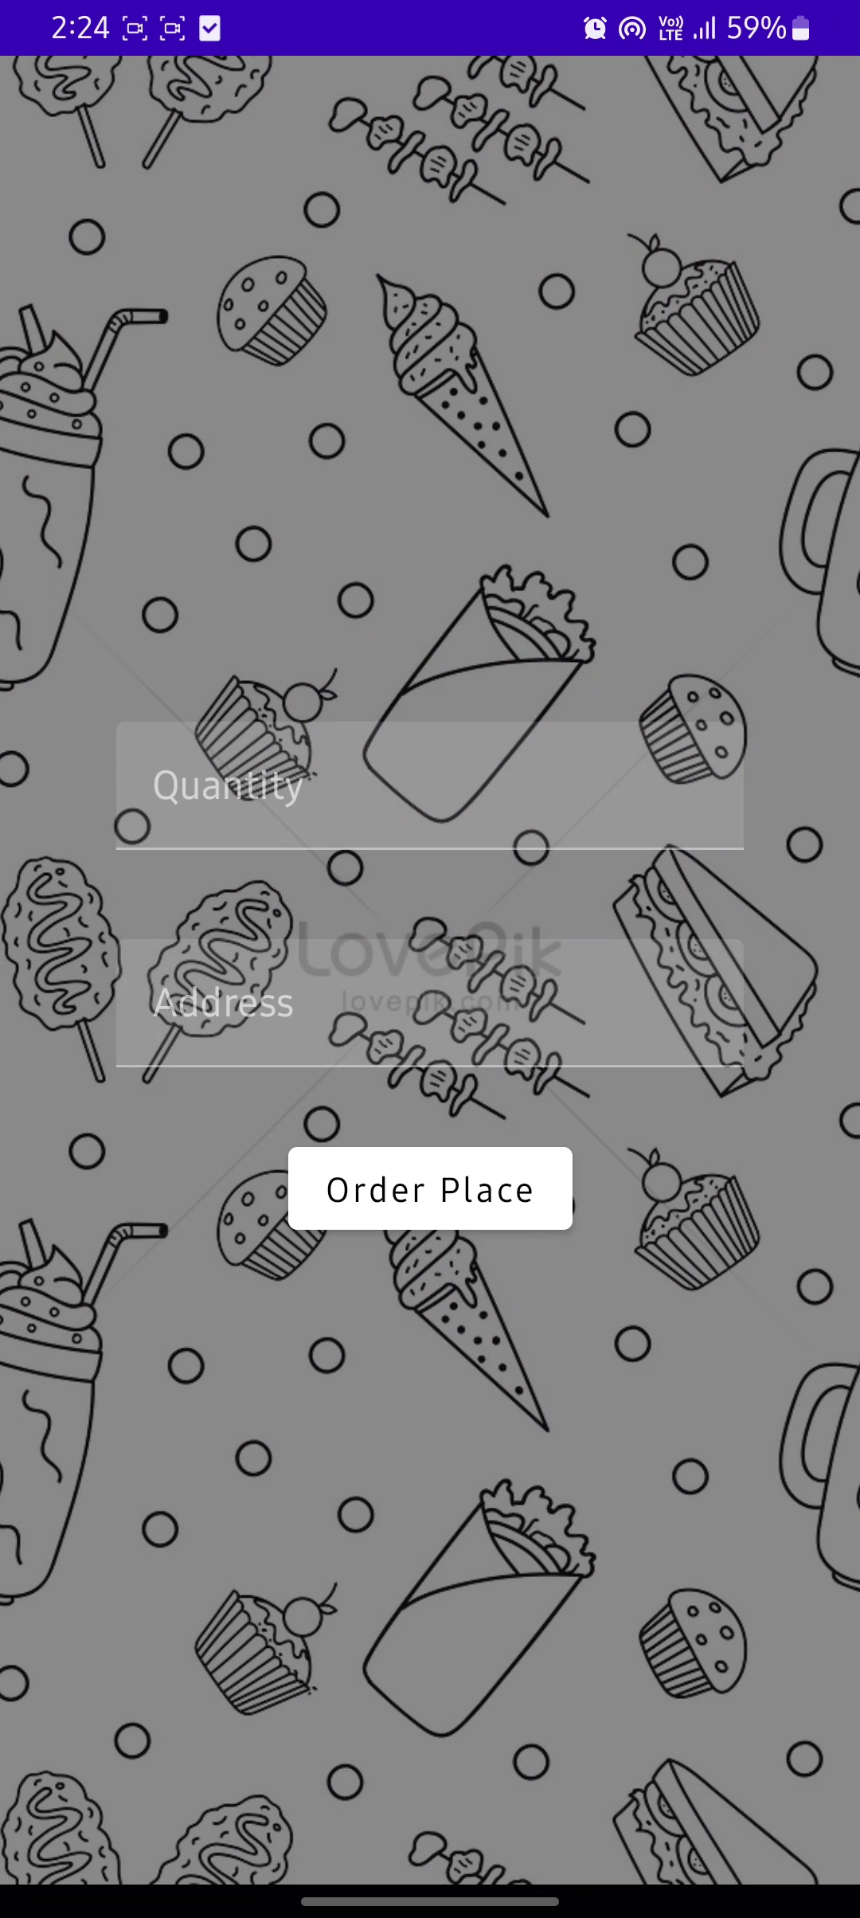

Slide 38
