Slide 1
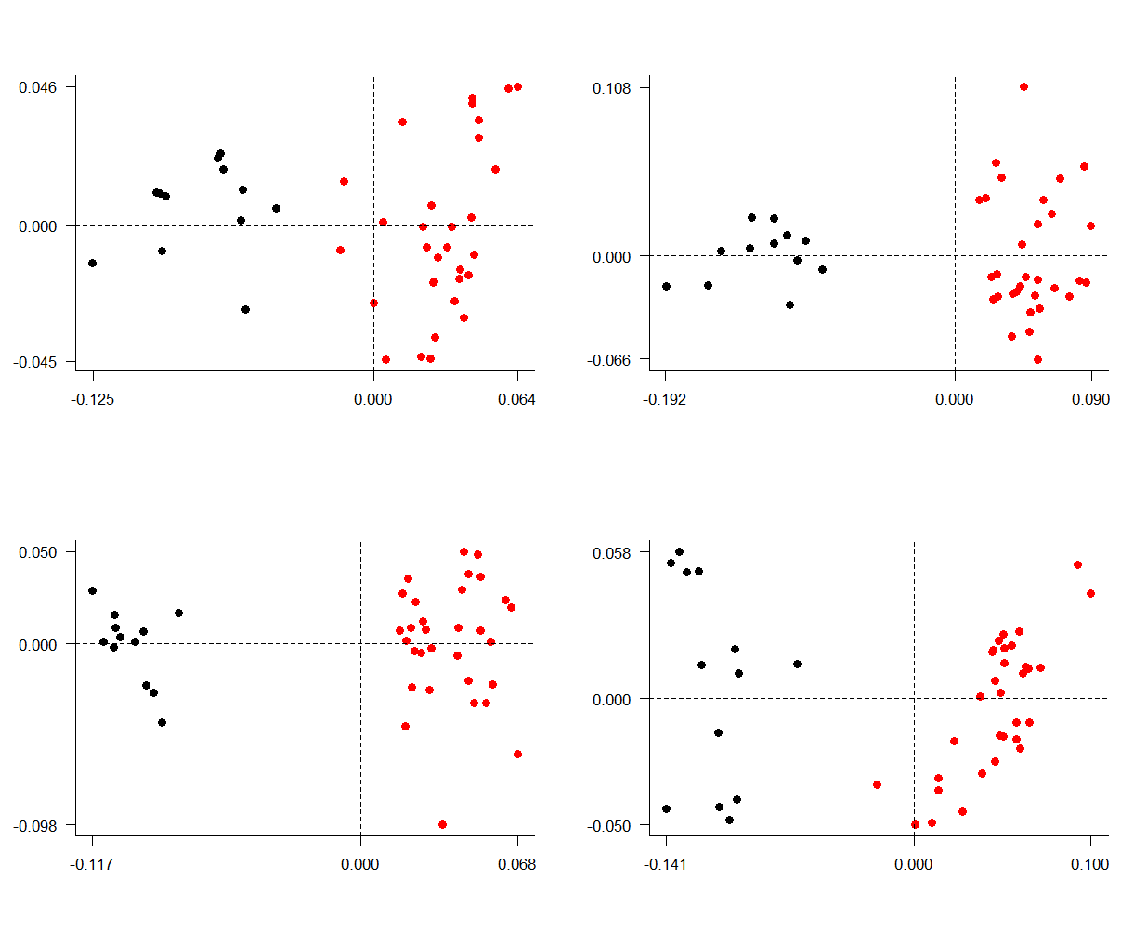
A
B
Species’ average PC2
C
D
Species’ average PC1

