Slide 1
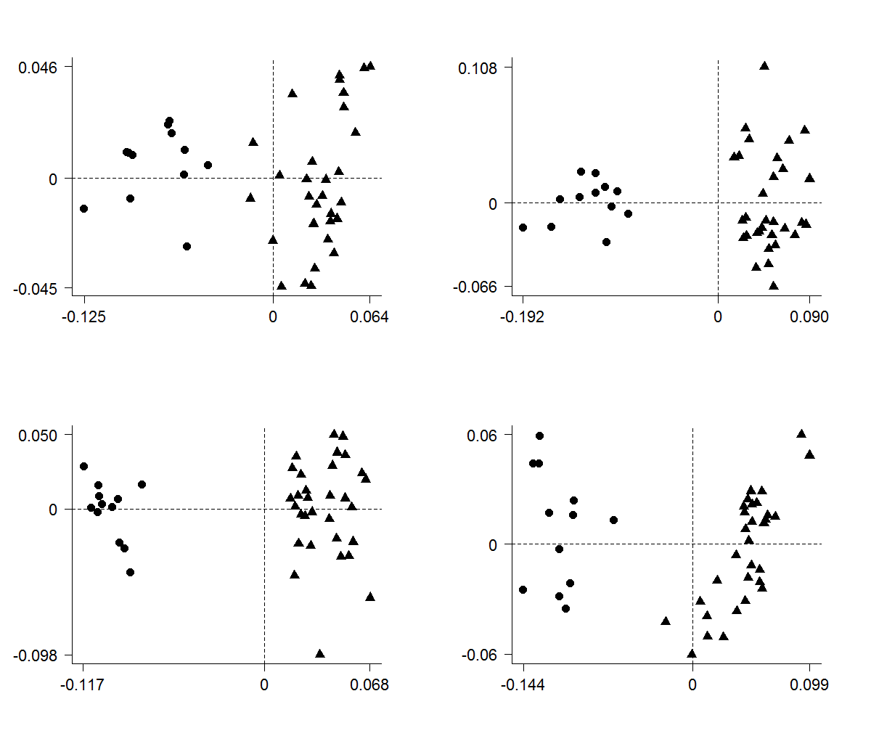




A
B
Species average PC2
C
D
Species average PC1

Slide 2


A
B
Species average PC2
C
D
Species average PC1

Slide 3
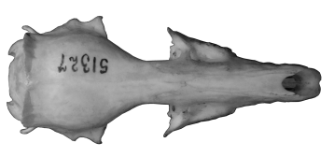
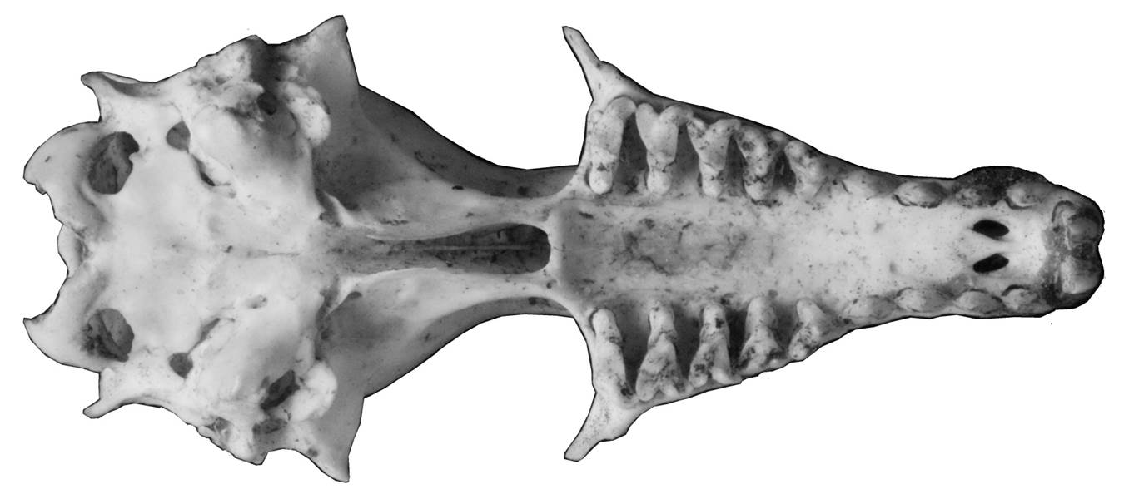

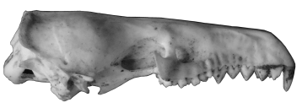

Species average PC2
Species average PC1

Slide 5



