Slide 1
Poll the following page for changes https://www.immigratemanitoba.com/category/mpnp-notices/eoi-draw/

Slide 2
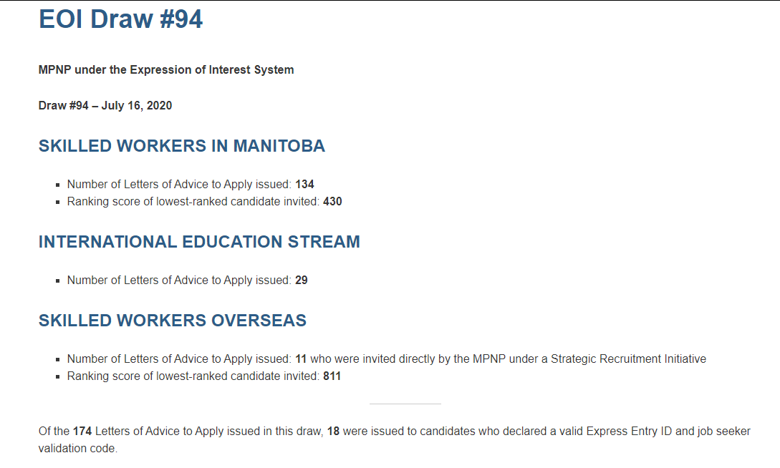
Then parse the following page by clicking “Continue Reading” and parse the specific numbers

