Slide 1

Poll the following link for changes http://www.immigration-quebec.gouv.qc.ca/en/informations/news/news-2020/index.html
Web scrape, and click on information

Slide 2
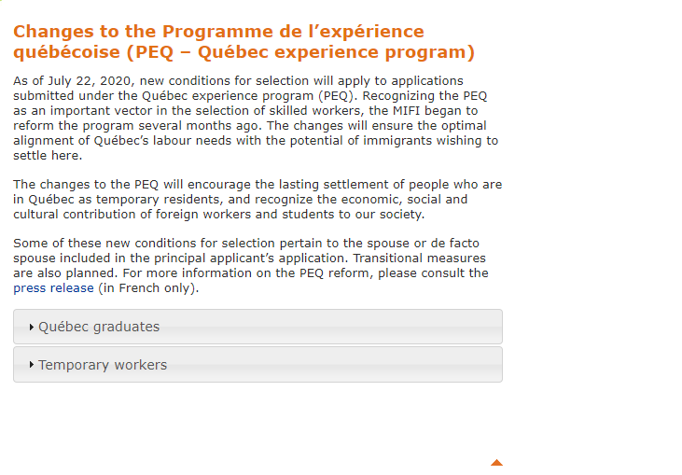
We get a page like this
Read the summary -> “as of July,” and send users this link

