Slide 1

LLM-Based Automatic Unit Test Generation
CEN 5035 (Instructor: Dr. Karim Elish)
Florida Polytechnic University
Team: Siwani Sah, Saarupya Sunkara, Alexandra Hyatali
Notes:
Hello everyone, Today we will be presenting our project on LLM-Based Automatic Unit Test Generation.
I am Siwani and I worked on this with my great teammates, Saarupya Sunkara and Alexandra Hyatali

Slide 2
A Focal-Method Approach
Can large language models write meaningful tests or just code that looks like tests?
Dataset
pyMethods2Test
88,000+ real method-test pairs
Models
Llama3 via Ollama
Technique
Focal-method prompting with 3 context strategies
Notes:
Our project is built around a 'Focal-Method Approach.
We set out to answer a fundamental question: Can LLM write meaningful tests, or do they just output code that simply looks like a test?
To test this, we utilized the pyMethods2Test dataset, which gave us over 88,000 real method-test pairs.
For the generation engine, we used Llama3, running it locally via Ollama
Our core technique relied on focal-method prompting, and we specifically tested this across three different context strategies to measure what works best.

Slide 3
PROBLEM & MOTIVATION

Slide 4
Why Unit Testing Matters
Testing is one of the most critical and most overlooked parts of software development.
Catch bugs early
Unit tests find regressions and logic errors before they reach production, where fixing them is 10× more expensive.
Enable safe refactoring
Without tests, changing code becomes a guessing game. With them, developers can refactor confidently and move fast.
Document intended behaviour
Well-written tests serve as living documentation they show exactly what a function is supposed to do and under what conditions.
Reduce long-term maintenance cost
Projects with high test coverage have significantly lower defect rates and are much easier to onboard new developers onto.
Notes:
Before we get into the AI, let's briefly touch on why unit testing matters in the first place.
Testing is one of the most critical, yet frequently overlooked parts of software development.
First, it helps us catch bugs early. Finding logic errors before they hit production is important, because fixing them later is roughly 10 times more expensive.
It also enables safe refactoring. Without tests, changing code is a guessing game; with them, developers can move fast with confidence.
Tests also document intended behaviour, serving as living documentation for exactly what a function should do.
Ultimately, projects with high test coverage reduce long-term maintenance cost, lower defect rates, and make onboarding new developers much easier.

Slide 5
The Manual Testing Bottleneck
Despite its importance, writing unit tests remains one of the most painful parts of a developer's day.
~20%
of development time spent on testing tasks
30–50%
of tests written are boilerplate with little variation
#1
reason tests are skipped: tight deadlines & pressure
Time-consuming
Writing meaningful tests for even a single function requires understanding its inputs, outputs, edge cases, and error conditions then expressing all of that as structured code. For a large codebase this takes days.
Repetitive and tedious
Most test scaffolding follows predictable patterns: set up data, call the function, assert the result. Developers are not paid to write the same boilerplate a hundred times yet here we are.
Often skipped under pressure
When sprint deadlines loom, test coverage is the first casualty. Teams promise to add tests later. They rarely do. Technical debt compounds silently until something breaks in production.
Notes:
Despite all those benefits, the industry faces a massive manual testing bottleneck and writing unit tests remains one of the most painful parts of a developer's day.
Developers spend around 20% of their time on testing tasks, and 30 to 50% of the tests they write are just repetitive boilerplate.
It is time-consuming and tedious, requiring you to carefully map out edge cases and set up predictable scaffolding over and over.
Because of this friction, the number one reason tests are skipped is tight deadlines and pressure

Slide 6
Can LLMs Help? The Promise
Large language models have transformed code generation, test generation is a harder, more constrained problem.
What LLMs CAN Do
✓ Generate syntactically correct Python code
✓ Understand function signatures and parameter types
✓ Create diverse test scenarios from examples
✓ Write assertions for common patterns automatically
✓ Handle multiple edge cases in a single pass
✓ Reduce the time to first-draft from hours to seconds
Why This Matters
Speed: Tests generated in seconds vs. hours of manual effort
Scale: Run across thousands of functions without human fatigue
Diversity: LLMs naturally explore combinations developers might miss
Accessibility: Even junior devs can produce high-quality test stubs
Notes:
So, can LLMs help solve this? The promise is definitely there.
While LLMs have transformed standard code generation, test generation is a strictly harder, more constrained problem.
But LLMs can do a lot: they can generate syntactically correct Python code, understand parameter types, and create diverse test scenarios.
They are great at writing assertions automatically and handling multiple edge cases in a single pass.
This matters because it drops the time to get a first-draft test from hours down to seconds.

Slide 7
The Reality: Where LLMs Fall Short
Early experiments showed a messy picture promising in theory, frustrating in practice.
Hallucinated dependencies: The LLM confidently imports libraries and calls methods that don't exist in the actual codebase. Tests look plausible but fail immediately at import time.
Context insensitivity: Without seeing the full class or module, the LLM doesn't know what helper methods are available, what the class state looks like, or what external dependencies are injected.
Wrong assertions: The LLM guesses what a function should return rather than knowing. Assertions may be syntactically valid but logically backwards checking the wrong value or the wrong condition entirely.
Lack of developer alignment: Generated tests don't reflect the original developer's intent. They miss the edge cases the human cared about and test things nobody was worried about.
Notes:
However, here is the reality of where LLMs fall short.
Our early experiments showed a messy picture; it was promising in theory, but frustrating in practice
We ran into hallucinated dependencies, where the LLM would confidently import libraries or call methods that simply don't exist in the codebase.
There is also context insensitivity. Without seeing the full module, the model doesn't know what helper methods are available.
We also saw wrong assertions. The model often guesses what a function should return, creating tests that are syntactically valid but logically backwards.
Furthermore, there is a lack of developer alignment - the AI often misses the edge cases a human would actually care about.
.

Slide 8
Research Questions & Objectives
Three focused questions shaped every design decision in the project.
Main Objective: Build a focal-method-aware pipeline that uses LLMs to generate meaningful, executable pytest unit tests for individual Python functions and rigorously evaluate the output.
RQ 1: Effect of Focal-Method Context on Test Quality
How does the inclusion of focal-method context (e.g., class signatures, imports) in the LLM prompt affect the compilability and correctness of generated tests compared to context-agnostic baselines?
We test two levels: context-agnostic baseline (method name only) and Focal Method (function body).
RQ 2: How Comprehensive Are LLM-Generated Tests in Terms of Assertions and Edge Cases?
We approximate coverage using assertion count and edge-case inclusion as proxy metrics, due to full runtime coverage being out of scope.
Assertion count per test and edge-case keyword presence were used as measurable indicators of test quality.
RQ 3: What Are the Common Failure Modes in LLM-Generated Test Cases?
We analyze failures such as missing assertions, extra non-code text, and syntax errors to understand LLM limitations in automated test generation.
Notes:
To systematically tackle these challenges, three focused questions shaped every design decision in our project.
Our main objective was to build a focal-method-aware pipeline that uses LLMs to generate meaningful, executable pytest unit tests, and to rigorously evaluate that output.
For RQ1, we want to know if giving the LLM the actual function code rather than just its name leads to better, more compliable tests.
For RQ2, asks how comprehensive these tests are. We approximated coverage using assertion counts and edge-case inclusion as our proxy metrics.
For RQ3, we look at why tests fail whether it's a syntax problem, missing assertions, or extra non-code text mixed in so we can understand where LLMs still fall short.

Slide 9
Approach

Slide 10
Dataset: pyMethods2Test
We chose a real-world benchmark to make our evaluation meaningful.
Each dataset entry provides:
Focal Method: The specific Python function we want to generate tests for
Class Context: The enclosing class with its fields and helper methods
File Path & Range: Exact location in the source repo (file, line start, line end)
Ground Truth Test: The actual test a developer wrote for this function
88,000+
Python method-test pairs
• Sourced from open-source GitHub repos
• Covers diverse domains & coding patterns
• Each pair is human-verified
• Used as reference for evaluation (assertion similarity proxy)
Why This Dataset?
• Gives us both input (focal method) and a human-written reference (ground truth test) essential for meaningful comparison.
• The diversity of real open-source projects means our pipeline is tested against messy, real-world code (not sanitized examples)
• 88,000 pairs means our evaluation has statistical weight. 100 was used for this study; the pipeline scales to the full set.

Slide 11
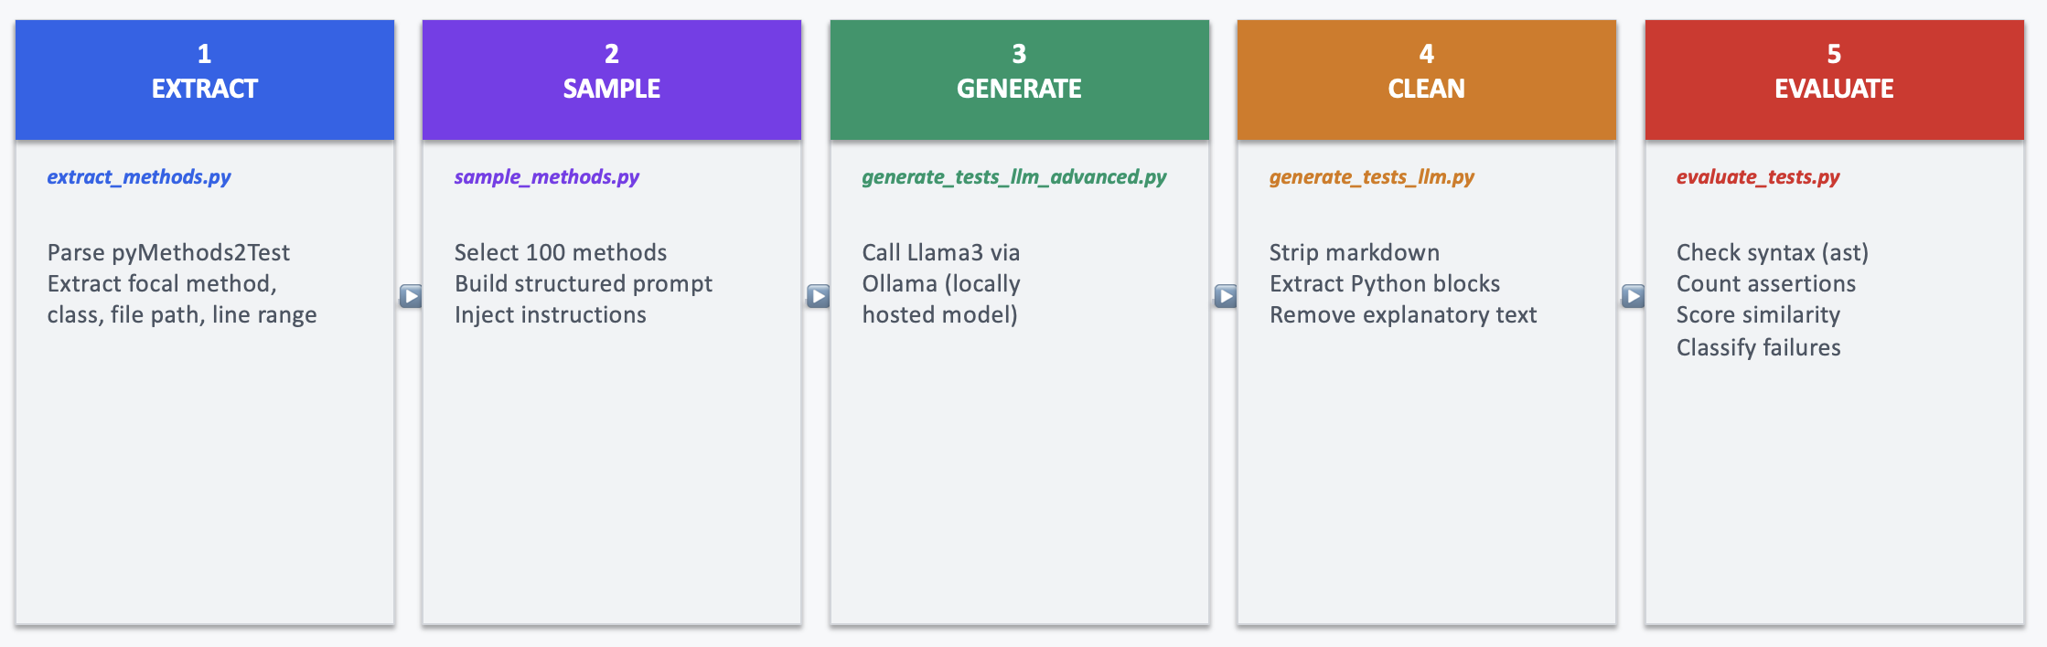
System Architecture: End-to-End Pipeline
A modular 5-stage pipeline each stage independently testable and swappable.
Design principle: every stage is independently modular. Change the prompt strategy or swap the evaluator and the rest of the pipeline is unaffected. This made it easy to compare 3 prompt strategies systematically without rewriting code.

Slide 12
Technical Implementation
Four key decisions that shaped how the system works.
LLM - Llama3 via Ollama
Locally hosted, zero API cost. All test generation runs entirely offline.
compile() for syntax check
Validates generated code without executing it safe and fast.
Failure mode Analysis
Categorizes outputs into syntax errors, missing assertions, and extra text issues..
Post-processing cleaner
Removes markdown artifacts and non-code text before evaluation.
Assertion-based evaluation Measures test quality using assertion count and edge-case coverage.

Slide 13
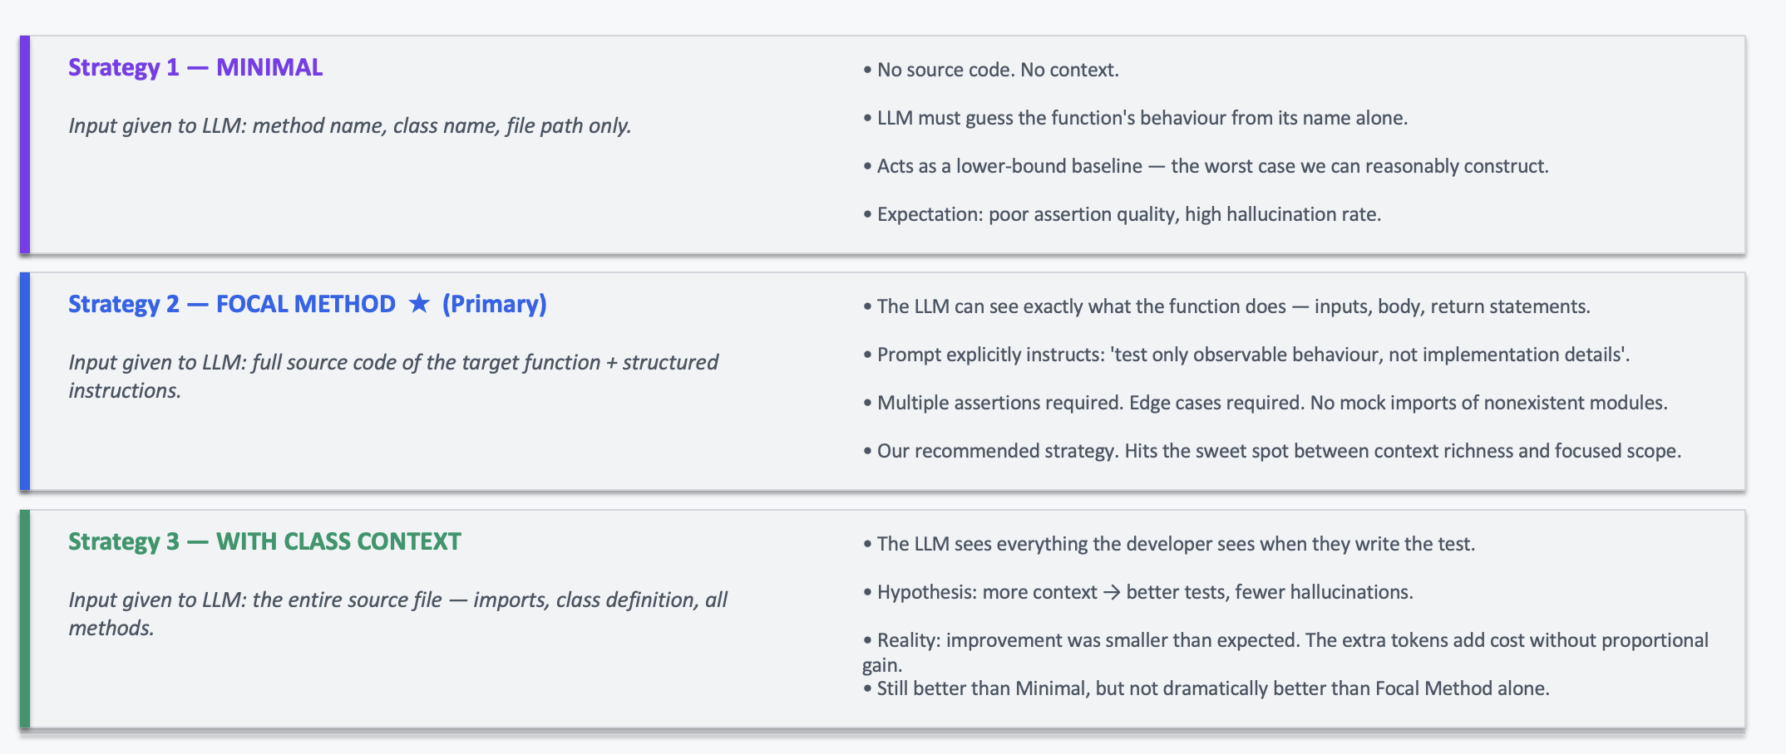
Three Prompting Strategies
Context is the controlled variable. Everything else model, temperature, output format — stays identical.

Slide 14

EVALUATION & RESULTS

Slide 15
Evaluation Methodology & Metrics
We defined four concrete, measurable criteria and applied them consistently across all outputs.
Compilability Rate
Does the generated code parse as valid Python?
Checked using compile() - no execution needed.
Assertion Count
How many assert statements per test?
Higher count indicates broader behaviour coverage.
Edge Case Coverage
Are diverse edge cases (zero, negative, empty, large inputs) present?
Counts how many generated tests include important edge cases
Failure Mode Analysis
Each output classified into one of four categories.
valid, syntax_error, missing_assertions, extra_text

Slide 16
Results: The Numbers at a Glance
100 tests generated and evaluated - here is what we found.
100
total tests generated
784
total assertions produced
7.84
average assertions per test
100%
edge case coverage rate
~80%
compilability (post-cleaning)
7.84 assertions/test
LLM explores multiple inputs, edge cases, and error paths not just a single happy-path check.
100% edge case coverage
Every test had at least one edge case. However, 'present' does not mean 'correct' assertion logic was not verified at runtime.
The 20% failure rate
Mostly extra_text (markdown mixed in) and import_error (hallucinated dependencies). True unrecoverable failures were under 2%.

Slide 17
Results: Does More Context Help?
Comparing the three prompting strategies output answer.
Metric | Minimal | Focal Method | With Class Context
Tests | 100 | 100 | 100
Avg assertions/test | 3.72 | 5.72 | 7.84
Total assertions | 372 | 572 | 784
Edge case coverage | 90% | 94% | 100%
Valid % | ~25% | ~35% | ~30%
Key Insight: The jump from Minimal → Focal Method is large. The jump from Focal Method → With Class Context is surprisingly small. Structured prompts matter more than raw context volume.

Slide 18

CONTRIBUTIONS

Slide 19
Project Contributions
What we built and delivered.
End-to-End Test Generation Pipeline 5-stage pipeline : load → prompt → generate → clean → evaluate | Ollama-Backed LLM Client (Llama3) Locally hosted via Ollama - zero API cost, fully offline
3 Prompting Strategies Compared across three prompting strategies: Minimal, Focal Method, and Class Context | Failure Mode Analysis valid, syntax_error, missing_assertions, extra_text
Streamlit Dashboard Basic result browser for viewing generated tests and evaluation metrics | Unit Testing Pipeline validated using an offline echo client (no model calls required)

Slide 20

LESSONS LEARNED

Slide 21
What We Learned and What Comes Next.
What Worked | What Didn't Work | What We'd Improve
• Focal-method prompts produced diverse, multi-assertion tests with genuine edge case coverage | • Syntax valid ≠ logically correct - compiles doesn't mean the test is meaningful | • Add pytest-cov for actual line and branch coverage measurement
• Llama3 via Ollama – reliable, low-latency test generation without API dependency | • No runtime execution - real line/branch coverage was never measured (limitation) | • Build a feedback loop: re-prompt the LLM with compile errors for self-correction
• Modular pipeline made it easy to compare 3 prompt strategies without rewriting code | • No direct comparison with ground-truth tests (evaluation limitation) | • Use retrieval-based context (RAG) to inject correct imports and reduce hallucinations
• Static analysis (compile()) reliably caught broken outputs without executing any code | • Post-processing for removing extra text was fragile and regex-dependent | • Extend to more diverse focal methods across all 88,000 dataset entries

Slide 22
The Big Picture Takeaway
LLMs are powerful assistants not autonomous testers
They lower the effort of writing a first test draft but every output needs human review. Syntax passing doesn't mean logic is correct.
Prompt design matters more than context volume
Focal Method prompts outperformed the full-file approach. Focused and structured beats 'dump everything in’.
Limitations are real and worth stating honestly
No manual test comparison, no runtime coverage, no semantic validation these are open problems, not failures. They define exactly where the next phase of work should go.

Slide 23
Conclusion
Project demonstrates that LLMs can assist in unit test generation using structured, focal method-aware prompting
Results show giving targeted context reduces hallucinated dependencies, increases number of assertions and improves compilability.
LLMs generate syntactically valid and comprehensive test cases, but lack reliable semantic understanding
LLMs work best as productivity tools instead of replacements for developers
LLMs accelerate initial test generation and expand coverage, but careful human review and refinement remain essential.

Slide 24
DEMO

Slide 25

Questions?
Thank You!

