Slide 1

CLUSTER: AI
TRIBHUVAN UNIVERSITY
INSTITUTE OF ENGINEERING, PULCHOWK CAMPUS
Simulated Annealing for the
Travelling Salesman Problem
Finding a short driving route through 20 real Kathmandu locations
AI Project
Nischal Ghimire(080BCT050),Sarthak Khadka(080BCT077),Siwansh Pathak (080BCT083)
Department of Electronics & Computer Engineering, Lalitpur, Nepal
Simulated Annealing for TSP

Slide 2

Optimisation Problems
• Many practical problems ask for the best arrangement out of a very large number of choices.
• Delivery routes, timetables, machine scheduling and circuit layout are all of this kind.
• For small cases we can check every option. For real sizes we cannot.
• A search method is then used, which looks for a good answer in a reasonable time instead of the perfect one.
This project uses one such method, Simulated Annealing, on a routing problem built from real Kathmandu roads.
Simulated Annealing for TSP
1

Slide 3
Simulated Annealing
• Annealing is a process in metallurgy. Metal is heated and then cooled slowly.
• While it is hot the atoms move freely. As it cools they settle into a low energy, stable structure.
• If it is cooled too quickly the structure is left with faults.
Annealing metal | Simulated annealing
Structure of the metal | A candidate solution
Energy of the structure | Cost we want to reduce
Temperature | How much worsening is allowed
Cooling slowly | Reducing the temperature over time
Low energy result | A good final solution
Kirkpatrick and others turned this into a search method in 1983.
The solution plays the part of the structure, its cost plays the part of the energy, and a temperature controls how freely the search is allowed to move.
The method is general. It only needs a way to measure a solution and a way to make a small change to it.
That is why the same idea works for routes, timetables and layouts.
Simulated Annealing for TSP
2

Slide 4
The Simulated Annealing Loop
Start from any solution
Make a small change
Measure the new cost
Better keep it
Worse keep it sometimes
Lower the temperature
The loop repeats until the temperature reaches its lowest value.
Early in the search The temperature is high, most worse solutions are accepted, and the search moves around the whole space.
Later in the search The temperature is low, worse solutions are almost always rejected, and the search behaves like a simple improvement method.
Throughout The best solution seen so far is stored separately, so a worse move can never lose it.
Simulated Annealing for TSP
3

Slide 5
The Acceptance Rule
P = exp(-delta / T)
Extra distance | T = 100 | T = 10 | T = 1
1 km | 0.99 | 0.90 | 0.37
5 km | 0.95 | 0.61 | 0.01
20 km | 0.82 | 0.14 | 0.00
• delta is how much worse the new solution is.
• T is the current temperature.
• A better solution is always accepted.
• A worse one is accepted only if a random number between 0 and 1 falls below P.
• A small worsening or a high temperature both make P large.
Probability of accepting a worse solution
At a high temperature even a 20 km worsening is usually accepted.
At a low temperature only tiny worsenings get through.
This is how the search changes from exploring to settling down.
Simulated Annealing for TSP
4

Slide 6
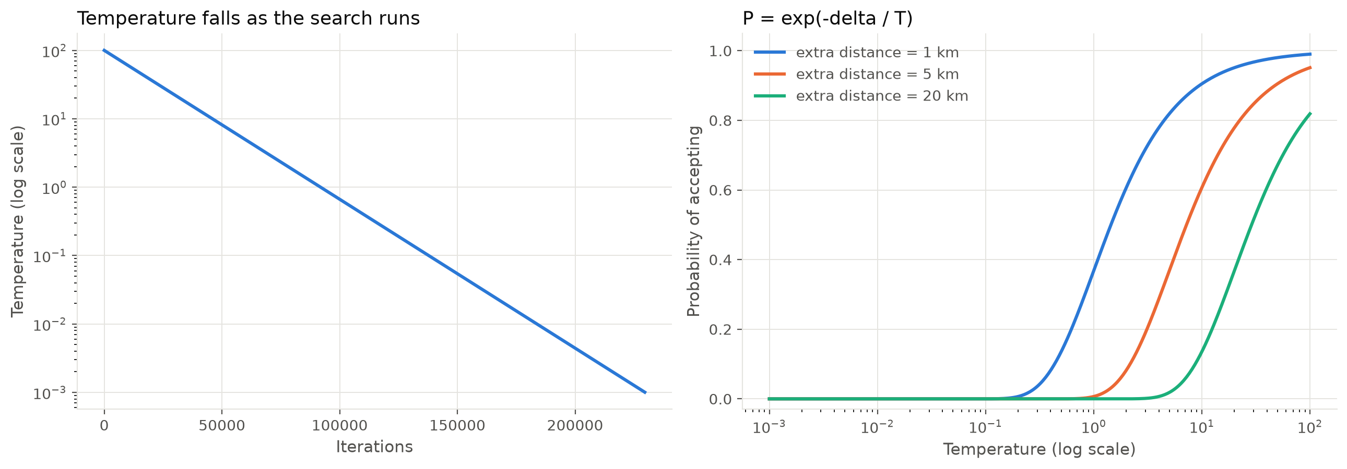
Temperature and Cooling Schedule
Setting | Value used | Meaning
Initial temperature | 100 | How freely the search moves at the start
Cooling rate | 0.995 | Temperature is multiplied by this after every 100 tries
Minimum temperature | 0.001 | The search stops when the temperature falls below it
Tries per temperature | 100 | How long the search stays at one temperature
Simulated Annealing for TSP
5

Slide 7
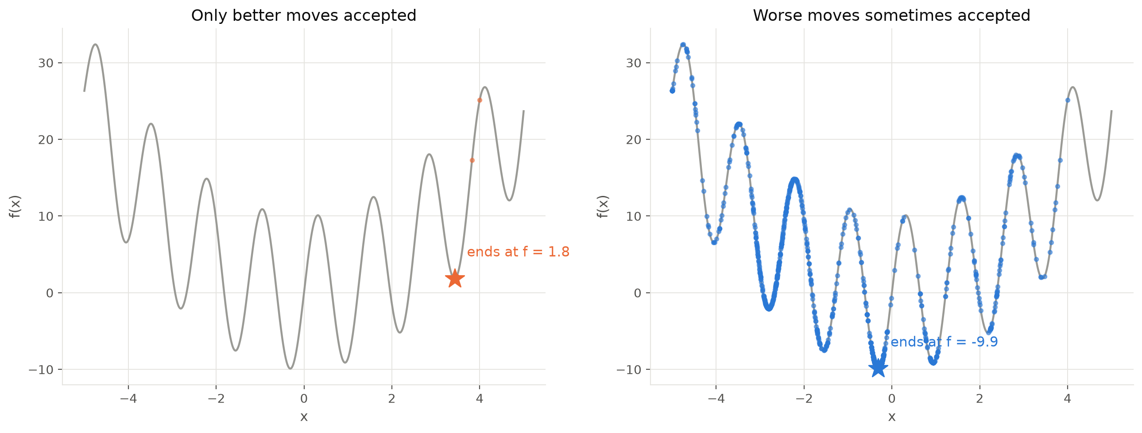
Escaping a Local Optimum
A method that only accepts improvements stops at the first dip it finds.
Accepting a worse solution now and then lets the search climb out and carry on.
Both searches start at the same point on the same function, from the introductory notebook in our project.
Simulated Annealing for TSP
6

Slide 8
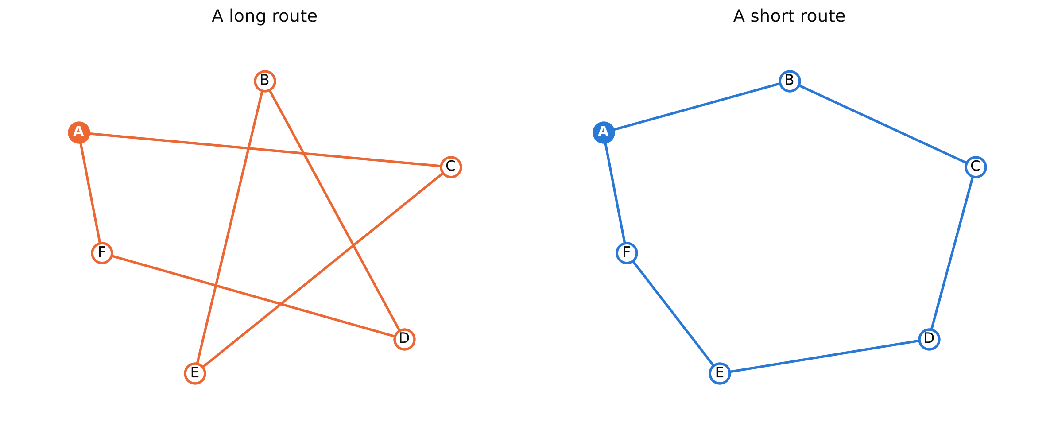
Travelling Salesman Problem
• Start from one city.
• Visit every other city exactly once.
• Return to the starting city.
• Make the total distance as small as possible.
Both routes on the right visit all six cities.
Only the order is different.
Simulated Annealing for TSP
7

Slide 9
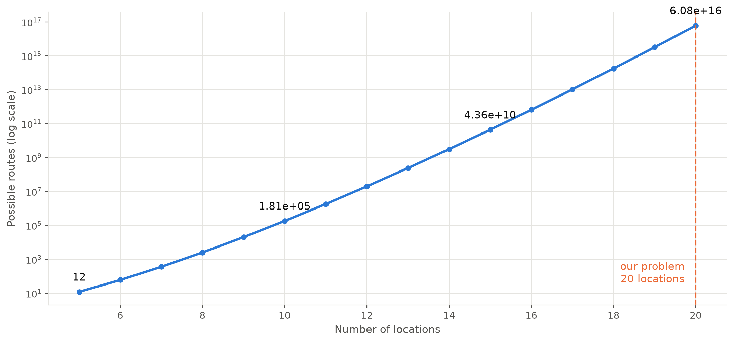
Growth of Possible Routes
With a fixed start, n locations give (n-1)! / 2 different routes.
10 places
181,440 routes
15 places
43.6 billion routes
20 places
6.08 x 10^16 routes
Checking every route is not practical, so we search for a good route instead.
Simulated Annealing for TSP
8

Slide 10
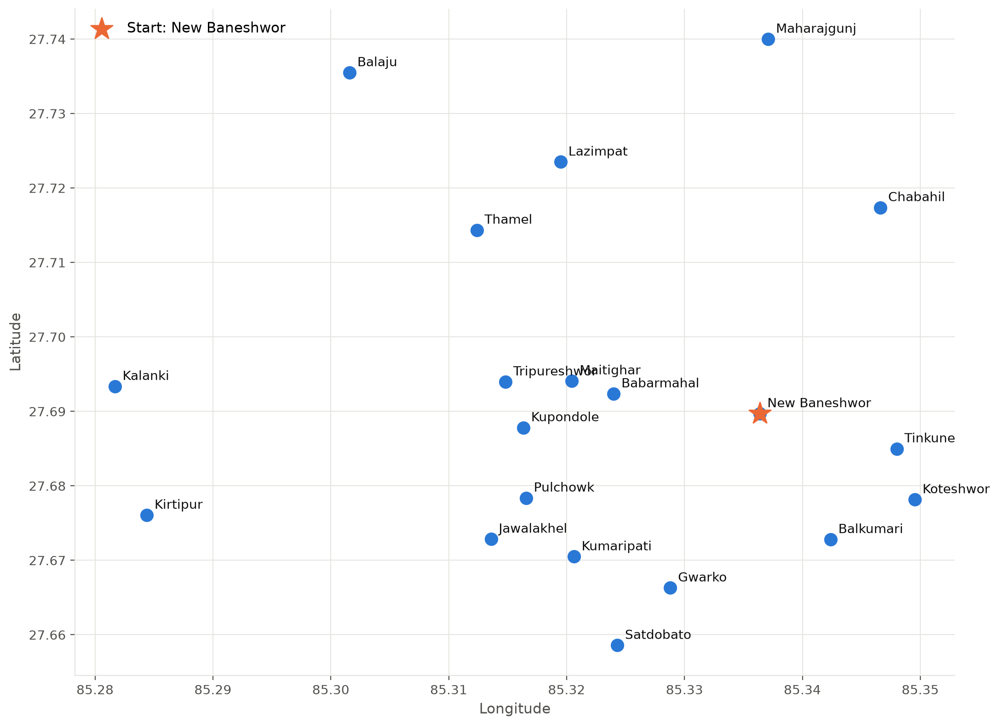
Kathmandu Route Problem
• 20 real locations in Kathmandu and Lalitpur.
• Distances are real driving distances from OSRM, not straight lines.
• The user picks the starting location when the program runs.
• The route visits every location once and comes back to the start.
Start used in this presentation: New Baneshwor
Simulated Annealing for TSP
9

Slide 11
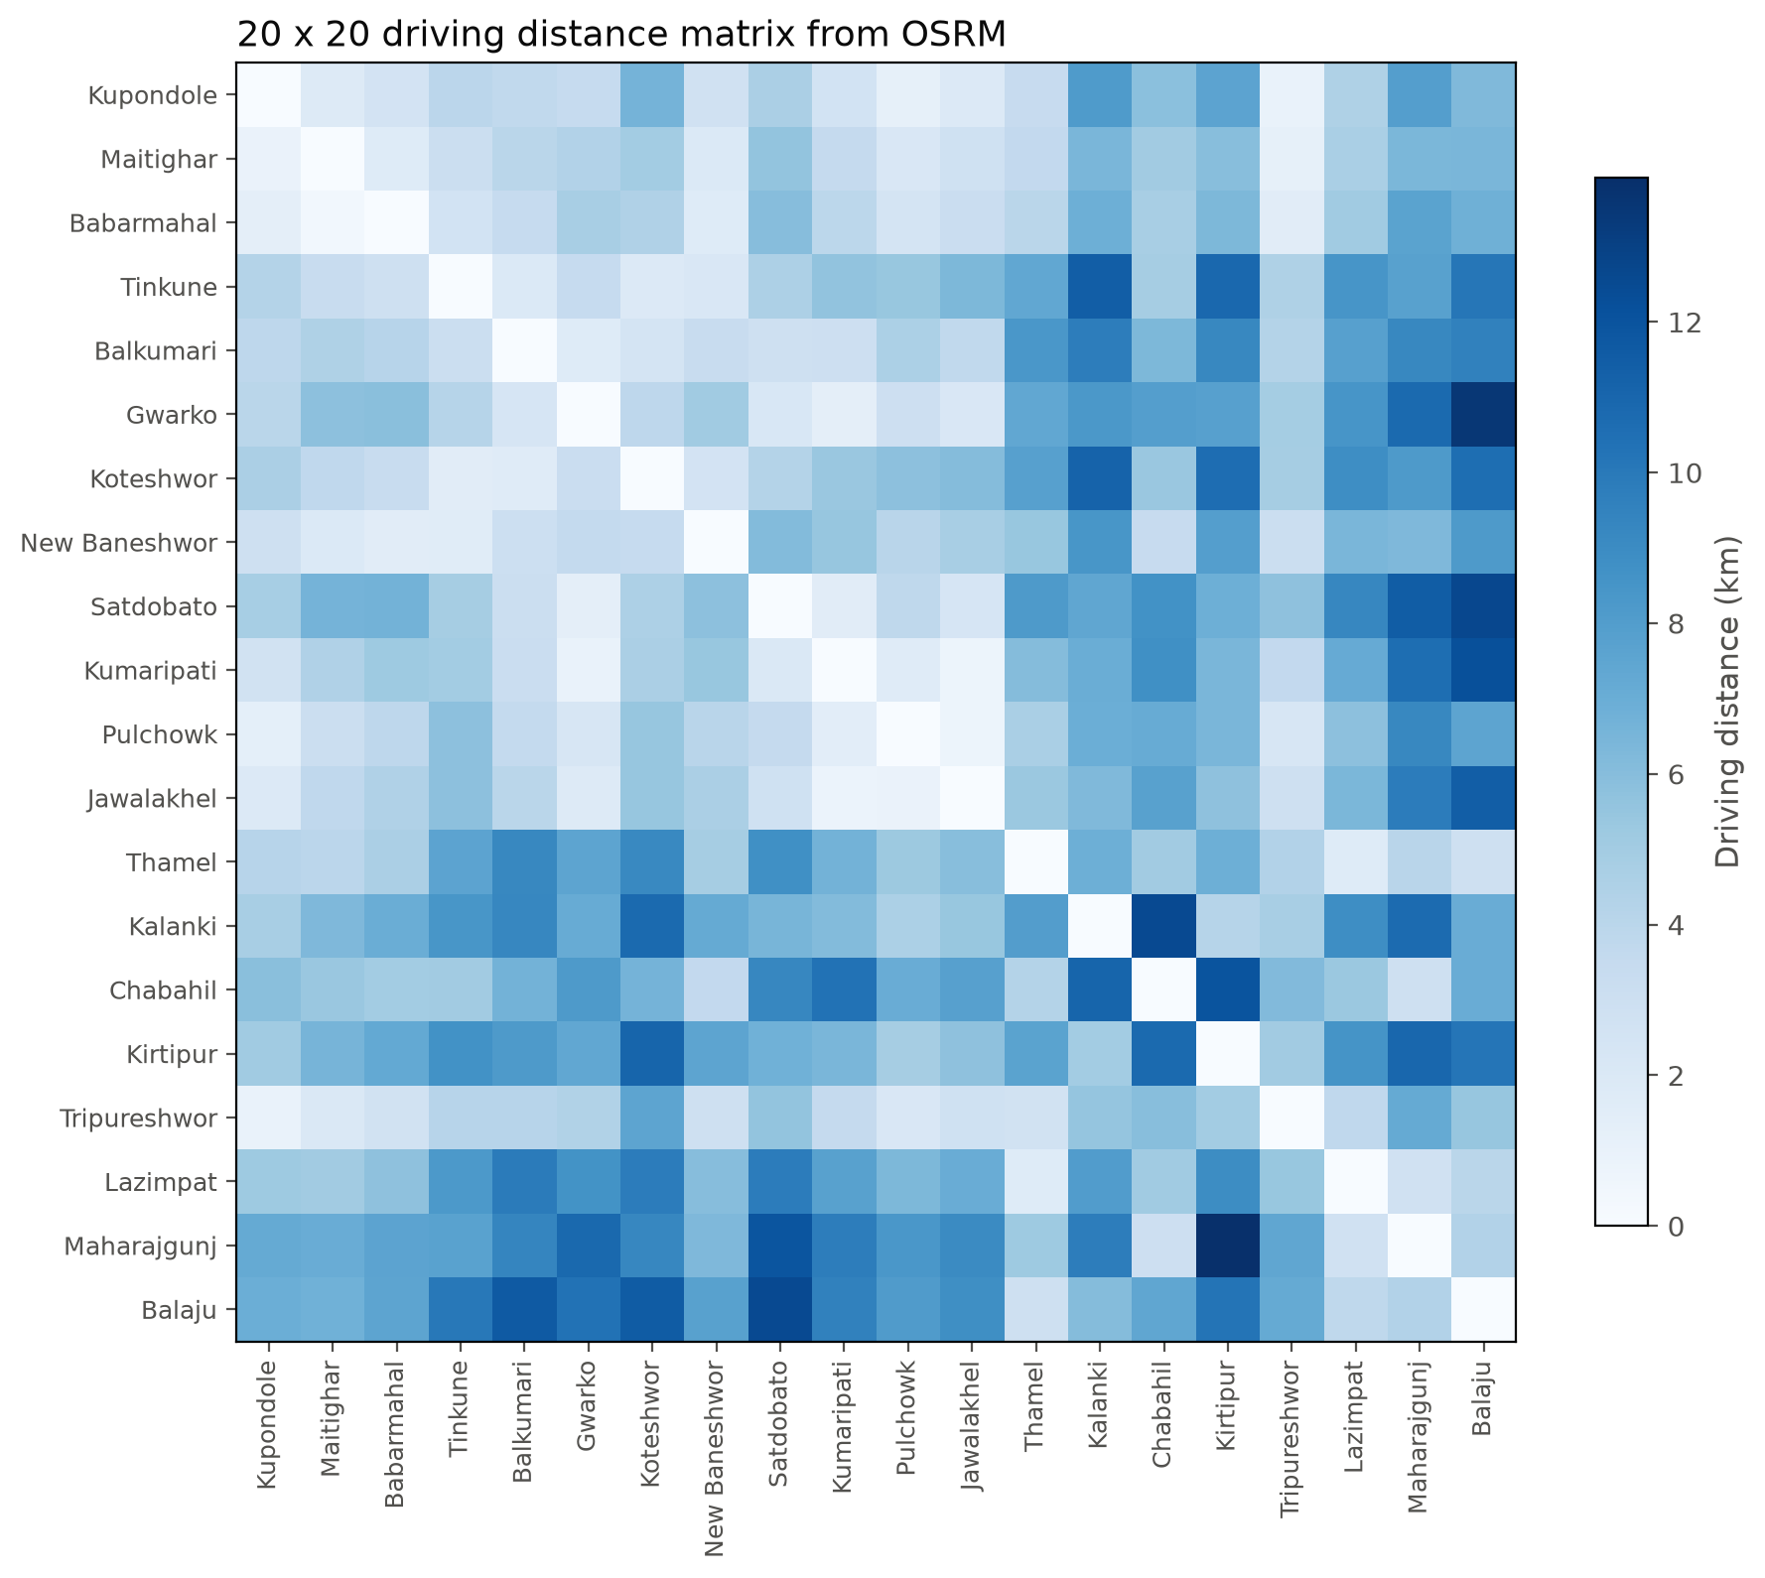
Kathmandu Road Distance Data
• Coordinates of 20 locations are stored in places.py.
• build_graph.py sends them to the OSRM table service once.
• The result is a 20 x 20 directed matrix saved in OUTPUT/tsp_graph.json.
• A to B and B to A can differ, because these are real road distances.
new_route = swap_two_cities(current_route, rng)
new_distance = route_distance(graph, new_route)
delta = new_distance - current_distance
if delta < 0:
current_route = new_route
current_distance = new_distance
else:
probability = math.exp(-delta / temperature)
if rng.random() < probability:
current_route = new_route
current_distance = new_distance
simulated_annealing.py, the accept step
Simulated Annealing for TSP
10

Slide 12
Simulated Annealing for Our Routes
Random start route
A route is a list that starts and ends at the chosen location.
A neighbour swaps two of the places in between, so the route stays valid.
The cost is the sum of the driving distances, including the leg back to the start.
Swap two locations to get a neighbour
delta = new distance - current distance
yes -> accept the route
delta < 0 ?
One run does 229,700 candidate routes.
The whole thing is repeated 30 times with different random seeds, and the best route is kept.
no -> accept with probability P
Cool down: T = T x 0.995
Stop when T < 0.001 and keep the best route
Simulated Annealing for TSP
11

Slide 13
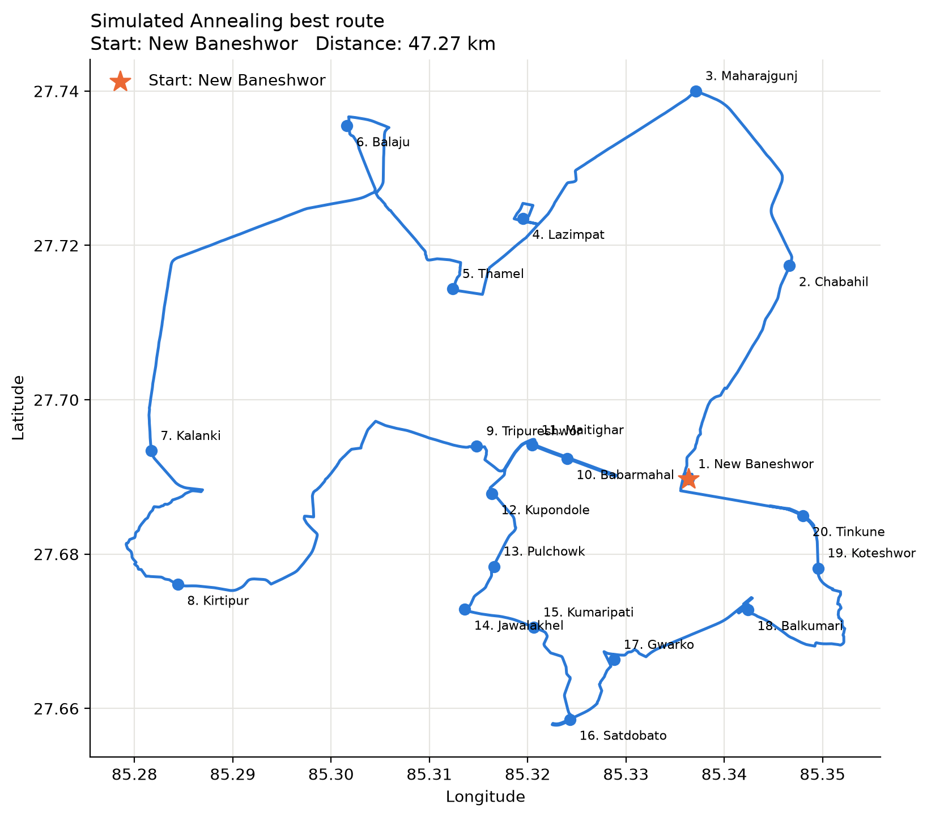
Best Route Found
Start
New Baneshwor
Best distance
47.27 km
Best of 30 runs, found with seed 3.
The line follows the real roads returned by OSRM, so short hops between nearby places can look longer than a straight line.
Simulated Annealing for TSP
12

Slide 14
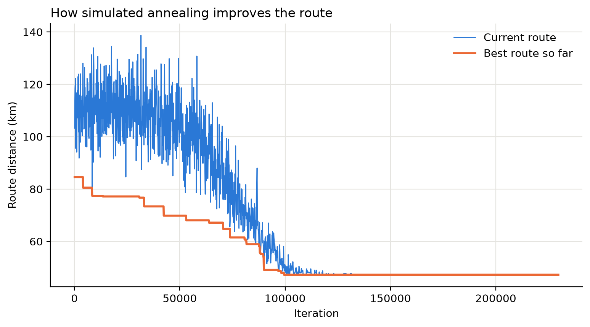
Simulated Annealing Results
Measure | Value
Best distance | 47.27 km
Average distance | 50.02 km
Worst distance | 53.03 km
Standard deviation | 1.60 km
Number of runs | 30
Iterations per run | 229,700
Time per run | 0.61 sec
Total time | 18.16 sec
Each run starts from a different random route, so the results differ.
The best run is kept as the final answer.
Blue is the route the search is currently on, orange is the best route found so far.
Simulated Annealing for TSP
13

Slide 15
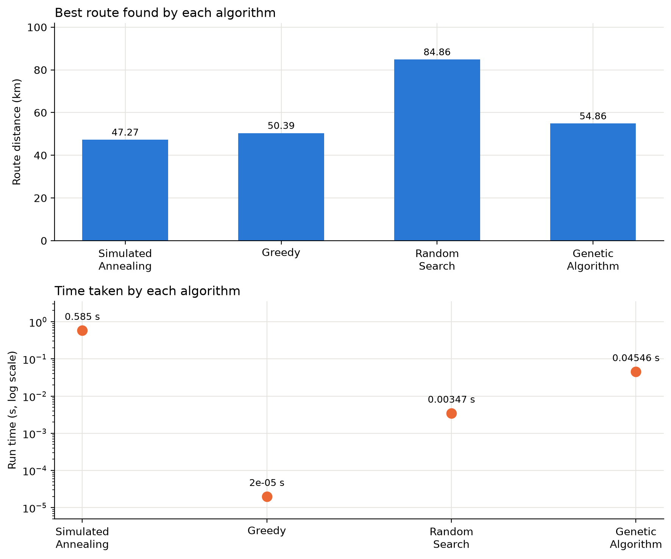
Comparison of TSP Approaches
Simulated annealing is the main algorithm. The other three are only used to check it, on the same 20 locations, the same matrix and the same start.
Method | Distance | Time per run | Runs
Simulated Annealing | 47.27 km | 0.58501 sec | 30
Greedy (Nearest Neighbour) | 50.39 km | 0.00002 sec | 1
Genetic Algorithm | 54.86 km | 0.04546 sec | 10
Random Search | 84.86 km | 0.00347 sec | 1000 routes
Distances come from fixed seeds, so they repeat exactly.
Times are from one measurement session and change a little with machine load.
Simulated Annealing for TSP
14

Slide 16
Spread of the Repeated Runs
Simulated annealing and the genetic algorithm are random, so they were run several times. Greedy is deterministic and random search is reported as the best of its 1,000 tries.
Method | Runs | Best | Average | Worst | Std dev
Simulated Annealing | 30 | 47.27 km | 50.02 km | 53.03 km | 1.60 km
Genetic Algorithm | 10 | 54.86 km | 57.86 km | 63.89 km | 2.63 km
Greedy (Nearest Neighbour) | 1 | 50.39 km | 50.39 km | 50.39 km | 0.00 km
Random Search | 1000 routes | 84.86 km | - | - | -
Simulated annealing is both the best and the most consistent Its worst run, 53.03 km, is still shorter than the best genetic algorithm run.
The genetic algorithm varies the most A spread of 2.63 km, and its worst run reached 63.89 km.
Greedy has no spread at all For a fixed start and a fixed matrix it always builds the same route.
Simulated Annealing for TSP
15

Slide 17
Algorithm Complexity
Taken from the loops in our own code, with n = 20 locations.
Method | Loop in our code | Time | Space
Simulated Annealing | 2,297 temperature levels x 100 iterations, each one measures a full route | O(L k n) | O(n + L)
Genetic Algorithm | 200 generations x population of 40, crossover and distance are both O(n) | O(G P n) | O(P n)
Greedy | for each location, scan the ones not yet visited | O(n^2) | O(n)
Random Search | 1,000 trials, each shuffles and measures one route | O(T n) | O(n)
L = temperature levels, k = iterations per level
G = generations, P = population size, T = trials
The 20 x 20 distance matrix is built once and shared, so every method also holds O(n^2) of data.
Method | Route evaluations | Result
Simulated Annealing | 229,700 per run | 47.27 km
Genetic Algorithm | 8,040 per run | 54.86 km
Greedy | one construction | 50.39 km
Random Search | 1,000 | 84.86 km
Simulated Annealing for TSP
16

Slide 18
Observations from the Results
Simulated annealing gave the shortest route
47.27 km, about 6 percent shorter than greedy on this instance.
Greedy was fast and surprisingly good
50.39 km in 0.00002 sec. Second best here, and thousands of times faster than SA.
The genetic algorithm came last of the three search methods
54.86 km, behind greedy. It used 8,040 route evaluations per run against 229,700 for SA.
Random search was the weakest
84.86 km from 1,000 random routes. Sampling without any strategy is not enough here.
These numbers describe our implementation and our settings. A different parameter choice, especially for the genetic algorithm, would change them. None of the four methods is guaranteed to find the shortest possible route.
Simulated Annealing for TSP
17

Slide 19
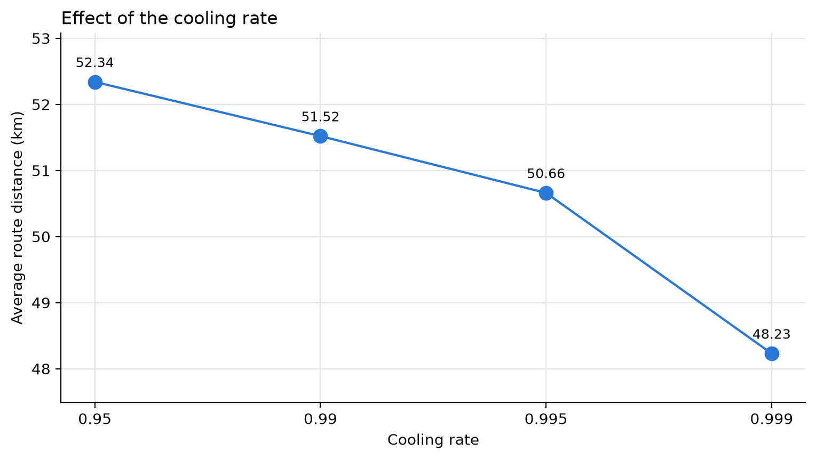
Effect of Cooling Rate
Cooling rate | Average | Best | Time per run
0.95 | 52.34 km | 47.36 km | 0.06 sec
0.99 | 51.52 km | 49.17 km | 0.29 sec
0.995 | 50.66 km | 47.27 km | 0.58 sec
0.999 | 48.23 km | 47.27 km | 2.92 sec
5 runs for each cooling rate.
A rate closer to 1 cools more slowly, gives more iterations and a shorter average route, but costs more time.
Here the average improved at every step. SA is random and 5 runs is a small sample, so a small reversal between two close rates would not be unusual.
Simulated Annealing for TSP
18

Slide 20
Limitations and Conclusion
Limitations
Conclusion
• SA is stochastic, so every run gives a slightly different route.
• It does not guarantee the shortest possible route, only a good one.
• Results depend on the temperature, cooling rate and number of iterations.
• Distances are fixed to the OSRM data collected when the matrix was built.
• SA found a 47.27 km round trip through all 20 locations from New Baneshwor.
• It was the shortest route among the four methods we tested.
• It needs more time than greedy, but under a second per run is acceptable here.
• Accepting worse routes early is what let it improve on the greedy answer.
Best result: 47.27 km, 30 runs, 229,700 iterations per run, about 0.6 seconds per run
Simulated Annealing for TSP
19

Slide 21
Thank You
Questions are welcome
Simulated Annealing for TSP

