Slide 1

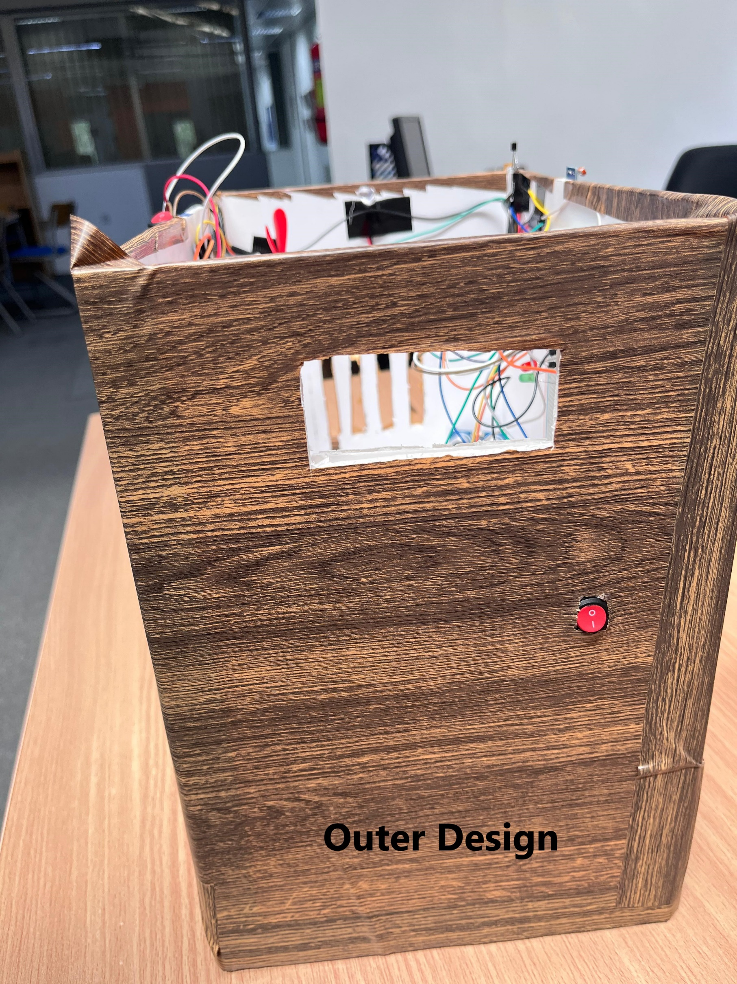
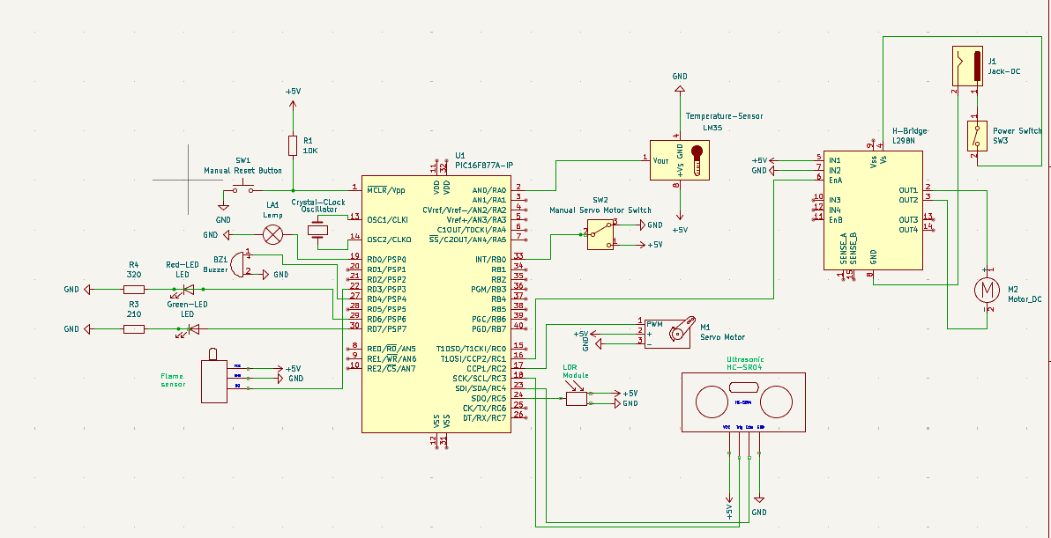
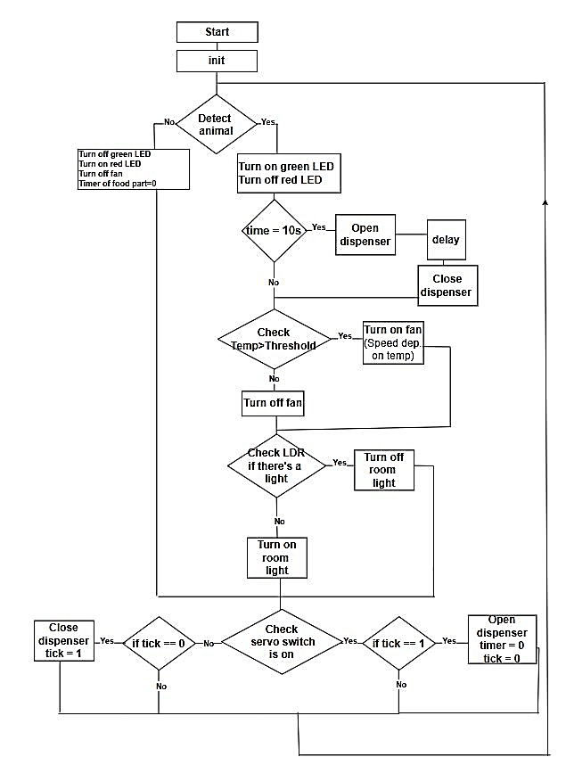
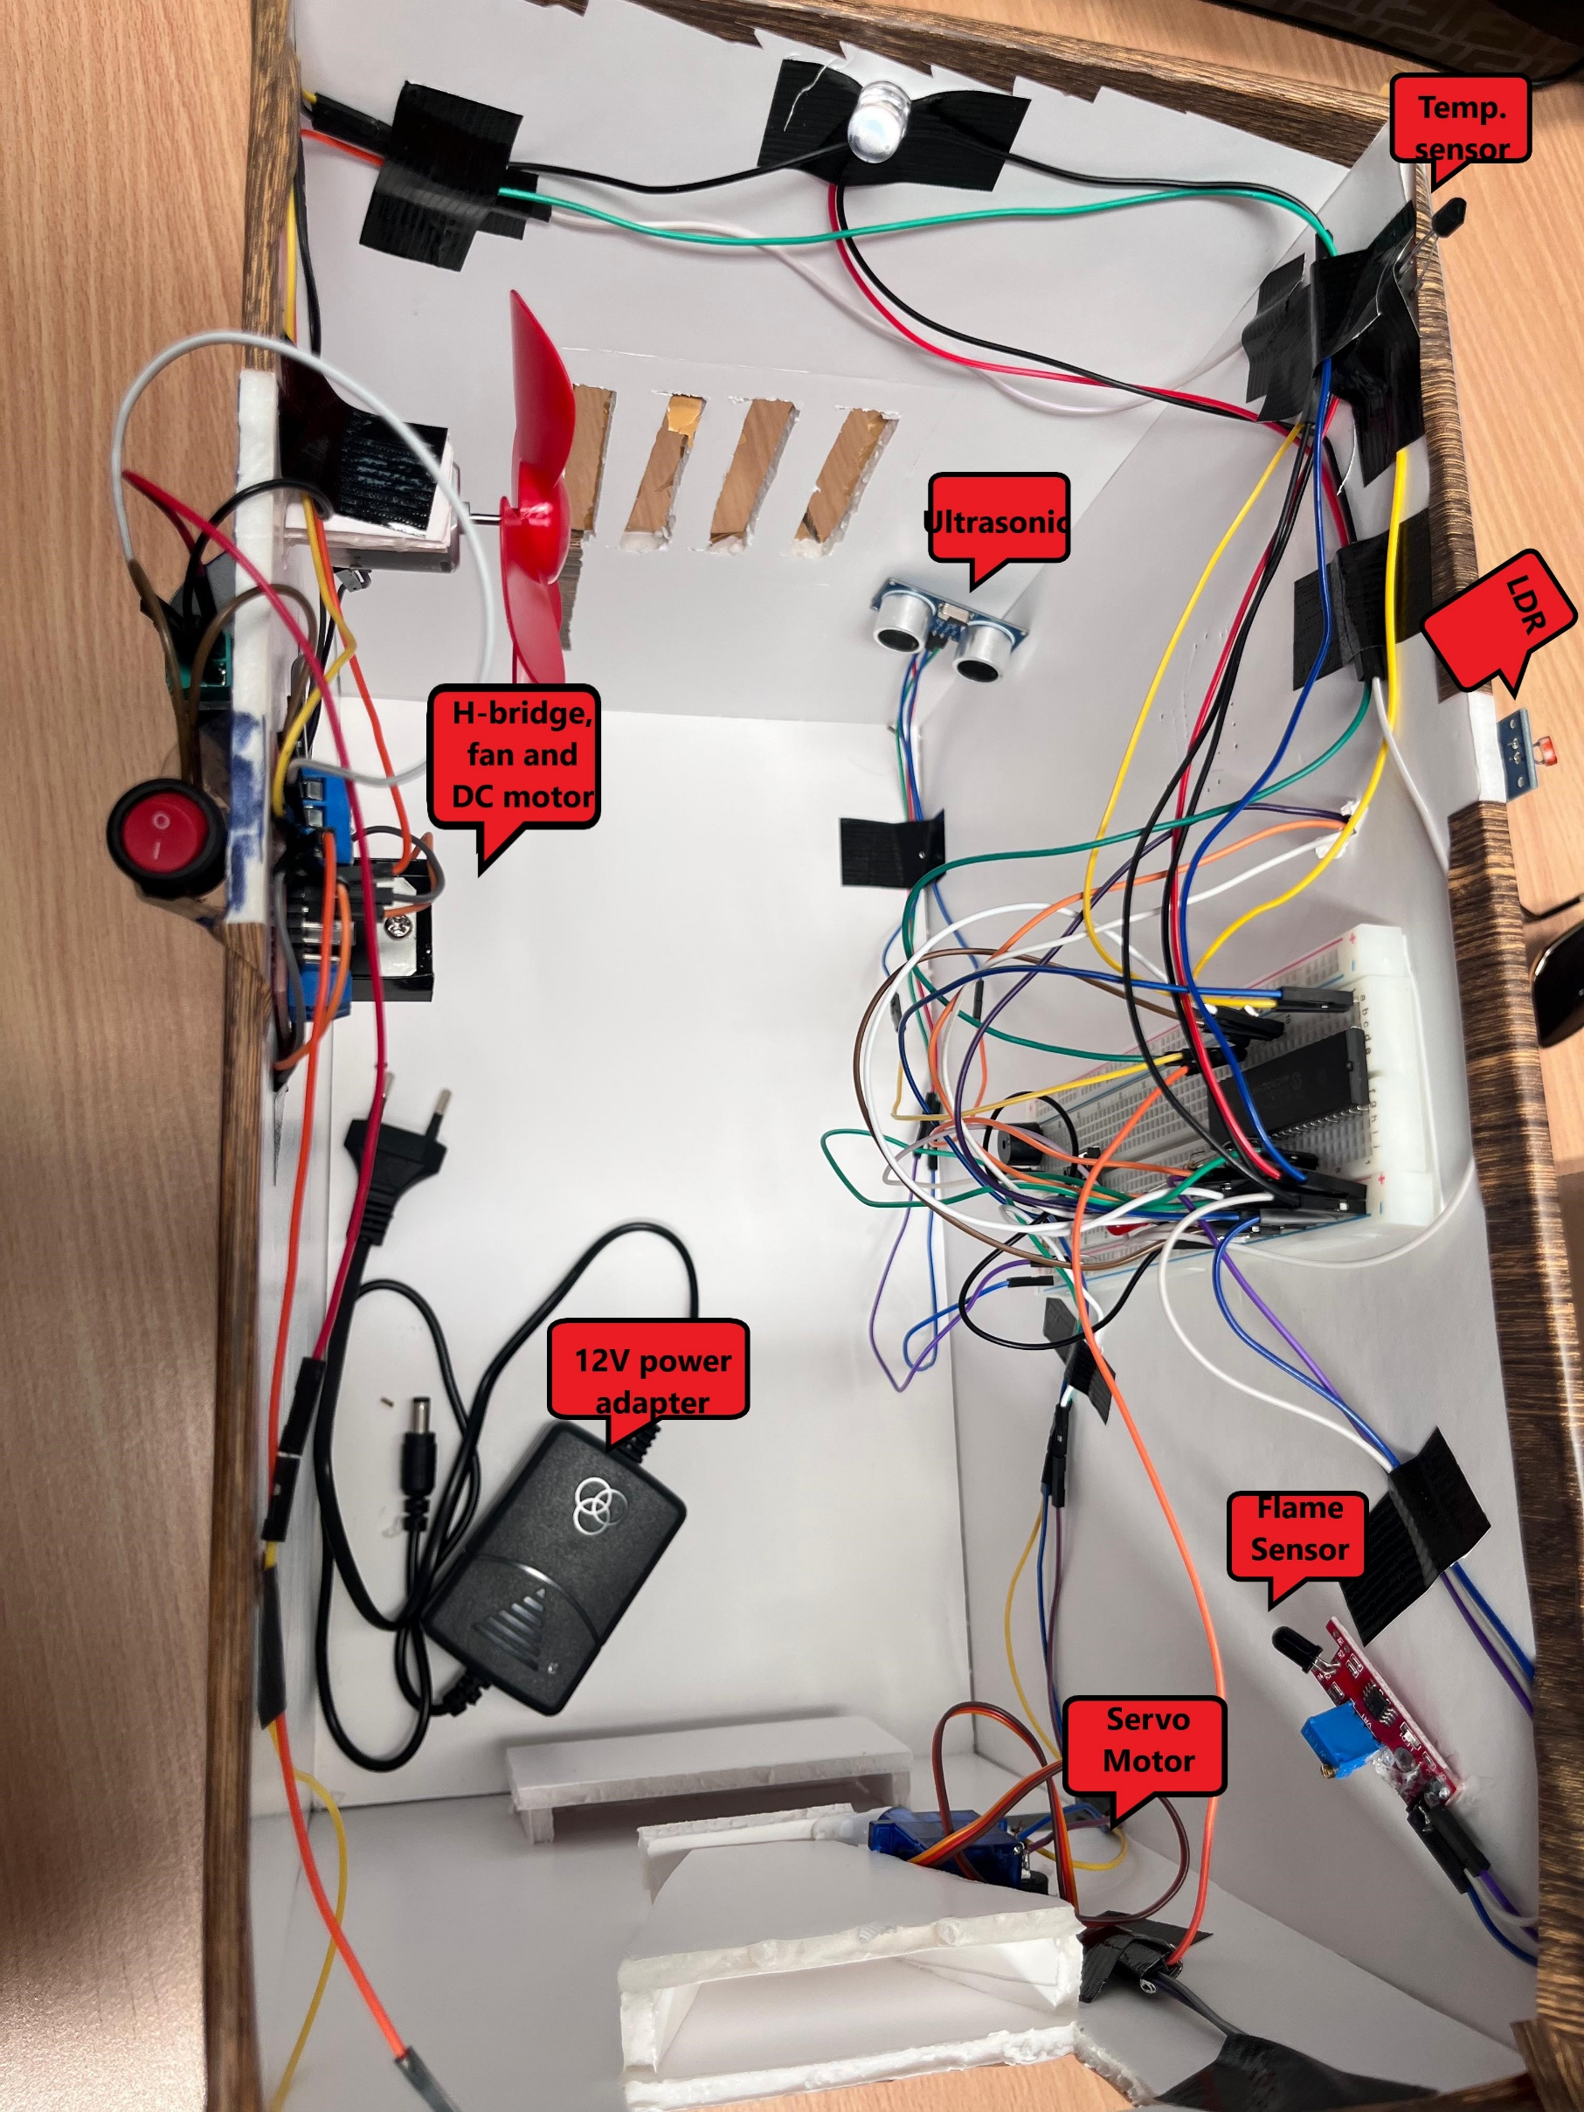
Meal4Pet
S. Madanat, W. Hinnawi and S. Oweis
Supervisors: Dr. Belal Sababha, Dr. Esam Qaralleh
Embedded Systems Final Design Project, Spring 2025
King Abdullah II School of Engineering
Princess Sumaya University for Technology
Introduction
Automated pet feeders offer a practical solution for ensuring pets are fed consistently and on schedule, even in the owner's absence. This project presents a microcontroller-based system that automates pet feeding while enhancing safety and environmental monitoring. The system detects the presence of a pet using an ultrasonic sensor and dispenses food via a servo motor. It also monitors ambient temperature and controls a fan to maintain a comfortable environment. Additionally, the system includes a flame sensor that activates a buzzer in case of fire and adjusts lighting based on surrounding light conditions. This multi-functional design aims to provide a reliable, safe, and responsive feeding solution for pet owners.
Results
When the pet approaches the machine, it gets detected by the ultrasonic, and various conditions are checked; such as temperature, flame and light (LDR) to ensure safety and comfort. After 10 seconds, the automatic dispenser gets activated and opens up; this guarantees that the pet gets fed on time according to the food schedule.
Design
The system uses a PIC16F877A microcontroller powered by a 12V adapter, with an H-Bridge driving a DC motor for the fan and servo motor. It includes flame, temperature, LDR, and ultrasonic sensors, plus LEDs, a buzzer, lamp, and manual switch for control.
Figure 3: Outer Details
Figure 1: Hardware Design
Figure 4: Inner Details
Figure 2: Software Design
Conclusion
In conclusion, our automated pet system demonstrates how embedded technology can reliably care for pets when owners are absent since it allows user to set feeding schedules, precise food dispensing and comprehensive environmental monitoring that provides a working model of energy-efficient automation with safety-critical features.
Offering a scalable framework for future IoT-enabled upgrades while delivering practical functionality today.

