Slide 1

ThinkBot
Customize Your Elder Care
Notes:
Intro: Siwen, I’ll introduce myself first
The lucas introduce, and lead to next slide

Slide 2

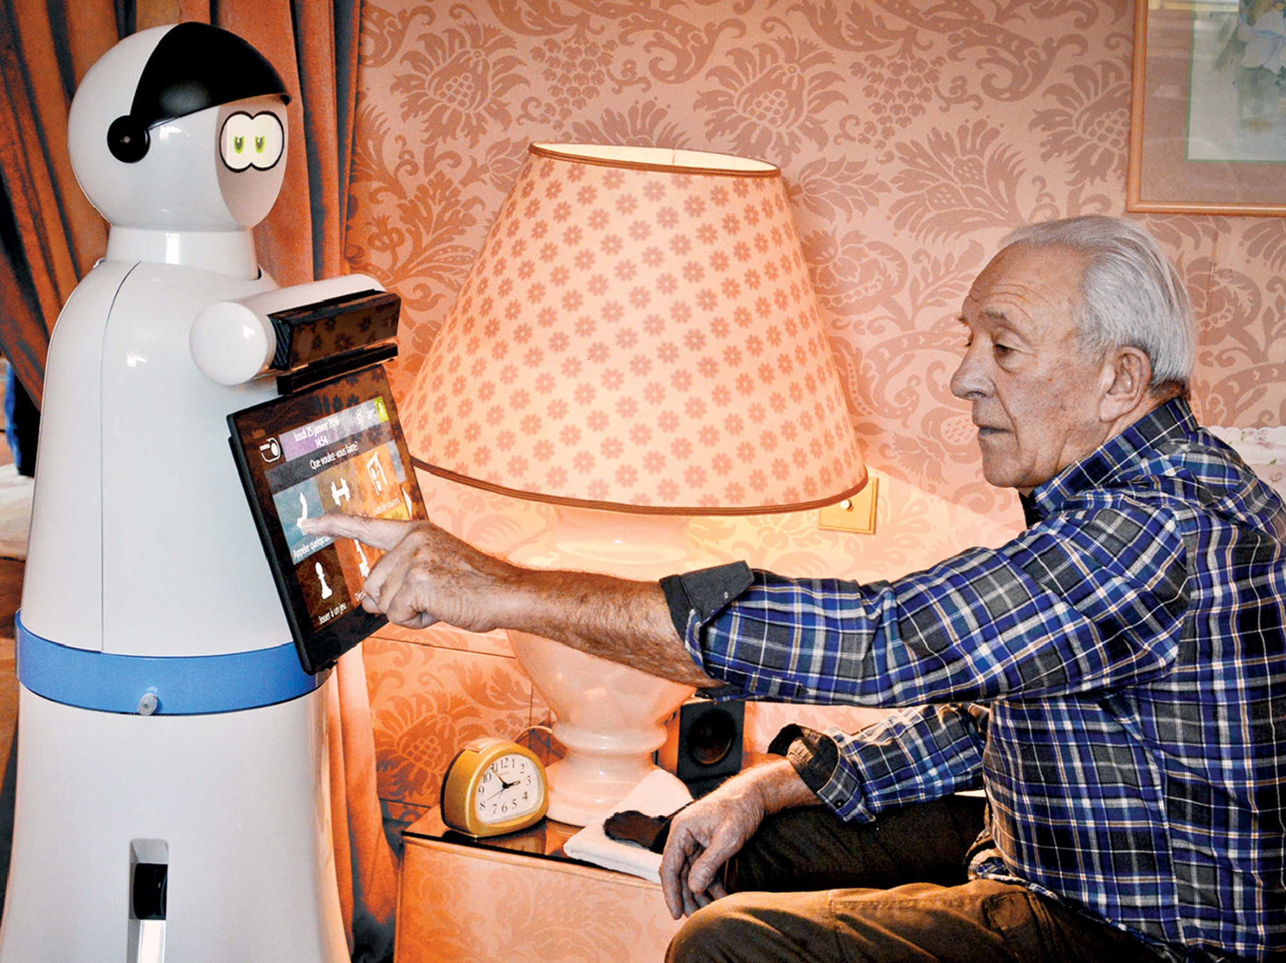
$42,000 - $90,000 per year!
Limited Interaction Methods
Notes:
Expensive and inaccessible care for elderly and paralysis patients
The price of hiring experienced nursing home care ranges between $42,000 and $90,000 per year.
Lucas

Slide 3
ThinkBot
Solution
Affordable,versatile and customizable elder care
Convenient,all-in-one site for purchasing
Notes:
Siwen

Slide 4
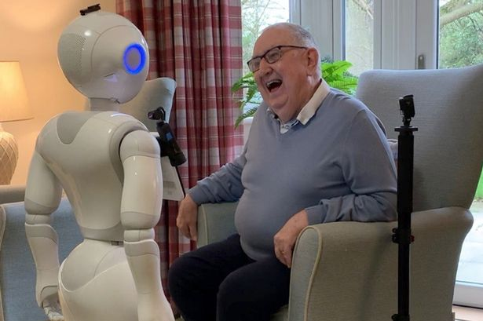
Market Size & Impact
- Elder care industry is growing at 7% Compound Annual Growth Rate
Expected to reach 2 trillion by 2027;
-About 5.4 million people live with paralysis
110 million people 80+ years old worldwide (data in 2011);
projected to reach 400 million by 2050
Notes:
Lucas

Slide 5
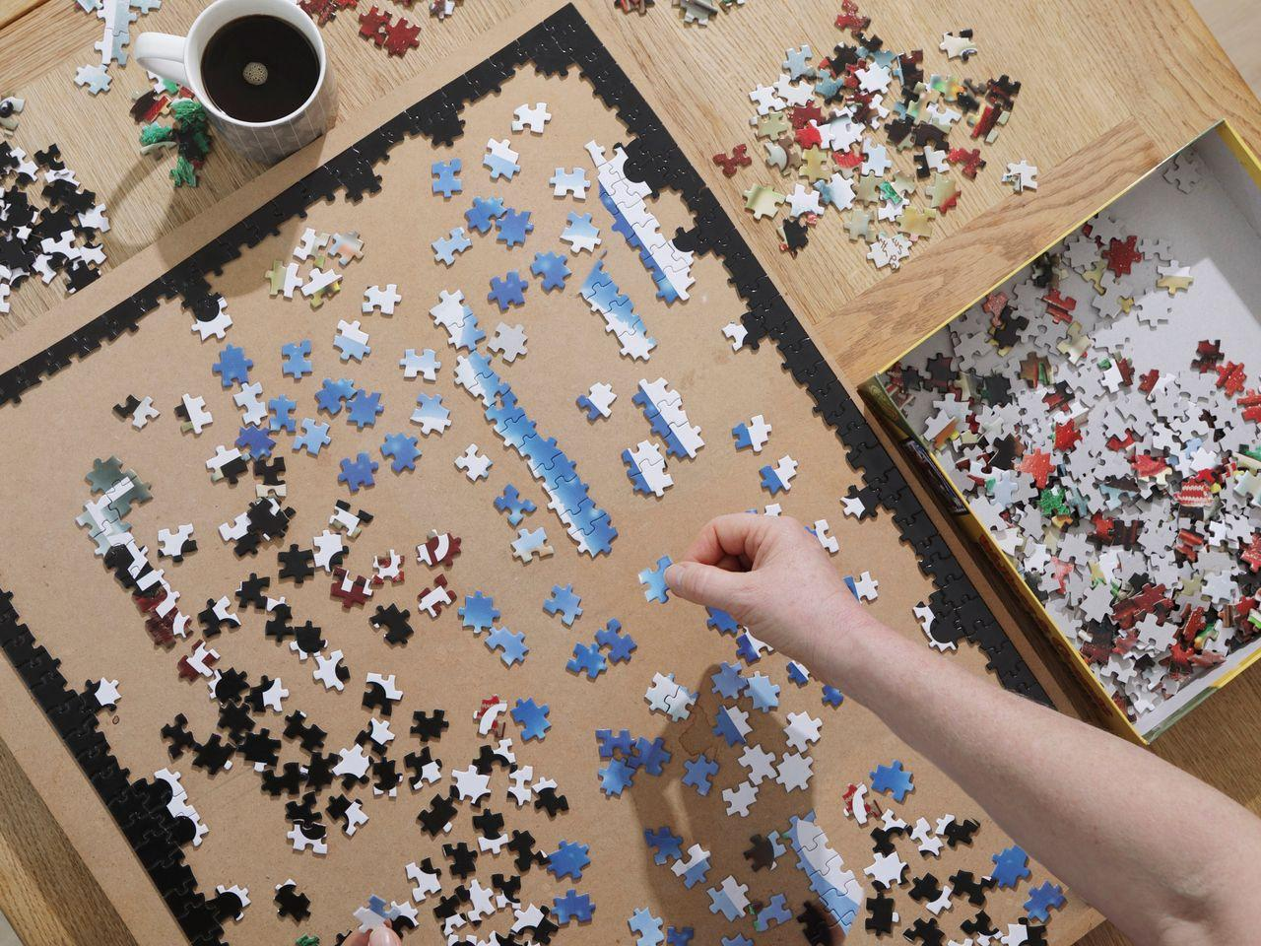
Business Model
https://wangsiwen529.wixsite.com/mysite
Notes:
Like jigsaw puzzle, order all the pieces and combine as one
Or ordering pizza
We’ll show how to order during the presentation by going the web
Siwen

Slide 6
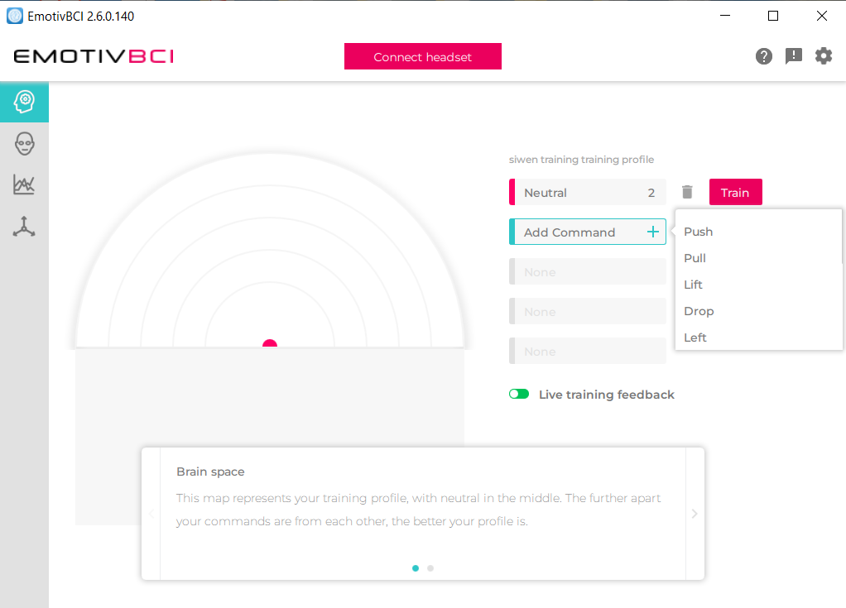
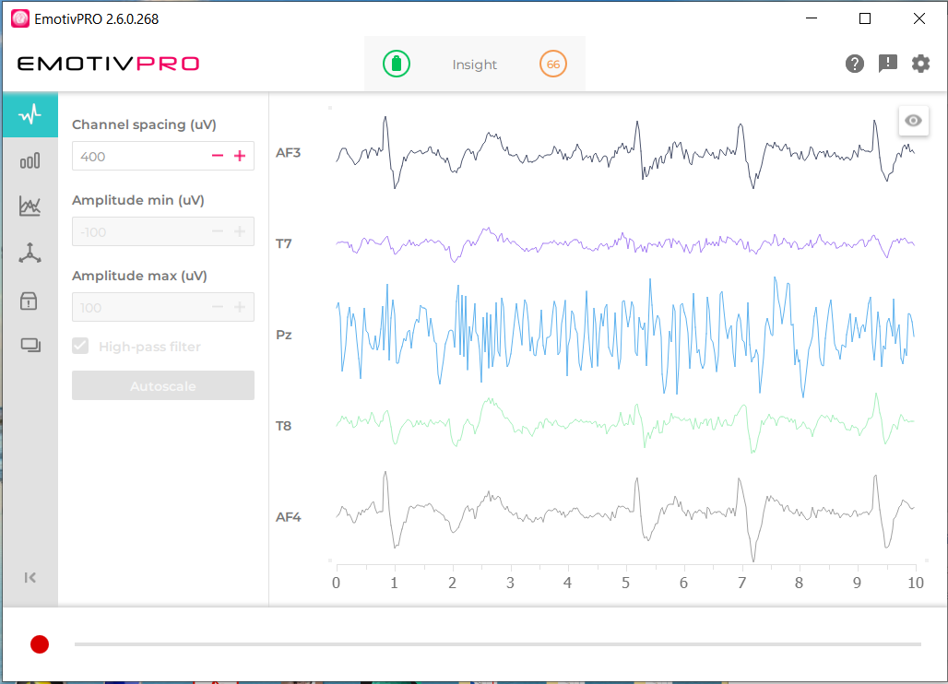
Underlying Technology (Brain Control)
-Easy Training
-Feature Detection (eye blink)
Notes:
Siwen

Slide 7



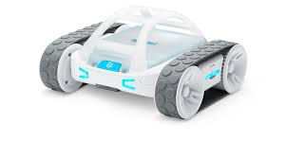
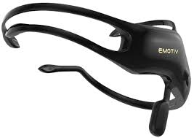


Reliable Close-loop Control
Wakes up data receiving
Travel to Desired location
Halt Data Receiving
[Neutral, Push]
INPUT
OUTPUT
OR
Bluetooth
Get people’s attention
Websocket
Notes:
Siwen

Slide 8
Timeline
Round A: $ 1 million
Marketing
increase production capacity
Round C: $ 50 million
Global Expansion
Sustaining Revenue Stream
Oversea Factory
First Prototype Model
2021.01
2022.08
2028+
2020.12
2021.08
2024.08
Angel Investing:$80,000
Internal Expansion
pilot testing
Round B: $ 10 million
Massive production
Positive income
External Expansion
Initial Public Offering (IPO)
Notes:
Lucas

Slide 9

Thank you!

