Slide 1
GPP Exam: Zombie AI

Slide 2
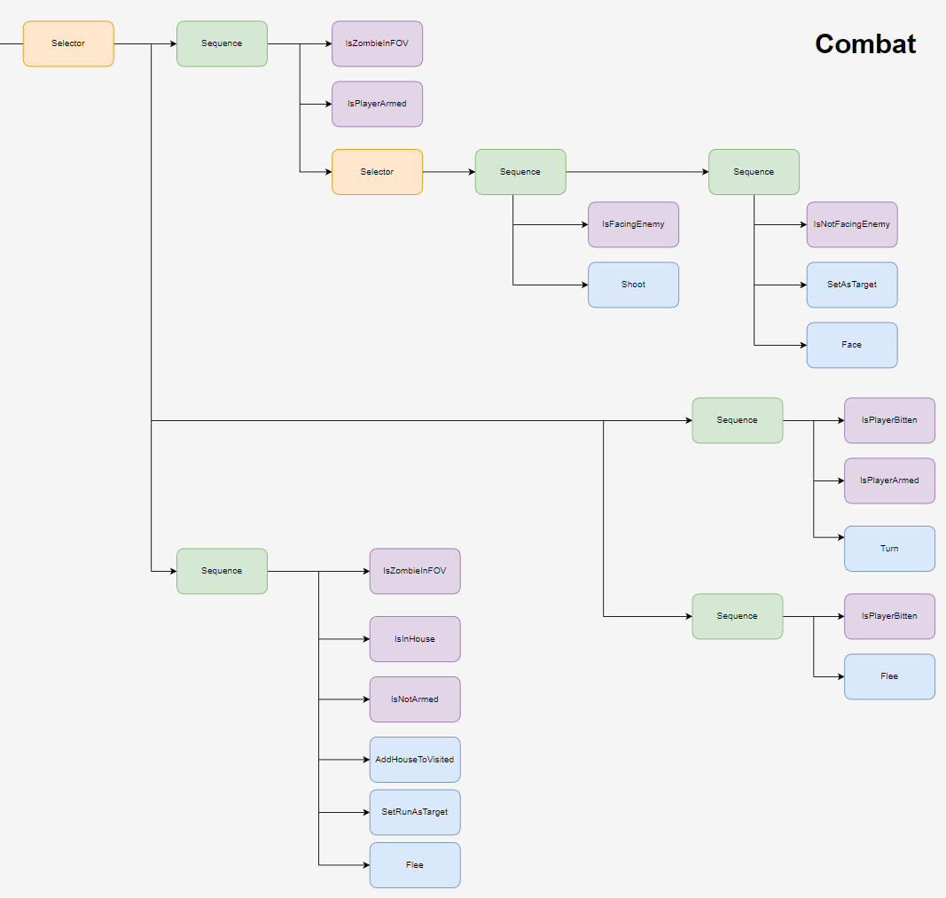
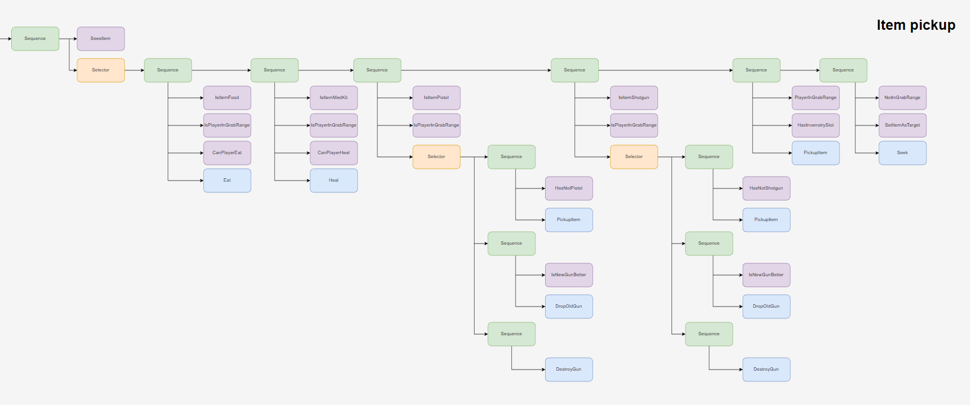
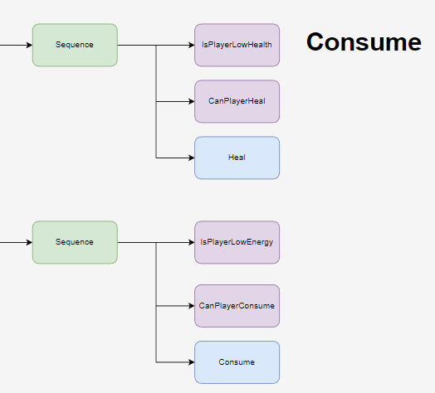
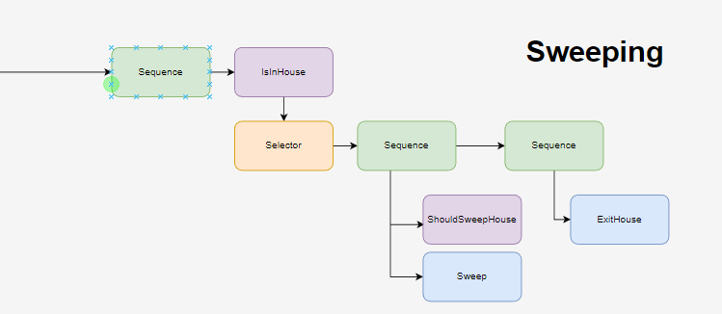
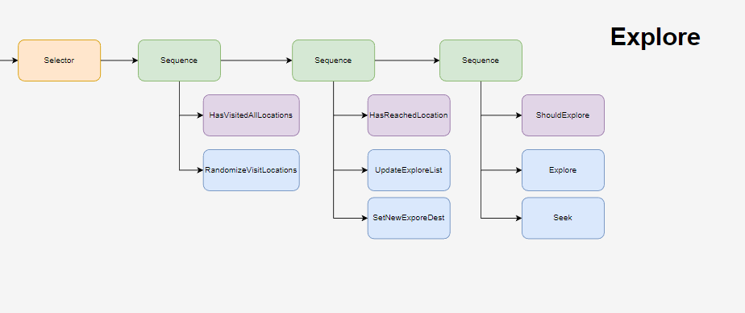
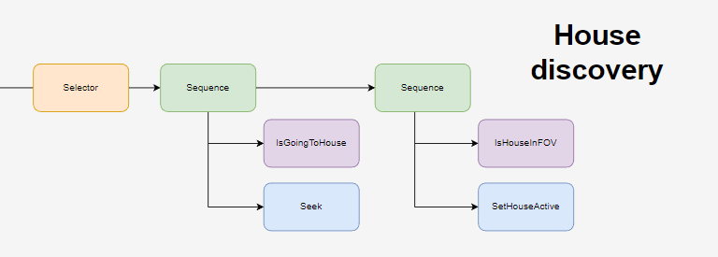
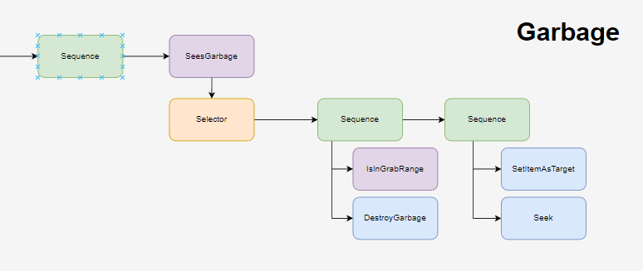
Decision Making

Slide 3
Enemy handling
When armed:
turn around and shoot
When unarmed:
run away quickly

Slide 4
Inventory
1 Slot per item type, will drop lower grade items for higher grade items.
House added to search list with cooldown.
Items will only be used after threshold (2.0 for health and energy)

Slide 5
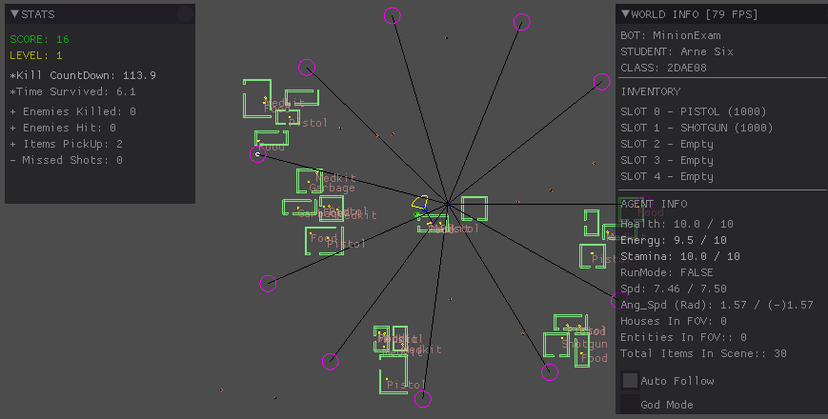
Movement & exploration
Agent travels to random points on unit circle.
Just simple seek and flee

Slide 6
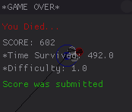
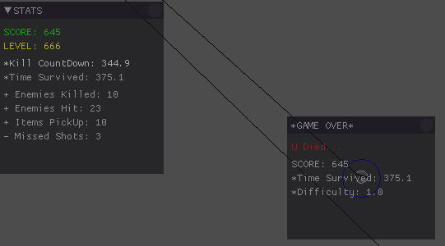
High Score
Screen shot or list of highest scores

