Slide 1
CEDC DevOps -CICD GitActions
Reporter：YangYang

Slide 2
Agenda
01
02
03
04
Introduction
Construct
Achievements
Analyze

Slide 3
Introduction
01.

Slide 4









Member
Yang Yang
PO
Julie Wang
SC
Ma Cui
SM
Hao Jing
TA
Jiang Ran
Dev
Lu Yan
Dev
Han Kunyuan
Dev
Liu Yuwei
Dev
Wang Youqun
Dev

Slide 5




Background
Industry DevOps Solutions
We hope to build a community that allows us to understand the solutions in the industry and improve the team's capabilities
Novartis
MSD
Bayer
Pfizer
Jenkins
Airflow
Glue
Jenkins
Airflow
Glue
GitActions
StepFunctions
Glue
GitActions
…
…

Slide 6

Project
Describe
CECD CICD project system.
Git Action for version control and continuous integration
Terraform manages the AWS infrastructure
Event Bridge implements event-driven integration
Lambda handles event logic
Step Functions Perform workflow orchestration
Glue performs data processing

Slide 7
Construct
02.

Slide 8
Architecture
Technical Diagram
Release Workflow
T
R
Business Diagram
B
T
Terraform Workflow

Slide 9
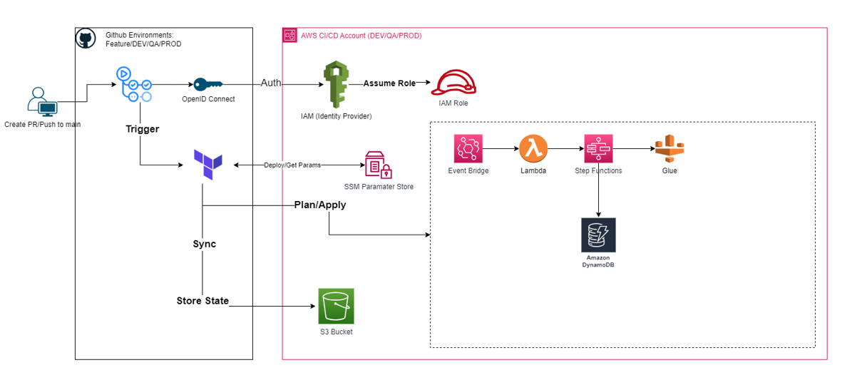
Technical Diagram
Notes:
3633ee74-0493-47db-88d1-52e235d52bbc.source.default.zh-Hans

Slide 10
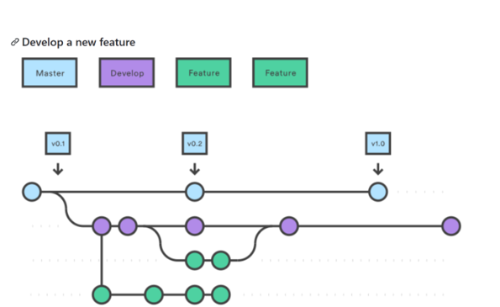
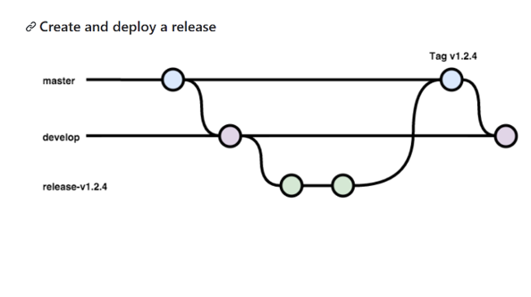
Release Workflow
Notes:
3633ee74-0493-47db-88d1-52e235d52bbc.source.default.zh-Hans

Slide 11
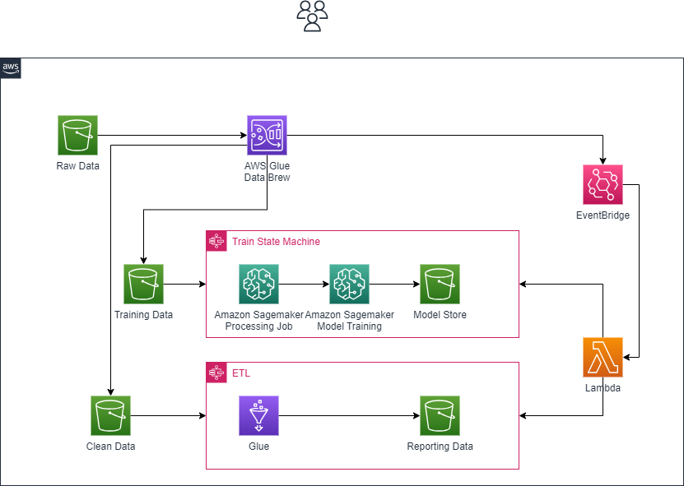
Business Diagram
Notes:
3633ee74-0493-47db-88d1-52e235d52bbc.source.default.zh-Hans

Slide 12
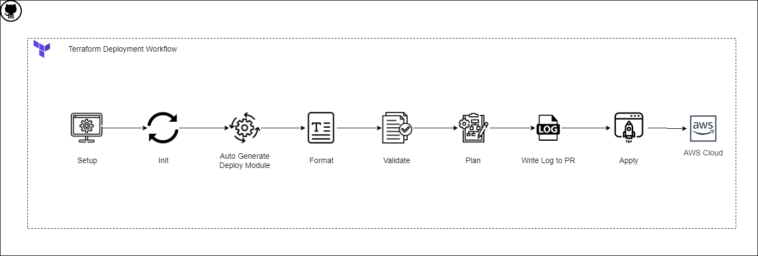
Terraform Workflow
Notes:
3633ee74-0493-47db-88d1-52e235d52bbc.source.default.zh-Hans

Slide 13
Achievements
03.

Slide 14
Roadmap
AWS StepFunctions Workshop
GitActions Demo
GitHub & AWS Integration
Implement Core Function
Development Documentation & Standard
Refactor GitActions Logic
week1
week3
Demo
week2
week4
Multiple Accounts Integration
Release Environment Setup
Terraform Module Design
Services Integration Test
Deployment Test
Code Review
Notes:
b75d0af2-83ba-468a-bfb1-d7d2a8cc1799.source.default.zh-Hans

Slide 15
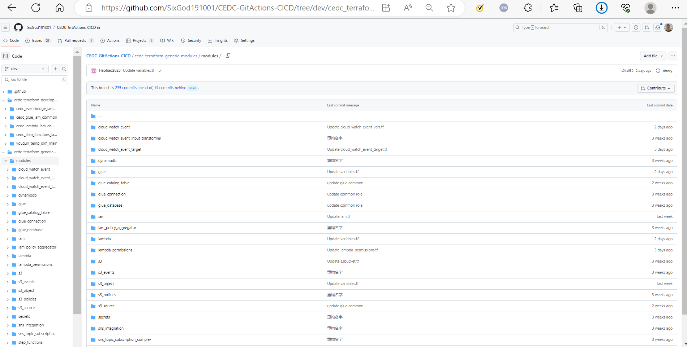
Framework

Slide 16
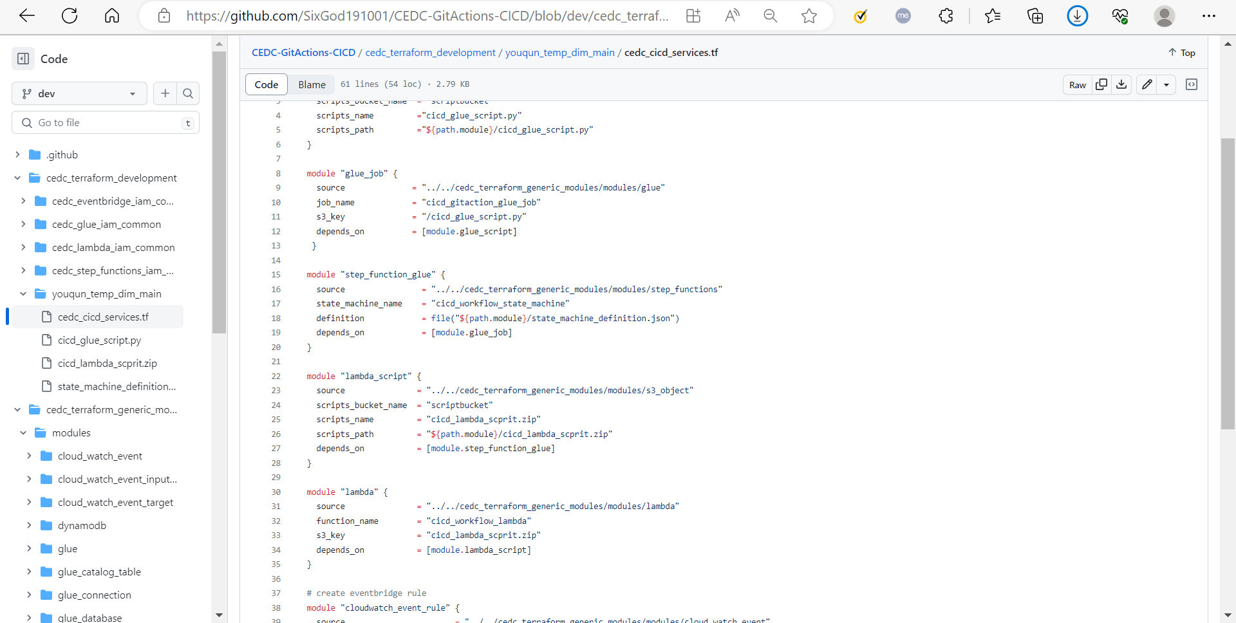
logic

Slide 17
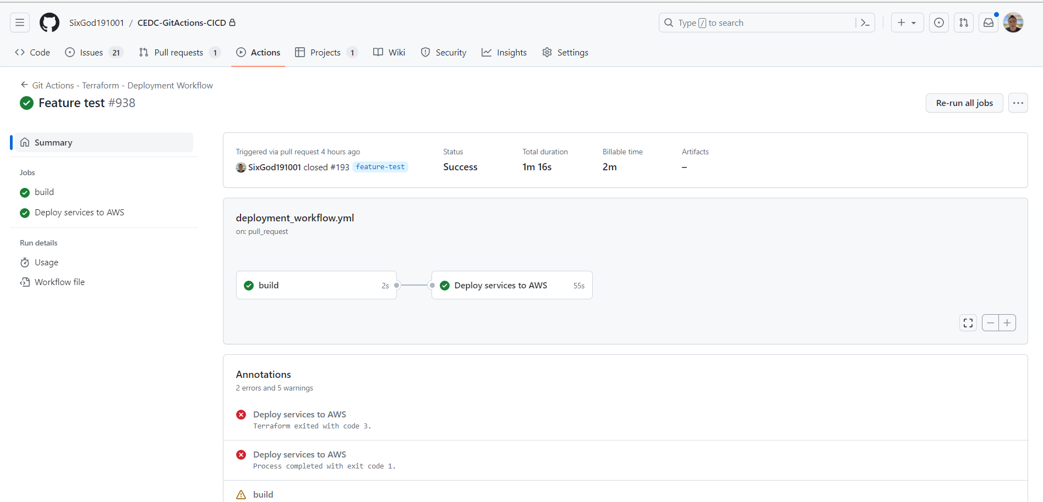
Deloyment

Slide 18
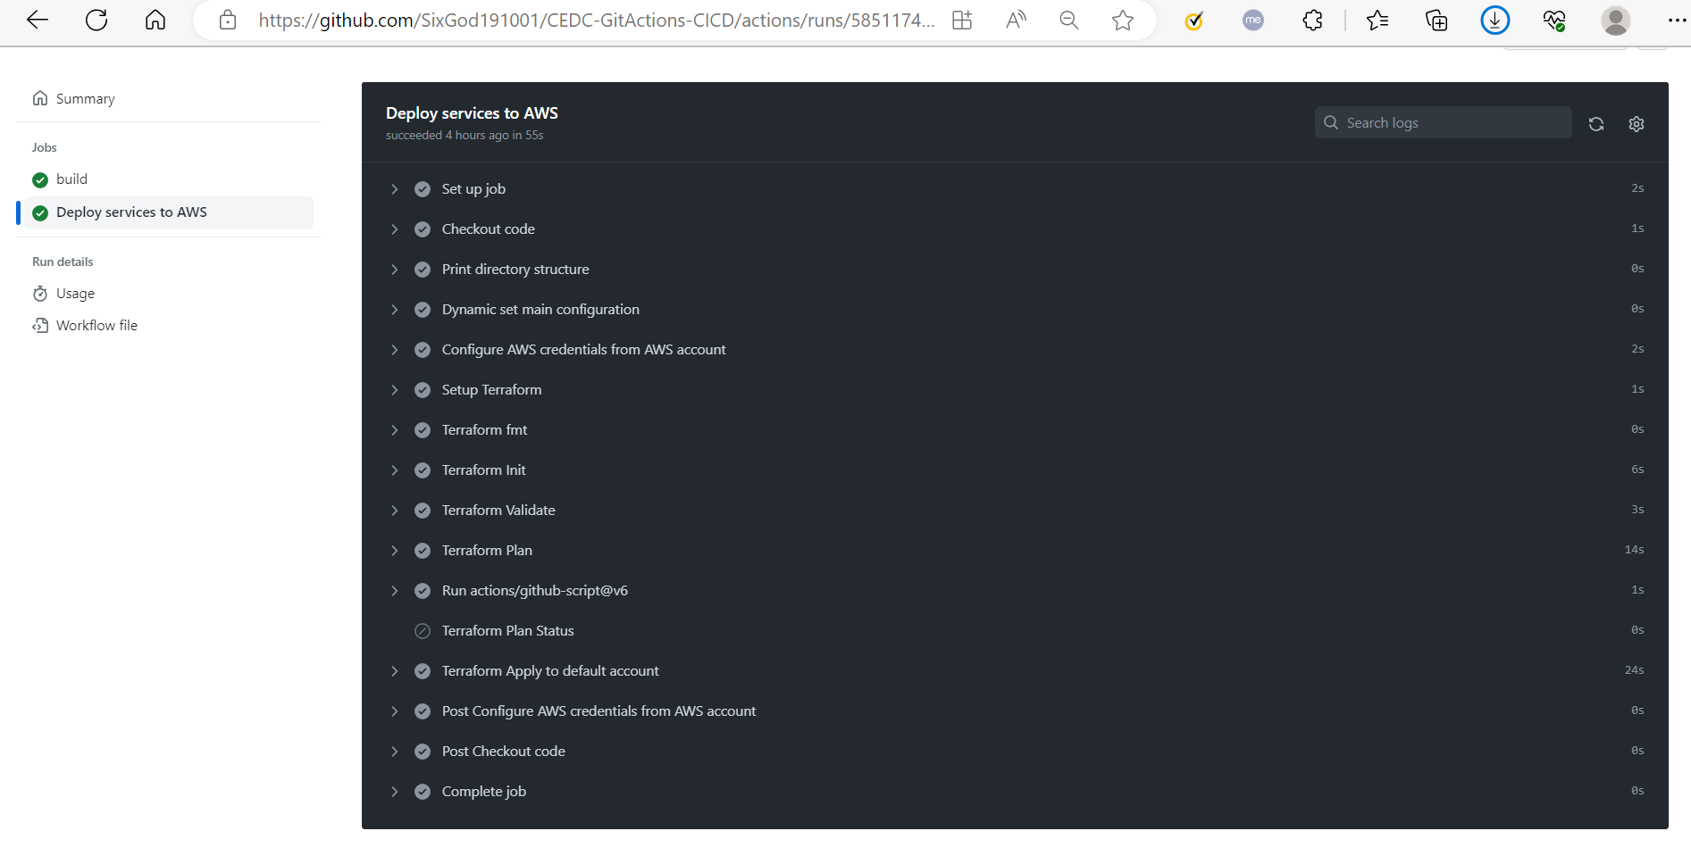
Terraform Workflow

Slide 19
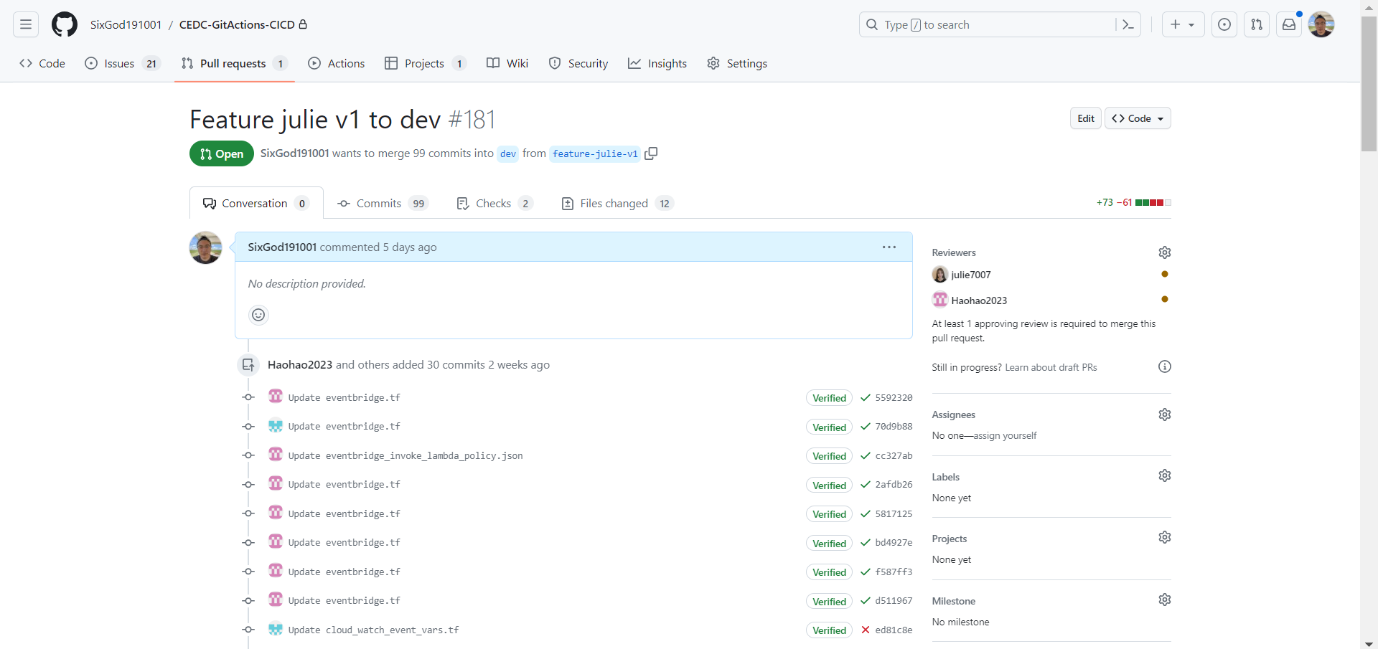
Pull Workflow

Slide 20
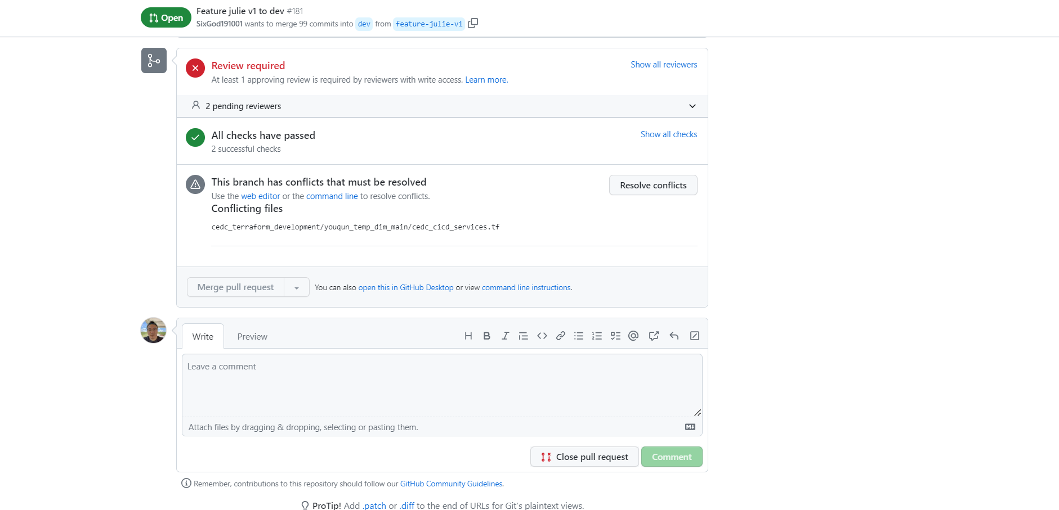
Pull Workflow

Slide 21
Analyze
04.

Slide 22






Analyze
VS
VS
VS
耦合
解耦合
Jenkins
Git Action
Cloud Formation
Terraform
Notes:
3633ee74-0493-47db-88d1-52e235d52bbc.source.default.zh-Hans

Slide 23
Thank you for
watching.
Reporter:YangYang

