Slide 1
Some important Unix commands
Note: Everything is case sensitive
ls - list the directory content
cd - change the directory
cp - copy a program like cp from to
pwd - show where you are in the directory
nano - code editor
python3 - is the programing language and also the command to execute our code
Our code is the directory EV3 – use cd EV3 to get to the directory
The code ends with *.py

Slide 2
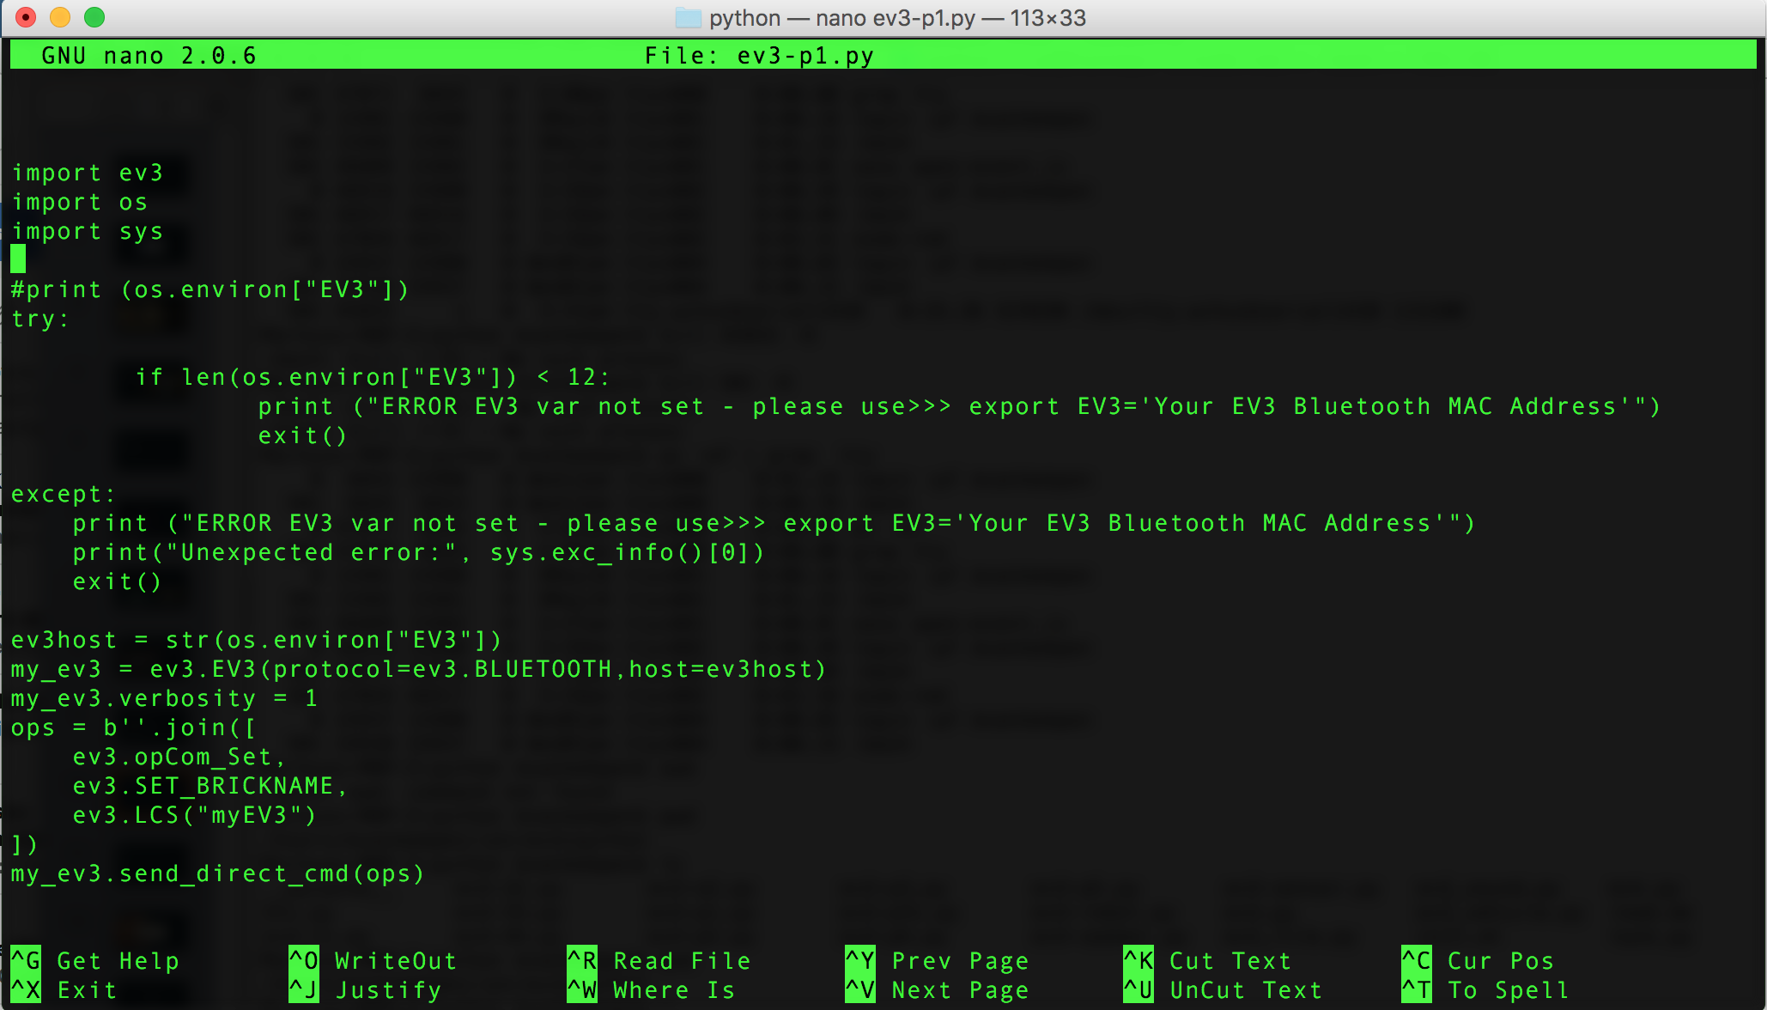
Unix editor - nano
nano is a small editor to edit the programs
like: nano ev3-1.py
Node. Control + X will let use exit and save the progam after you changed something

Slide 3
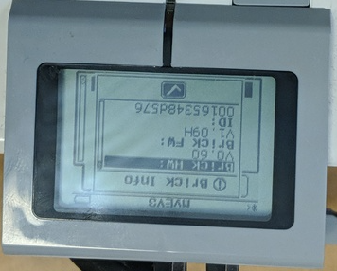
Set the MAC address of the EV3
We need to set the MAC address of the EV3 in the shell
The MAC Address you can find in the EV3 under
the system menu -> Brick info ->ID
Note: you have do add “:” for the address
Address /ID translates into
00:16:53:48:d5:76

Slide 4
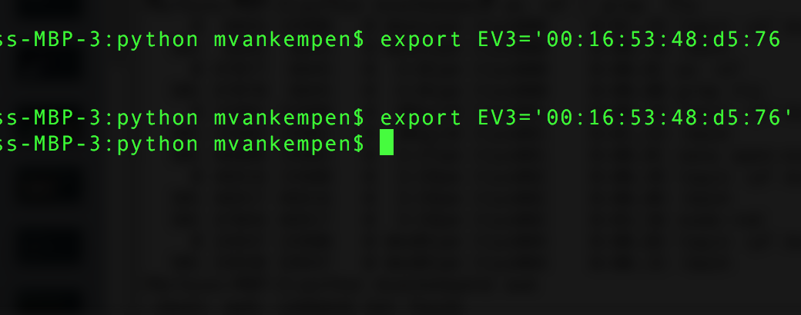
Set the MAC address in the shell
export EV3='00:16:53:48:d5:76'

Slide 5
Execute code
Run you 1st python3 program
Change to the EV3 directory – cd EV3
Execute the program
python3 ev3-1.py
Look at the code via nano and change it change the EV3 name to myEV(YourGroupNumber) like myEV-32
ev3-1.py = Change the name of your rover
ev3-2.py = Play a sound and switch on the LED
ev3-3.py = Driving program

Slide 6
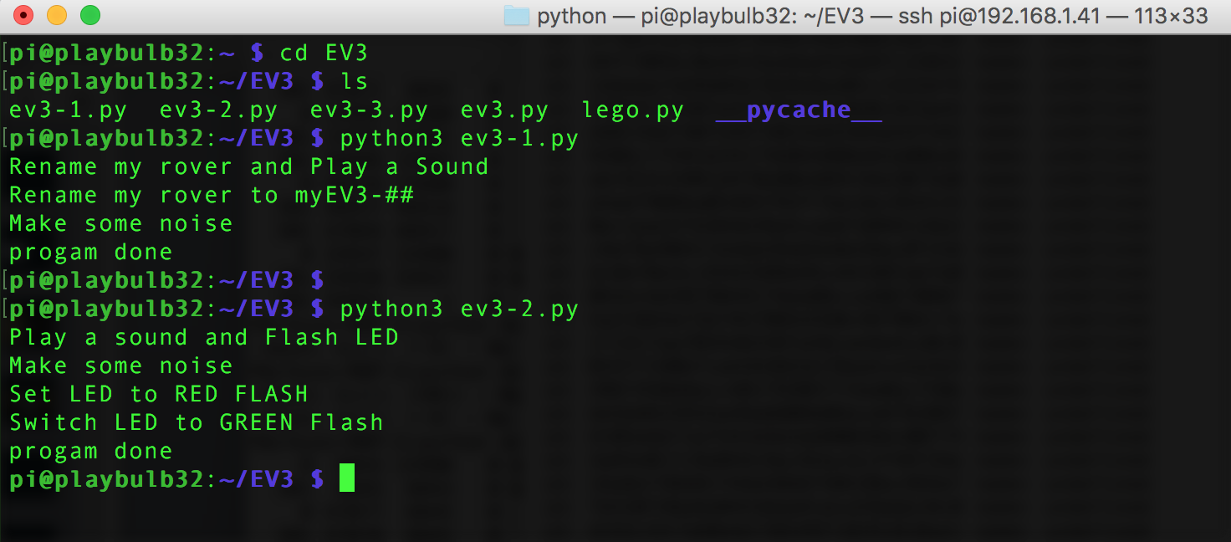
Executing the 1st python program

