Slide 1
BagNet: Berkeley Analog Generator with Layout Optimizer
Boosted with Deep Neural Networks
kourosh hakhamaneshi
Electrical Engineering and Computer Sciences
University of California at Berkeley

Slide 2
BagNet
BagNet: it proposes a new sample-efficient evolutionary-based optimization algorithm for designing analog circuits using layout generators.
Structure：
1、 Algorithm Overview
2、 Experiments: Run several example AMS circuits
3、Conclusions

Slide 3
Algorithm
由Population-Based Methods的缺点引出进化算法：
Population-Based Methods：从一个initial population开始，通过一些进化操作(如组合、变异)，从old population迭代地得到new population 。然后，一些选择机制为下一代挑选population中的精英，这个过程被称为elitism。这个过程一直持续到Population的mean cost达到最低。
此方法会sample inefficiency ，且容易收敛不稳定。并由于随机性，过程须重复多次。因此，不能直接用于需要大量时间来仿真的layout-based optimizations。
导致sample inefficiency的两个原因：
1、 许多new population相比old仅轻微改善，并且随着不断改善，取代old的难度也增大。因此需要多次迭代，直到产生足够好的new population取代old。
2、Only total cost :不考虑cost对每个design constraint的敏感性，即不考虑每个spec是如何影响total cost 的。人们通常根据最限制其设计的constraint来确定设计目标的优先级。而仅考虑total cost可能会产生误导，搞错指标的优先级。

Slide 4
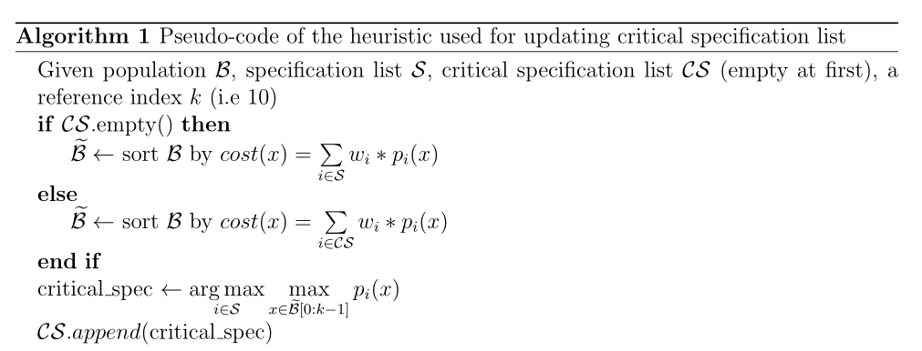
Algorithm
对缺点1的解决：oracle(DNN model)：tell us how two designs were compared in terms of each design constraint, then use it to direct the selection of new designs. Each time a new design is generated we can run the oracle(查看新设计与上一代的一些平均设计相比如何)(oracle:评估模型)
对缺点2的解决：先查看total cost，但要确定 a set of critical specifications (最具限制性且应优先考虑的规范). Each step that we search the oracle, we only add designs that have better performance than the reference design in all metrics in the critical specification set. Once a metric enters the critical specification，it will keep。For each time to find critical specification ，the algorithm shows below：

Slide 5
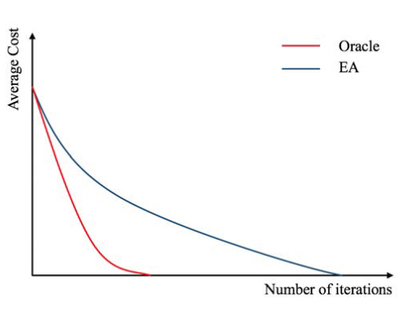
Algorithm
This illustration shows that the oracle can significantly reduce
the number of iterations for convergence if we knew what designs to add and what designs to reject

Slide 6
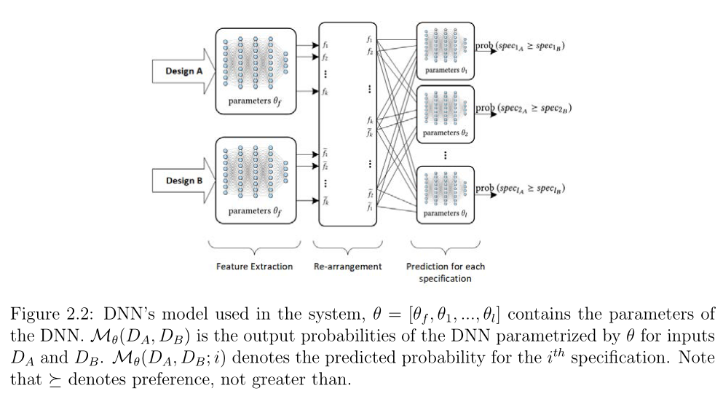
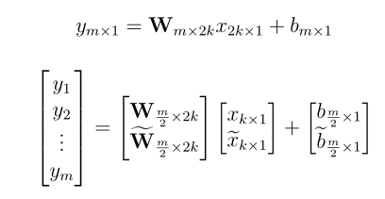
Algorithm
The model of oracle:
FC layer
1、Each sepc has a sub-DNN layer (使用FC层预测spec的preference)
2、A constrain：网络应该预测输入的互补概率[D_{A},D_{B}]VS[D_{B},D_{A}],即
这样根据输入的顺序，预测的概率不应该存在矛盾。
3、为了保证constrain特性，并更容易train，所以sub-DNN layer应具有偶数个隐藏单元，并且decision networks中的weight和bias matrices有如下关系：

Slide 7
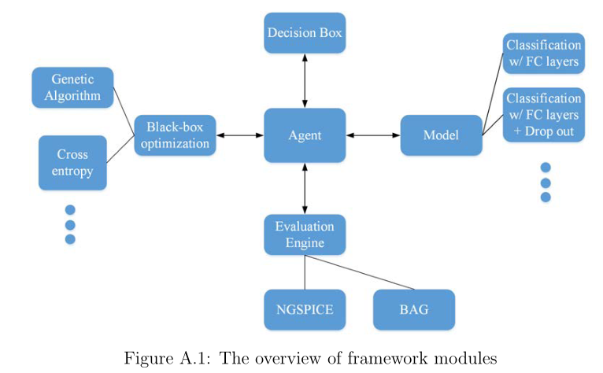
Overview of Framework Structure
1、The agent：handle the flow of full algorithm.
2、Evaluation Engine：run the evaluation core and handles parallel evaluation. The module itself is initialized by a specification file that has all the information about the parameters to optimize, their range, the circuit specification, and how to evaluate the cost function.
3、model（oracle）：the neural network model（FC / FC+Drop out）
4、Black-box optimization: handle all the evolutionary operations needed for the optimization framework.
5、Decision Box： handles all the heuristic-based decisions
such as determining which designs to accept based on DNN’s output,
whether the convergence condition is met, and getting parents and the reference design from population.

Slide 8
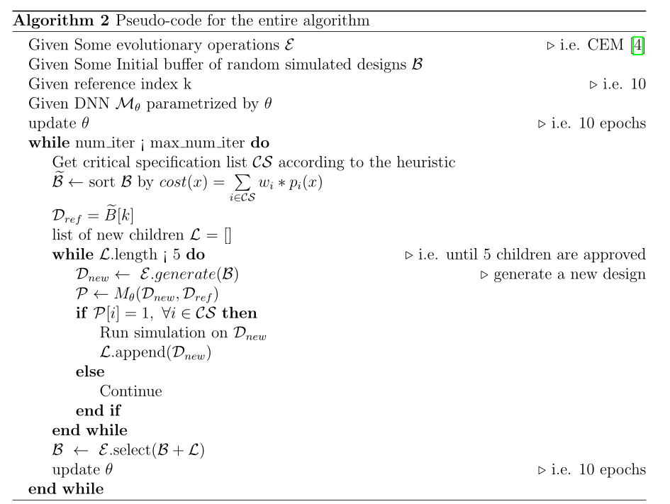
Full Algorithm Process

Slide 9
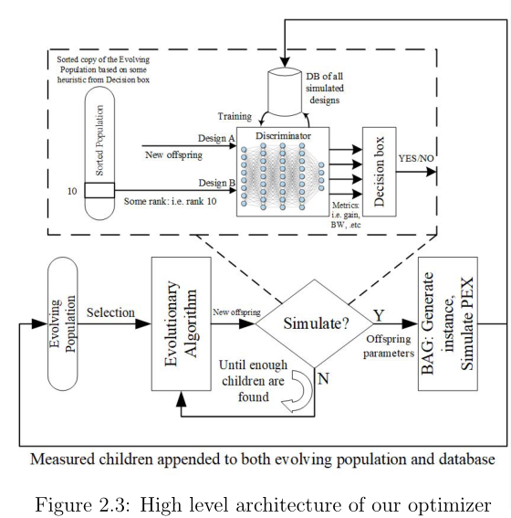
High level architecture

Slide 10
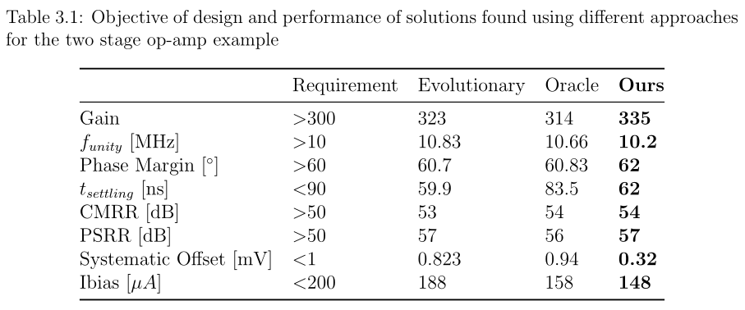
Experiments
Example1:Schematic Design of a Two Stage Amplifier
use 45nm BSIM models on NGSPICE to clarify the convergence and benefits of the algorithm

Slide 11
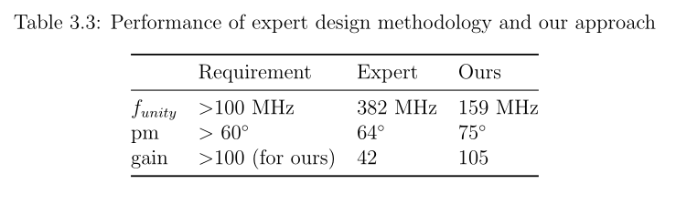
Experiments
Example2:Layout Design of a Two Stage Amplifier and
Comparison against an Expert Design
In this circuit the resistor and capacitor are schematic parameters, while all
transistors and all connecting wires use the GF14 nm PDK extraction model.

Slide 12
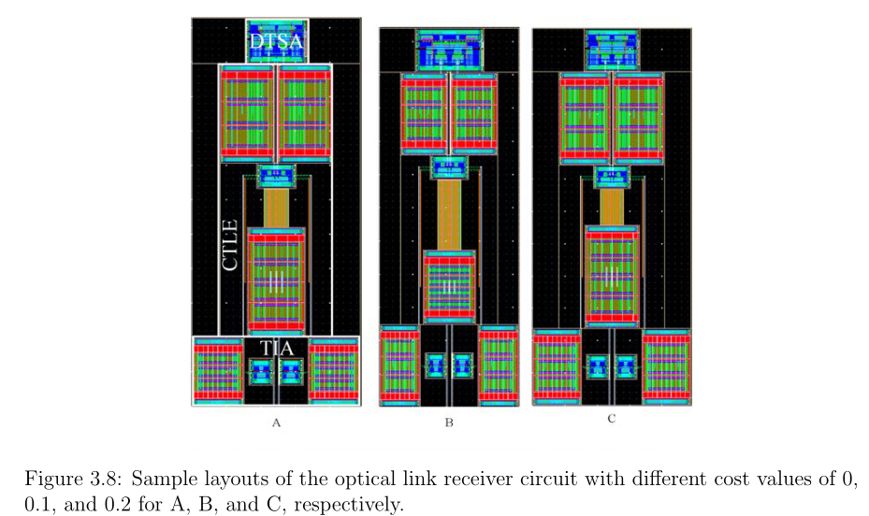
Experiments
Example3: End-to-End Layout Optimization of an Optical
Receiver Link

Slide 13
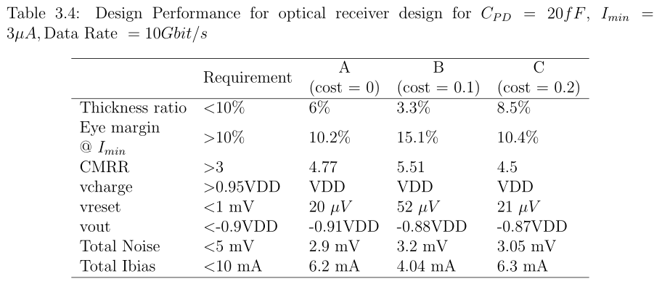
Experiments
Example3: End-to-End Layout Optimization of an Optical
Receiver Link

Slide 14
Conclusion
可供参考的创新点(paper中提到的future work)：
1、缺少一个无偏性能指标来比较BagNet中部署的不同DNN模型。
2、可以根据原理图训练一些东西，用相同的参数将这些知识转移到版图上，并加快算法的收敛速度。即可以从优化原理图开始，然后微调布局。
3、对于模拟的BAG，其API是有限的。需要加快BAG中的模拟过程，以便更方便地调试。

