Slide 1
MLParest: Machine Learning based Parasitic
Estimation for Custom Circuit Design
Brett Shook ,Prateek Bhansali
Intel Corporation, Hillsboro, OR, USA

Slide 2
MLParest
This work presents a machine learning based parasitic estimation framework: MLParest 。
MLParest提供了pre-layout desgin阶段预测post-layout interconnect parasitics的准确估计。
MLParest估算互连电阻和电容，来辅助Circuit Design 。这允许设计者在原理图设计阶段将互连效应纳入电路性能。这减少了布局后和布局前模拟结果之间的差距，这有助于减少这两个阶段之间的设计迭代。因此，MLParest可以大大加快模拟设计的周转时间。

Slide 3
Machine Learning Based Parasitic Estimation
This work leverages machine learning techniques with existing post-layout extraction data(布局后提取数据) to train estimation models and predict interconnect parasitics.
In analog mixed signal domain, it is worthwhile to emphasize that
using a machine learning paradigm in the context of parasitic
estimation is an industry first.

Slide 4
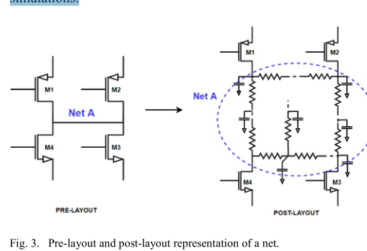
Machine Learning Based Parasitic Estimation
Here a pre-layout net transforms into a multi-port RC circuit after interconnect parasitics are extracted. This transformation happens for every net of a circuit, which then leads to significant differences in pre-
layout and post-layout circuit simulation.
With MLParest this paper aims to estimate this RC-network for each pre-layout net and then use it as a proxy(代理) for the post-layout network in pre-layout simulations

Slide 5

Machine Learning Based Parasitic Estimation
Model：Extracted nets can be of an arbitrary structure, typically a tree, with several resistors and capacitors. Each net can be different from others in terms of its topology and routing.
To solve this problem with ML：This paper approximate（估计） each post-layout net using two scalars – effective capacitance(Ceff) and effective resistance(Reff).
effective capacitance: 网络上入射的总电容的总和
effective resistance: ((时间常数/有效电容)

Slide 6
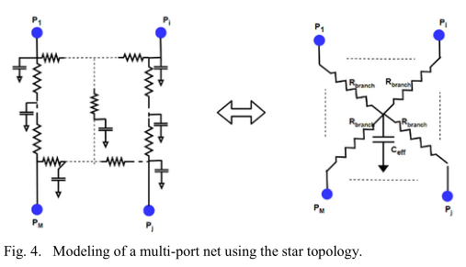
Machine Learning Based Parasitic Estimation
With effective resistance and capacitance，this paper synthesizes a post-layout net using a simple star topology shown in Fig. 4

Slide 7
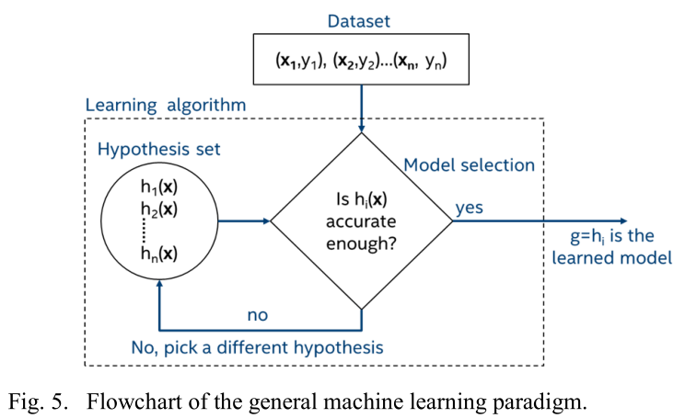
Machine Learning Based Parasitic Estimation
1、x is the vector of input variables and y is the response，即y=f（x）。
It is this unknown function f（x） that an ML algorithm tries to learn given a dataset
2、Learning algorithm从一组称为hypothesis set的候选函数中进行选择。基于适当的error criteria，如均方误差（MSE）或平均绝对误差（MAE），来自hypothesis set中最优函数g（x）被确定。
函数g(x)就是对未知函数f（x）的预测，后面的应用中g（x）就作为f（x）
的代理。

Slide 8
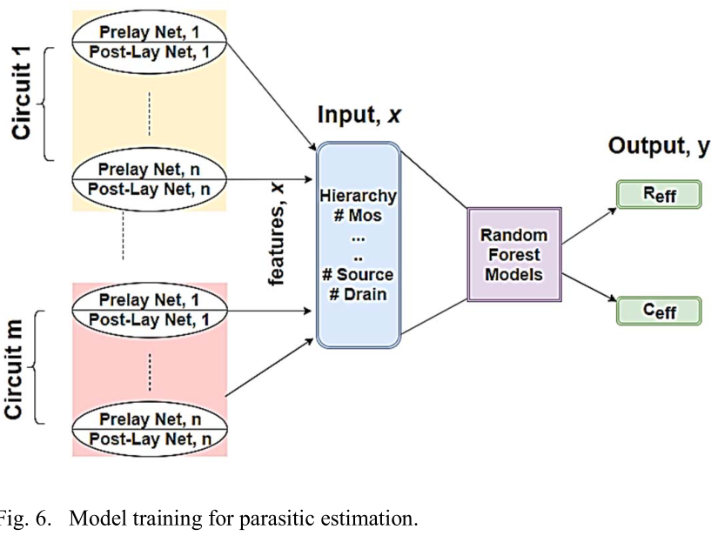
Machine Learning Based Parasitic Estimation
R、C

Slide 9
Machine Learning Based Parasitic Estimation
1、start with a collection of circuits with pre-layout (schematic) and post-layout extracted (R C) data.
2、Next, extract features of each net for all circuits by traversing circuit netlists.
3、The x variables in the dataset, on a per net basis, are the features from the pre-layout netlist: the number of connections on a net, the number of hierarchies the net traverses, the number of the drain, gate and source connections, the total width of all MOS devices, net type , and the number of p-type and n-type devices.
4、The y variables are the Reff and Ceff values from the post-layout circuits
5、The model learns two functions: one for resistance and one for capacitance.
It computes actual Reff and Ceff using post-layout nets.
6、It choses the Random Forest model（随机森林模型）for supervised learning since it offered the best prediction accuracy based on experiments.
7、 70% for training and 30% for testing
Once a model has been learned, we use it to predict
interconnect parasitics of pre-layout schematic nets that haven’t
been seen before.

Slide 10
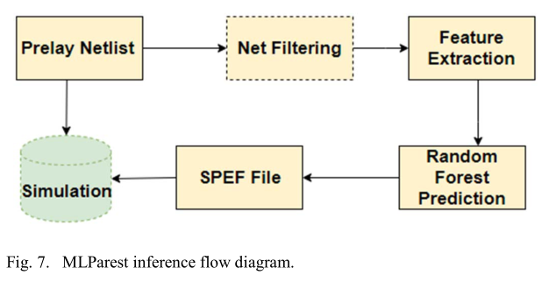
Machine Learning Based Parasitic Estimation
首先解析pre-layout网络列表并提取每个网络的特征。接下来，将这些特征输入到经过训练的随机森林模型中，用于产生预测的Reff与Ceff预测值。使用这些标量，可以为每个网络合成一个星形拓扑

Slide 11
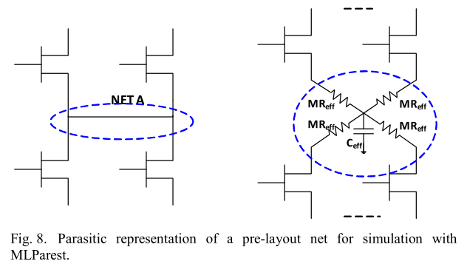
Machine Learning Based Parasitic Estimation

Slide 12
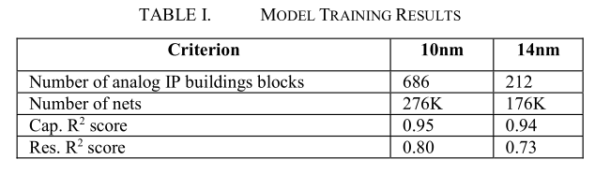
Training
Training：
1、使用scikit包在Python中实现了MLParest框架和相关的模型学习。
2、对于MLParest，分别使用212和647个模拟块在14nm和10nm过程中进行训练，对于14nm与10nm的电容与电感预测图见下页

Slide 13
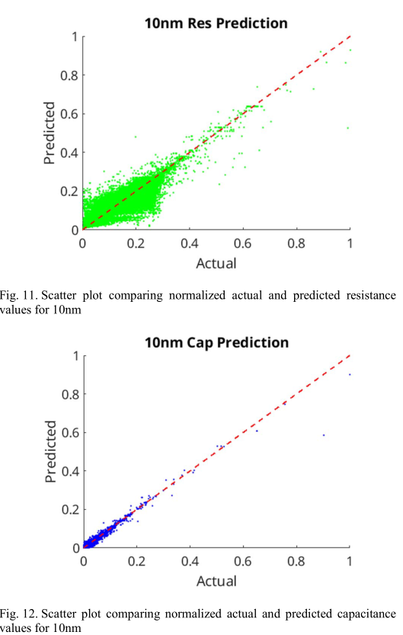
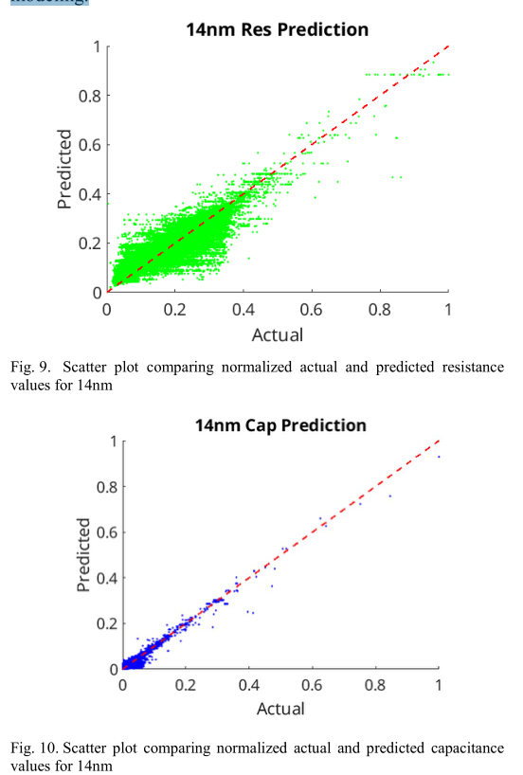
Results

Slide 14
Results
随机森林模型可以很好地预测R和C。据观察，电阻预测的变化大于电容的变化。这可能是因为电路功能列表缺少影响导线长度和电阻的放置信息。
与机器学习一样，在预测中发现了异常值。它们通常发生在启用、时钟和全局信号上，数千个设备连接到它们。在实践中，一旦这些信号被打开，由于其恒定的性质，它们对影响电路性能的测量没有多大贡献。捕获这些异常值还值得改进.

Slide 15
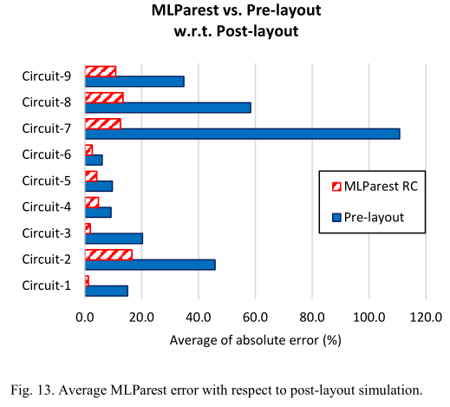
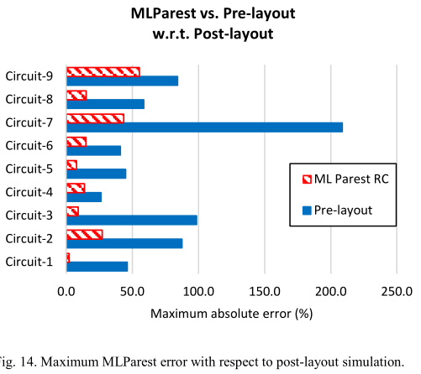
Results
还测试了使用九个10nm模拟电路上使用MLParest的结果
1、图13显示了针对布局前和布局后结果的MLParest的10nm测试用例上模拟测量的平均绝对误差（%）（MAE）。这些指标包括延迟、上升/下降时间、带宽、增益、随时间变化的平均电流、泄漏电流和振荡器频率。
2、图14显示了预布局和MLParest与后布局模拟结果之间的最大绝对误差（%）。

