Slide 1
AutoCkt: Deep Reinforcement Learning of Analog Circuit Designs
Keertana Settaluri, Ameer Haj-Ali, Qijing Huang, Kourosh Hakhamaneshi, Borivoje Nikolic
University of California, Berkeley

Slide 2
AutoCkt
Abstract：Existing automated solutions that optimize circuit parameters for a given target design specification have limitations：being schematic-only, inaccurate, sample-inefficient or not generalizable.
This work presents AutoCkt, a machine learning optimization framework
trained using deep reinforcement learning that not only finds
post-layout circuit parameters for a given target specification,
but also gains knowledge about the entire design space through a
sparse subsampling(稀疏子采样)technique.

Slide 3
AutoCkt
The Feartures Of AutoCkt(Contributions)：
1、The framework is able to understand tradeoffs between different target specifications across the design space.
2、During run-time, it converges∼40X faster than a traditional evolutionary algorithm. This allows the analog designer to quickly iterate through designs in an agile manner.
3、It reliably reaches many target specifications(在电路图仿真中，对于多种电路拓扑，收敛和满足所有target specifications达96.3%)
4、 Using transfer learning, AutoCkt designs circuits while taking into account layout parasitics, 9.6X faster than the state-of-the-art.

Slide 4
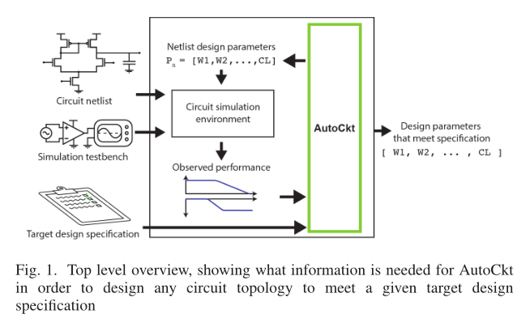
AutoCkt
Structures：1、The reinforcement learning agent（RL agent）
2、Simulation environment
P₁
RL agent
P_{H}
O
*O

Slide 5
The Reinforcement Learning Agent
Process：1、At each environment step, the RL agent observes the state of the environment and takes an action based on what it knows. The environment then returns a new state that is used to calculate the reward for taking that particular action.
2、The agent iterates through a trajectory of multiple environment steps, accumulating the rewards at each step until the goal is met or a predetermined maximum number of steps is reached. After running multiple trajectories the neural network is updated to maximize the
expected accumulated reward via policy gradient.

Slide 6
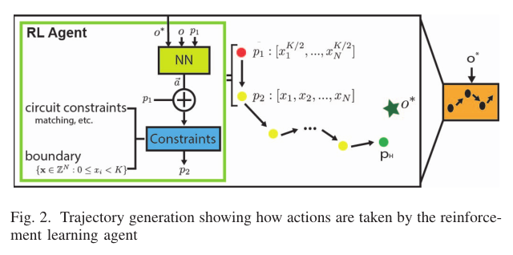
The Reinforcement Learning Agent
Trajectory generation:(Autockt如何生成一个Trajectory)
1、Upon reset, the parameters are initialized to the center point K/2.
2、The neural network then uses the observed performance o(由模拟电路创建) and
target specification o∗, as well as cuincrement, decrement, or retain the same value for each circuit parameterrrent parameters p1 to decide whether to. These actions are then constrained by any circuit specific rules or boundary limitations for the parameters.
3、The RL agent has H total simulation steps to reach o∗. If the objective is reached before H steps, the trajectory ends.
Note：For different topologies，约束constraints可以是特定的也可以是通用的。 AutoCkt is not reliant on having these circuit constraints exist.

Slide 7

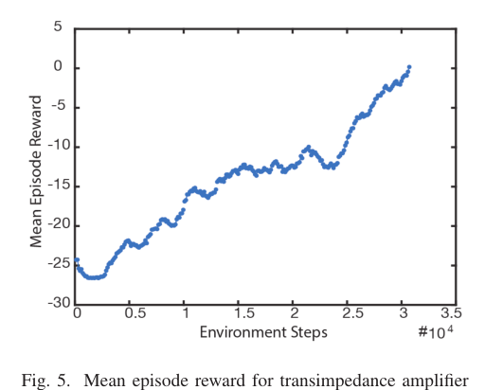
The Reinforcement Learning Agent
Train and Deployment:
To train the RL agent，50 target specifications are randomly sampled:
The number of target specifications needed to train was optimized through a hyperparameter sweep（通过超参数扫描优化训练所需的target specifications数量）， L trajectories are then generated，whose targets are chosen from O∗
The reward for each trajectory is obtained by accumulating the rewards for
each action, The reward increases as the RL agent’s observed Performance O gets closer to the target specification O*. The training terminates once the mean reward has reached 0, meaning all target specifications are consistently satisfied.

Slide 8
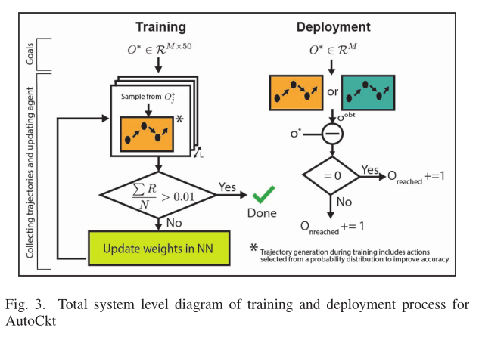
The Reinforcement Learning Agent
In implementation, the neural network is a three layers with 50 neurons(神经元) each, trained with Proximal Policy Optimization using OpenAI Gym and the Ray framework for running distributed reinforcement learning tasks
During deployment, the trained agent is used to generate trajectories with unique target specifications sampled from O∗.
Note： the simulation environment can be different from the one used in training. The final O obtained by the trajectory is then compared with O∗ and incremented in a respective counter.

Slide 9
Simulation environment
AutoCkt is able to interface with different simulation environments.
This work demonstrates results using a simulator that works on predictive technology models（PDK） and Spectre(原理图级仿真), which run on schematic level simulations, as well as the Berkeley Analog Generator (BAG)(布局寄生仿真), which runs simulations in Cadence with layout parasitics automatically.

Slide 10
EXPERIMENTS
This paper uses three different simulation environments as well as four circuit topologies:（图见下页）
1、 Transimpedance amplifier(跨阻放大器)
2、Two stage operational amplifier(两级运放)
3、Two stage OTA with negative g_{m} load（带g_{m}负载的两级跨导放大器）
4、 Two stage operational amplifier with negativegmload and
layout parasitics
In these circuit testbenchs: this work compares AutoCkt to the combined machine learning and genetic algorithm.

Slide 11
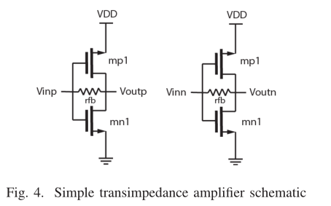
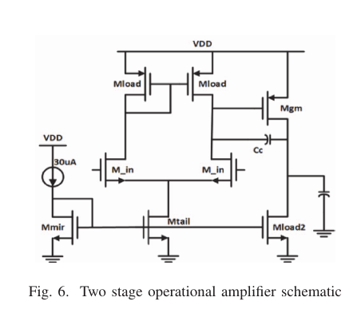
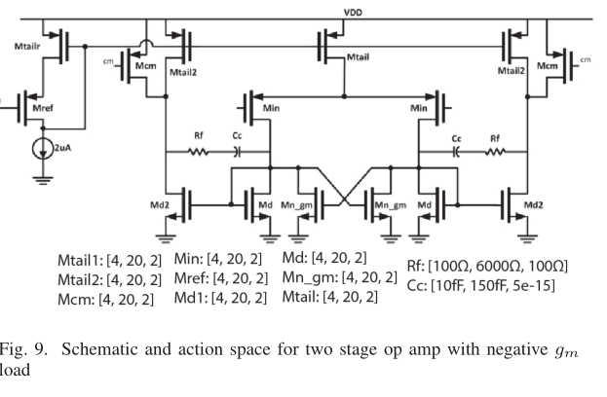
EXPERIMENTS

Slide 12
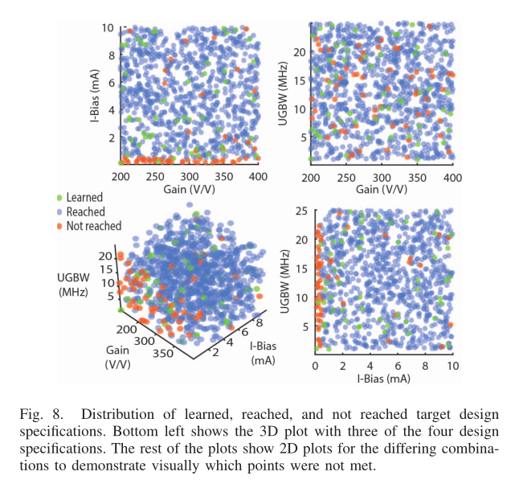
EXPERIMENTS
例如：在两级运放拓扑的testbench中，AutoCkt能够达到1000个目标设计规范中的963个，模拟步骤的平均为27步，比遗传算法快40倍。并且在上图中，Not reached的设计点位于一个垂直区域，该区域的I-bIas非常低。即可以假设这些点确实是实际不可达的power。这些Not reached的聚合设计规范，可以看出它试图在最小化功率的同时满足增益和带宽要求，类似于电路设计者处理这个问题的方式。

Slide 13
Summary
可创新点（参考）：
1、摘要中的limitations：
being schematic-only,
inaccurate
sample-inefficient
generalizable
2、NN模型 -> GNN
3、spec： type and number做改变
4、自主design的电路拓扑结构

