Slide 1
Pitchdeck.io
Connect with investors, startups, and more

Slide 2
Problem
Contacting multiple investors for a Pitch is tedious and not efficient. Googling “Venture capital firms” and going from website to website.
Looking for the “contact” button to copy and paste into your email, filling out form after form complicates the process of getting the startup’s idea to the investor.

Slide 3
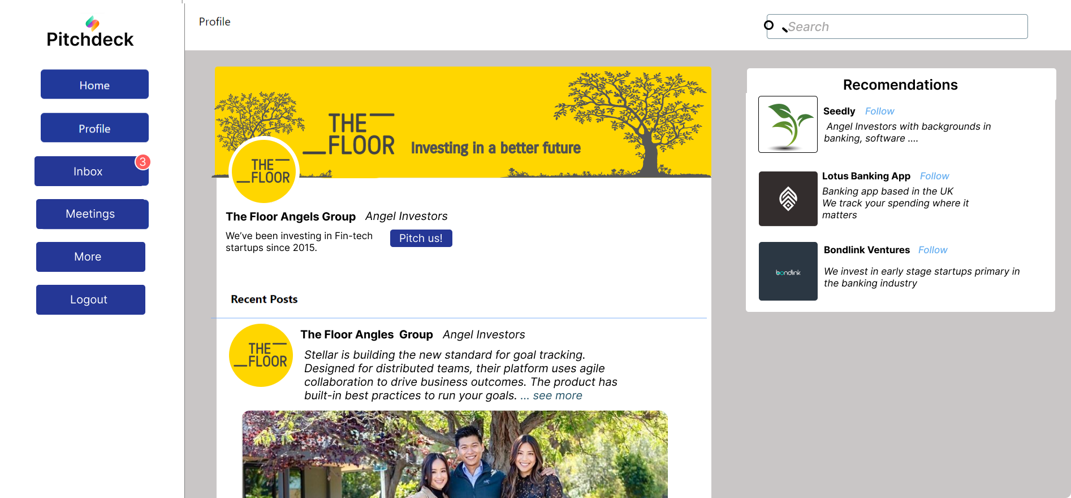
Solution - Create an online profile and get matched with Investors that suit your startups need. Send a pitch in one click

Slide 4
Complicated forms and hidden “contact” buttons leads to less pitches
Costing you as the investor potential exists.

Slide 5
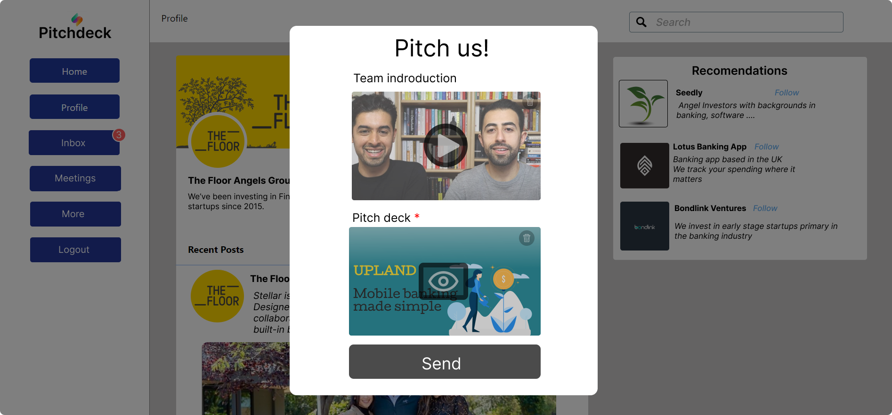
Startups can instantly send a pitch and you can filter out the right candidates for you.

Slide 6

Use advanced search features and recommendations to get the best match for your interests

Slide 7

How it makes money
Offer crowdfunding at a 5% fee for funds raised
To pitch directly to VC’s and investment firms offer 20 free pitches then charge $2.99 for a refill of 30. Or unlimited pitches for $9.99 per month
Marketing & Advertising || offer PPC ads to grow online presence || offer an ad campaign manager tool to track insights

Slide 8
Current Progress
MVP in development
Beta should be ready within 6 - 8 months
Published GitHub repository
Frontend design completed
Backend server in progress
Database has been integrated

Slide 9
About the founder
Technical with a programming and sales background
Has previous experience leading and building teams
Previous experience building software products to production
Working on this full time since November
Contact info:
Andrew Rivera
Phone: 708 712 8163
Email: 2353andrew@gmail.com (preferred)

