Slide 1
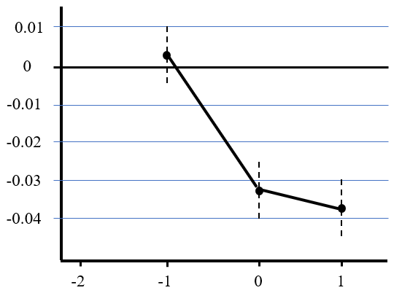
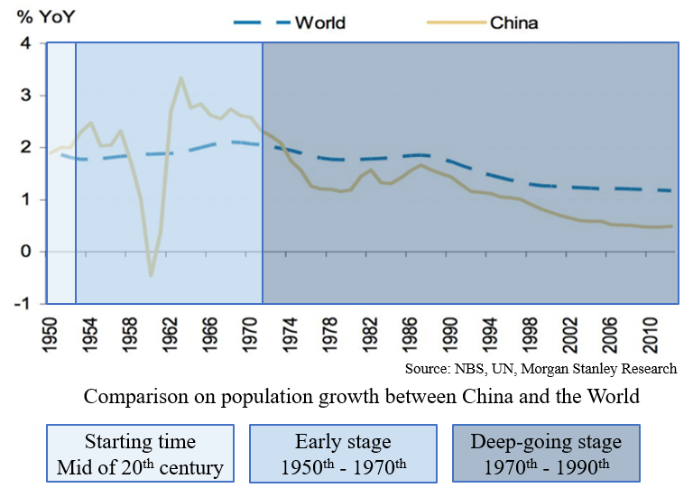
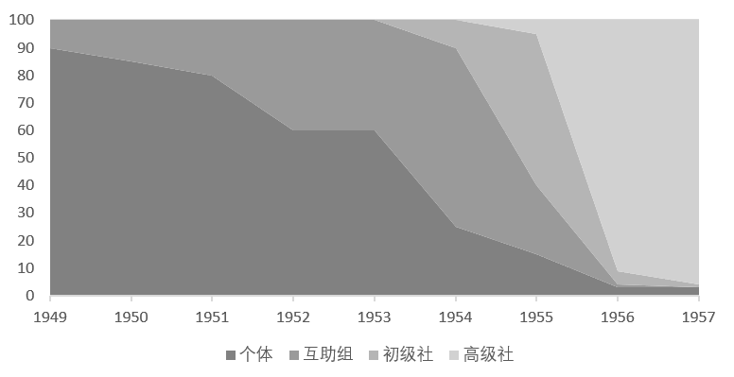
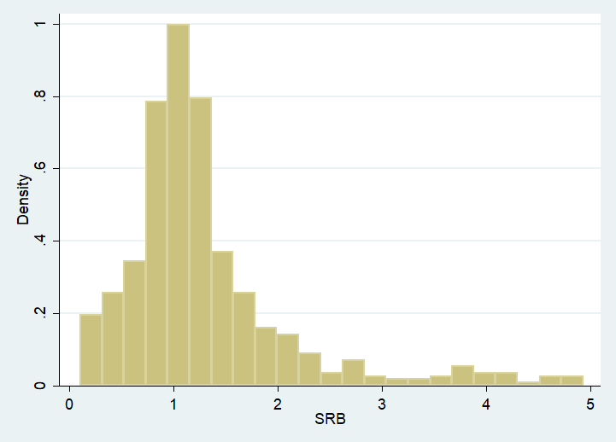
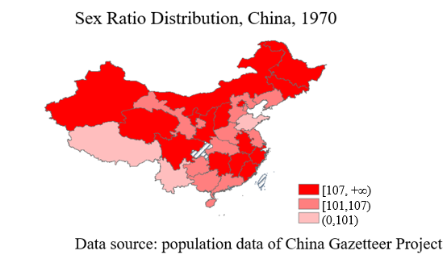
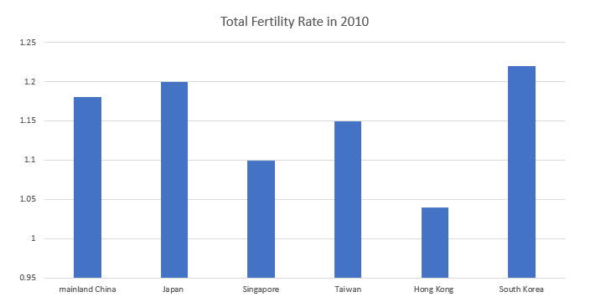
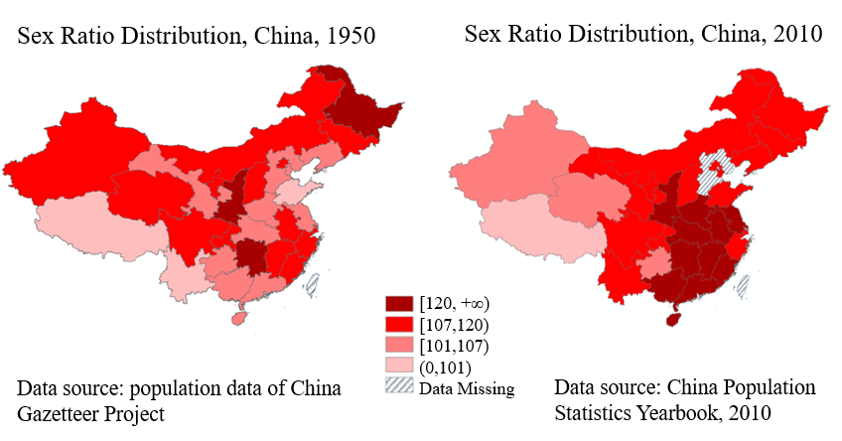
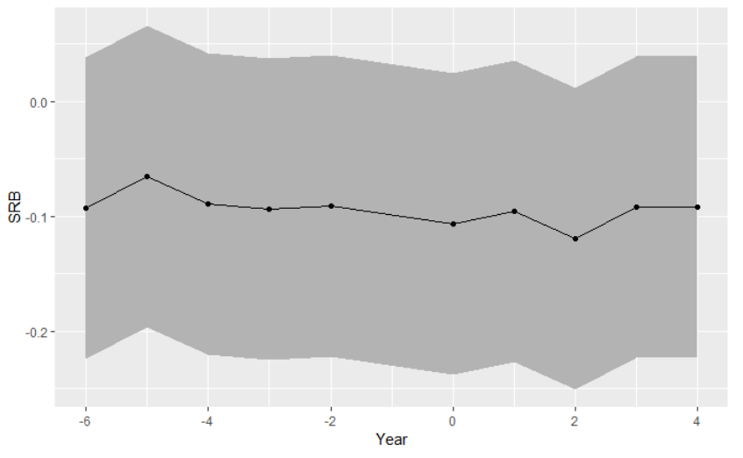
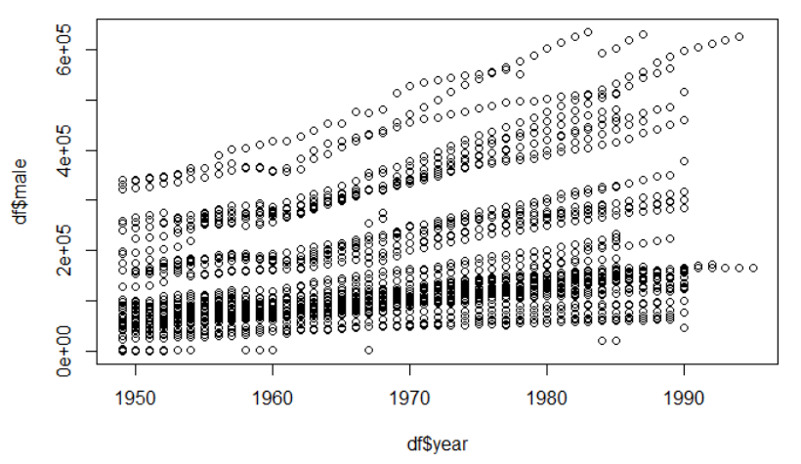
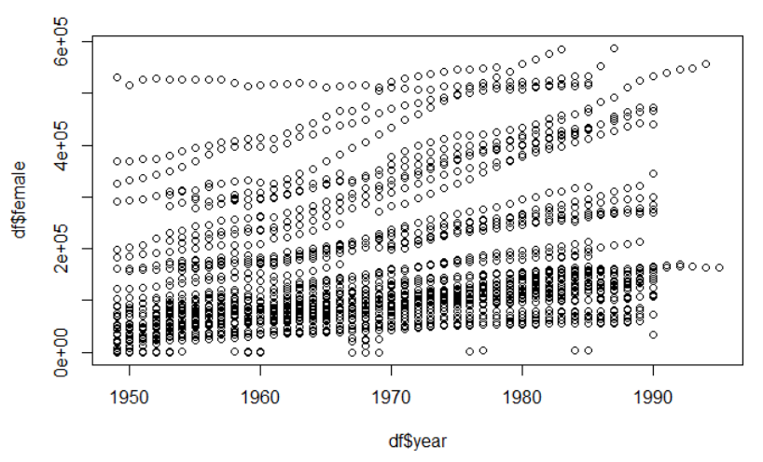


Did agricultural collectivization normalize the skewed sex ratio in China?
Sixue Liu
Advisor: Richard W. Evans
INTRODUCTION
METHODS
RESULTS
CONCLUSIONS
Further explore the fundamental reason of the skewed sex ratio in China
The seriousness of the gender imbalance problem and the current China’s situation
A short normalization of gender ratio period and industrialization and agricultural collectivization time
Three main stages in agricultural collectivization: mutual aid group of agricultural production; the primary agricultural production cooperative and the advanced agricultural production cooperative
Among the 46 counties selected, each county started to implement the collectivization in a different time. Therefore, I use a fixed effect model to explore the effects of different stages on the sex ratio at birth
We can see that the presence of advanced agricultural production cooperative has a significant negative impact on gender ratio, regardless of whether or not the control variables are added.
The primary agricultural production cooperative also has some influence; the mutual aid group nearly has no impact. At 95% significant level, the establishment of an advanced agricultural production cooperative can reduce the sex ratio at birth by about three percentage points.
The establishment of advanced agricultural production cooperatives has indeed reduced the gender ratio at birth
The impact of the first two stages of collectivization on the sex ratio at birth is not very significant
Based on my result, the establishment of a high-level agricultural production cooperatives has reduced the sex ratio by about three percentage points
Specifically, the influence results in Shaanxi province are in line with the situation in the whole country. Additionally, the establishment of a senior agricultural production cooperatives has reduced the sex ratio by nearly four percentage, which is higher than the national level.
$${SRB}_{it}=β∙{collect}_{it}+{year}_{t}+d_{i}+X_{it}+ε_{it}$$
In addition, we can visually see the effect of collectivization on gender ratio over time by the mean shift of β obtained by regression equation.
$$∆{SRB}_{it}=\sum_{k}{β_{k}}×I\left({CY}_{it}=k\right)+{year}_{t}+X_{it}+e_{it}$$
 | （1） | （2） | （3） | （4）
Mutual aid group | 0.051 | 0.035 | -0.094 | -0.072
Primary cooperative | -0.018 | -0.021* | -0.039 | -0.029
Advanced cooperative | -0.033* | -0.026** | -0.034** | -0.033**
Cultivated area per capita |  | 0.001 | 0.062 | 0.052*
Agricultural output value per capita |  | 0.069* | 0.085 | 0.024*
Annual crop yield per capita |  | -0.001 | -0.002 | -0.001
Number of primary schoold student per thousand people |  | 0.003* | 0.002* | 0.003*
Number of high school students per thousand people |  | 0.129 | 0.007 | 0.006
Number of high school per thousand people |  | 0.018 | 0.033* | 0.036
Constant | 9.923*** | 8.234 | 7.525 | 10.232
County-level fix effects | N | N | Y | Y
Year fix effects | N | N | N | Y
Observations | 540 | 515 | 501 | 501
SITUATION
Dynamic change of the influence of collectivization on gender ratio
China’s population development:
DATA
LIMITATIONS
General statistical description of collectivization and sex ratio
The sex ratio I use is calculated by the county-level death population data and the death ratio by sex. It’s better to use more accurate data for this research.
Due to the missing county records, the data coverage in this study is not wide enough.
The sex ratio at birth data in this research is from 1949 to around 1985, and it would be better if the data can be extended to a longer period. This could help to gain a more convincing result.
After controlling the fixed effect at the county level. It can be clearly seen that the influence of advanced agricultural production cooperative on the sex ratio is still stable, and the influence of the primary agricultural production cooperative is also significant, but the significance level is lower.
After adding the fixed effect of county level and year to the regression (i.e. column (5)). The influence of the advanced agricultural production cooperative on the sex ratio is still very significant.
Skewed sex ratio and one-child policy
The main data source is from China Gazetteer Project. This database collects the China’s development in population, education, and agriculture of nearly 2000 counties from 1949 to 1990. At present, the project has initially established a database covering 2,000 counties and cities for 65 years and a total of more than 120 variables.
The real influence of one-child policy on sex ratio
CONTACT
Male and female population change charts
Author: Sixue Liu
sixueliu@uchicago.edu
Computational Social Science Program
https://github.com/SixueLiuMACSS
Advisor: Richard W. Evans
rwevans@uchicago.edu
https://sites.google.com/site/rickecon/

