Slide 1

Project Title - Seasonal Agriculture Performance Analysis
Student Name – Siya Rajesh Tambe
College Name – Dr. D. Y. Patil College of Engineering and Innovation
AICTE STU ID : STU69dc7c237cf7d1776057379

Slide 2

PROBLEM STATEMENT
Agricultural activities are influenced by seasonal variations in environmental conditions, farming practices, resource availability and market conditions. As a result, agricultural performance may differ from one season to another.
However, raw agricultural data does not clearly explain how agricultural performance changes across seasons or what patterns can be observed in different seasonal conditions.
The problem is to analyze the given agricultural dataset and investigate seasonal differences in agricultural performance by identifying meaningful patterns, trends, relationships and variations within the available data.

Slide 3
PROJECT DESCRIPTION
This project analyzes a dataset of 4,000 farm records across multiple
Indian states, crops, and irrigation methods to understand how agricultural
performance varies by season (Kharif, Rabi, Zaid).
The analysis covers data cleaning, exploratory data analysis (univariate, bivariate, multivariate), correlation analysis, seasonal comparisons, and
three independent student-designed investigations concluding with evidence-based recommendations for improving seasonal agricultural outcomes.

Slide 4

WHO ARE THE END USERS?
Farmers : to make informed decisions on crop selection, irrigation method, and seasonal planning
Agricultural policymakers : to design season-specific support programs
Agribusiness & agri-tech companies : to identify high-potential regions and crops for investment
Researchers & students : as a reference for seasonal agricultural data analysis

Slide 5

TECHNOLOGY USED
Python (Google Colab)
Pandas : data cleaning, aggregation, groupby analysis
Matplotlib & Seaborn : data visualization (histograms, boxplots, heatmaps, scatter plots, line charts)
Statistical method: IQR (Interquartile Range) for outlier detection

Slide 6
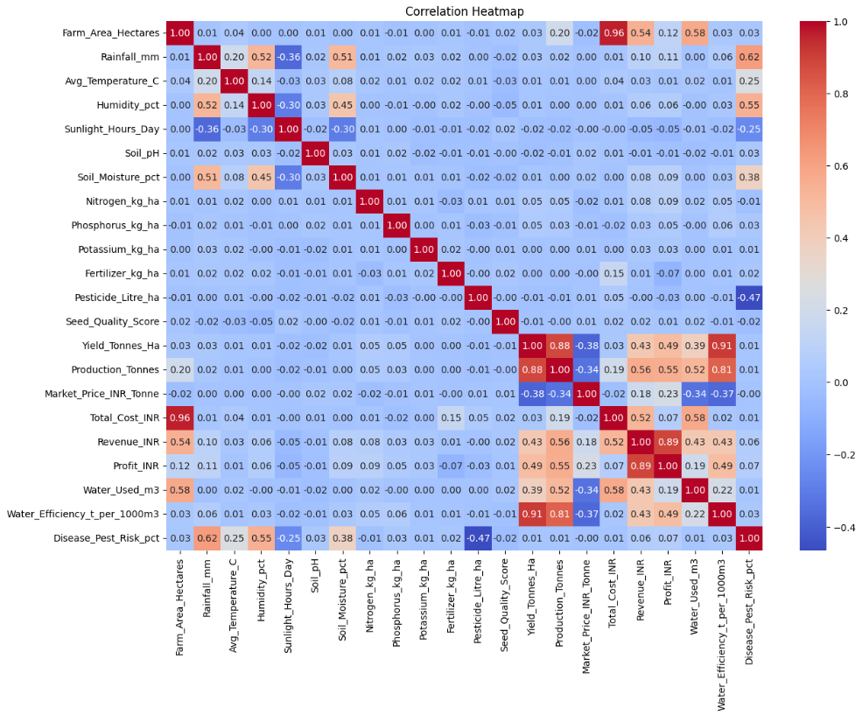
RESULTS

Slide 7
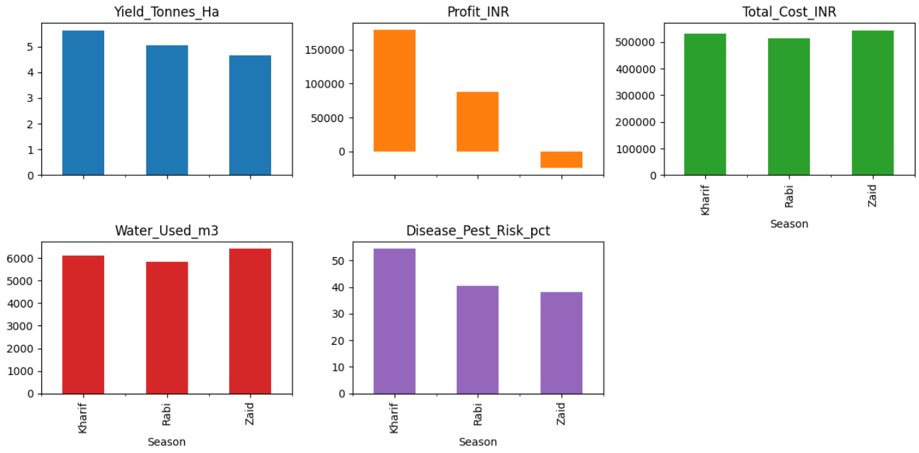
RESULTS

Slide 8
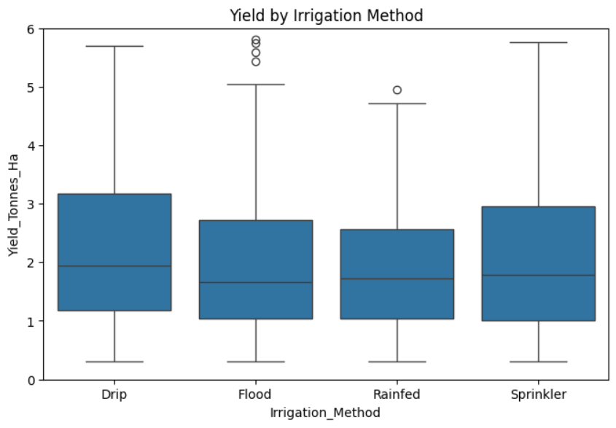
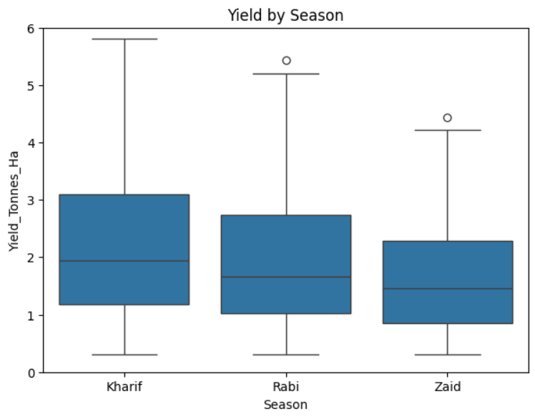
RESULTS

Slide 9
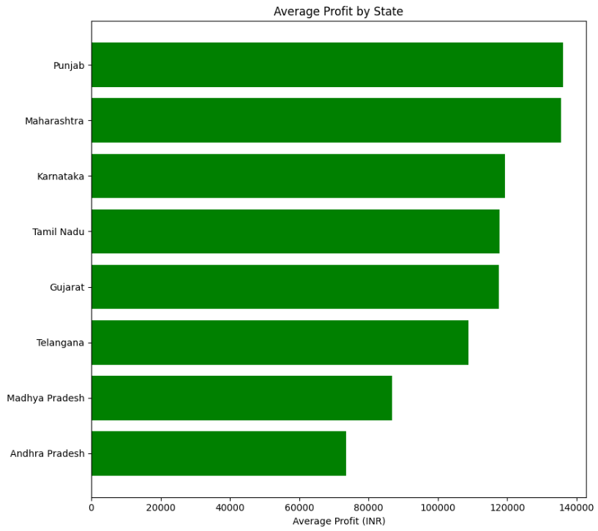
RESULTS

Slide 10
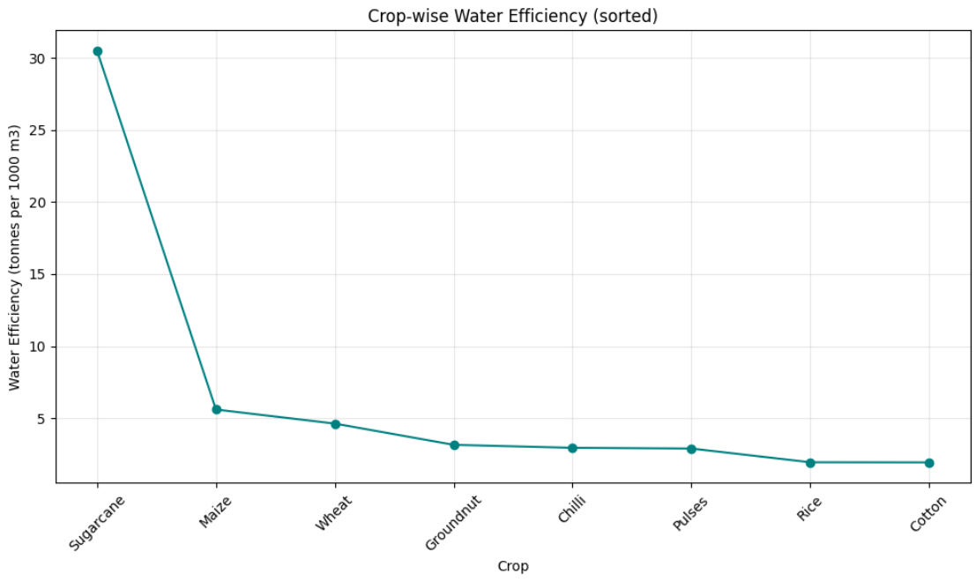
RESULTS

Slide 11
FUTURE SCOPE
Build a predictive model to forecast optimal season and crop combination for maximum profitability
Incorporate real-time weather data for dynamic seasonal recommendations
Expand analysis with more balanced Zaid season data for reliable insights
Investigate root causes of the non-linear disease risk–profit relationship
Develop an interactive dashboard for farmers and policymakers

Slide 12
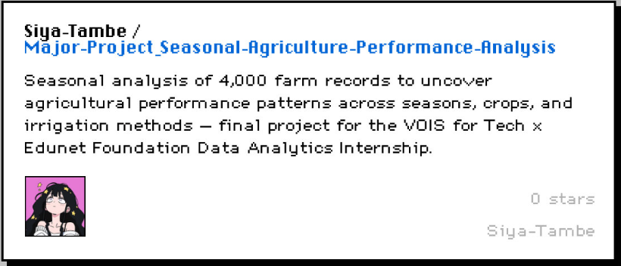
GITHUB LINK
Github repository link : https://github.com/Siya-Tambe/Major-Project_Seasonal-Agriculture-Performance-Analysis

Slide 13
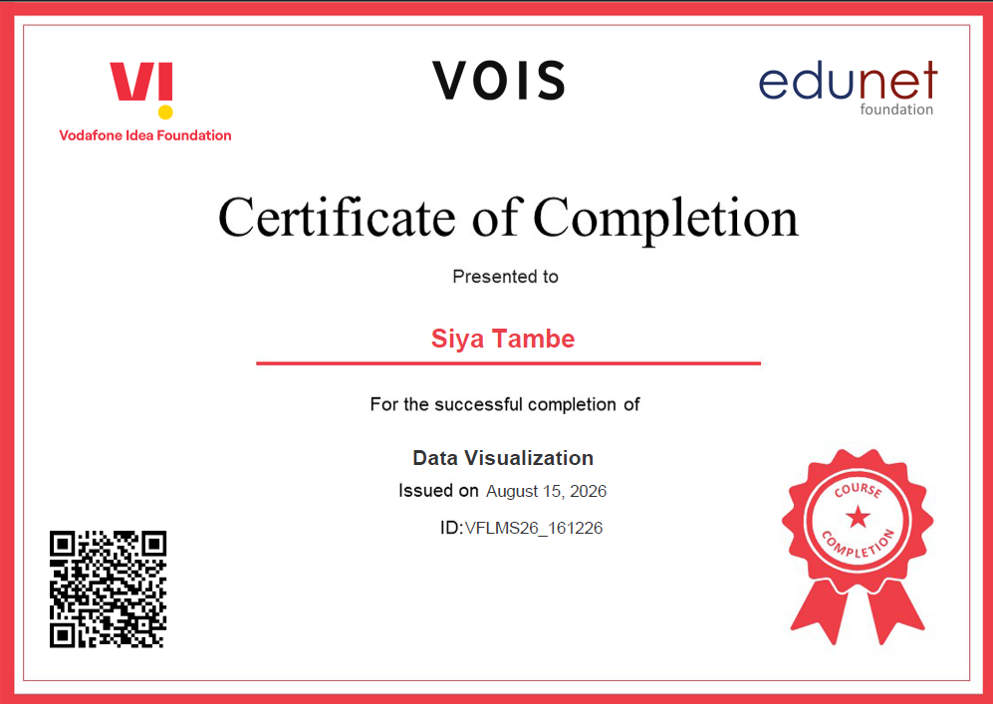
VOIS Course completion certificate Course name - Data Visualization

Slide 14
THANK YOU
Thank you to VOIS for Tech and Edunet Foundation for this valuable internship experience. This project helped me strengthen my data analytics skills through real-world application, and I'm grateful for the support and guidance provided along the way.
.
.

