Slide 1
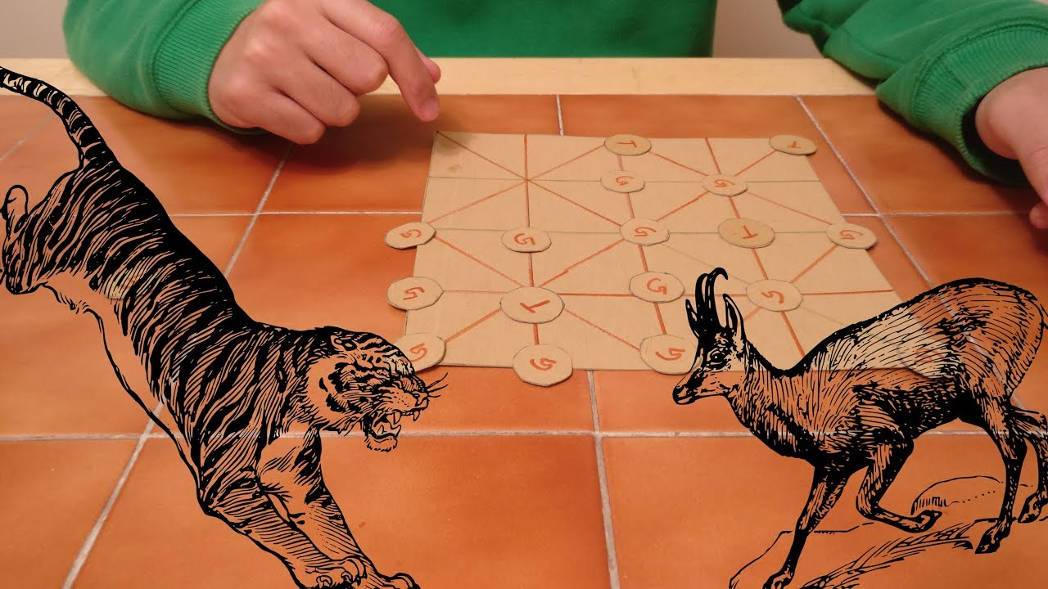
BAGHCHAL
Made by:
Siya Dhokane:111903106
Gauri Dighe:111903119

Slide 2
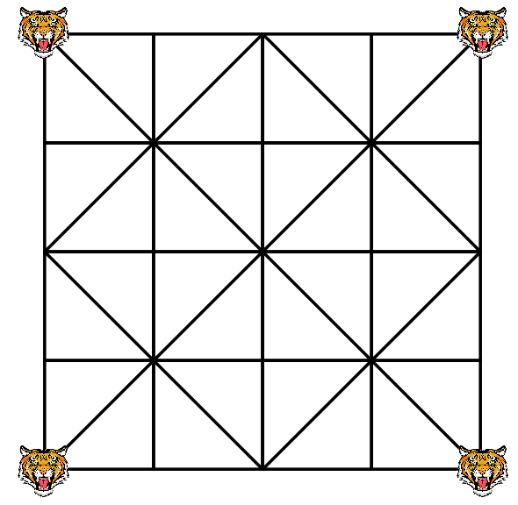
What is baghchal game?
Baghchal is a two-player board game.
Game played on a 5x5 grid.
Pieces are positioned at the intersection of the lines
Directions for movement are connected by lines.
                At the start of game all 4 Tigers are placed on the four corners of the grid.

Slide 3
3 phases:
  Player controls 4 Tigers and computer upto 20 Goats.
  Player controls upto 20 Goats and computer controls 4 Tigers.
  Autoplay i.e. both are played by computer.
Strategy:
  Tiger : Capture the goats
  Goats attempts to block the tigers and prevent its hunt
Goal:
  Tiger : capture 5 goats to win (capturing is performed by jumping over the goats)
  Goat : block all tigers

Slide 4
How to play?
Rules for tiger
They can move to an adjacent free position along the lines.
They can capture goats during any move, and do not need to wait until all goats are placed.
They can capture only one goat at a time.
They can jump over a goat in any direction, as long as there is an open space for the tiger to complete its turn.
A tiger cannot jump over another tiger.
Rules for Goats
Goats cannot move until all goats have been positioned on the board.
They must leave the board when captured.
They cannot jump over tigers or other goats.

Slide 5
PEAS Description
Performance measure:number of goats captured or number of tigers blocked
Environment:board of 5x5 grid
Agents:Goats and tigers
Sensor:Position of goats and tigers
Evironment types:Fully obervable,deterministic,static,discrete
Score 12 if goat is killed (tiger)
(4-movable tiger)*3 for goats

Slide 6
Which algorithm we used?
We use minmax and alpha beta pruning
Pygame library for graphical interface
While playing with computer possible best moves were calculated with the help of minimax algorithm
  Tiger-Maximizer
  Goat-Minimizer
Alpha-beta pruning is used to decrease the number of nodes that are evaluated

