Slide 1
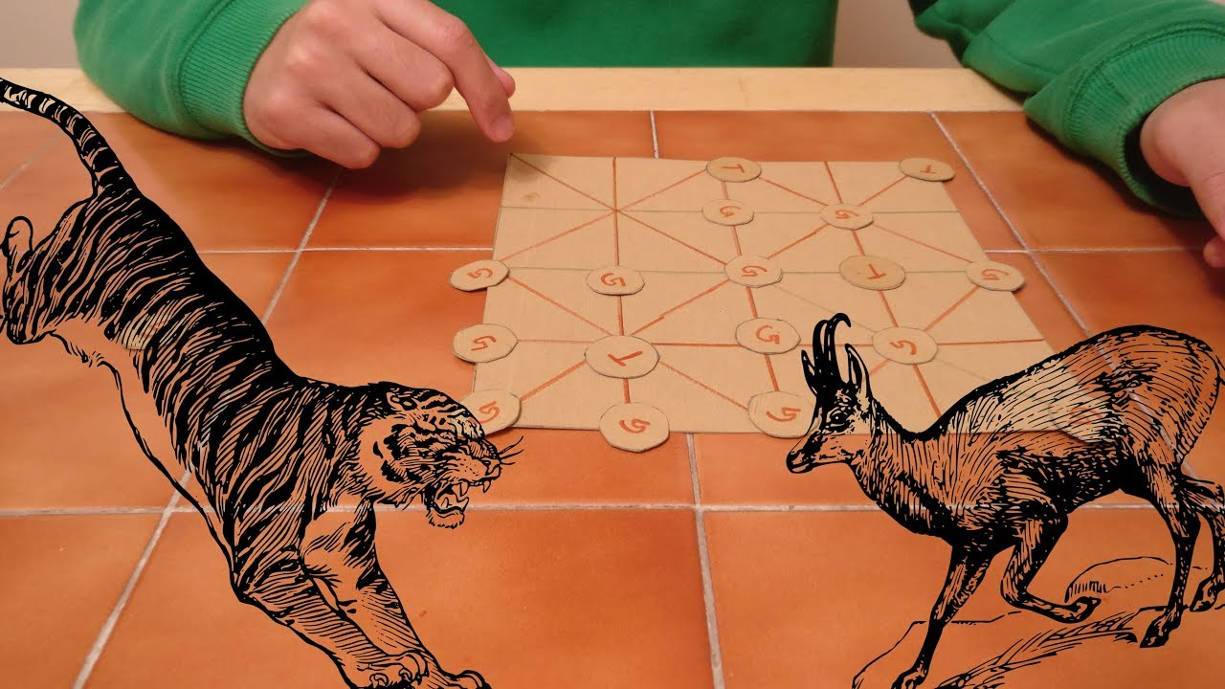
BAGHCHAL
Made by:
SiyaDhokane:11190106
Gauri Dighe:111903119

Slide 2
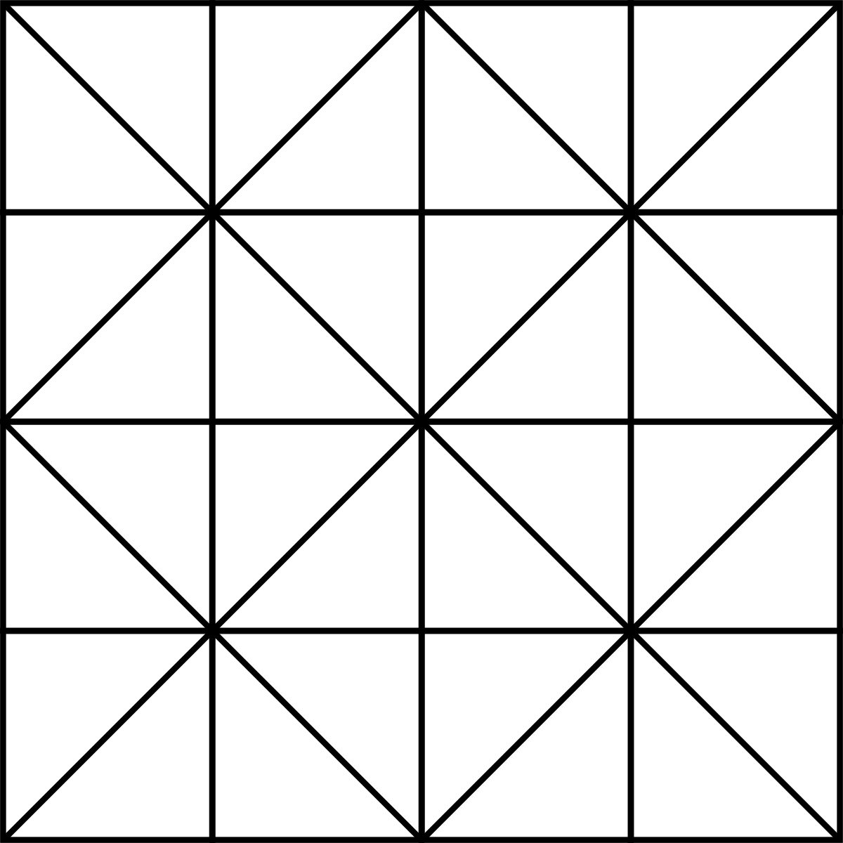
What is baghchal game?
Baghchal is a strategic, two-player board game that originated in Nepal. The game is asymmetric in that one player controls four tigers and the other player controls up to twenty goats. The tigers 'hunt' the goats while the goats attempt to block the tigers' movements.
The game is played on a 5×5 point grid, like alquerque. Pieces are positioned at the intersection of the lines and not inside the areas delimited by them. Directions of valid movement between these points are connected by lines.

Slide 3
How to play?
Rules for tiger
They can move to an adjacent free position along the lines.
They can capture goats during any move, and do not need to wait until all goats are placed.
They can capture only one goat at a time.
They can jump over a goat in any direction, as long as there is an open space for the tiger to complete its turn.
A tiger cannot jump over another tiger.
Rules for Goats
Goats cannot move until all goats have been positioned on the board.
They must leave the board when captured.
They cannot jump over tigers or other goats.

Slide 4
Which algorithm we used?
We use minmax and alpha beta pruining
Pygame liabrary for graphical interface
PEAS
Performance measure:kill 5 goats or trap all 4 tigers
Environment:board of 5x5 grid
Agents:Goats and tigers
Sensor:Position of goats and tigers
Evironment types:Fully obervable,deterministic,static,discrete
Score 12 if goat is killed (tiger)
(4-movable tiger)*3 for goats

