Slide 1
DSA PROJECT
Name: Siya Dhokane Mis: 111903106

Slide 2
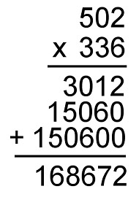
Multiplication

Slide 3
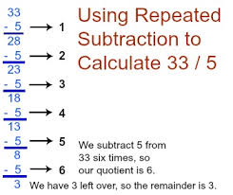
1) Division by repeated subtraction

Slide 4
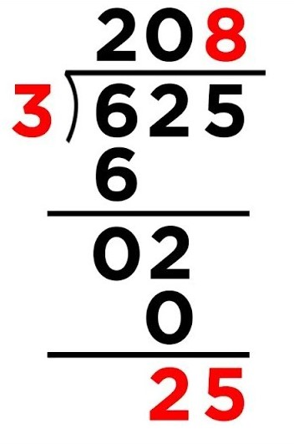
2)Normal division

Slide 5
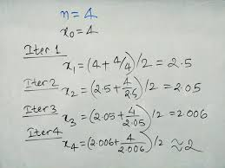
Square root

Slide 6
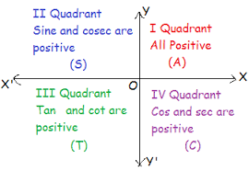
Trigonometry

