Slide 1
Agile Testing
Software Testing
ISTQB / ISEB Foundation Exam Practice

Slide 2
Contents
ISTQB / ISEB Foundation Exam Practice
Agile Testing
What is Agile Testing?
Test Plan for Agile
Agile Testing Strategies
QA challenges with agile
Risk of Automation in Agile Process
Summary: Key Points
Notes:
https://www.guru99.com/agile-testing-a-beginner-s-guide.html#4

Slide 3
What is Agile Testing?
Agile Testing can begin at the start of the project
Agile Testing is not sequential but continuous.
Agile team works as a single team towards a common objective of achieving Quality.
Testing has shorter time frames called iterations (say from 1 to 4 weeks)

Slide 4
Test Plan for Agile
Test plan is written and updated for every release. Typical test plans in agile includes:
    1) Testing Scope
    2) New functionalities which are being tested
    3) Level or Types of testing based on the features complexity
    4) Load and Performance Testing
    5) Infrastructure Consideration
    6 )Mitigation or Risks Plan
    7) Resourcing
    8) Deliverables and Milestones

Slide 5
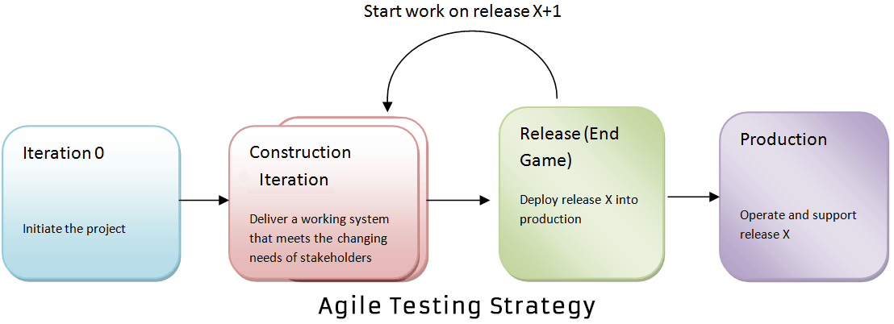
Agile Testing Strategies

Slide 6
QA challenges with agile software development
Chances of error are more in agile, as documentation is given less priority, eventually puts more pressure on QA team
New features are introduced quickly, which reduces the available time for test teams to identify whether the latest features are according to the requirement and does it truly address the business suits
Testers are often required to play a semi-developer role
Test execution cycles are highly compressed
Very less time to prepare test plan
For regression testing, they will have minimal timing
Change in their role from being a gate-keeper of quality to being a partner in Quality
Requirement changes and updates are inherent in an agile method, becoming the biggest challenge for QA

Slide 7
Risk of Automation in Agile Process
Automated UI provides a high level of confidence, but they are slow to execute, fragile to maintain and expensive to build.
Unreliable tests are a major concern in automated testing.
If the automated test are initiated manually rather than through CI (Continuous Integration) then there is a risk that they are not regularly running and therefore may cause failing of tests
Automated tests are not a replacement for an exploratory manual testing. To obtain the expected quality of the product, a mixture of testing types and levels is required
Many commercially available automation tools provide simple features like automating the capture and replay of manual test cases.

Slide 8
Risk of Automation in Agile Process
In order to save time, many times automation test plan is poorly planned or unplanned which results in the test fail
Test set up and tear down procedures are usually missed out during test automation, while Performing manual testing, test set up and tear down procedures sounds seamless
Productivity metrics such as number of test cases created or executed per day can be terribly misleading, and could lead to making a large investment in running useless tests
Members of the agile automation team must be effective consultants: approachable, cooperative, and resourceful, or this system will quickly fail
Automation may propose and deliver testing solutions that require too much ongoing maintenance relative to the value provided
Automated testing may lack the expertise to conceive and deliver effective solutions
Automated testing may be so successful that they run out of important problems to solve, and thus turn to unimportant problems.

Slide 9
Summary: Key Points
ISTQB / ISEB Foundation Exam Practice
Agile testing involves testing as early as possible in software development life cycle.
It demands high customer involvement and testing code as soon as it becomes available.
The code should be stable enough to take it to system testing.
Extensive regression testing can be done to make sure that the bugs are fixed and tested. Mainly, Communication between the teams makes agile testing success._x000b_

