Slide 1
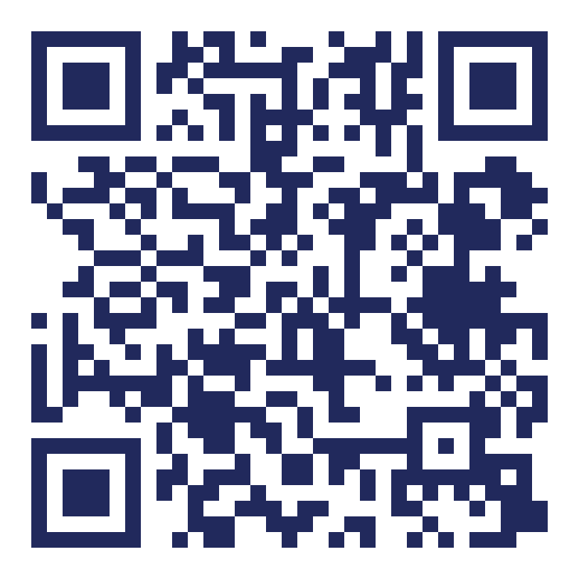
Interact With The App
Try This
1
Search & get directions
Search taxis and route fares, then tap through to Google Maps for directions.
Scan the QR code to open the app, then follow the steps on the right.
2
Log in & share location
Log in and accept location sharing.
3
Capture plate & board
Capture the taxi number plate and click Board.
4
Complete the manifest
Fill in the travel manifest and save.
5
Share via WhatsApp
Share your ride details with someone via WhatsApp.
6
Confirm live tracking
erank.onrender.com
Ask them to open the link and track your live location.

