Slide 1

Ubuntu-Connect:
AI-Powered Student At-Risk
Early-Warning System
Business Analysis 3.2 (AIBUY3A) | Diploma: Information Technology
An AI Solution for Industries — Education sector
Vaal University of Technology | IT Project Group 18
1

Slide 2
Bayede Mthethwa
Problem, objective, and constraints
THE PROBLEM
OBJECTIVE & SUCCESS
CONSTRAINTS
• Staff only learn about failing students after end-of-term results.
• Marks, attendance and failures are never analysed together.
• Avoidable failure, dropout and wasted fees follow.
• Early-warning flags with clear reasons.
• Precision ≥70% — achieved 76%.
• Every flag explains the cause — 100% met.
• Goal: reduce failures through a pilot.
• Public data; 46 at-risk test students.
• Synthetic teacher notes.
• 12 weeks; small budget.
• Free open-source tools only.
• Tips are suggestions, not decisions.
2

Slide 3
Sphamandla Radebe
The data
1,044
students
STRUCTURED DATA
TIME SERIES
TEXT DATA
395 Maths + 649 Portuguese.
Marks, absences, failures, family support and school support.
Merged into one analysis table.
Three time steps:
G1 → G2 → G3
G3 is used only to label at-risk status — never as a model input.
Teacher notes are synthetic generated data.
The source dataset contains no real text.
This limits the validity of NLP results.
3

Slide 4
Siyabonga Nzotho
Feature engineering & time series
Student
G1
G2
G3
Change
Avg
At risk
ENGINEERED FEATURES
1
5
6
6
+1
5.5
1
Change = G2 − G1 (trend)
Average = (G1 + G2) / 2 (level)
11 model features; G3 excluded.
2
5
6
0
+1
5.5
1
TRAIN / TEST
Stratified 80/20 split, random_state=42
835 training • 209 test
46 at-risk students in test set
4

Slide 5
Pontsho Radebe
Random Forest baseline
0.64
0.89
0.75
0.87
Precision
Recall
F1 score
Accuracy
REFERENCE MODEL
CONFUSION MATRIX
Balanced class weights
Trained on 11 features
Feature importance supports explanations
Recall prioritised to catch more at-risk students
140
23
5
41
Rows: actual low / high Columns: predicted low / high
5

Slide 6
Humphrey Maluleke
Model comparison & why RF + SMOTE
WHY SMOTE
Applied to training data only. Precision rose 0.64 → 0.71 while recall remained the priority at 0.87.
HIGH • 0.66+
46 flagged | precision 0.76 | recall 0.76
MEDIUM + HIGH • 0.33+
71 flagged | precision 0.61 | recall 0.93
6
Code and project board: github.com/SiyabongaBlessingNzotho/Ubuntu-connect | Data: Cortez and Silva (2008), UCI Student Performance dataset

Slide 7
Natural language processing
Khutso Boloka
APPROACH
F1
0.78 → 0.76
TextBlob scored synthetic teacher notes for polarity and subjectivity.
Two sentiment features were added to the Random Forest.
Because the notes are synthetic, they contain no dependable real-world signal.
Precision
0.71 → 0.70
Recall
0.87 → 0.85
NOT DEPLOYED — real teacher comments are expected to add value.
7

Slide 8
Prudence Mbele
Deep learning — Keras neural network
INPUT
11 scaled features
DENSE 1
32 units • ReLU + dropout
DENSE 2
16 units • ReLU + dropout
OUTPUT
1 unit • sigmoid risk probability
0.76
0.83
0.79
0.90
DEPLOYMENT CHOICE
Precision
Recall
F1
Accuracy
929 trainable parameters
Caught 38 of 46 at-risk students
Random Forest preferred: recall 0.87 vs 0.83.
Next: LSTM with weekly marks.
8

Slide 9
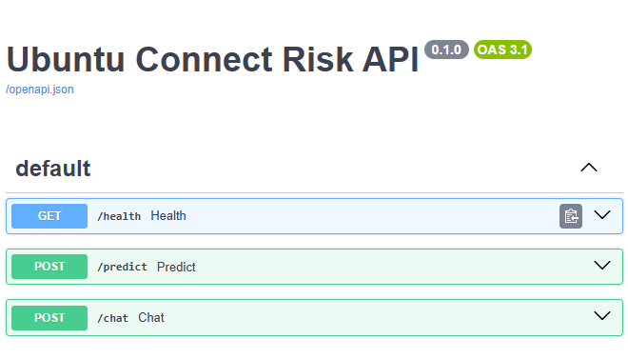
Esnath Kwinda
API endpoints & Swagger UI
GET /health | POST /predict | POST /chat | interactive docs at /docs
RISK TIERS
LOW
below 0.33
MEDIUM
0.33 to 0.65
HIGH
0.66 or above
Built with the FastAPI framework.
9

Slide 10
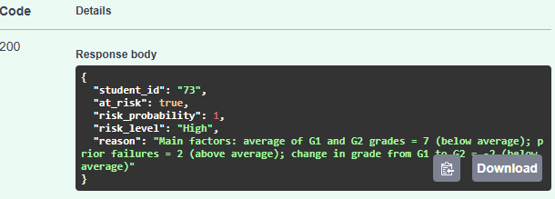
Esnath Kwinda
API demo — POST /predict (Student 73)
INPUT • 11 numbers; no names, no personal text
{
"student_id": "73",
"features": {
"age": 15.0,
"studytime": 2.0,
"failures": 2.0,
"absences": 2.0,
"g1_to_g2_change": -2.0,
"avg_g1_g2": 7.0,
"address": 0.0,
"famsize": 0.0,
"Pstatus": 1.0,
"schoolsup": 1.0,
"famsup": 1.0
}
}
10

Slide 11
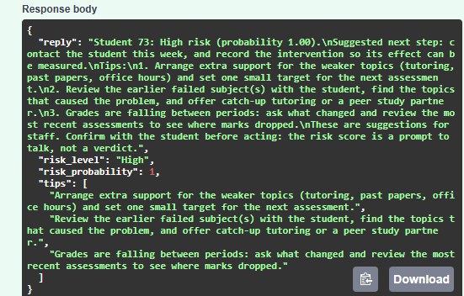
Khanimamba Maluleke
API demo — POST /chat (Student 73)
POST /chat • real reply
“input :
{
"message": "What intervention steps should be taken for this high-risk student?",
"student_id": "73",
"features": {
"age": 15,
"studytime": 2,
"failures": 2,
"absences": 2,
"g1_to_g2_change": -2,
"avg_g1_g2": 7,
"address": 0,
"famsize": 0,
"Pstatus": 1,
"schoolsup": 1,
"famsup": 1
}
}
“These are suggestions for staff. The risk score is a prompt to talk, not a verdict.”
11

Slide 12
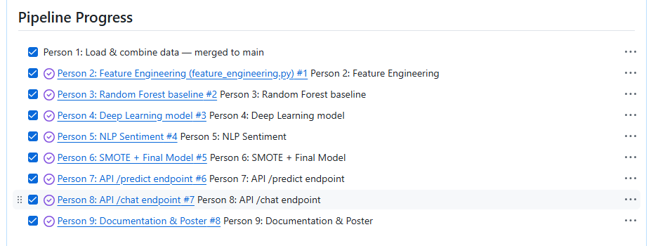
Conclusion, limits, and next steps and Pipeline progress
KEY TAKEAWAY
LIMITS
ETHICS
NEXT STEPS
High-risk precision 0.76 — above the 70% target.
Medium + High catches 93% of at-risk students.
Every flag has a clear reason.
Prompts to talk, not verdicts.
46 at-risk test students.
Synthetic teacher notes only.
No intervention outcome data yet.
Fairness review: age, address, family size.
POPIA: consented data use.
Staff decide; AI remains advisory.
Pilot with consented real data.
Develop a staff dashboard.
Implement LSTM on weekly data.
Measure intervention outcomes.
12

