Slide 1
Solving socioeconomic problems with GraphADT
MR SN Sithole 219090500

Slide 2
Introduction
This project is about to demonstrate how we can solve socioeconomic problems using graphADT.
Where we solve issue related to health institutions(clinic, hospital and regional departments that supply medicines and equipment to hospitals and Clinics)

Slide 3
Problem Statement
government health facilities always have problems related to shortages of medicine and health equipment.
it happens that one health institution has abundance compared to another institution.
causes a lot of delays in hospitals and clinics where people don’t get medical assistance in due time as there is an imbalance in medical equipment and medicine

Slide 4
Solution
a solution is to create a connection amongst health institutions so that they can share necessary medicine and medical equipment effectively
a clinic can directly connect to any health institution across the country, a clinic in Gauteng can connect to regional department in KZN without it being limited to the Gauteng regional department, it can also make requests to any hospital in the country.
like wise with other facilities they can connect and share material amongst each other more efficiently and effectively

Slide 5
How the project work:
-the user can enter the name of the institution that is making a medical request and also enter the name of the institution that a request is made from.
A connection is then made and represented by an edge.
Distance between the two institutions is displayed and the cost of distribution is calculated and displayed in the notification booth.To show how much it is to distribute the requested item
A cost estimation status is then displayed to show if its cheaper, affordable or expensive to distribute medicine or equipment that is being requested.

Slide 6
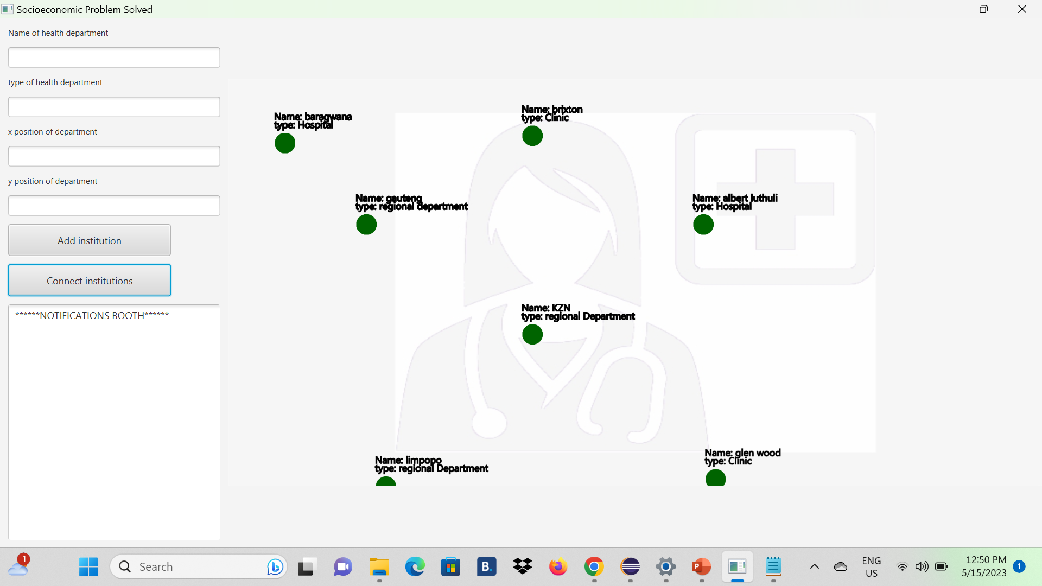
How project Works

Slide 7
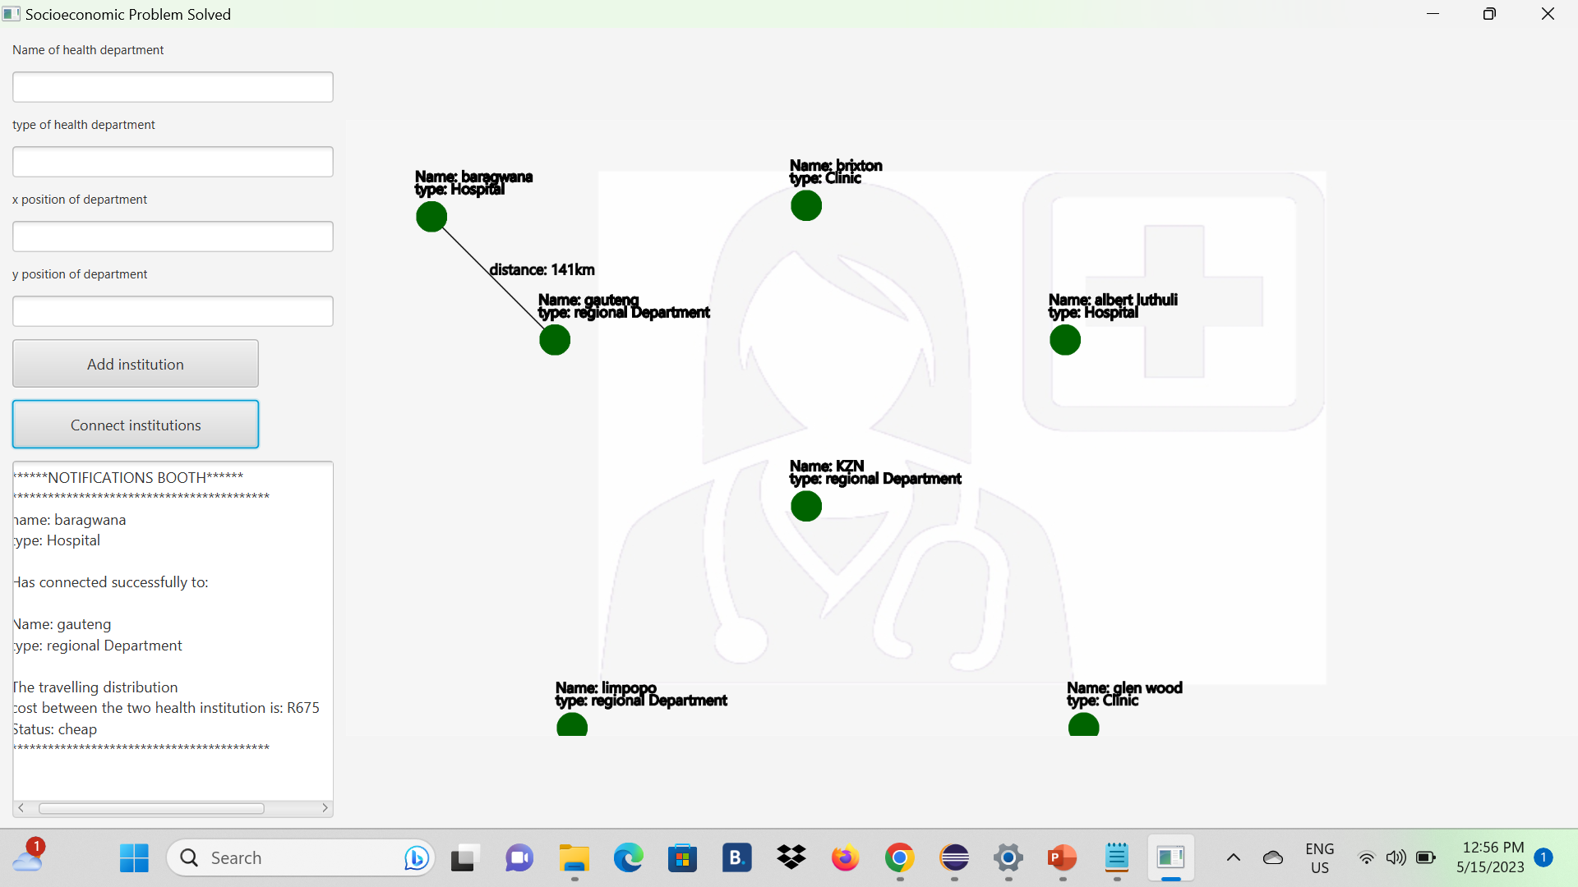

Slide 8
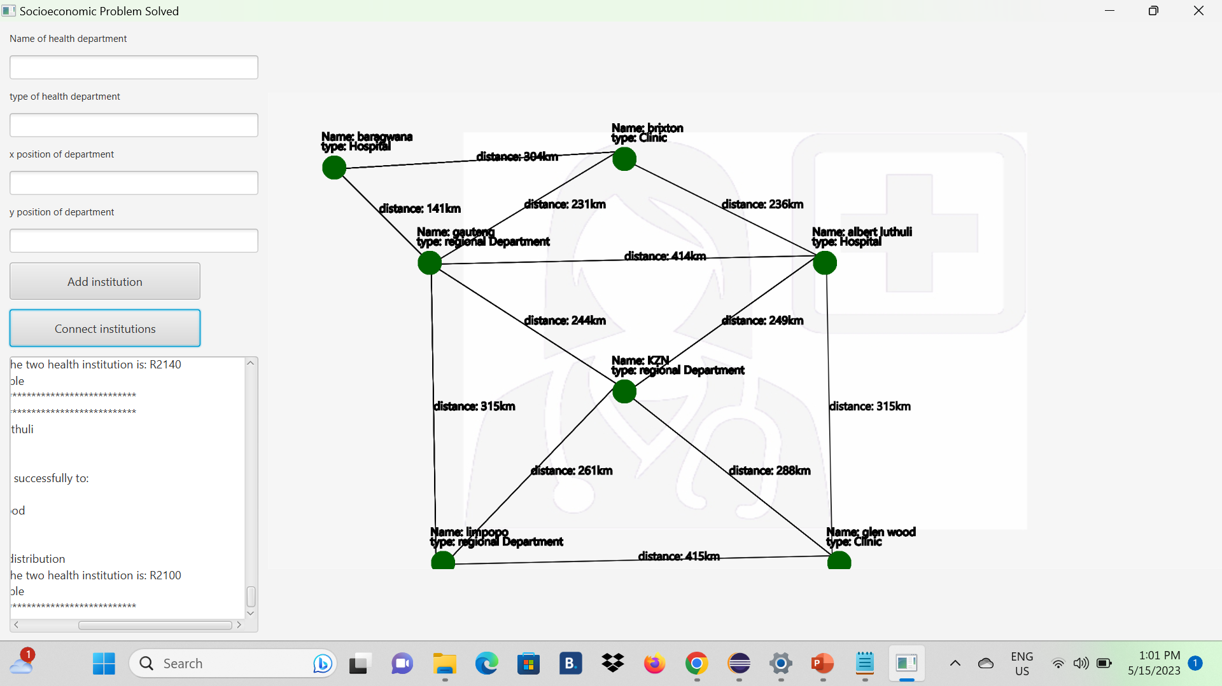

Slide 9
Video demo
Alternative location for the video
https://youtu.be/v070Ag9EgjM

