Slide 1

DIGITAL PORTFOLIO
STUDENT NAME: R S SIYAM SUNDAR
REGISTER NO AND NMID: 212403880/autunm1455bca6666619
DEPARTMENT: BCA
COLLEGE: TAGORE COLLEGE OF ARTS AND SCIENCE , CHROMPET, CHENNAI, UNIVERSITY OF MADRAS
1
Notes:
1

Slide 2

PROJECT TITLE
SIYAM SUNDAR PORTFOLIO
2

Slide 3



AGENDA
Problem Statement
Project Overview
End Users
Tools and Technologies
Portfolio design and Layout
Features and Functionality
Results and Screenshots
Conclusion
Github Link
3/21/2024 Annual Review
3

Slide 4

---
👉 “In today’s competitive world, having a strong digital presence is essential. Many students and professionals struggle to showcase their skills, achievements, and projects in an organized way. Traditional resumes are often limited and do not fully reflect creativity and technical expertise. Hence, there is a need for a personal portfolio website that highlights individual skills, projects, and accomplishments in a professional yet interactive manner.”
---?
PROBLEM STATEMENT
4

Slide 5

---
👉 “This project is a personal portfolio website designed to showcase my skills, projects, and achievements in a structured and professional way. It provides an easy-to-navigate layout, modern design, and responsive features to make it accessible on any device. The portfolio highlights my technical knowledge, creativity, and career aspirations, serving as a digital resume for recruiters and professionals.”
---
PROJECT OVERVIEW
5

Slide 6

End Users
Recruiters & Hiring Managers – to evaluate my skills and projects
Peers & Professionals – for networking and collaboration
General Audience – to know about my work and expertise
---
WHO ARE THE END USERS?
6

Slide 7

---
Tools and Technologies
Frontend: HTML, CSS, JavaScript
Frameworks/Libraries: Bootstrap / React (if used)
Backend (if any): Node.js / Express (optional)
Database (if any): MySQL / MongoDB
Version Control: Git & GitHub
Design Tools: Canva / Figma (if used)
TOOLS AND TECHNIQUES
7

Slide 8
Portfolio
Projects: Portfolio Website, Mini Web Apps
Skills: Web Design, Programming, UI/UX
Achievements: Certificates, Awards
Layout Idea:
Left → Project screenshots
Right → Bullet points (Projects, Skills, Achievements)
POTFOLIO DESIGN AND LAYOUT
8

Slide 9
Features & Functionality
Responsive Design – works on all devices
Easy Navigation – simple menu & structure
Project Showcase – displays my work clearly
Contact Form – direct way to connect
Modern UI/UX – clean and attractive look
FEATURES AND FUNCTIONALITY

Slide 10

RESULTS AND SCREENSHOTS
Result & Screenshots
Result:
Successfully created a personal portfolio website
Showcases skills, projects, and achievements
Provides a professional digital presence
Useful for career opportunities and networking
Screenshots (Layout idea):
Left side → 1 large screenshot of homepage
Right side → 2 small screenshots (Projects page & Contact page)
Add short labels under each image (e.g., Home, Projects, Contact)
3/21/2024 Annual Review
10

Slide 11
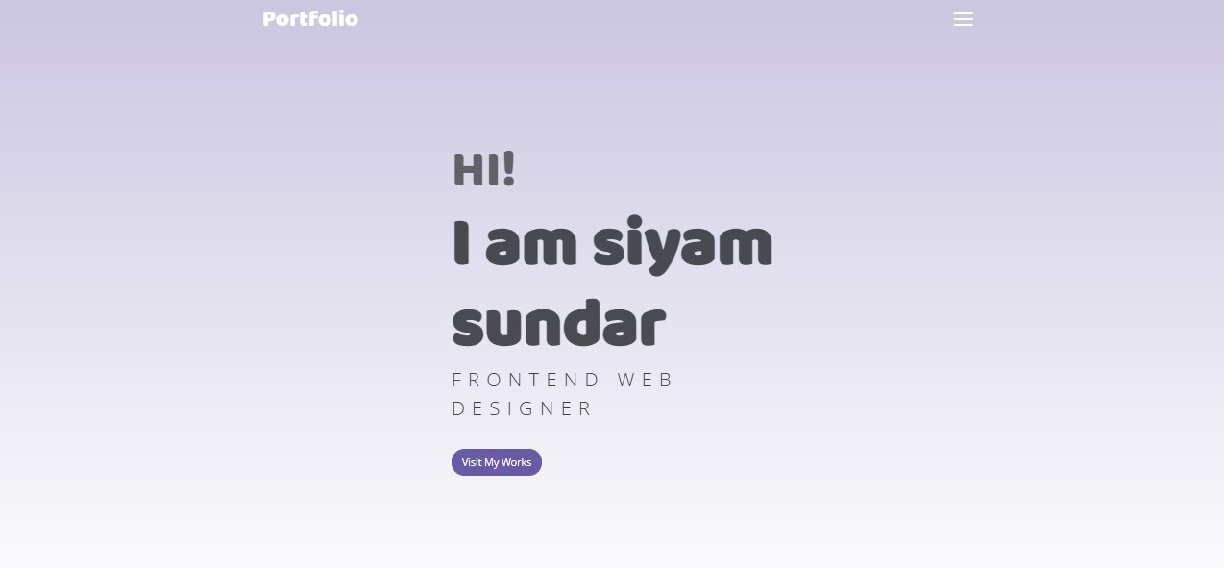

Slide 12
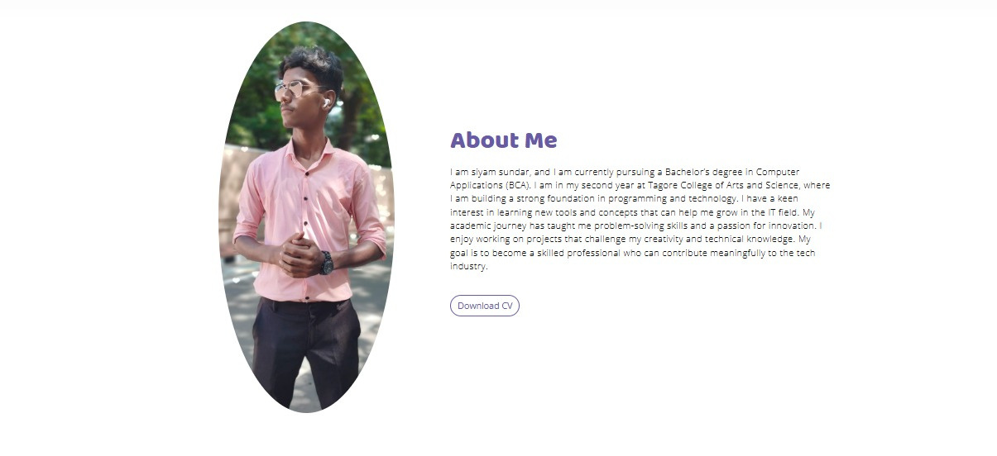

Slide 13
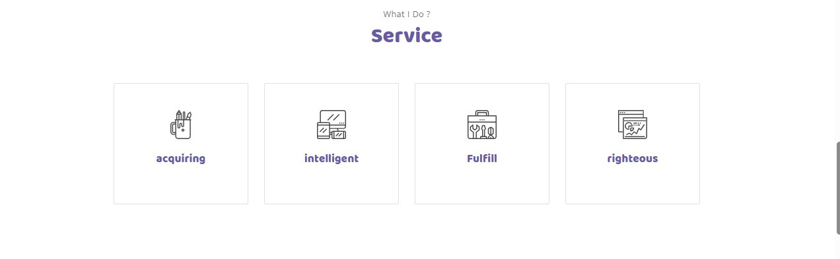

Slide 14
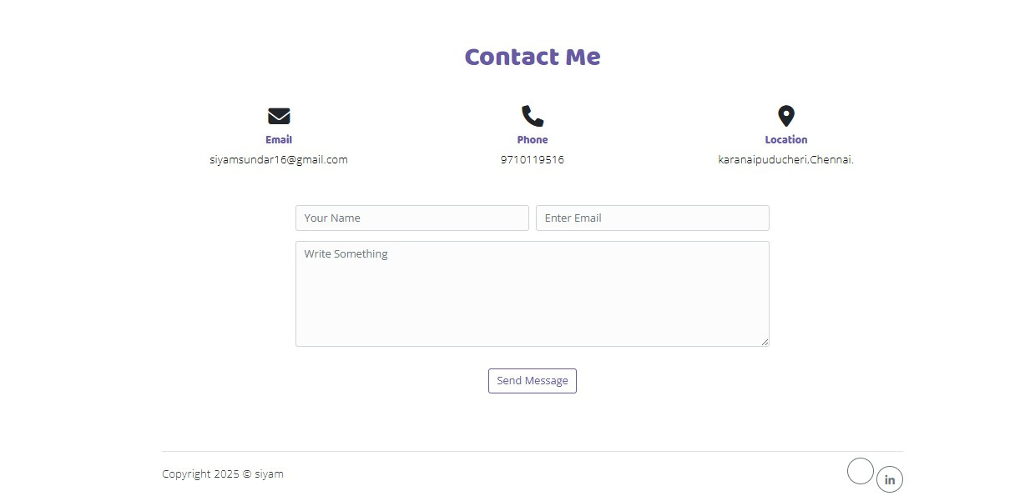

Slide 15

CONCLUSION
Developed a portfolio website to showcase my skills and projects
Gained hands-on experience with web technologies
Created a professional platform for career growth
Thank You
GitHub Repository: https://siyamsundar146.github.io/siyam /
11

