Slide 1
MixRoom
Voice control for the musician
who is also the engineer
A studio companion for recording, mixing, and musical ideas
SABERA BANU (Leader) · UDDIN SIYAM
MixRoom / DIGITAL AF Seoul
01
Notes:
[0:00–0:10] We are Sabera and Siyam. MixRoom lets musicians run a studio session by voice while their hands stay on the instrument.
Sources and context:
/Users/uddinsiyam/Desktop/digital-af/mixroom-app/docs/HACKATHON_IMPLEMENTATION.md
DIGITAL AF challenge brief supplied in the conversation.

Slide 2
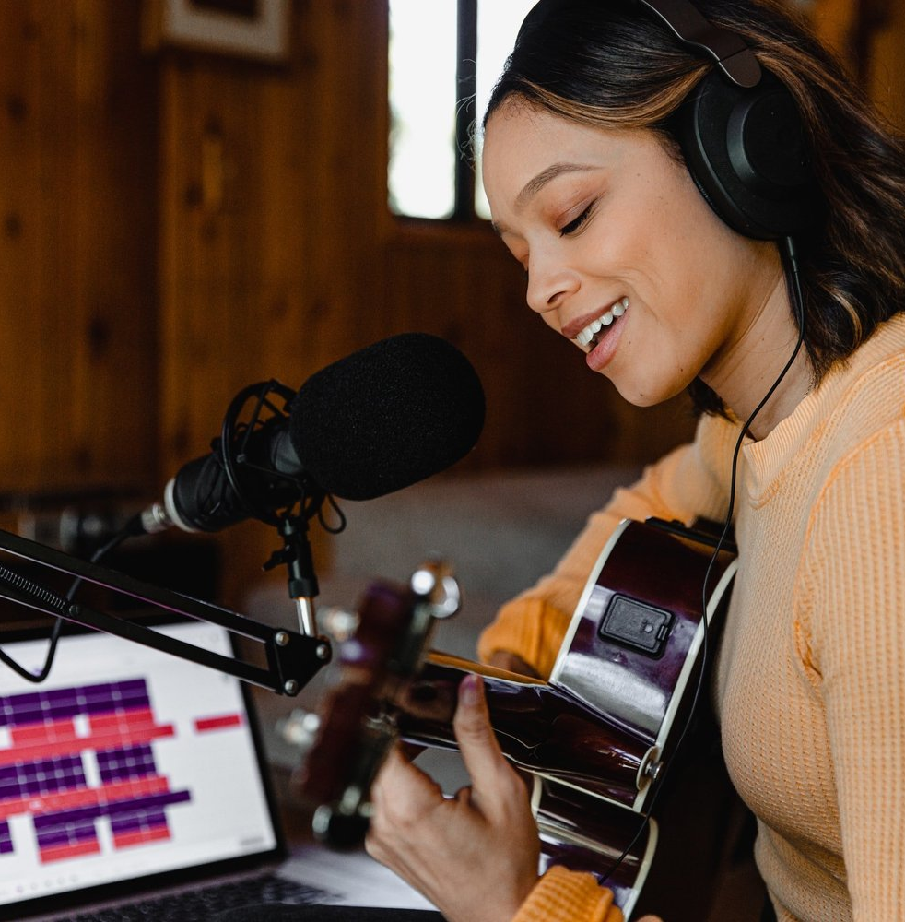
Solo recording
Both hands are
on the instrument
Starting a take or changing the mix still asks you to reach for the computer.
The job: capture the idea
without putting the instrument down.
MixRoom / DIGITAL AF Seoul
02
Notes:
[0:10–0:25] A solo musician is also the recording engineer. Starting a take, adjusting a track, and remembering an idea all compete with playing. We focus on that interruption. Customer interviews and willingness to pay still need validation.
Sources and context:
Problem framing is a product hypothesis, not quantified customer research.
Editorial image source: https://www.westlanerecords.com/for-music-supervisors
Image: https://images.squarespace-cdn.com/content/v1/620f05b072311379ff1713c0/1646697128878-4GACYBAJ6SYU4ZFQQGNQ/unsplash-image-d0sXdsCnhF8.jpg

Slide 3
Five actions in one voice session
FEATURE | SAY | CHECK ON THE MAC
Mix | “Lower Backing by two decibels.” | The track gain changes.
Compare + undo | “Before. After. Keep after.” | Hear the latest mix change.
Record | “Record ten seconds.” | A saved audio take.
Hum to instrument | “Turn my humming into Warm Keys.” | Original audio plus editable MIDI.
Session notes | “Remember: a quieter second verse.” | A saved note at the playhead.
MixRoom / DIGITAL AF Seoul
03
Notes:
[0:25–0:40] The companion covers five jobs: spoken mix changes, before-and-after comparison with undo, timed takes, humming into editable instrument notes, and project notes. Each successful edit needs confirmation from the native app. Clarifications and failed requests remain visibly different.
Sources and context:
/Users/uddinsiyam/Desktop/digital-af/mixroom-app/lib/screens/audio_editor_voice.dart
/Users/uddinsiyam/Desktop/digital-af/mixroom-app/voice_companion/src/voice/VoiceStudio.tsx
These are implemented capabilities. Real native microphone and complete GUI acceptance remain unverified at deck preparation.

Slide 4
A ten-second melody
Demo request: “Record ten seconds of humming and turn it into Warm Keys.”
Original audio
Record the humming
A saved take stays in the project.
After a two-second countdown, the Mac records the selected input.
Editable Warm Keys MIDI
Basic Pitch turns the melody into notes.
Then: lower Backing, compare before/after, and keep the version you prefer.
Live native audio acceptance remains pending
MixRoom / DIGITAL AF Seoul
04
Notes:
[0:40–1:25] Live demo: select an audio track and speak the displayed request. Wait for the preparation and countdown, hum a short melody, then play the original audio and MIDI result. Say “Lower Backing by two decibels,” compare before and after, and keep the preferred version. If the live acceptance checks are not complete, present this as the intended sequence and show only the checks actually completed. Do not narrate a failed or pending edit as successful.
Sources and context:
/Users/uddinsiyam/Desktop/digital-af/mixroom-app/lib/screens/audio_editor_voice.dart
/Users/uddinsiyam/Desktop/digital-af/mixroom-app/docs/MANUAL_TESTING.md
Default instrument is mixroom.warm_keys. It is not an acoustic piano model. Maximum timed capture is 60 seconds. Native live-audio acceptance remains pending.

Slide 5
The Mac makes the music
Command speech uses cloud providers. Musical audio stays in the native project.
Lovable companion
Local Python backend
MixRoom on Mac
Voice controls
Session status
Verified results
Pairing and durable queue
OpenAI command planning
SQLite session state
Recording and mixing
Undo and project notes
Local Basic Pitch
ElevenLabs
Scribe command transcription and streamed spoken replies
MixRoom / DIGITAL AF Seoul
05
Notes:
[1:25–1:45] ElevenLabs handles command transcription and spoken replies. A small Python backend pairs the browser with the Mac and queues requests. OpenAI returns typed plans through the bundled Node planner. MixRoom executes and checks them. Recording, instruments, and Basic Pitch remain on the Mac. The same Python service has a Docker package and a local development fallback.
Sources and context:
/Users/uddinsiyam/Desktop/digital-af/mixroom-app/voice_backend/README.md
/Users/uddinsiyam/Desktop/digital-af/mixroom-app/voice_backend/planner/README.md
/Users/uddinsiyam/Desktop/digital-af/mixroom-app/voice_companion/src/voice/speech.ts
Diagram abstracts token minting and provider connections. Browser Scribe uses a short-lived token. Backend proxies TTS. Native application sends planning context through the local service. Provider keys remain server-side.
The integrated companion is published at https://mix-voice-studio.lovable.app. Public browser sign-in, pairing-code creation, waiting-for-Mac state, and session revocation were verified. Jev is optional and is not configured for this demo.

Slide 6
First customer hypothesis
Independent musicians
who record every week
Proposed pilot: five observed sessions with musicians in Seoul.
Measure completed takes without mouse use, repeat use,
and willingness to pay for a recurring voice workflow.
Pricing and paid demand remain unvalidated
MixRoom / DIGITAL AF Seoul
06
Notes:
[1:45–2:00] Our first customer hypothesis is independent musicians who record every week. Next, we want five observed sessions in Seoul. We will measure completed takes without mouse use, repeat use, and willingness to pay. We have not validated pricing or paid demand yet.
Sources and context:
Pilot plan and business model are hypotheses, not customer, revenue, or traction claims.

Slide 7
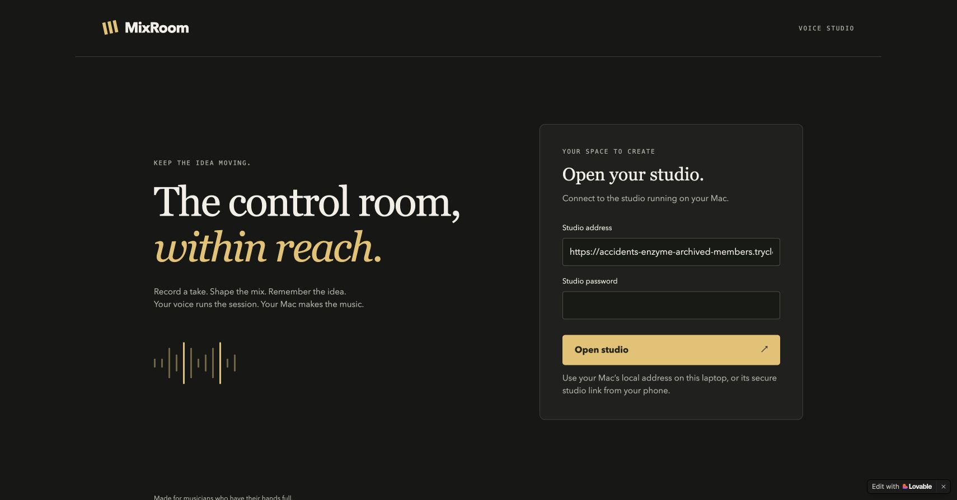
Demo setup
1 Open the Lovable companion
https://mix-voice-studio.lovable.app
2 Sign in, then Pair your Mac
The secure studio address is prefilled.
3 Connect the native Mac app
Voice session / Connect
http://127.0.0.1:8766/api/voice
Studio password sign-in. Music stays on the Mac.
Keep the Mac, backend, and secure tunnel running for the demo.
MixRoom / Demo appendix
07
Notes:
Setup appendix, outside the two-minute main pitch. Open https://mix-voice-studio.lovable.app. The HTTPS studio API is prefilled. Enter the studio password, then choose Pair your Mac. In the native Mac app, open Voice session / Connect, enter that code, and use http://127.0.0.1:8766/api/voice as the native relay URL. Public and local URLs reach the same backend. The Mac, Python backend, and Cloudflare Quick Tunnel must stay running. The temporary tunnel hostname can change after a restart. Open a project, select an audio track, and use headphones. The studio password is MIXROOM_PASSWORD in private voice_backend/.env. Do not show that file on screen. Provider keys never go in the browser or native pairing dialog. Browser sign-in, pairing-code creation, and revocation passed; native microphone and audio acceptance remain pending.
Sources and context:
Verified public-site screenshot supplied by root: /tmp/mixroom-lovable-published-signin.png, JPEG content, 1710×895.
/Users/uddinsiyam/Desktop/digital-af/mixroom-app/docs/MANUAL_TESTING.md
Public Lovable site https://mix-voice-studio.lovable.app and public login/pairing/revocation verified by the implementation lead. The native loopback URL works only on the same Mac; the public companion uses the secure tunnel.

Slide 8
What we have verified
Status on October 1, 2026
Checked
Still to complete
Native Mac build and launch
19 native tests
36 browser tests
37 backend tests
9 real OpenAI planning requests
ElevenLabs speech checks
8 pitches in a melody fixture
Public login and pairing code
Lovable site published
Native pairing and microphone tests
Live humming and audible A/B
Customer and pricing validation
Jev is not configured
MixRoom / Demo appendix
08
Notes:
Verification appendix, outside the two-minute main pitch. Counts and live checks were supplied by root after current testing: 19 native, 36 frontend, 37 backend tests plus 8 subtests, 9 real OpenAI plans, ElevenLabs provider checks, and a fixture with 8 detected pitches. These do not establish a live microphone or complete native GUI demonstration. The native app was built, launched, and its editor inspected. The integrated Lovable public website was updated and verified: the new studio-password UI loads with its secure API address prefilled, sign-in succeeds, pairing-code creation shows Waiting for your Mac with audio controls disabled, and End session revokes that session. Native pairing and musical audio acceptance remain pending. Jev has no configured credential and must not be claimed as demonstrated.
Sources and context:
/Users/uddinsiyam/Desktop/digital-af/mixroom-app/docs/HACKATHON_IMPLEMENTATION.md
/Users/uddinsiyam/Desktop/digital-af/mixroom-app/docs/MANUAL_TESTING.md
Latest verification counts supplied by the implementation lead during this session.
Lovable project: https://lovable.dev/projects/9f999e25-9d24-4f94-9560-34ca0b28be84

