Slide 1
Heapsort

Slide 2
Heapsort
Combines the better attributes of merge sort and insertion sort.
Like merge sort, but unlike insertion sort, running time is O(n lg n).
Like insertion sort, but unlike merge sort, sorts in place.
Introduces an algorithm design technique
Create data structure (heap) to manage information during the execution of an algorithm.
The heap has other applications beside sorting.
Priority Queues

Slide 3
Data Structure Binary Heap
Array viewed as a nearly complete binary tree.
Physically – linear array.
Logically – binary tree, filled on all levels (except lowest.)
Map from array elements to tree nodes and vice versa
Root – A[1]
Left[i] – A[2i]
Right[i] – A[2i+1]
Parent[i] – A[⎣i/2⎦]
length[A] – number of elements in array A.
heap-size[A] – number of elements in heap stored in A.
heap-size[A] ≤ length[A]

Slide 4
Heap Property (Max and Min)
Max-Heap
For every node excluding the root, value is at most that of its parent: A[parent[i]] ≥ A[i]
Largest element is stored at the root.
In any subtree, no values are larger than the value stored at subtree root.
Min-Heap
For every node excluding the root, value is at least that of its parent: A[parent[i]] ≤ A[i]
Smallest element is stored at the root.
In any subtree, no values are smaller than the value stored at subtree root

Slide 5
Heaps – Example
26
24
20
18
17
19
13
12
14
11
Max-heap as an
array.
1 2 3 4 5 6 7 8 9 10
Max-heap as a binary
tree.
26
24
20
18
17
19
13
12
14
11
Last row filled from left to right.

Slide 6
Height
Height of a node in a tree: the number of edges on the longest simple downward path from the node to a leaf.
Height of a tree: the height of the root.
Height of a heap: ⎡lg n⎤
Basic operations on a heap run in O(lg n) time

Slide 7
Heaps in Sorting
Use max-heaps for sorting.
The array representation of max-heap is not sorted.
Steps in sorting
Convert the given array of size n to a max-heap (BuildMaxHeap)
Swap the first and last elements of the array.
Now, the largest element is in the last position – where it belongs.
That leaves n – 1 elements to be placed in their appropriate locations.
However, the array of first n – 1 elements is no longer a max-heap.
Float the element at the root down one of its subtrees so that the array remains a max-heap (MaxHeapify)
Repeat step 2 until the array is sorted.

Slide 8
Heap Characteristics
Height = ⎡lg n⎤
No. of leaves = ⎡n/2⎤
No. of nodes of
height h ≤ ⎡n/2^{h+1}⎤

Slide 9
Maintaining the heap property
Suppose two subtrees are max-heaps, but the root violates the max-heap property.
Fix the offending node by exchanging the value at the node with the larger of the values at its children.
May lead to the subtree at the child not being a heap.
Recursively fix the children until all of them satisfy the max-heap property.

Slide 10
MaxHeapify – Example
MaxHeapify(A, 2)
26
24
24
14
20
14
18
17
19
18
14
14
24
13
12
14
14
18
11

Slide 11
Procedure MaxHeapify
MaxHeapify(A, i)
1. l ← left(i)
2. r ← right(i)
3. if l ≤ heap-size[A] and A[l] > A[i]
4. then largest ← l
5. else largest ← i
6. if r ≤ heap-size[A] and A[r] > A[largest]
7. then largest ← r
8. if largest≠ i
9. then exchange A[i] ↔ A[largest]
10. MaxHeapify(A, largest)
Assumption:
Left(i) and Right(i) are max-heaps.

Slide 12
Running Time for MaxHeapify
MaxHeapify(A, i)
1. l ← left(i)
2. r ← right(i)
3. if l ≤ heap-size[A] and A[l] > A[i]
4. then largest ← l
5. else largest ← i
6. if r ≤ heap-size[A] and A[r] > A[largest]
7. then largest ← r
8. if largest≠ i
9. then exchange A[i] ↔ A[largest]
10. MaxHeapify(A, largest)
Time to fix node i and its children = Θ(1)
PLUS
Time to fix the subtree rooted at one of i’s children = T(size of subree at largest)

Slide 13
Running Time for MaxHeapify(A, n)
T(n) = T(largest) + Θ(1)
largest ≤ 2n/3 (worst case occurs when the last row of tree is exactly half full)
T(n) ≤ T(2n/3) + Θ(1) ⇒ T(n) = O(lg n)
Alternately, MaxHeapify takes O(h) where h is the height of the node where MaxHeapify is applied

Slide 14
Building a heap
Use MaxHeapify to convert an array A into a max-heap.
How?
Call MaxHeapify on each element in a bottom-up manner.
BuildMaxHeap(A)
1. heap-size[A] ← length[A]
2. for i ← ⎣length[A]/2⎦ downto 1
3. do MaxHeapify(A, i)

Slide 15
BuildMaxHeap – Example
Input Array:
24
21
23
22
36
29
30
34
28
27
Initial Heap:
(not max-heap)
24
21
23
22
36
29
30
34
28
27

Slide 16
BuildMaxHeap – Example
MaxHeapify(⎣10/2⎦ = 5)
MaxHeapify(4)
24
36
MaxHeapify(3)
24
MaxHeapify(2)
21
30
34
24
21
23
36
23
MaxHeapify(1)
36
36
27
21
29
36
21
30
28
23
34
22
24
22
34
22
28
24
27
21

Slide 17
Correctness of BuildMaxHeap
Loop Invariant: At the start of each iteration of the for loop, each node i+1, i+2, …, n is the root of a max-heap.
Initialization:
Before first iteration i = ⎣n/2⎦
Nodes ⎣n/2⎦+1, ⎣n/2⎦+2, …, n are leaves and hence roots of max-heaps.
Maintenance:
By LI, subtrees at children of node i are max heaps.
Hence, MaxHeapify(i) renders node i a max heap root (while preserving the max heap root property of higher-numbered nodes).
Decrementing i reestablishes the loop invariant for the next iteration.

Slide 18
Running Time of BuildMaxHeap
Loose upper bound:
Cost of a MaxHeapify call × No. of calls to MaxHeapify
O(lg n) × O(n) = O(nlg n)
Tighter bound:
Cost of a call to MaxHeapify at a node depends on the height, h, of the node – O(h).
Height of most nodes smaller than n.
Height of nodes h ranges from 0 to ⎣lg n⎦.
No. of nodes of height h is ⎡n/2^{h+1}⎤

Slide 19
Running Time of BuildMaxHeap
Tighter Bound for T(BuildMaxHeap)
T(BuildMaxHeap)
Can build a heap from an unordered array in linear time

Slide 20
Heapsort
Sort by maintaining the as yet unsorted elements as a max-heap.
Start by building a max-heap on all elements in A.
Maximum element is in the root, A[1].
Move the maximum element to its correct final position.
Exchange A[1] with A[n].
Discard A[n] – it is now sorted.
Decrement heap-size[A].
Restore the max-heap property on A[1..n–1].
Call MaxHeapify(A, 1).
Repeat until heap-size[A] is reduced to 2.

Slide 21
Heapsort(A)
HeapSort(A)
1. Build-Max-Heap(A)
2. for i ← length[A] downto 2
3. do exchange A[1] ↔ A[i]
4. heap-size[A] ← heap-size[A] – 1
5. MaxHeapify(A, 1)

Slide 22
Heapsort – Example
26
24
20
18
17
19
13
12
14
11
1 2 3 4 5 6 7 8 9 10
26
24
20
18
17
19
13
12
14
11

Slide 23
Algorithm Analysis
HeapSort(A)
1. Build-Max-Heap(A)
2. for i ← length[A] downto 2
3. do exchange A[1] ↔ A[i]
4. heap-size[A] ← heap-size[A] – 1
5. MaxHeapify(A, 1)
In-place
Not Stable
Build-Max-Heap takes O(n) and each of the n-1 calls to Max-Heapify takes time O(lg n).
Therefore, T(n) = O(n lg n)

Slide 24
Heap Procedures for Sorting
MaxHeapify O(lg n)
BuildMaxHeap O(n)
HeapSort O(n lg n)

Slide 25
Priority Queue
Popular & important application of heaps.
Max and min priority queues.
Maintains a dynamic set S of elements.
Each set element has a key – an associated value.
Goal is to support insertion and extraction efficiently.
Applications:
Ready list of processes in operating systems by their priorities – the list is highly dynamic
In event-driven simulators to maintain the list of events to be simulated in order of their time of occurrence.

Slide 26
Basic Operations
Operations on a max-priority queue:
Insert(S, x) - inserts the element x into the set S
S ← S ∪ {x}.
Maximum(S) - returns the element of S with the largest key.
Extract-Max(S) - removes and returns the element of S with the largest key.
Increase-Key(S, x, k) – increases the value of element x’s key to the new value k.
Min-priority queue supports Insert, Minimum, Extract-Min, and Decrease-Key.
Heap gives a good compromise between fast insertion but slow extraction and vice versa.

Slide 27
Heap Property (Max and Min)
Max-Heap
For every node excluding the root, value is at most that of its parent: A[parent[i]] ≥ A[i]
Largest element is stored at the root.
In any subtree, no values are larger than the value stored at subtree root.
Min-Heap
For every node excluding the root, value is at least that of its parent: A[parent[i]] ≤ A[i]
Smallest element is stored at the root.
In any subtree, no values are smaller than the value stored at subtree root

Slide 28
Heap-Extract-Max(A)
Implements the Extract-Max operation.
Heap-Extract-Max(A)
1. if heap-size[A] < 1
2. then error “heap underflow”
3. max ← A[1]
4. A[1] ← A[heap-size[A]]
5. heap-size[A] ← heap-size[A] - 1
6. MaxHeapify(A, 1)
7. return max
Running time : Dominated by the running time of MaxHeapify
= O(lg n)

Slide 29
Heap-Insert(A, key)
Heap-Insert(A, key)
1. heap-size[A] ← heap-size[A] + 1
i ← heap-size[A]
4. while i > 1 and A[Parent(i)] < key
5. do A[i] ← A[Parent(i)]
6. i ← Parent(i)
7. A[i] ← key
Running time is O(lg n)
The path traced from the new leaf to the root has length O(lg n)

Slide 30
Heap-Increase-Key(A, i, key)
Heap-Increase-Key(A, i, key)
If key < A[i]
then error “new key is smaller than the current key”
A[i] ← key
while i > 1 and A[Parent[i]] < A[i]
do exchange A[i] ↔ A[Parent[i]]
i ← Parent[i]
Heap-Insert(A, key)
heap-size[A] ← heap-size[A] + 1
A[heap-size[A]] ← –∞
Heap-Increase-Key(A, heap-size[A], key)

Slide 31
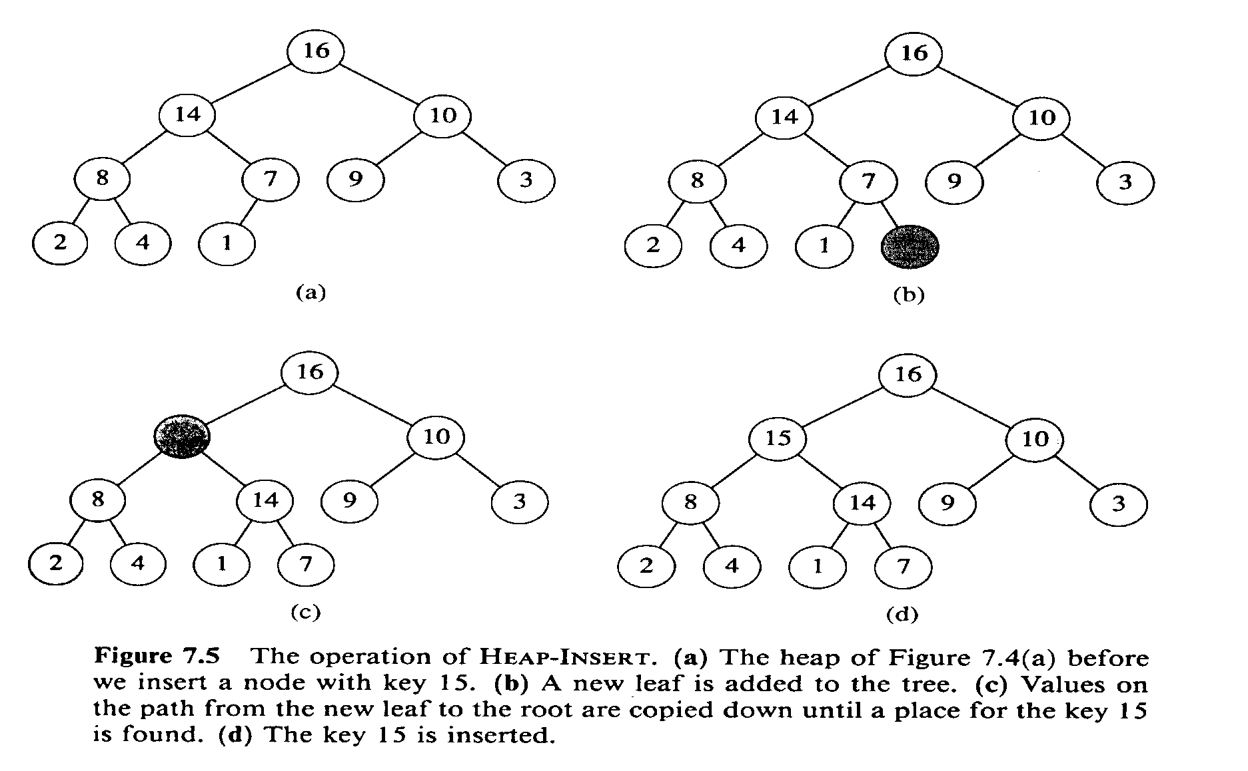
Examples

